Slide 1
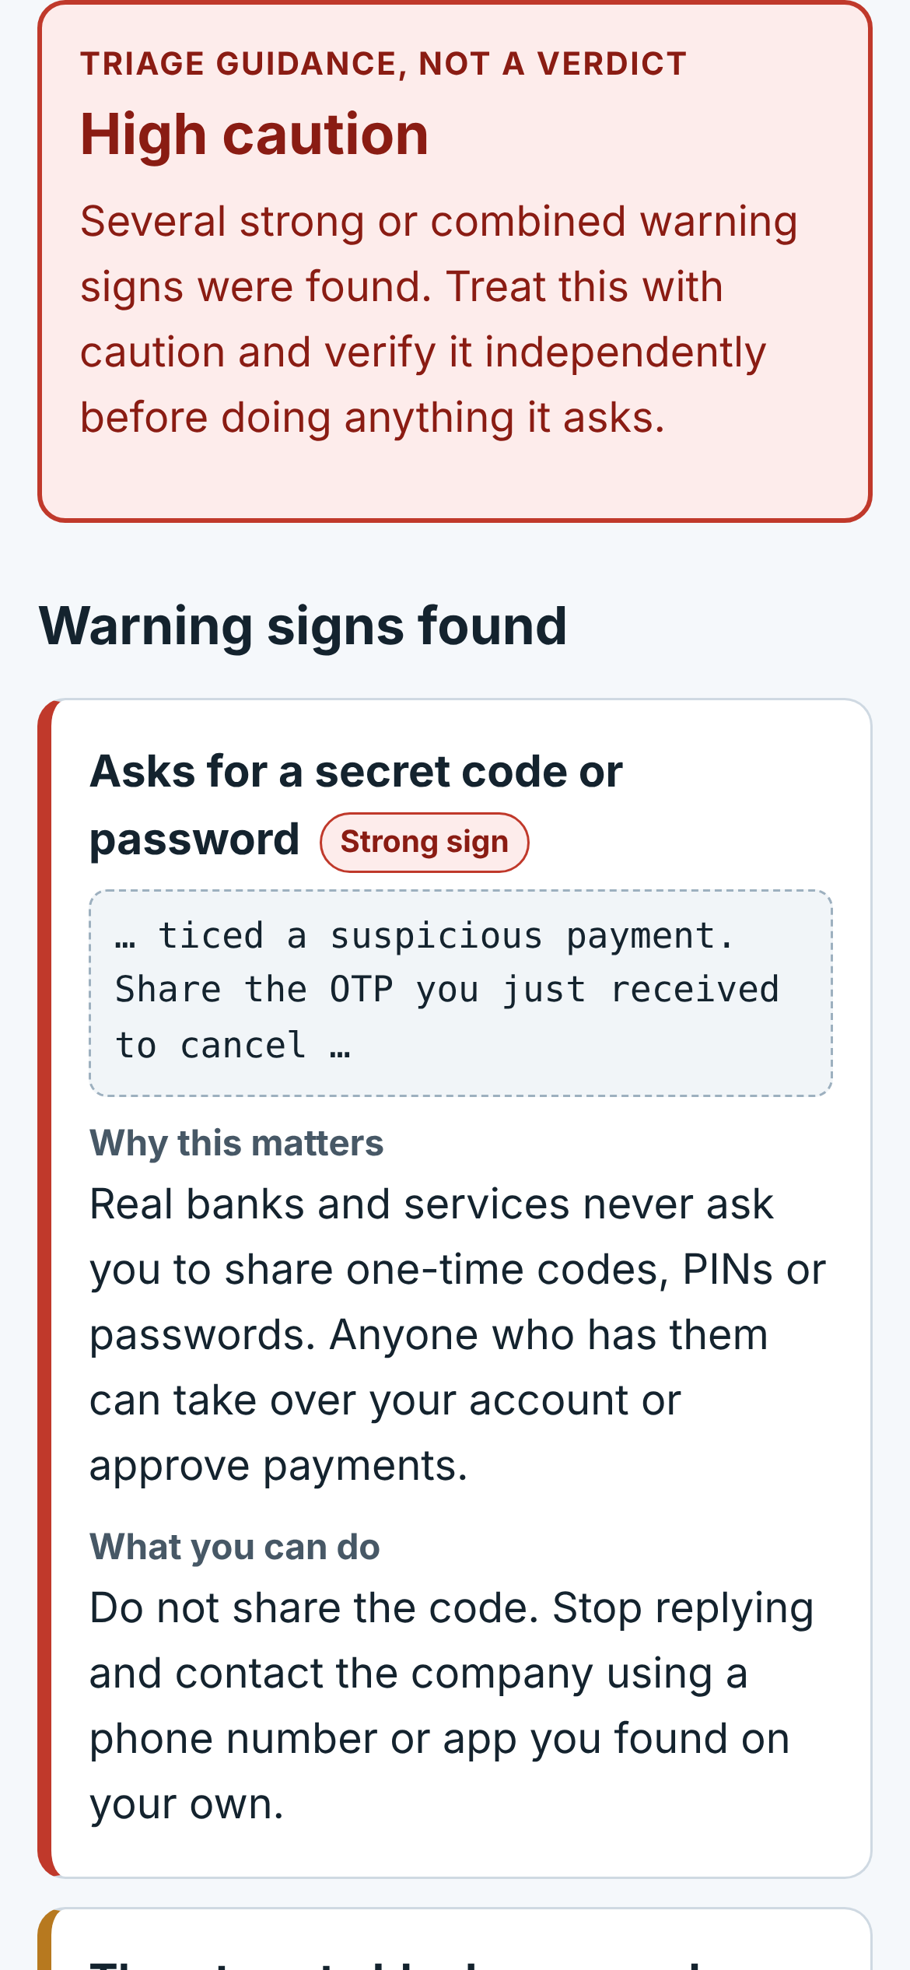

ScamShield
HACK FOR SOCIAL CAUSE | VBYLD 2027
Digital Fraud Awareness for Everyone
Spot suspicious messages and links, learn how common scams work, and prepare safer next steps. Everything runs on your own device.
SDG 9
SDG 10
SDG 16
Theme: Digital Safety and Cyber Fraud Awareness
Real screenshot of the prototype
Notes:
Open with the problem in one sentence: scam messages are designed to rush people, and most people have never been shown what the warning signs look like. ScamShield is a small, private learning tool. Everything on this deck reflects what is actually built. The screenshot is a real capture of the prototype running on a phone-sized screen, using a fictional message.

Slide 2






Scams are built to rush people
Account will be blocked
Parcel fee link
The gap
Warning signs are hard to see under pressure
Evidence and next steps are unclear
Advice is full of technical words
Job registration fee
OTP or remote access
Who it helps
Students and first-time payment users
Older adults
Community trainers
Guaranteed returns
Family in trouble
Notes:
These are the six patterns the brief highlights: blocked-account threats, parcel fees, job fees, OTP and remote-access requests, guaranteed returns and family-emergency messages. The common thread is pressure. People may not know which parts of a message to question, how to keep evidence, or what a safe next step is, and most advice uses technical terms. We are not quoting statistics in this deck. ScamShield targets understanding and confidence, not detection.

Slide 3
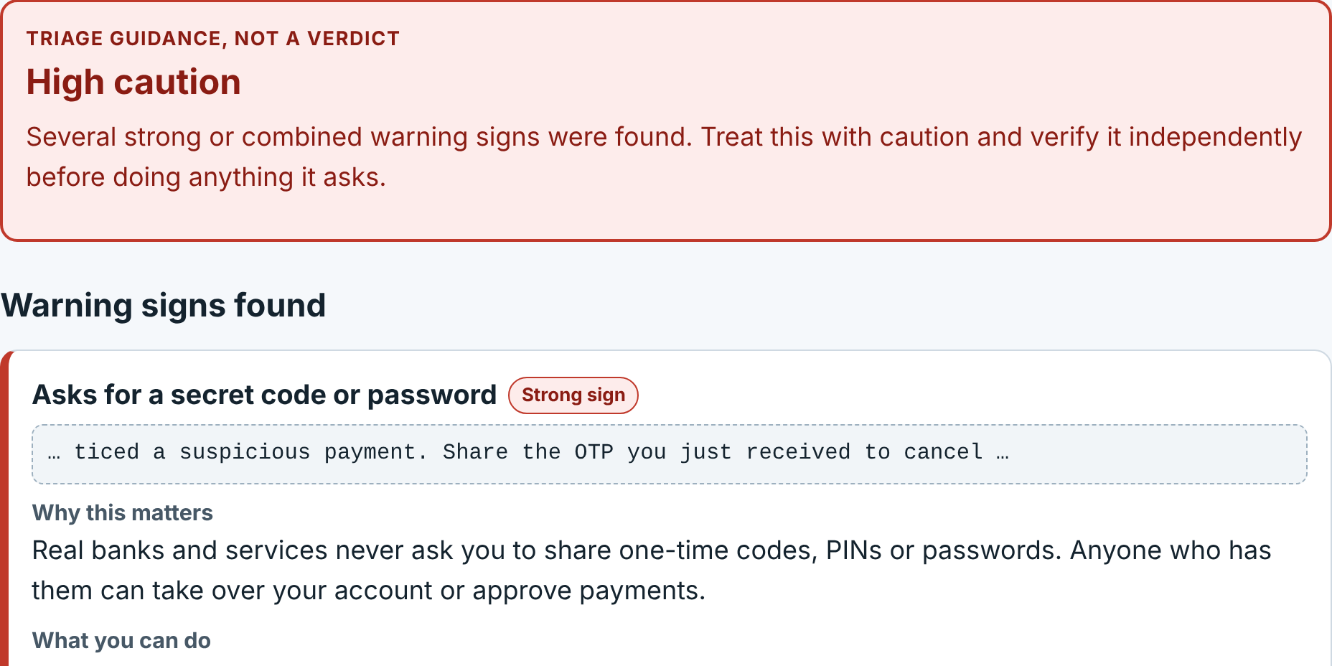
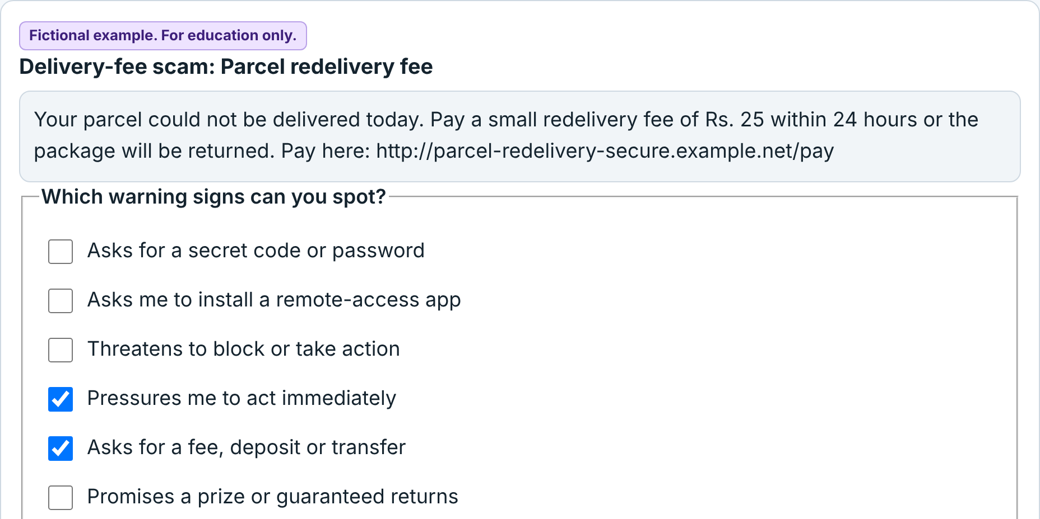
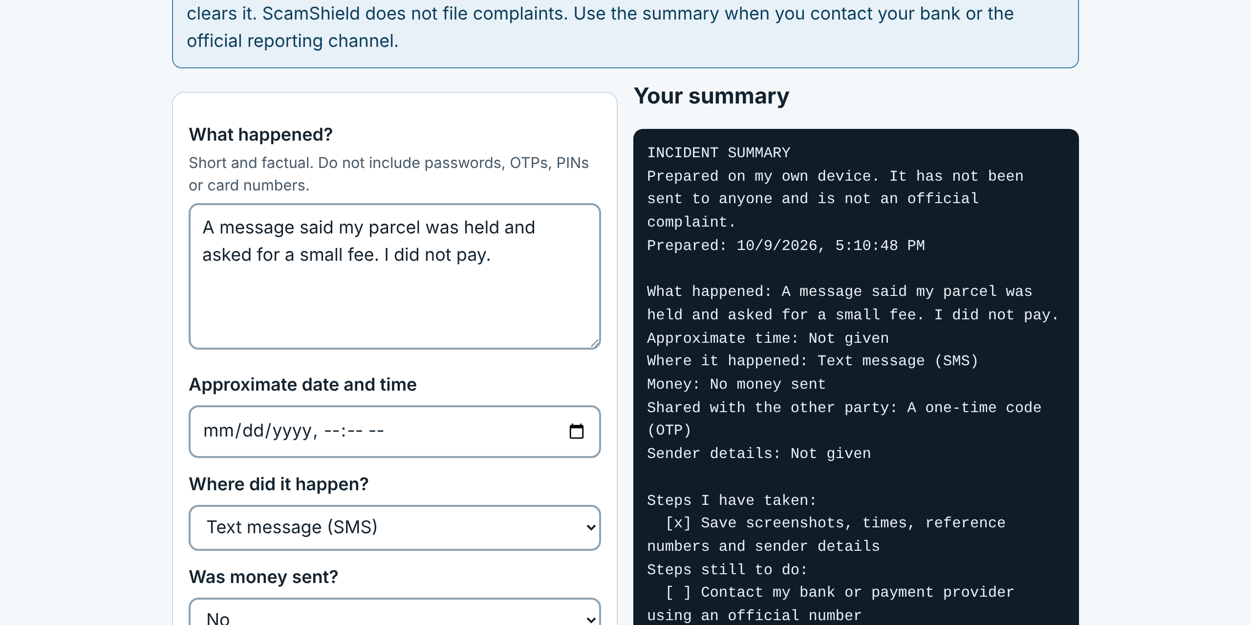
How ScamShield helps
1
Paste a message or link
2
Checked on your device
3
Read the warning signs
4
Follow safe next steps
5
Learn or prepare a summary
Check
Learn
Checklist
Paste text or a link. See each warning sign and why it matters.
9 fictional examples and a 7-question quiz with instant feedback.
Prepare a private summary to copy or download.
Notes:
This is the user workflow in five steps. The three tools share one idea: slow the person down and explain. Check explains a message or link. Learn builds the skill using fictional examples. Checklist helps someone who thinks they have been scammed gather facts for their bank or the official reporting channel. The thumbnails are real captures of each screen.

Slide 4
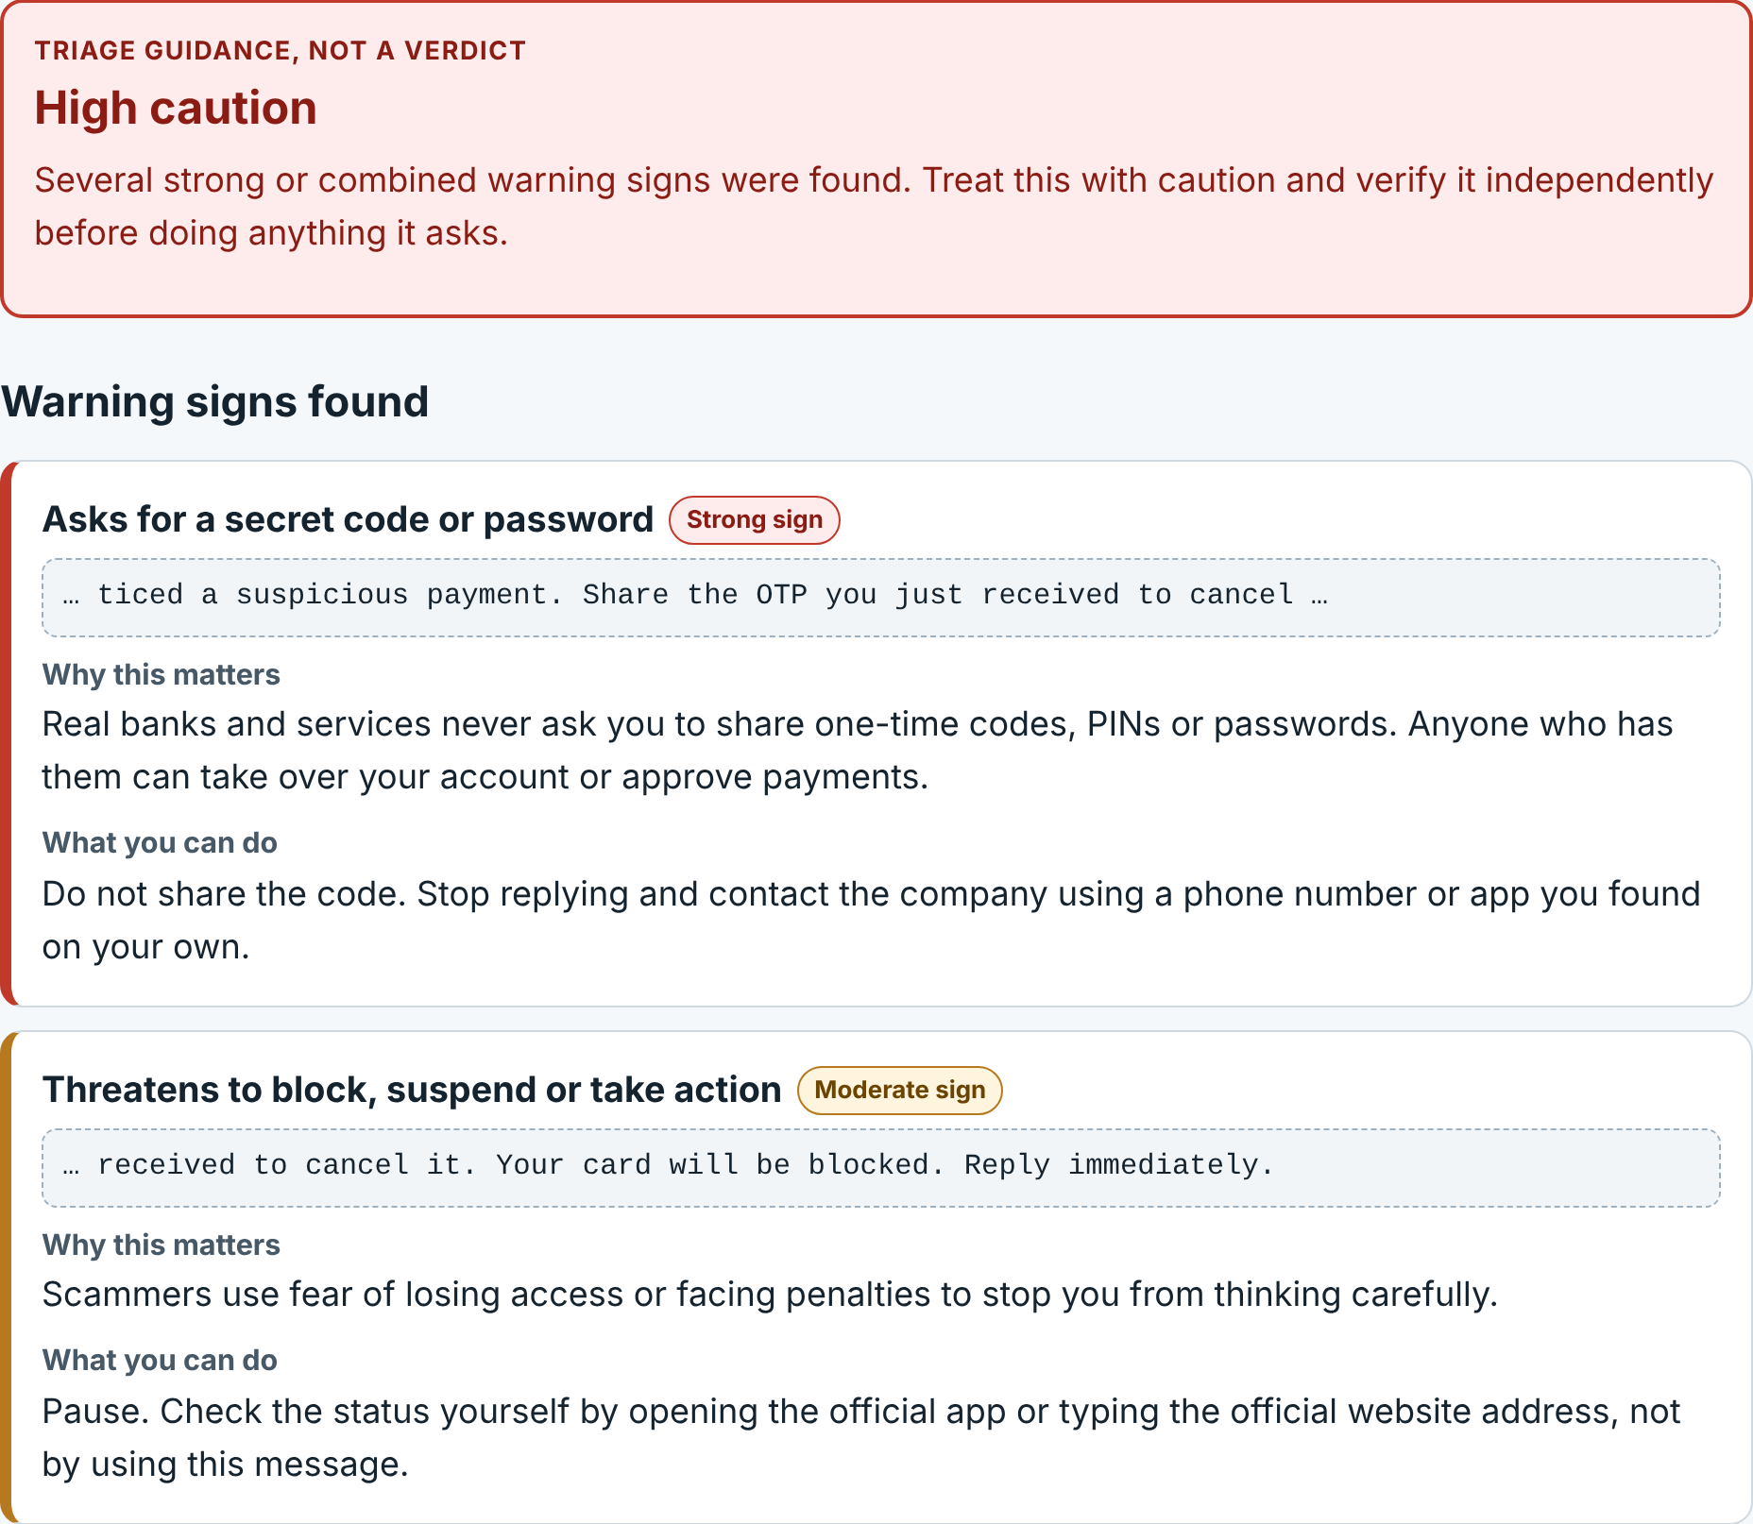
Every warning sign is explained
FICTIONAL EXAMPLE, FOR EDUCATION ONLY
This is the fraud team from your bank. We noticed a suspicious payment. Share the OTP you just received to cancel it. Your card will be blocked. Reply immediately.
Strong sign
Moderate
Minor
Then it shows safe next steps
Do not share the code
Verify using a number you find yourself
If money was sent, contact your bank
Real screenshot of the prototype. The label is triage guidance, not a verdict.
Notes:
Demo moment. Paste the fictional bank message. ScamShield shows the label High caution, tagged as triage guidance, not a verdict. Each warning sign shows the matched text, a plain-English reason and a suggested action. Colors are paired with the words Strong, Moderate or Minor so meaning never depends on color alone. Below the signs, it lists safe next steps and what to do if money or codes were already shared. A low-risk result always carries a reminder that it does not prove a message is legitimate.

Slide 5




Private by design
Static file server: sends the app files, receives nothing
Stays on your device
No uploads, accounts or analytics
YOUR DEVICE: every check runs here
Links are never opened
They are read as text only
Interface
Check, Learn, Checklist, Privacy
Triage, not a verdict
No percentages. Limits are shown
Local analysis engine
Message rules and link parsing
Learning content
Examples and quiz
Local storage
Opt-in only: text size, saved examples
Easy to use
Keyboard, larger text, phone layouts
Notes:
Architecture in one picture. The server only sends files. All analysis happens in the browser, using a transparent rule list rather than an opaque AI score. Nothing is stored unless the person presses a save button, and the incident checklist is never stored. The page also tells the browser not to allow any network connections from its scripts. On the right are the four design commitments: private, never opens links, triage rather than verdict, and usable with keyboard, large text and phones. Accessibility was considered and checked in automated browser tests, but no screen-reader or user testing has been done yet.

Slide 6
Proposed measures of impact
31 / 31
TARGET, NOT YET MEASURED
TARGET, NOT YET MEASURED
Quiz scores
Share of questions correct before and after the Learn tab
Time to spot signs
Seconds to find the signs in a fictional message
expected warning signs shown across 9 fictional examples
Measured. A consistency check, not accuracy on real scams.
TARGET, NOT YET MEASURED
TARGET, NOT YET MEASURED
Workshop use
Examples completed per community session
Pilot feedback
Clarity and usability, with consent
Why this is social impact
It builds understanding and safer choices for people with less digital experience.
SDG 9
A light tool with no accounts
SDG 10
Plain English for everyone
SDG 16
Safer steps and official reporting
No external statistics are used in this deck. Any pilot needs consent and honest reporting of sample size.
Notes:
Only one number here is measured: the automated test confirms that for all 9 fictional examples, every expected warning sign appears in the result (31 of 31). That is a consistency check, not a claim about accuracy on real scams. The four cards are proposed measures and are clearly labelled as targets, not results. They come from the project brief: quiz scores before and after, time to spot signs, examples completed in a workshop, and consent-based pilot feedback. Any pilot would need consent, no sensitive data, and honest reporting of sample size and limits. No outside statistics or sources are cited in this deck.

Slide 7



What is built, and what is next
Built and tested
Honest limits
Next steps
Message and link checker
9 fictional examples, 7-question quiz
Private incident summary
38 automated tests and 21 browser checks passed
Simple English rules can miss scams
Accuracy and impact not measured yet
Reporting details not set for a location
Consent-based pilot
Verified local reporting details
Screen-reader testing
Admin page, printable guide, PWA
Try it: paste a fictional message and see exactly why it raises caution.
Notes:
Close with honesty. Built and tested: the checker, the examples and quiz, the incident summary, and the privacy page, backed by 38 automated tests and 21 browser checks that all passed. Limits: simple English rules, no measured accuracy or impact, and reporting details that still need to be set for a real location. Next: a consent-based pilot with a community group, verified local reporting details, screen-reader testing, and the optional items from the brief (admin page, printable guide, installable app). Then invite the judges to try it with a fictional message.

