Slide 1

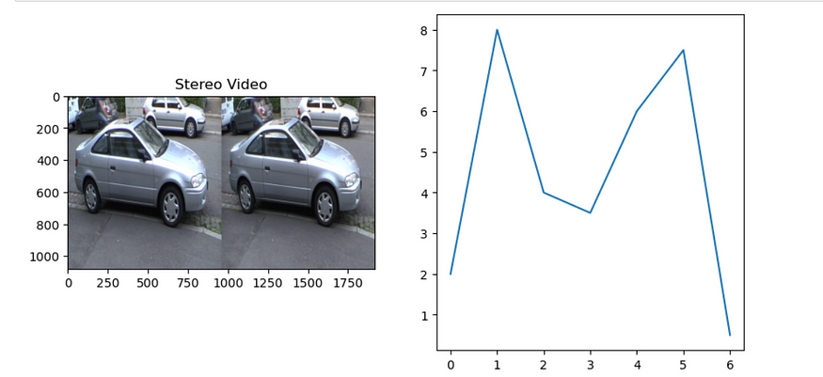
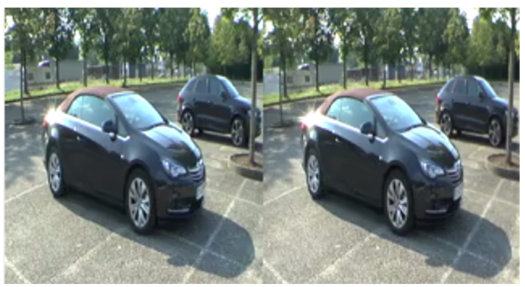
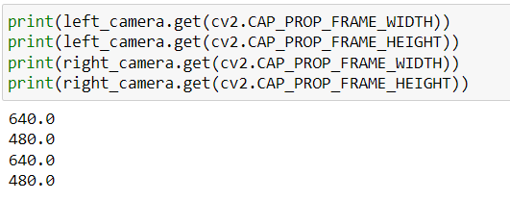
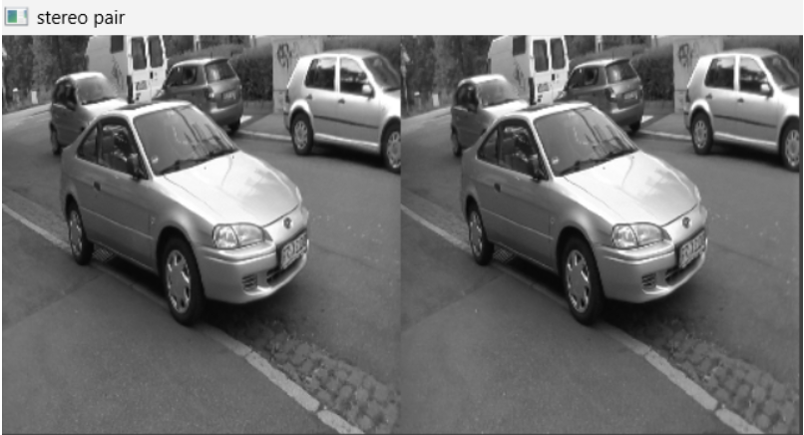
Real-Time video (stereo ego-motion) Depth estimation Srinath-20WU0101031
Overview
An important part of improving picture quality is video stabilization. Early approaches rely on feature tracking to recover either 2D or 3D frame motion, however these approaches struggle with the robustness of local feature extraction and tracking in shaky videos. For this project I choose stereo ego motion datasets with 3D video , by this it is possible to estimate the intensity of video frames in 3D space, which can use in applications in virtual reality
Problem Objectives
Data set
The data contains 52 videos of a stereo motion of cars which were taken in different locations and different camera angles.
Output
To handle complex scenarios such as occlusions and textureless areas.
Handling different types of stereo camera configurations, such as different baseline distances and camera orientations.
With real-time processing, we can see the good visualization of the 3D scene.
Outcomes
A better understanding of the spatial and temporal features that influence the intensity values of 3D videos
Improving the accuracy and efficiency such as video processing and virtual reality
Results
Novelty
Use of deep learning techniques to accurately estimate the intensity of each pixel in a 3D video
The 3D video that taken in low level light can be used to determine the intensity
Capturing different views of a scene with multiple cameras, then combining those views to calculate the intensity
Reference
Unsupervised Monocular Depth Estimation with Left-Right Consistency" by Zhou et al.: https://arxiv.org/abs/1609.03677
"Unsupervised Learning of Depth and Ego-Motion from Video" by Zhou et al.: https://arxiv.org/pdf/1704.07813.pdf
Set video resolution
Convert to stereo pair

