Slide 1

Real-Time video (stereo ego-motion) Depth estimation
V.Srinath
ID:20WUO101031

Slide 2
Agenda
Title
Abstract
Problem Objectives
Outcomes
Novelty
Gantt Chart
Implementations
Results

Slide 3
Abstract
An important part of improving picture quality is video stabilization. Early approaches rely on feature tracking to recover either 2D or 3D frame motion, however these approaches struggle with the robustness of local feature extraction and tracking in shaky videos.
The main aim of the project on 3D video estimation is to create a novel method for estimating the intensity values of 3D videos. In order to learn the intensity patterns of the video, the project involves collecting and processing a dataset of 3D videos, designing and training a deep neural network, and accessing the performance through a variety of metrics. For this project I choose stereo ego motion datasets with 3D video , by this it is possible to estimate the intensity of video frames in 3D space, which can use in applications in virtual reality.

Slide 4

Problem Objectives
To handle complex scenarios such as occlusions and textureless areas.
Handling different types of stereo camera configurations, such as different baseline distances and camera orientations.
With real-time processing, we can see the good visualization of the 3D scene.

Slide 5
Outcomes
A better understanding of the spatial and temporal features that influence the intensity values of 3D videos
Improving the accuracy and efficiency such as video processing and virtual reality

Slide 6
Novelty
Use of deep learning techniques to accurately estimate the intensity of each pixel in a 3D video
The 3D video that taken in low level light can be used to determine the intensity
Capturing different views of a scene with multiple cameras, then combining those views to calculate the intensity

Slide 7

Dataset
The data contains 52 videos of a stereo motion of cars which were taken in different locations and different camera angles.
Dataset Link:https://lmb.informatik.uni-freiburg.de/resources/datasets/StereoEgomotion.en.html

Slide 8
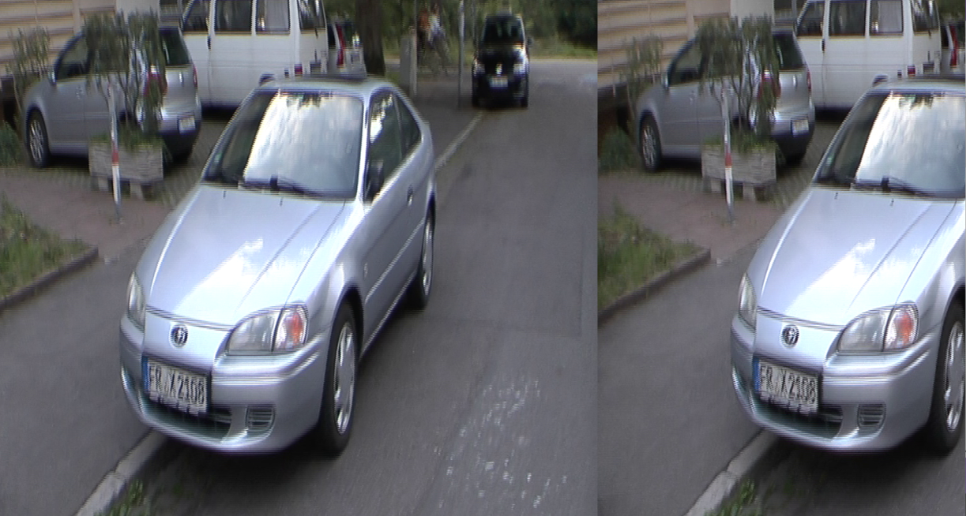
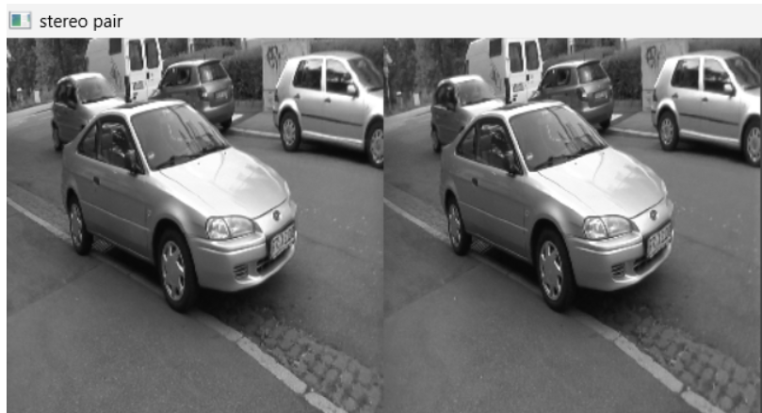
Implementations
Convertion of stereo video in stereo pair image

Slide 9
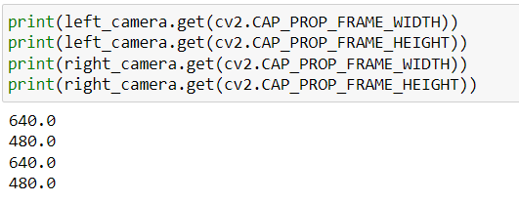
Set the video resolution

Slide 10
Task | Start Date | End Date | Duration
project planning | 03-02-2023 | 07-02-2023 | 4 days
Data collection and Cleaning | 08-02-2023 | 20-02-2023 | 12 days
Stereo ego motion for extracting images and splitting them | 21-02-2023 | 30-02-2023 | 10 days
Working with on video resolutions and frames for the single video | 01-02-2023 | 12-03-2023 | 12 days
Depth map estimation for a single video | 13-03-2023 | 28-03-2023 | 15 days
Performing the depth estimation for all videos containing in the dataset | 30-03-2023 | 12-04-2023 | 12 days
TimeLine

Slide 11
References
"Unsupervised Monocular Depth Estimation with Left-Right Consistency" by Zhou et al.: https://arxiv.org/abs/1609.03677
"Unsupervised Learning of Depth and Ego-Motion from Video" by Zhou et al.: https://arxiv.org/pdf/1704.07813.pdf

Slide 12
Thank You

