Slide 1
Go Green - B22NT03
An application suite for paperless administration

Slide 2

Team
Dr. Nikhil Tripathi Mentor
Kaleri Srineer S20190010079
Kamasani Bharath S20190010080
Pathlavath Govardhan Naik S20190010135
(Project Code - B22NT03)

Slide 3
Agenda
Work Done Now
Problem
Application
1
3
5
2
4
6
Solution
Work Done Before
Future Work

Slide 4
The Problem
Paper is the number one material thrown away and also one of the biggest polluting industries. Papermaking has an impact on the environment because it destroys trees in the process.
Industry experts indicate that to produce 1 ton of printing paper, approximately 12 trees are required each about 40 feet tall with a diameter of roughly 6-8 inches and requires nearly 20,000 gallons of water. [1]
Office workers spend 30-40 percent of their time looking for documents in physical file cabinets. [2]
Working with paper documents creates problems that prevent an employee from being productive and an organization from saving costs. [2]

Slide 5
Solution
We can try to minimize the adverse effect the paper industry is causing to the environment and make employees more productive by adapting to a Paperless Administration.
A paperless office is a workplace that has minimal paper-based processes and relies on digitized documents instead.
This typically involves transitioning to an electronic document managing system that digitizes files and stores it in a central repository.
We are trying to digitize all things which require paper and solve those problems through our web application.

Slide 6
Benefits
We can save valuable time in retrieval of information.
We can improve security of information.
We can save money spent on paper and filing cabinets, as well as other costs like photocopier ink and office stationery.
We will be saving space by storing a full cabinet of data onto a single disk.
Multiple employees being able to access old files and able to edit them, which optimizes the workflow when working together.

Slide 7


Slide 8
Similar Applications
1. MyClassCampus: [3]
Features: Academics, Admissions, Attendance Management, Courses Management, Document Management, Examination Management, Timetable, Student Information, Database Backup.
Drawbacks: Paid Software, Does Not support Mac Os, It is generalized so many features are redundant.

Slide 9
Similar Applications
2. Campus 365: [4] Features: Academics, Accounting, Attendance Management, Courses Management, CRM , Database Backup, Document Management
Drawbacks: Paid Software, There is no certificate management. Confusing to use.

Slide 10
Similar Applications
3. M-Files: [5] Features: Document Management, Email Integration, Electronic Signature, File Scanning, Performance Management, Content Management System, Security Management Drawbacks: Primarily File storage Application, Paid Software, No web support and only supports mobile app, No ticket support, Setting up is complex.

Slide 11
Similar Applications
4. Canvas: [6] Features: This tool has a responsive web design, has a dashboard, which presents a detailed list of our recent activity , gives educators the ability to create content to evaluate and upload grades to the system, Drawbacks: Teachers seeing student grades in other classes, Some of the functions/features can be hard to find, System does not have auto-save.

Slide 12
Similar Applications
5. Blackboard: [6] Features: It is easy to use, It is inexpensive to use and maintain. You do not need a technical training for maintenance and uses.
Drawbacks: It always gets the users looking dirty and rough. You may need regular maintenance in order to get the board really black. The person who polishes it always gets dirty with black stains at the end.

Slide 13
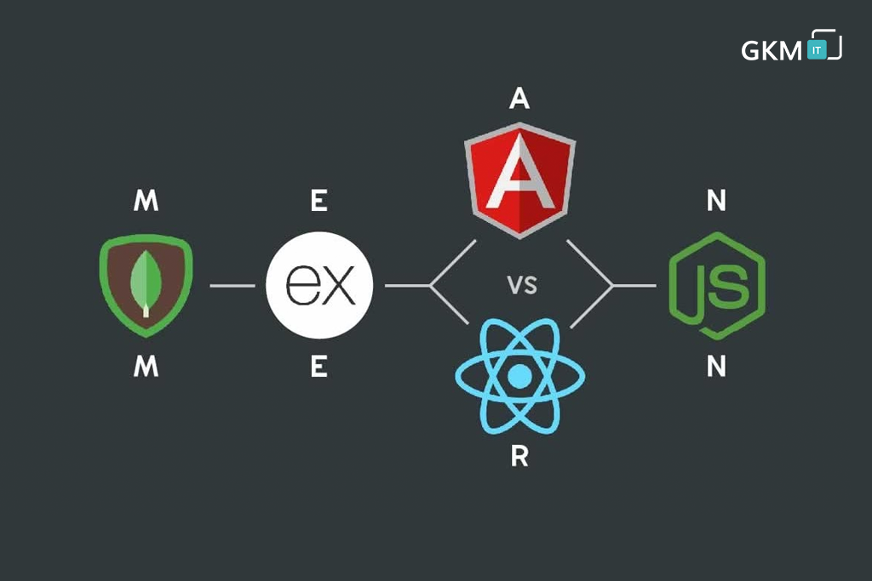
Tech Stack Used
Frontend: React with Redux Backend: Node JS with Express and Mongoose Database: MongoDb

Slide 14
Backend - Models & Routes
Admin Model
Student Model
Student Attendance
Teacher Model
Teacher Attendance
Teacher Salary
Student Leave
Student Fees

Slide 15
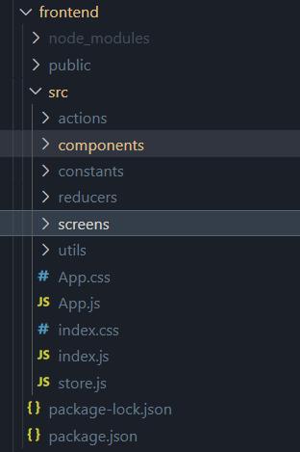
Frontend
We have used React for the frontend, and used redux for the state management.
We have only used vanilla css for the frontend.
We have component based architecture where we have developed many reusable components.

Slide 16
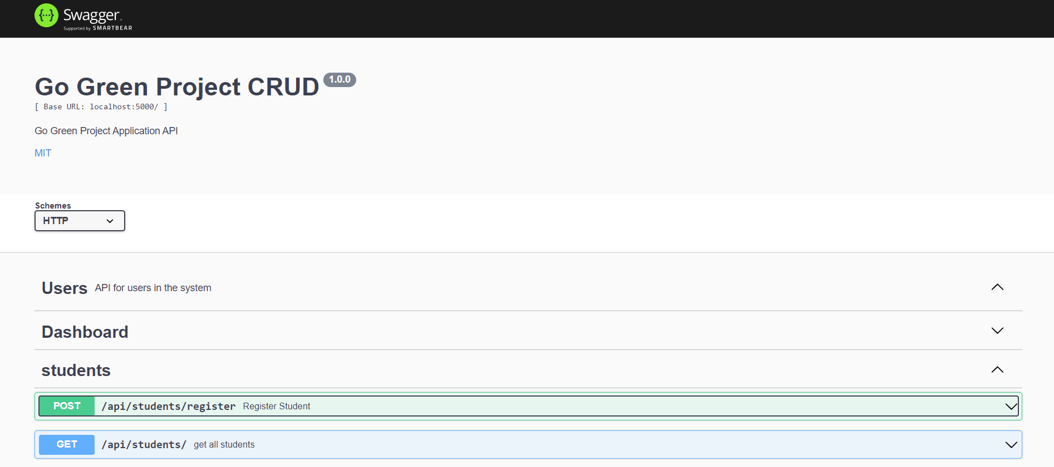
Swagger UI

Slide 17
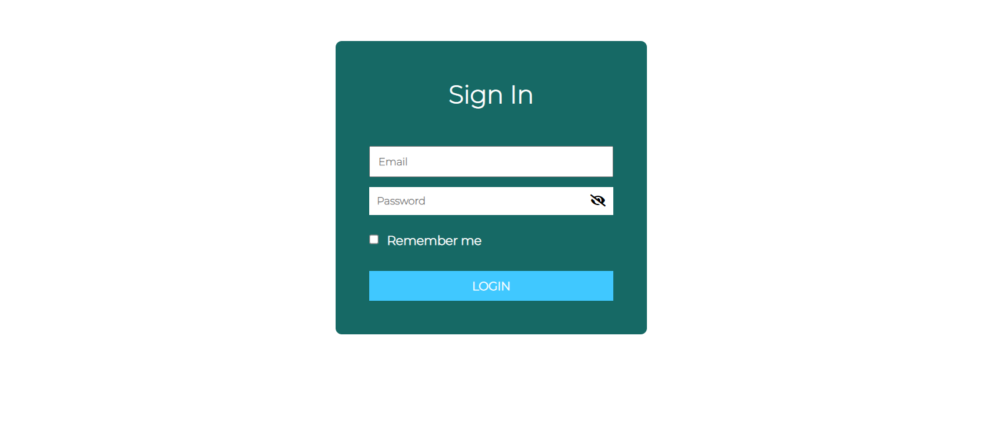
Login Page

Slide 18
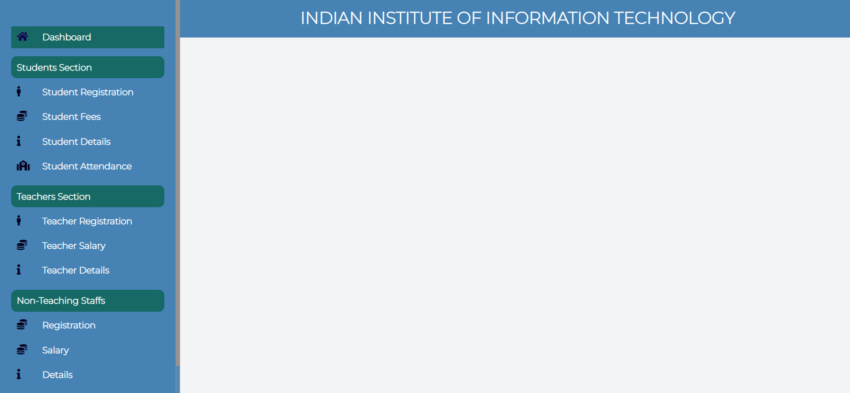

Slide 19
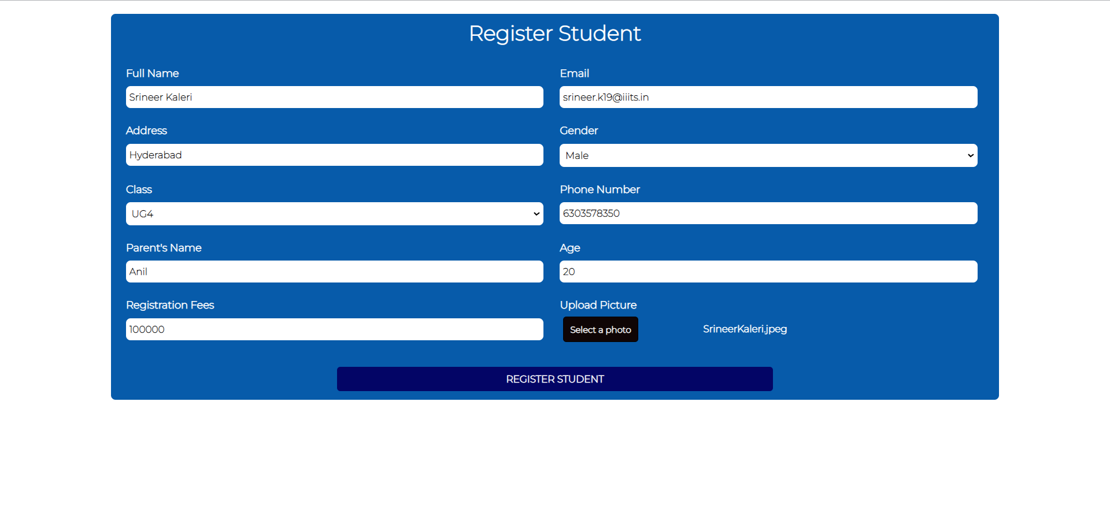
Register Page for Admin

Slide 20
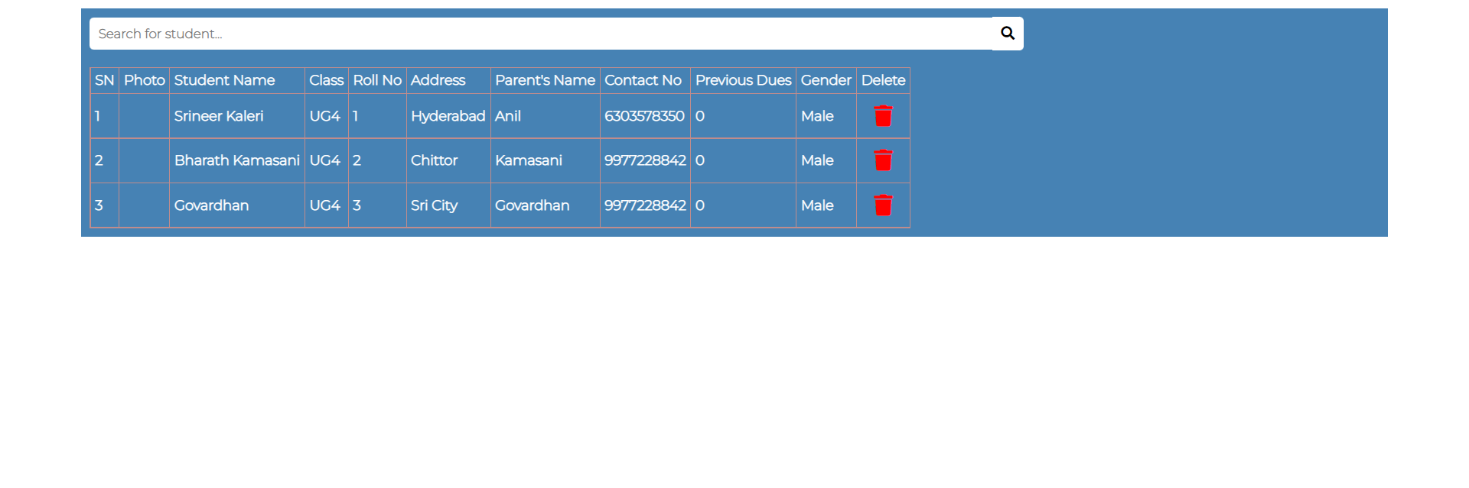
List of Students

Slide 21
Things for Final Evaluation
We will complete the interface for the student and faculty and add some features.
Those features include leave requests from both student and faculty.
We will then try to optimize the application.
Conduct some testing to make sure there are no fatal flaws or security issues.
We will deploy the application, after which the application will be ready to use.

Slide 22
References
https://www.worldatlas.com/articles/how-many-trees-does-it-take-to-make-1-ton-of-paper.html [1]
https://www.hyland.com/en/resources/terminology/paperless-office [2]
https://myclasscampus.com/home [3]
https://www.campus365.io/ [4]
https://www.m-files.com/ [5]
https://canvas.instructure.com/login/canvas [6]

Slide 23
Thank You and Questions…

