Slide 1

A Glimpse into the World of Artificial Intelligence
By Epoch Team, IIT Hyderabad

Slide 2
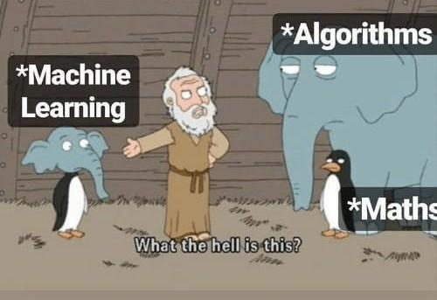
We don’t do definitions, We do memes

Slide 3
What is Artificial Intelligence?
Artificial intelligence is the simulation of human intelligence processes by machines, especially computer systems.
Some standard applications of AI are:
Natural Language Processing (NLP)
Computer Vision (CV)

Slide 4
What is Machine Learning?
Machine learning is a branch of artificial intelligence (AI) and computer science which focuses on the use of data and algorithms to imitate the way that humans learn, gradually improving its accuracy.
“Machine Learning is the study of computer algorithms that improve automatically through experience.” - Tom Mitchell

Slide 5
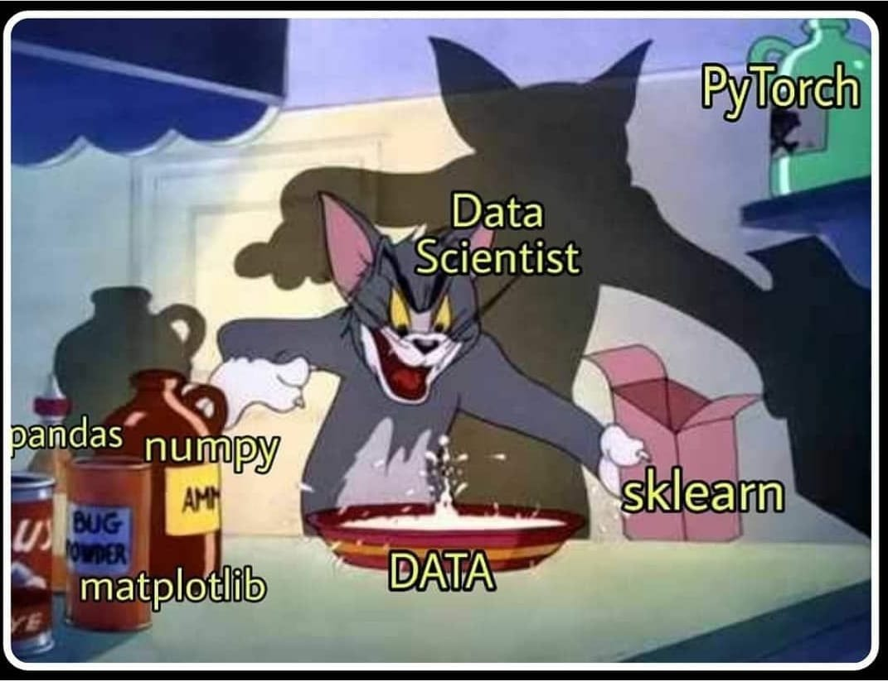
What is Data Science?
Data science is the field of applying advanced
analytics techniques and scientific principles
to extract valuable information from data for
business, decision-making, strategic planning
and other uses.

Slide 6
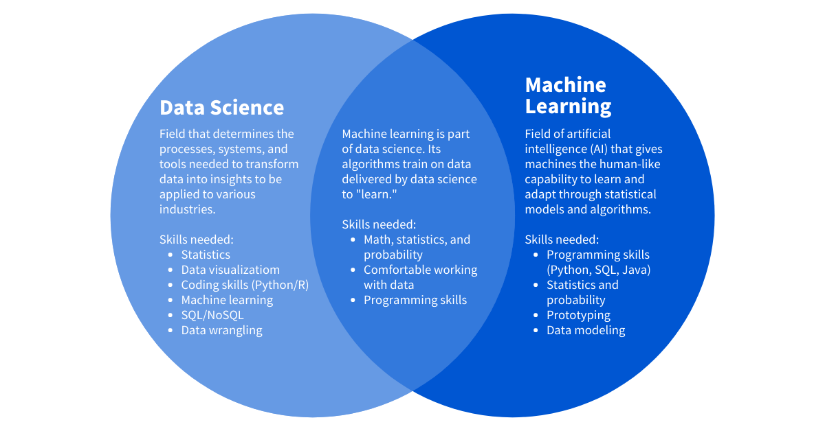

Slide 7


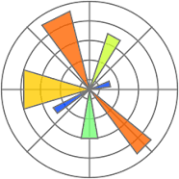

Brief insight of these libraries
Numpy - to work with arrays and vectors
Pandas - to work with the dataset (.csv files)
Matplotlib & Seaborn - for visualization
Tensorflow - to create deep learning models

Slide 8





Slide 9
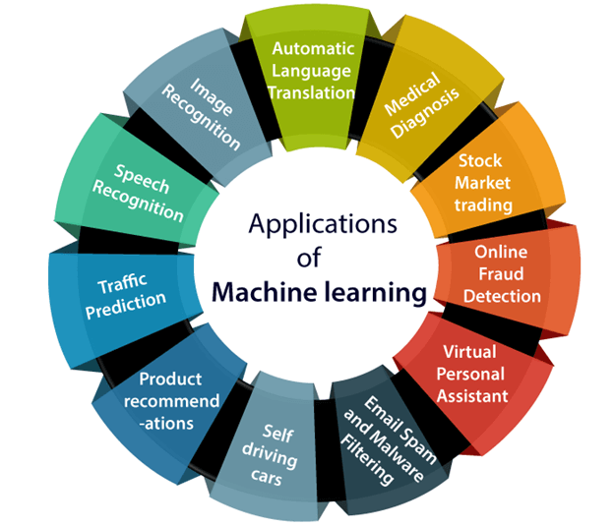
Why machine learning?
Image Recognition - Google lens
Medical Diagnostics - Medical image processing
Stock Market - Stock price prediction
Content Personalization - Netflix, Spotify, Youtube
Traffic Prediction - Google Maps
Speech Recognition - Virtual assistant like Alexa

Slide 10
Type of Machine Learning
Supervised Learning vs Unsupervised Learning
Supervised learning trains a model on known input and output data so that it can predict future outputs whereas unsupervised learning finds hidden patterns or intrinsic structures in input data.
Or in other words, supervised learning make predictions based on labeled training data & unsupervised learning itself identifies relationships between the unlabeled training data.
Train/Test : The data set is splitted into two sets: a training set and a testing set. Say, 80% for training, and 20% for testing. The model is trained using the training set and tested using the testing set.

Slide 11
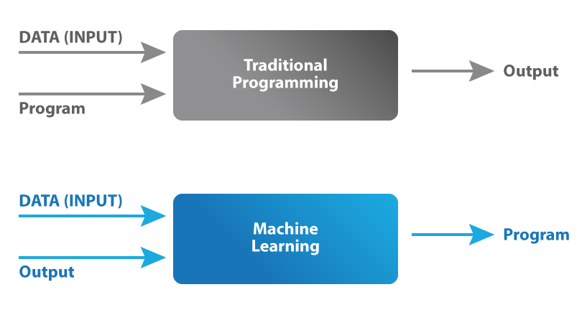
How exactly does a model learn?
Setting aside the mathematical jargon, a supervised model basically learns a function that maps the inputs X to the outputs Y.
In supervised learning, we give the model a certain set of parameters, that it continuously tune, so that it can learn an appropriate function that does well on the input dataset.

Slide 12

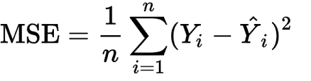
Loss function
Loss function predicts the deviation of the predicted outcome from the actual result. It measures how well the machine learning algorithm models the training dataset.
We convert the machine learning problem into an optimization problem, by defining the loss function and then gradually optimizing the algorithm so that the loss function is minimized.
One of the common loss functions is mean squared
error (MSE).

Slide 13
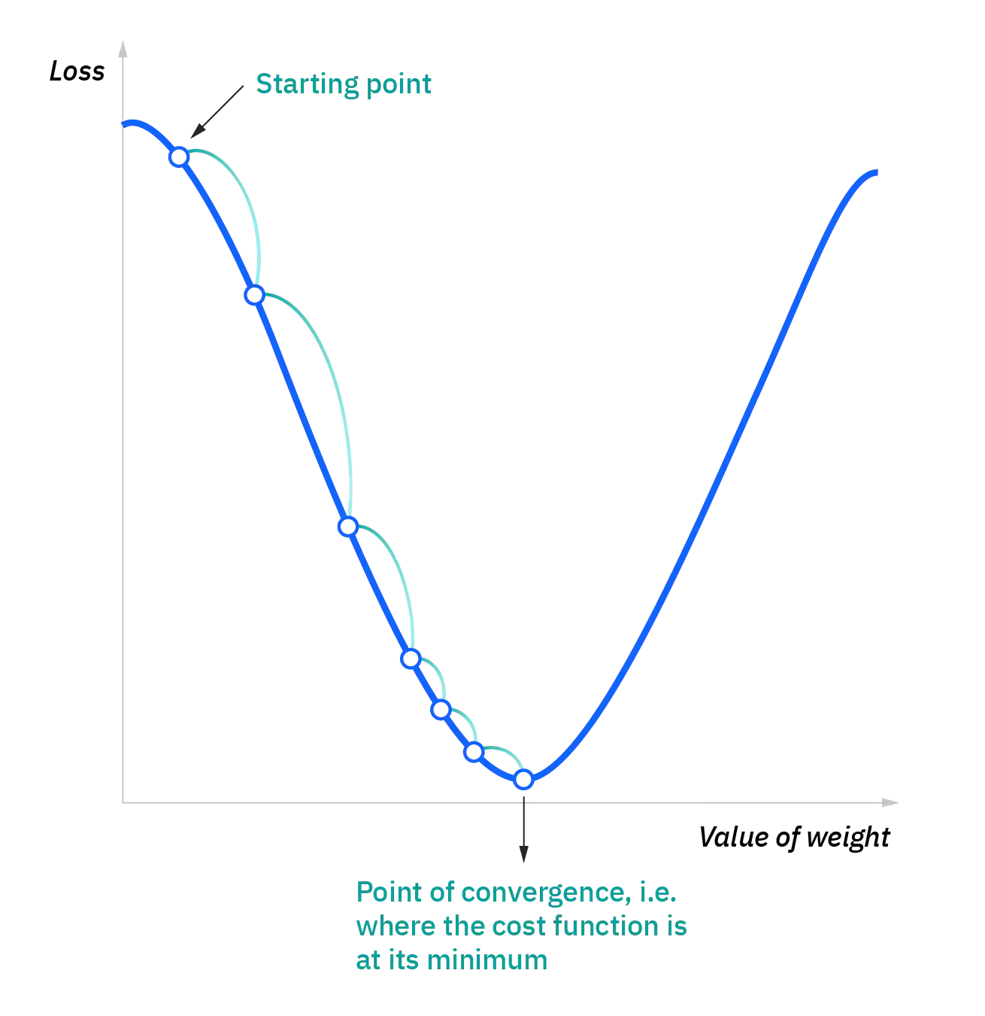
Now, what is gradient descent…
Gradient descent is an optimization algorithm/technique
commonly used to train machine learning models.
The key idea behind this algorithm is to take the fastest route
towards the minimum of the function from current point to
converge fast.
So, we take repeated steps in the opposite direction of the
gradient of the function as that is the steepest descent possible.

Slide 14
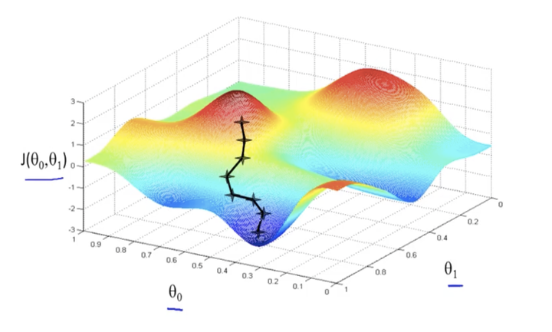
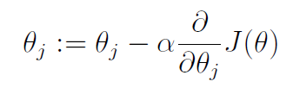
Gradient descent
Compute the slope (gradient) that is the first-order derivative of the function at the current point
Move-in the opposite direction of the slope increase from the current point by the computed amount

Slide 15
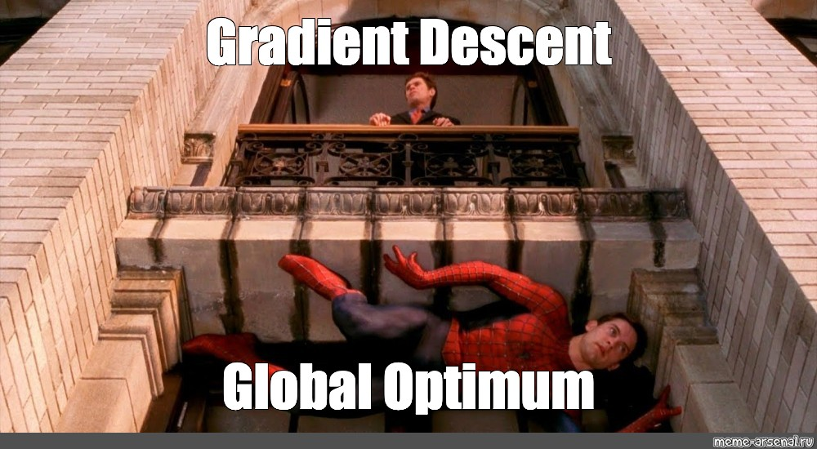

Slide 16
Computer Vision - 101
No, it’s not about the webcam.
Computer vision is a field of artificial intelligence (AI) that enables computers and systems to derive meaningful information from digital images, videos and other visual inputs — and take actions or make recommendations based on that information.

Slide 17
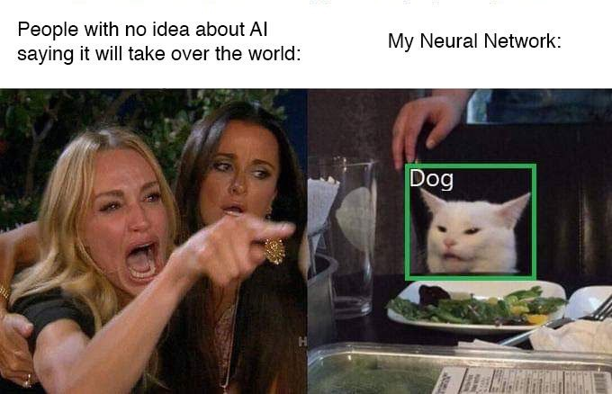

Slide 18
Classification - The Holy Grail
One of the first tasks that was tackled “Computer Vision” involved simple Classification of Hand-written digits.
Later on (after a lot of effort) the ImageNet dataset was created and it was being used for benchmarking models. There were many models working on it , each achieving only 40 -50 % accuracies at best.
During 2012, Alex Krizhevsky invented the AlexNet (You may call this the advent of the real “Deep learning”, it smashed the competition by nearly 10.8 % difference in the top-5 error rate.)

Slide 19
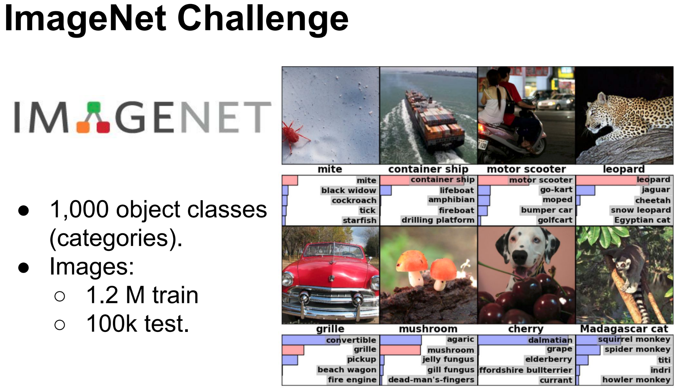
The ImageNet dataset

Slide 20
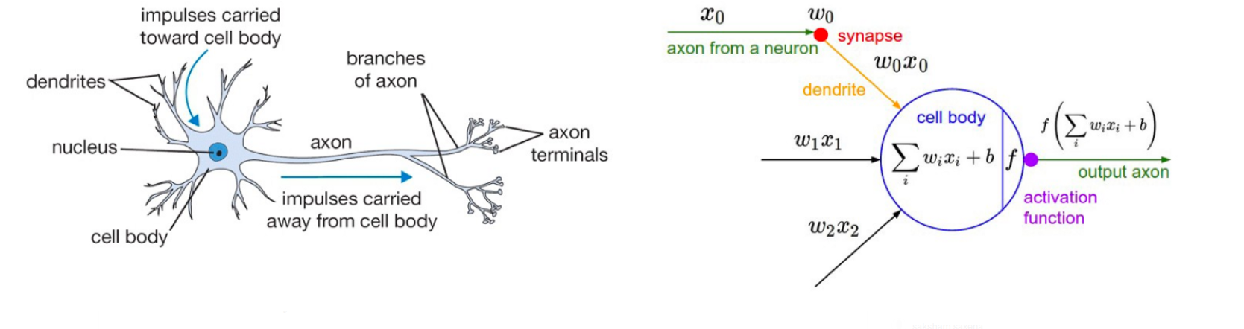
Neural Networks
You know the story, These Machine Learning Models were “inspired” from how the brain actually works. However we aren’t even close to actually achieving human performance yet.

Slide 21
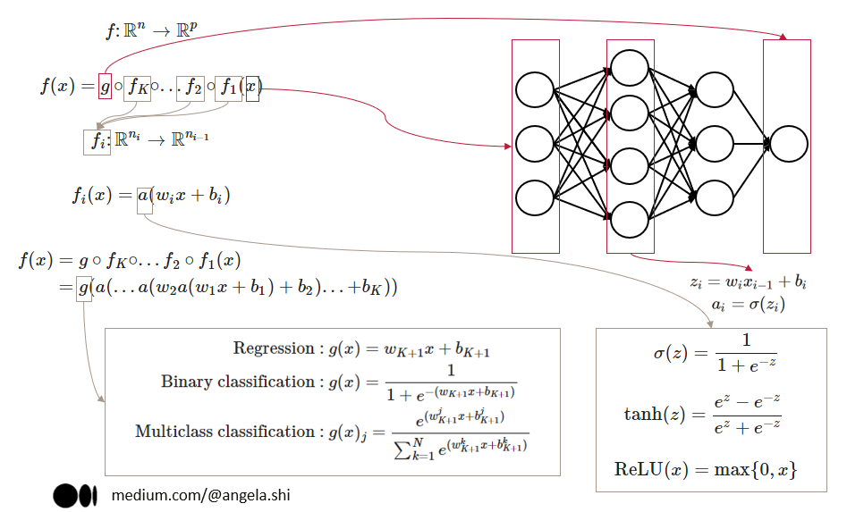
Structure of a Neural network

Slide 22
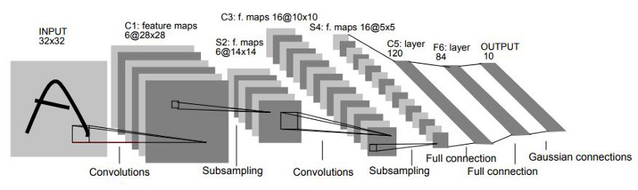
Convolutional Neural Networks
Sharing of parameters and the ability to learn deeper aspects of a particular image, like edges and even later, faces.

Slide 23
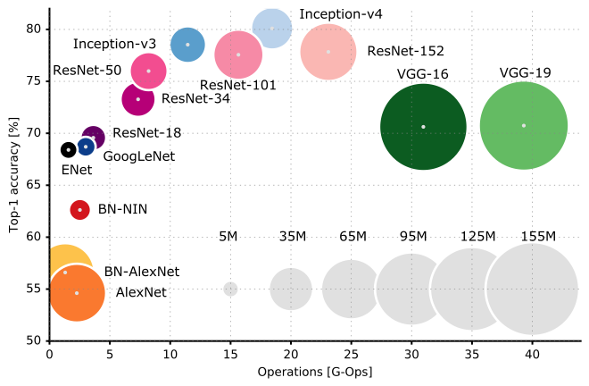
A few Different Model Names that fly around

Slide 24
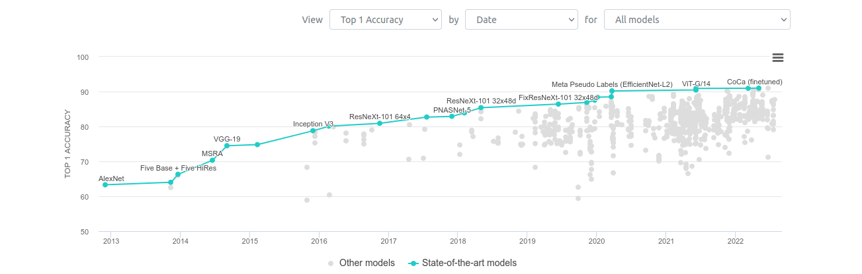
ImageNet Performance charts over a few years

Slide 25
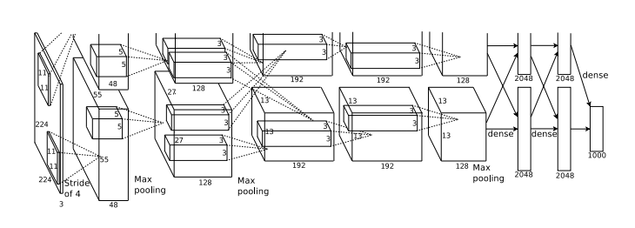
A few “Deep” Architectures
AlexNet - Highly optimized using GPU’s

Slide 26
Why was AlexNet so damn good!
The RELU non-linearity really became popular after the AlexNet paper.
GPU’s have the ability to perform computations in parallel with several cores,
Think about Matrix multiplication, things could speed if each row and column vector dot products happen simultaneously. This difference starts to become apparent. When the number of parameters become huge (Deep Neural Networks).
AlexNet had ~ 61M parameters ! : ()
It was nearly 4 times as fast compared to the CPU version.

Slide 27
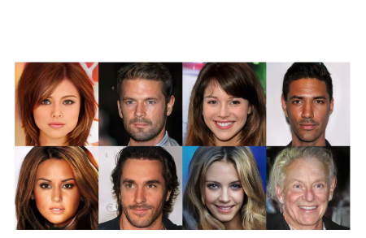
Recognize the Celebs!

Slide 28
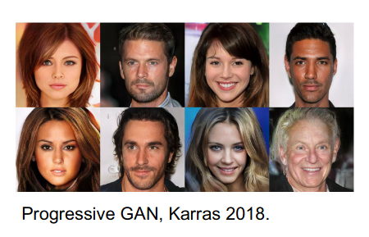
Sike , Image generation using GAN’s
All of These images are generated by Generative Adversarial Networks

Slide 29
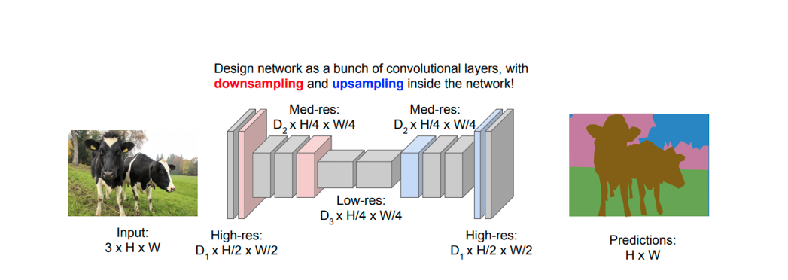
Semantic Segmentation
The goal of Semantic Segmentation is to label every single pixel of an image with a particular class. This is used in Autonomous driving!

Slide 30
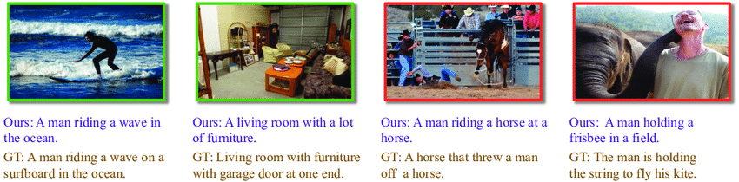
Image Captioning
Image captioning involves finding a “caption” that suits or describes a particular image, Microsoft COCO is the dataset that’s widely used.
Okay? But how do we go about this ?

Slide 31
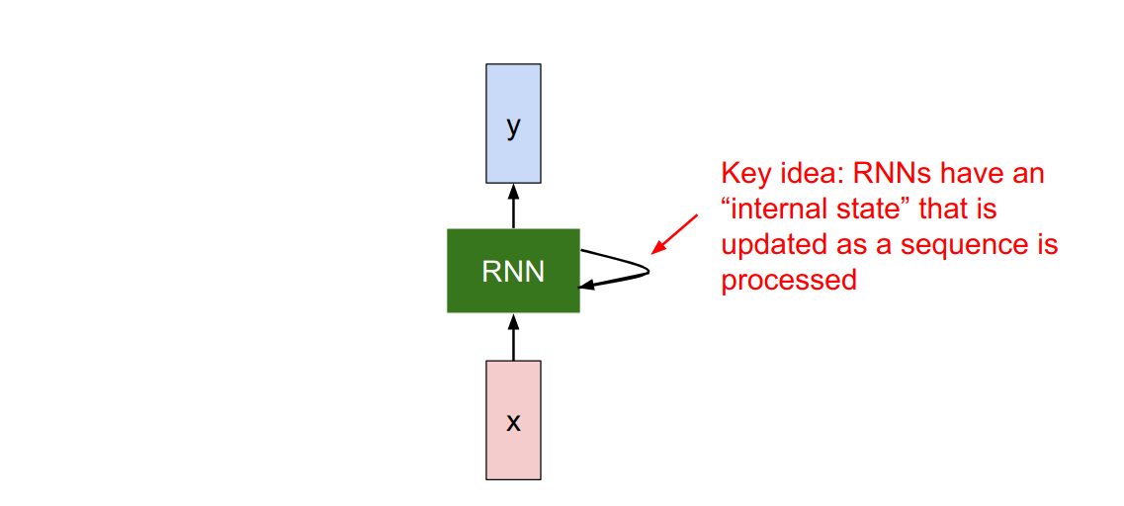
Recursive Neural Networks

Slide 32
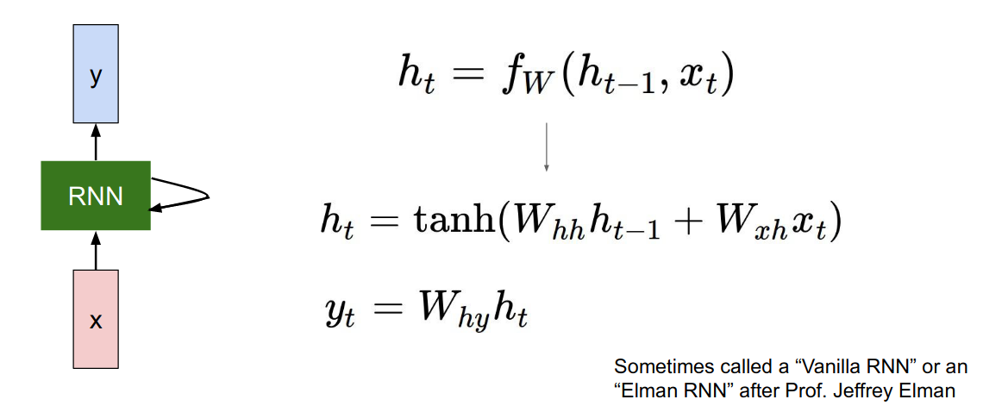
The structure of a “Vanilla” RNN

Slide 33
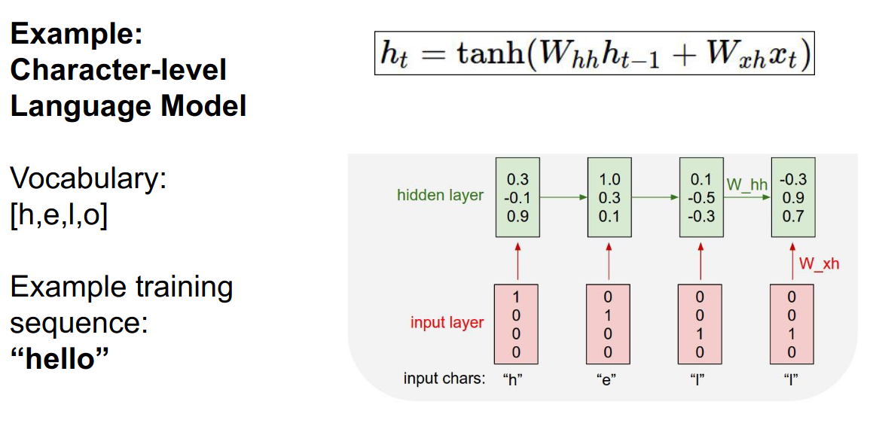
Character Level RNN’s

Slide 34
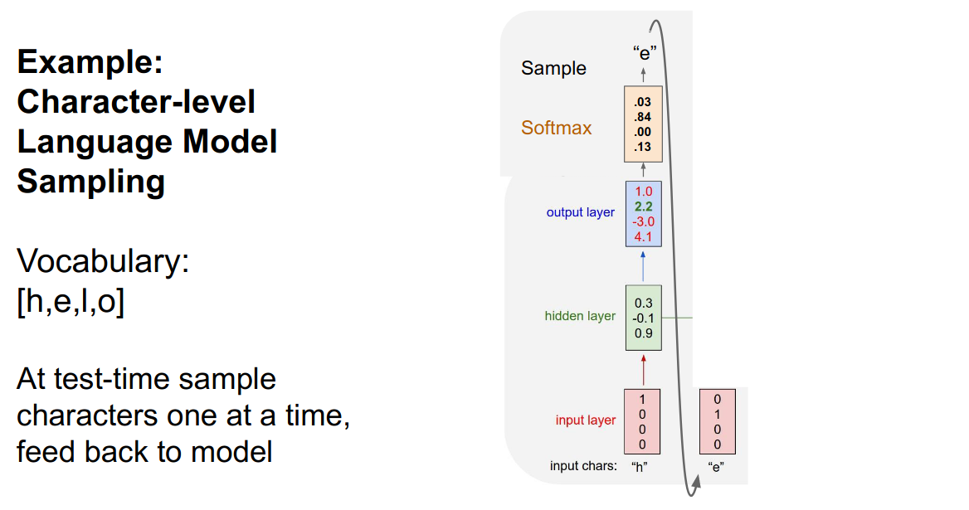
Sequence to Sequence Sampling

Slide 35
Doing random Stuff with RNN’s
Since RNN’s work on sequenced data, you pretty much have the freedom to put any sort of sequenced data straight into the RNN’s. Including Shakespeare’s Sonnets, LaTeX Source code for a book on Algebraic Topology, or even the entire source code of Linux.
:)

Slide 36
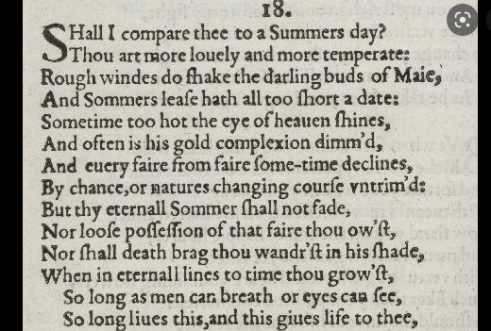
The Sonnets

Slide 37
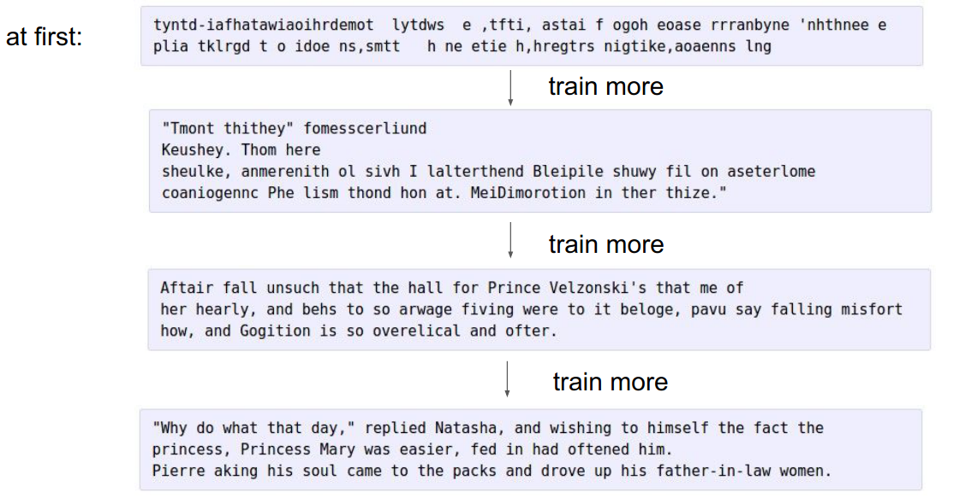
Shakespeare-> RNN-> Output
Courtesy:
CS231N

Slide 38
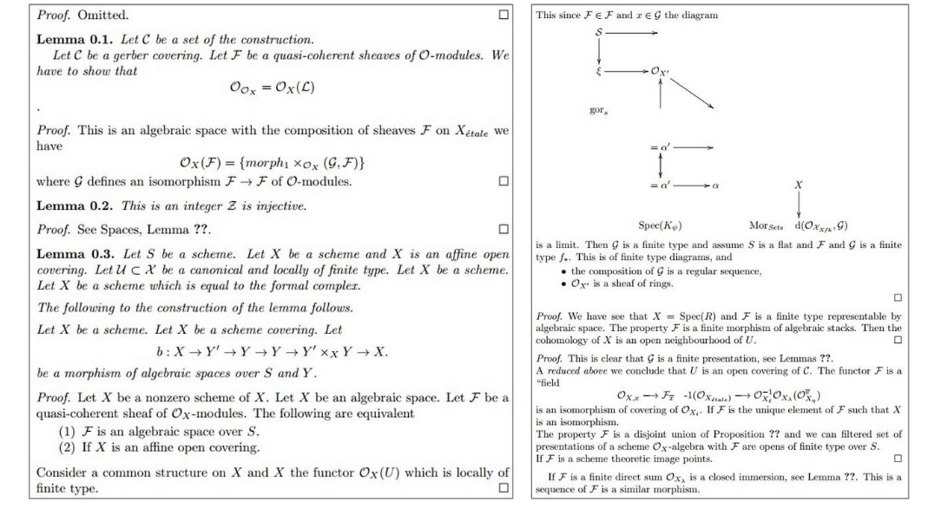
Algebraic Topology -> RNN -> Output
Courtesy: CS231N (Stanford)

Slide 39
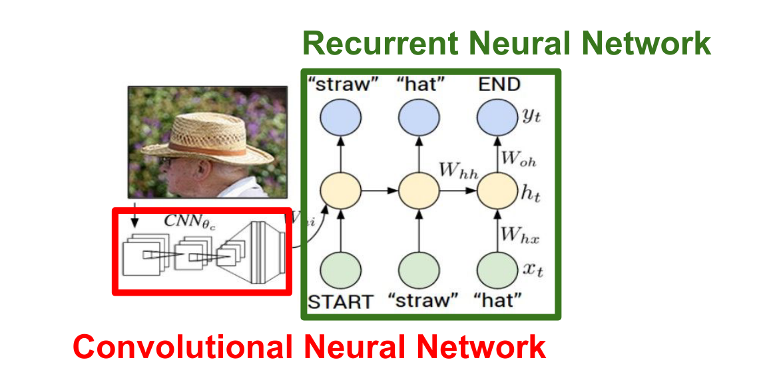
Finally! Image Captioning with RNN’s

Slide 40
Natural Language Processing
Natural Language processing is the ability of a machine to interpret human language.

Slide 41
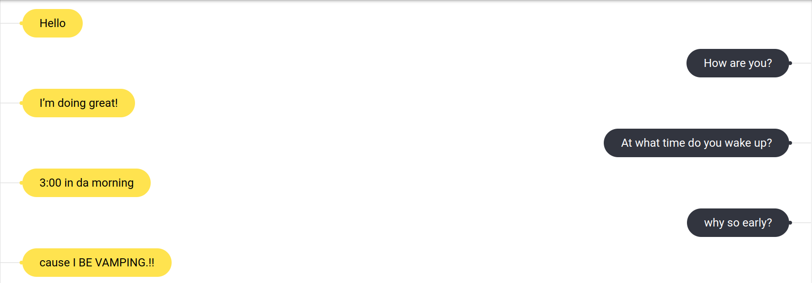
Chatbot

Slide 42
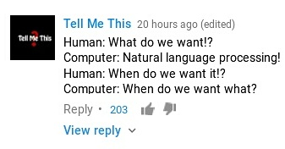

Slide 43
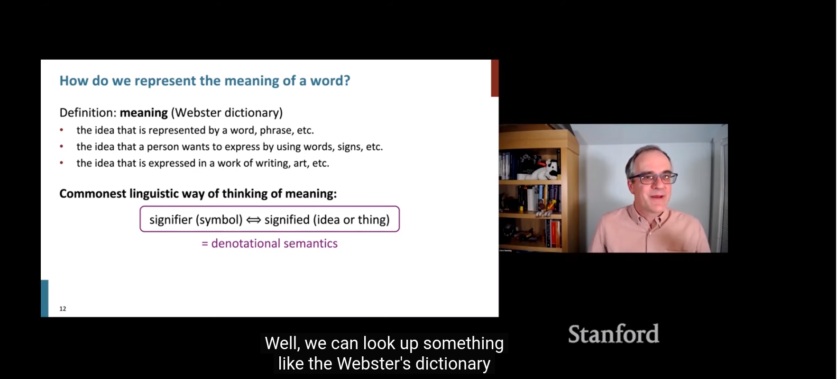
Speech to Text

Slide 44
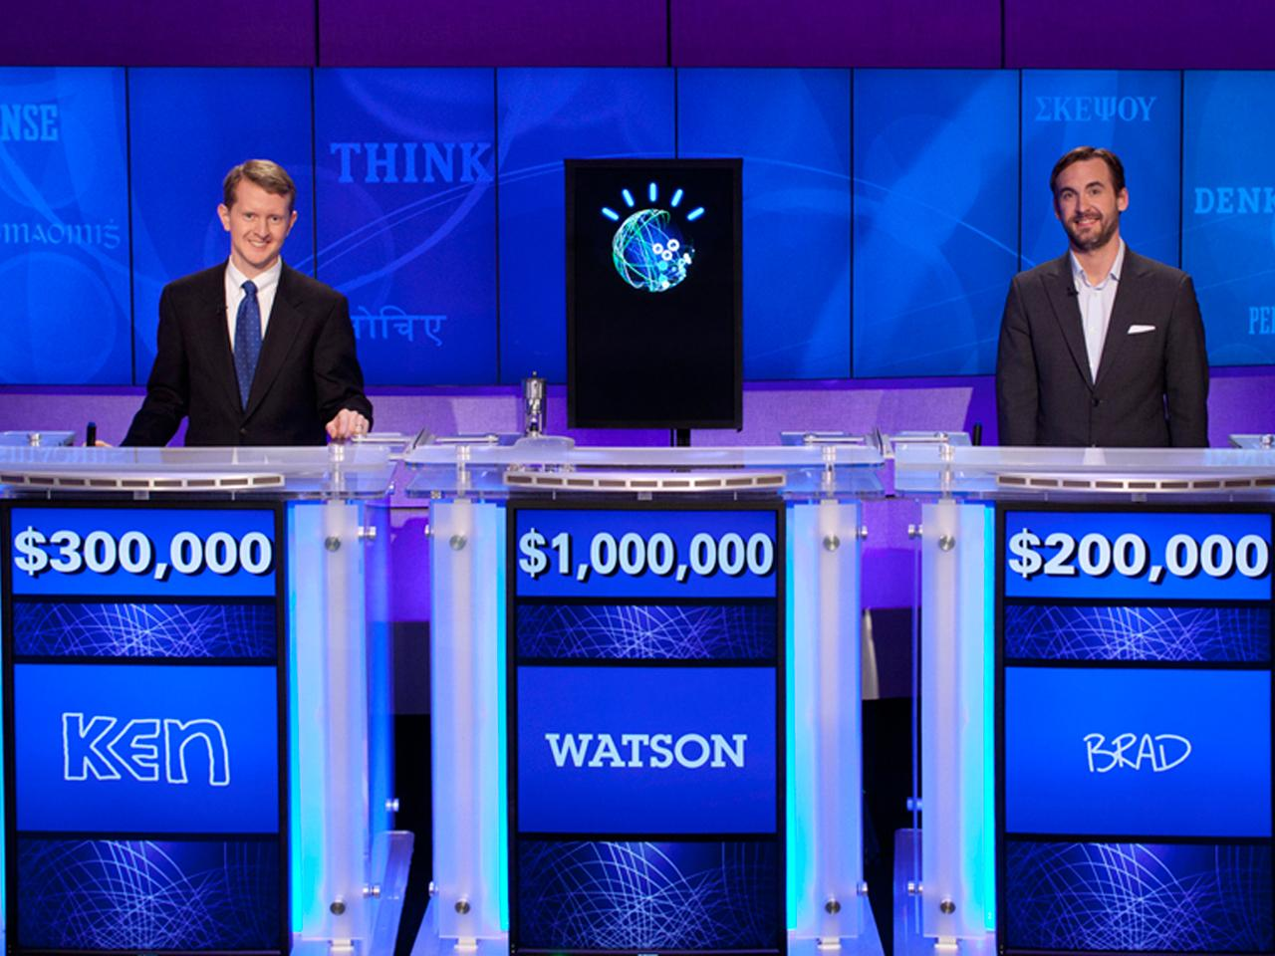
Question Answering

Slide 45
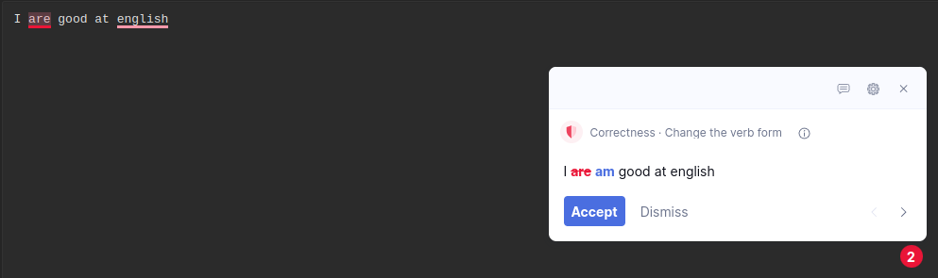
Spell Correction

Slide 46
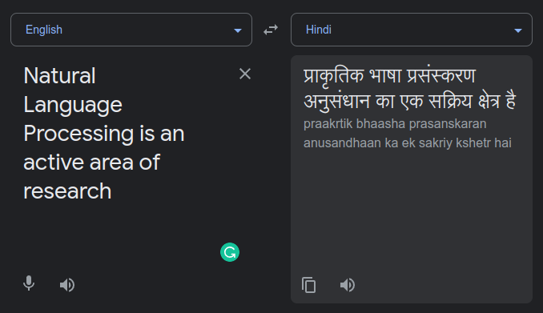
Machine Translation

Slide 47
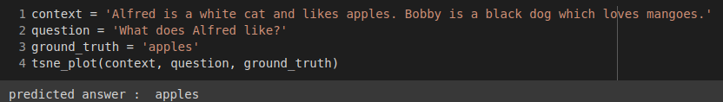
Closed Domain Question Answering

Slide 48
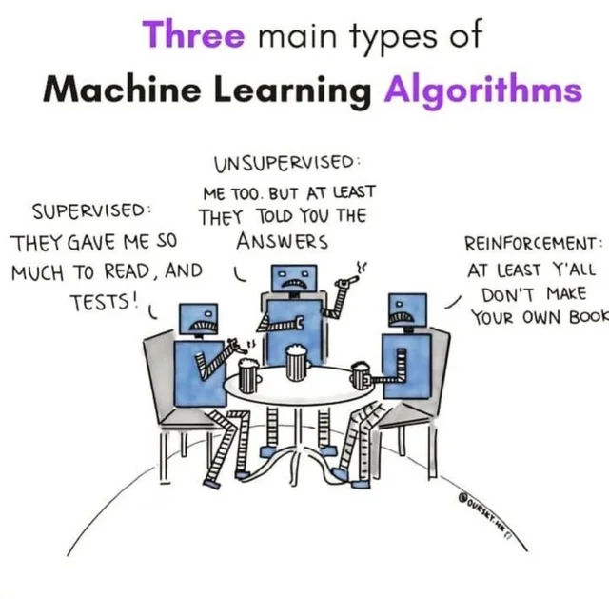
Reinforcement Learning

Slide 49
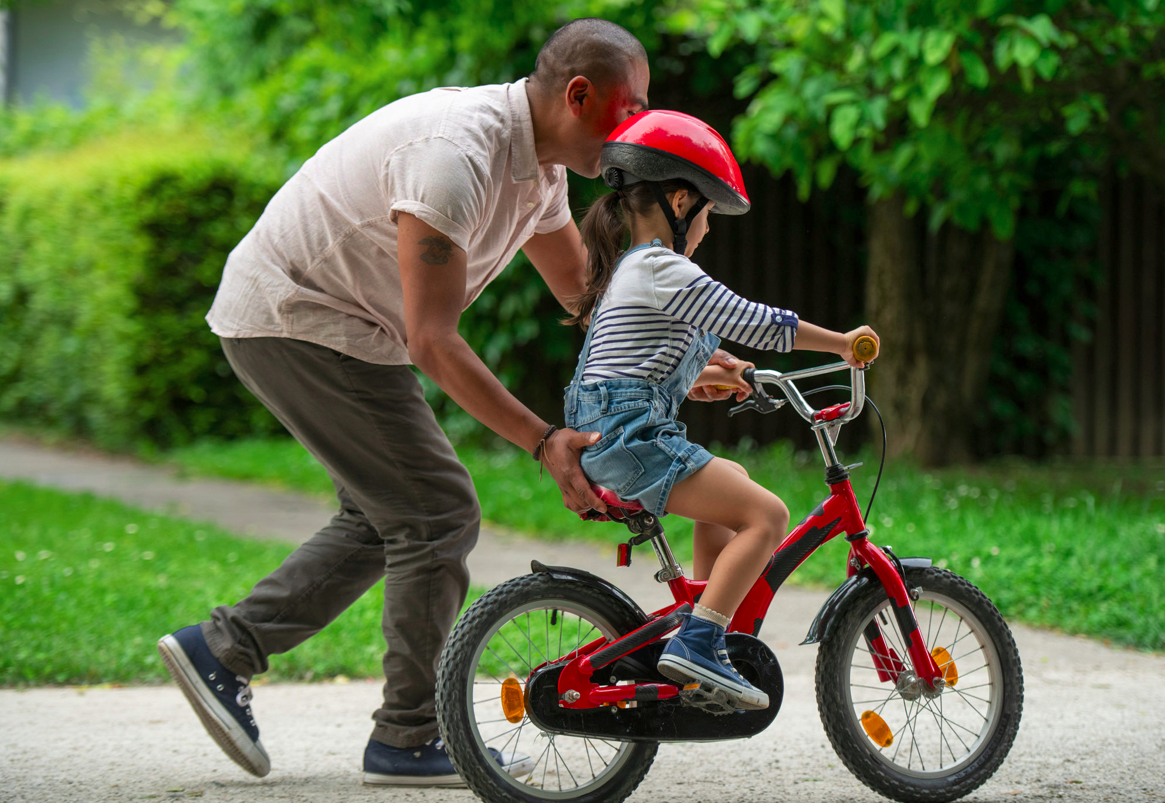
How did you learn to cycle
Notes:
Great example, often used by Balaraman Ravindran
Learning to cycle, is not an example of supervised learning
Not supervised learning either, because it would mean, that you watched hundreds of videos of people cycling and learnt inherent pattern and reproduced it
So this is distinct from supervised and unsupervised learning
Mathematical formalism for learning through reward and punishment/negative reward, etc

Slide 50
How did you learn to cycle
Not supervised learning

Slide 51
How did you learn to cycle
Not supervised learning
Not unsupervised learning

Slide 52
How did you learn to cycle
Not supervised learning
Not unsupervised learning
Learning by Trial & Error

Slide 53
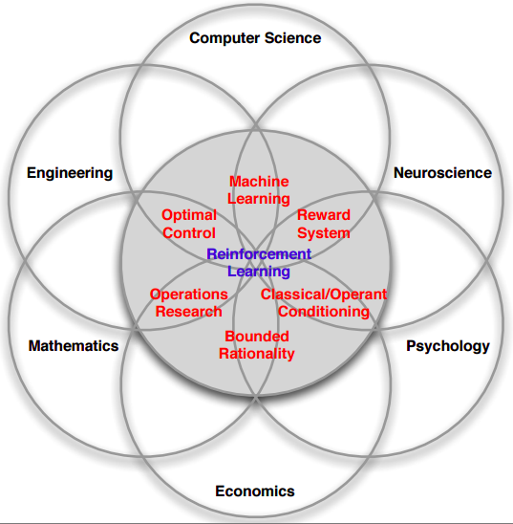
Notes:
Fundamentally - Science of decision making
Economics: Game theory, rational being, etc
Neuroscience and Psychology: Pavlov’s dog
Computer Science: Machine learning
Mathematics and Engineering: Control Theory

Slide 54
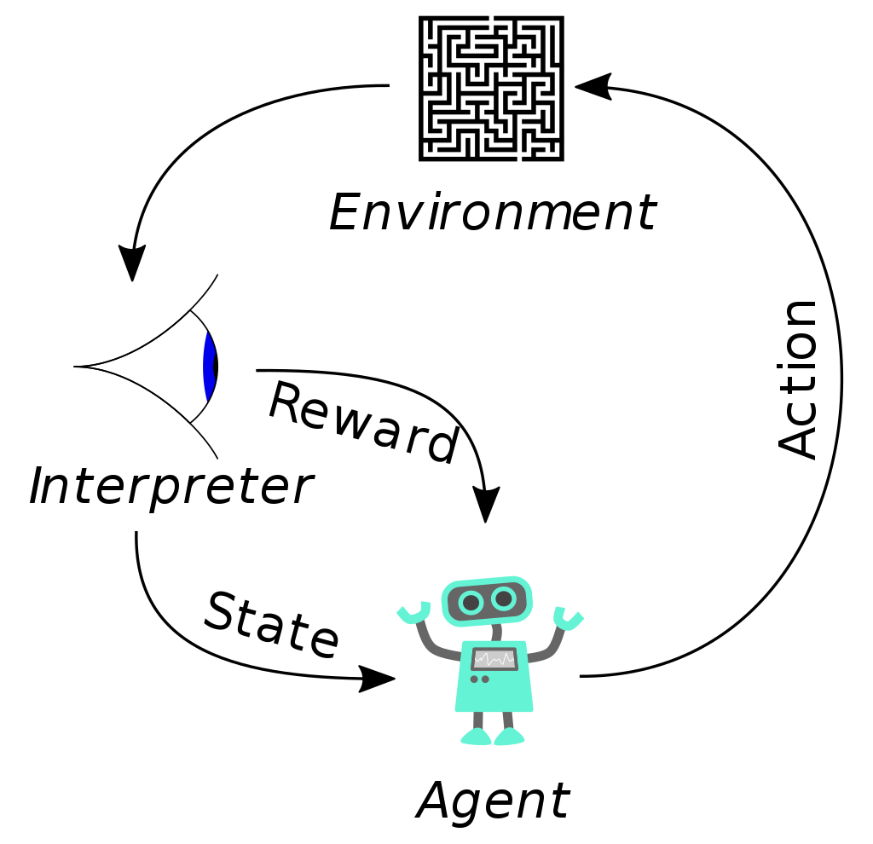
What is it?
Notes:
State: Are the observation that the agent receives, example: in chess how the pieces are placed, here all the information is known, whereas for blackjack state will only be the cards on the table
Environment:
Reward: win or lose
Action: for a maze, what direction will the robot go in
Agent: a robot, or person playing chess, etc

Slide 55
What is it?
A policy defines the learning agent’s way of behaving at a given time

Slide 56
What is it?
A policy defines the learning agent’s way of behaving at a given time
A reward signal defines the goal of a reinforcement learning problem

Slide 57
What is it?
A policy defines the learning agent’s way of behaving at a given time
A reward signal defines the goal of a reinforcement learning problem
A value function specifies what is good in the long run

Slide 58
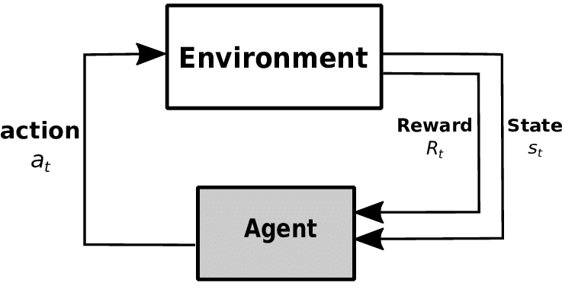
Reinforcement learning: An Example

Slide 59
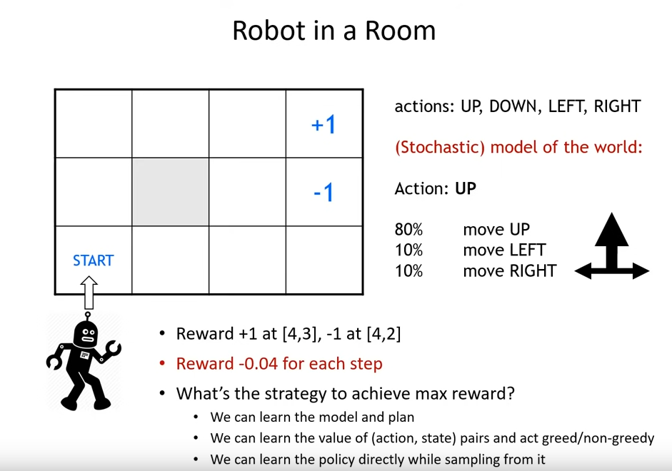
Courtesy: MIT 6.S091: Introduction to Deep Reinforcement Learning (Deep RL)

Slide 60
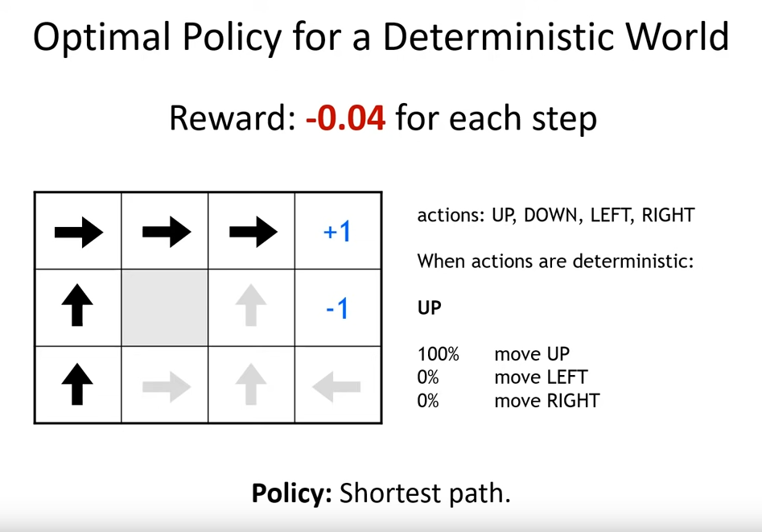

Slide 61
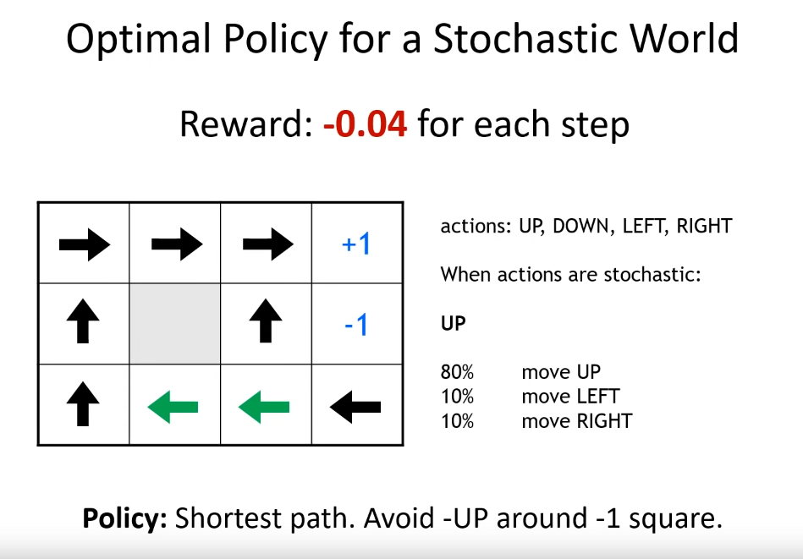

Slide 62
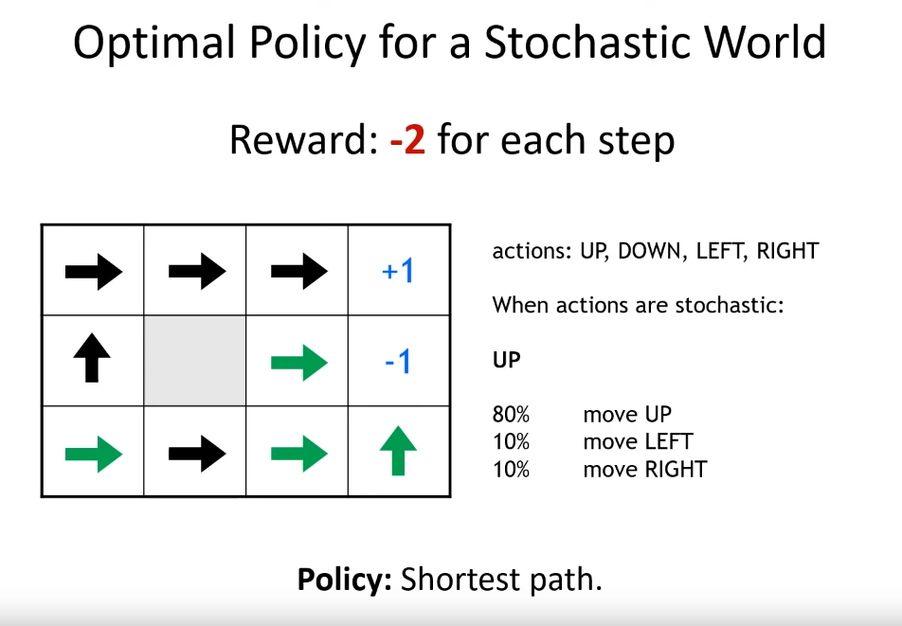

Slide 63
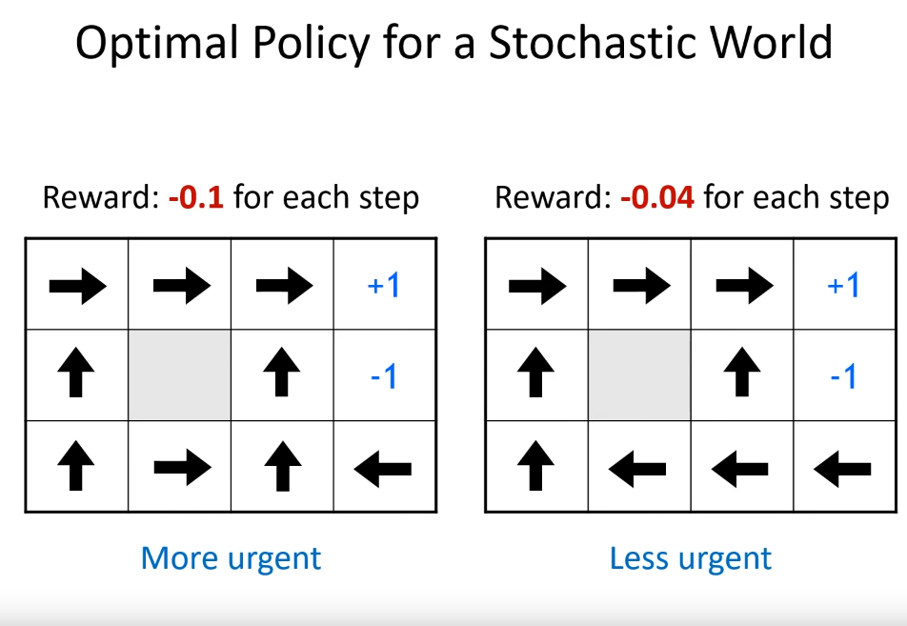

Slide 64
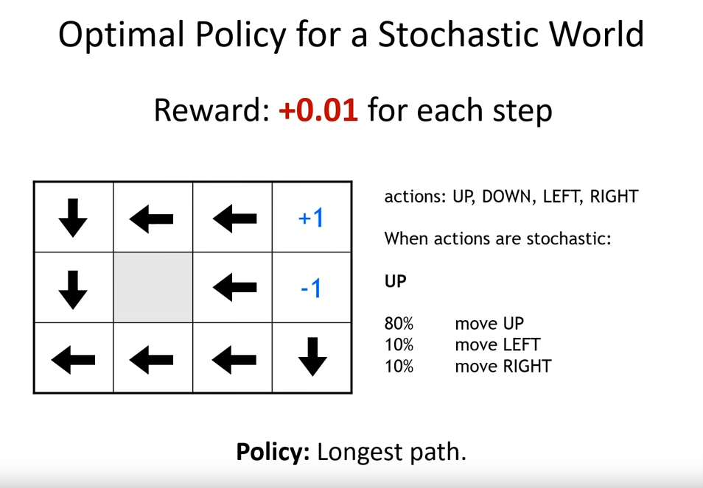

Slide 65
Conclusion
Important parameters

Slide 66
Conclusion
Important parameters
Environment

Slide 67
Conclusion
Important parameters
Environment
Reward

Slide 68
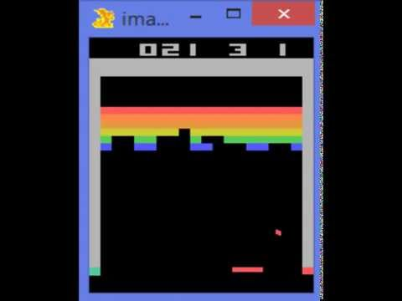
Applications
Notes:
This though is with a caveat,
the problems we face in the real world can be extremely complicated in many different ways and therefore a typical RL algorithm has no clue to solve
But breakthrough was found through the combination of deep learning and Reinforcement learning to get Deep Reinforcement Learning

Slide 69

Applications

Slide 70


doi:10.1038/nature14236

Slide 71

Alpha Zero & Alpha Go

Slide 72

Why is this important?
Notes:
https://www.quantamagazine.org/is-alphago-really-such-a-big-deal-20160329/
Transfer Learning, etc

Slide 73
Why is this important?
IBM Deep Blue vs Gary Kasparov
Notes:
Ultimately, the Deep Blue developers used two main ideas. The first was to build a function that incorporated lots of detailed chess knowledge to evaluate any given board position. The second was to use immense computing power to evaluate lots of possible positions, picking out the move that would force the best possible final board position.

Slide 74
Why is this important?
IBM Deep Blue vs Gary Kasparov
AlphaGo vs Lee Sedol. Is it any different?
Notes:
To begin, AlphaGo took 150,000 games played by good human players and used an artificial neural network to find patterns in those games. In particular, it learned to predict with high probability what move a human player would take in any given position. AlphaGo’s designers then improved the neural network by repeatedly playing it against earlier versions of itself, adjusting the network so it gradually improved its chance of winning.

Slide 75
Why is this important?
IBM Deep Blue vs Gary Kasparov
AlphaGo vs Lee Sedol. Is it any different?
Ability to replicate intuitive pattern recognition is a big deal
Notes:
In an earlier paper, the same organization that built AlphaGo — Google DeepMind — built a neural network that learned to play 49 classic Atari 2600 video games, in many cases reaching a level that human experts couldn’t match. The conservative approach to solving this problem with a computer would be in the style of Deep Blue: A human programmer would analyze each game and figure out detailed control strategies for playing it.

Slide 76
Recent Progress in ML
Computer Vision / Image Recognition
ImageNet, CNNs, Autonomous driving
Speech Recognition
Voice assistants
Language Models
GPT-3, PaLM
Game Playing / Deep Reinforcement Learning
AlphaGo, AlphaZero
Text-to-Image Models
Dall-E, ImaGen

Slide 77
How to approach Machine Learning?
Python/R and libraries like NumPy, SciPy, Matplotlib, Seaborn, Scikit-Learn, Pandas, TensorFlow, PyTorch
Mathematics for ML
Probability & Statistics - Random variables, Expectations, Distributions
Linear Algebra & Matrix Calculus - Gradients/Hessians, Eigenvalue/vector
Understand the internals of ML algorithms
Build ML applications to know which algorithms to use when
Can read some ML research papers
Some good resources are mentioned at the last slide.

Slide 78
Resources!
3b1b Series on Neural Network
CS229
CS244D
CS231N
CS224N
Pattern Recognition and Machine Learning: Bishop

Slide 79




Social Media
Follow our social media handles for regular updates
Instagram
Twitter
YouTube
WhatsApp

