Slide 1


Math for ML
An Epoch-GDSC Collaboration

Slide 2
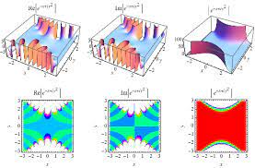
Probability Distributions

Slide 3

Probability Distributions: Gaussian Distribution
Gaussian/Normal distribution
- The probability density for the Gaussian distribution is
Saw this in Modern Physics right?
It’s not that scary as it looks!
The function has its peak at the mean, and its “spread” increases with the standard deviation. This implies that normal is more likely to return samples lying close to the mean, rather than those far away.

Slide 4
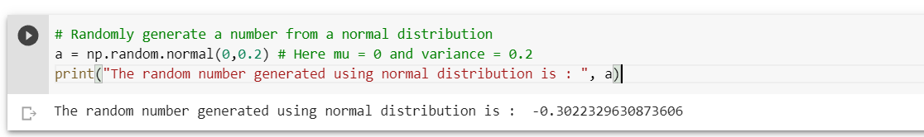
Random Sampling from Distributions
np.random.normal(loc = 0.0, scale = 1.0, size = None)
  It generates random numbers from a normal distribution.
  Here, loc is the mean of the distribution and scale = variance of the distribution.
Confusing?? Let’s plot it !!

Slide 5
Other Distributions!
There are still a lot of distributions that NumPy offers like:
np.random.weibull()
np.random.poisson()
np.random.binomial()
np.random.uniform()
etc.,
These are left for you to explore !
And stay tuned for the Math for ML session!

Slide 6

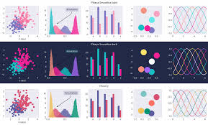
Intro to

Slide 7
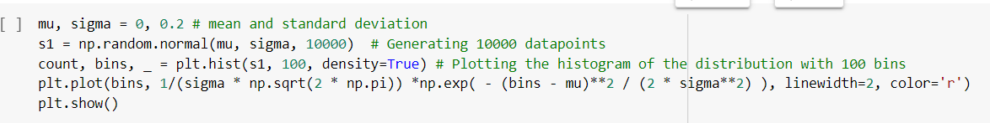
Plotting - Let’s get started!
We use matplotlib for plotting figures in python.
Matplotlib is a comprehensive library for creating static, animated, and interactive visualizations in Python.
plt.hist(x,bins, density) : Plot the histogram of the data
plt.plot() : Plot the curve in the figure
We will see this in more details in the upcoming slides

Slide 8
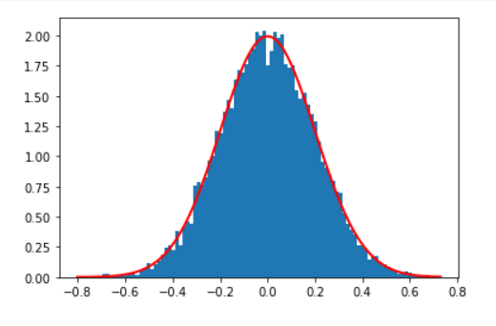
Gaussian Distribution - The Bell Curve!

Slide 9
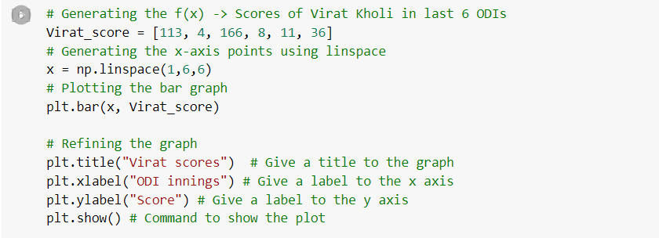
Cricketing Analyst - Tutorials!
Let’s plot some interesting data.
I extracted out the scores of Virat Kohli in the last 6 ODI innings. Let begin our journey to Cricket Analyst and plot the data.
plt.bar(x, height, width = 0.8, align = “center”) : Plots the bar graph of the data x
We generate the x using np.linspace and Virat score is the height of our bars.

Slide 10
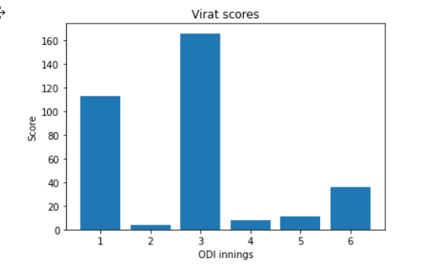
Plotting - Important Functions
plt.title()
  gives a title to the graph
plt.xlabel()
  gives a label to the x-axis
plt.ylabel()
  gives a label to the y-axis

Slide 11
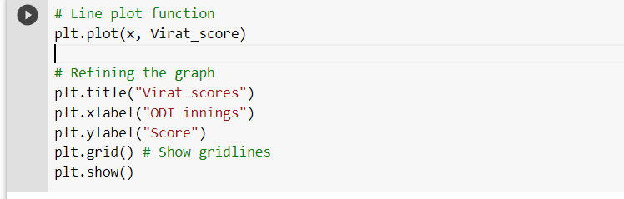
The plt.plot() function!
plt.plot(x, y, color, marker, linestyle, linewidth, label)
  Plot y versus x as lines
Color - To specify a colour to our line plot
Linestyle - To customize our line
Linewidth - To customize our line width
Label - To label our line

Slide 12
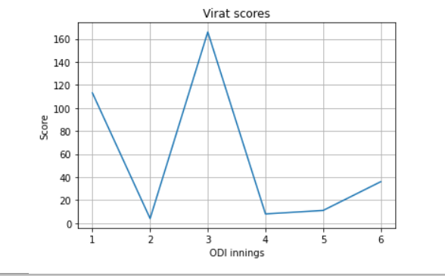
plt.grid()
plt.grid() - Plots the gridlines in the graph

Slide 13
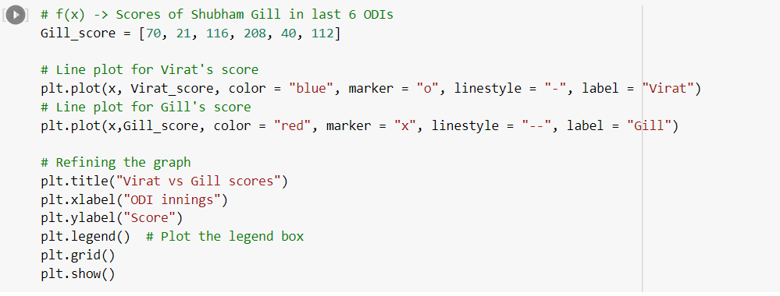
Can we plot multiple plots in a single figure? Yes!
Multiple plots in a single figure

Slide 14
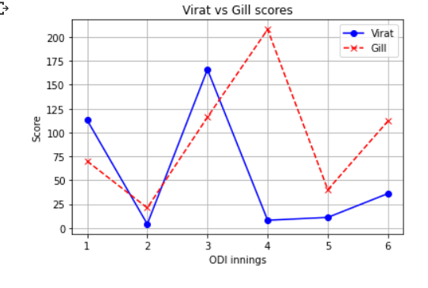
plt.legend(): Yeah Virat is a legend, but this is different!
plt.legend() - Plots the legend box in the figure

Slide 15
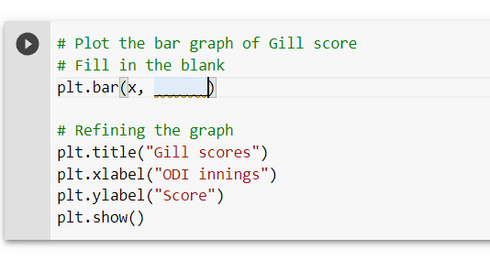
Upcoming Legend? Tendulkar?? Sara Shubman Gill
Exercise Time!
Plot the bar graph of Shubman Gill’s scores

Slide 16
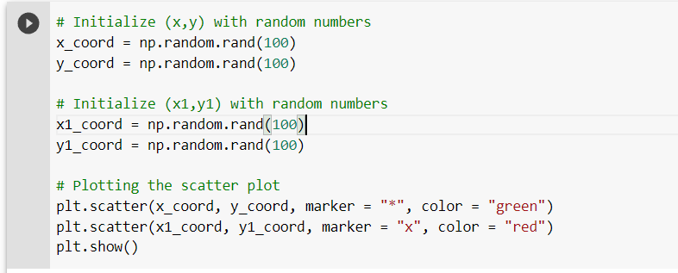
Scatter Plots!
plt.scatter(x, y, marker, color)
  Plots the scatter plot of x v/s y with varying markers.

Slide 17
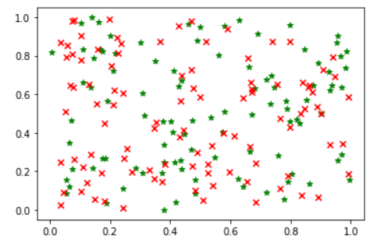
The Final Plot!

Slide 18
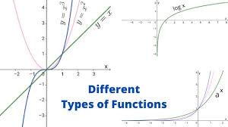
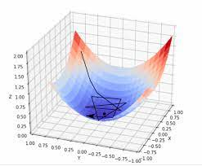
Functions and Gradients

Slide 19
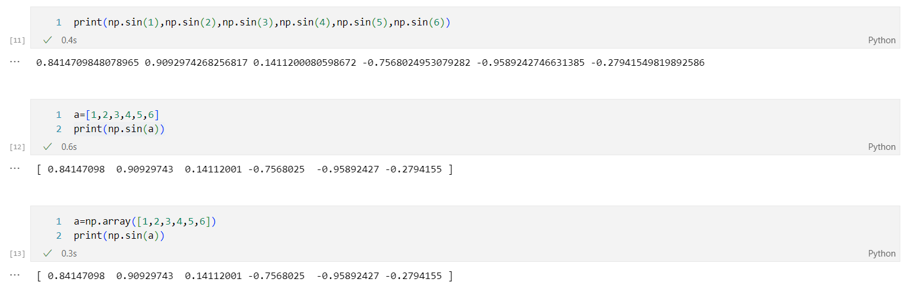
Mathematical Functions - Wait, we gonna see Cal - 1? Absolutely not!
Mathematical functions in numpy are special because they can be used to perform operations element-wise on either python lists or numpy arrays.

Slide 20
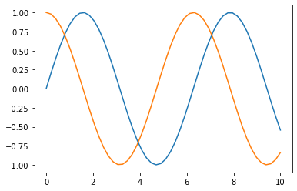
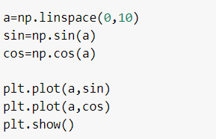
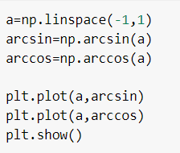
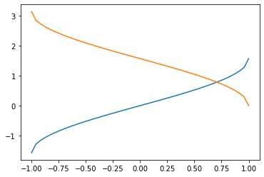
Trig Functions!
.sin(), .cos(), .tan()
.arcsin(), .arccos(), .arctan()

Slide 21
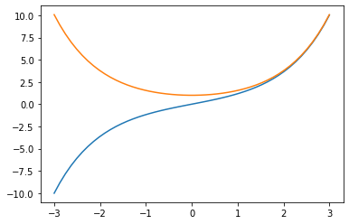
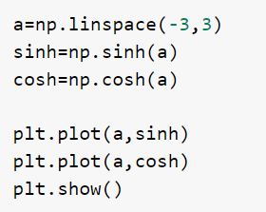
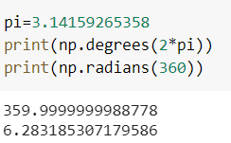
Trigonometric functions
.sinh(), .cosh(), .tanh()
.degree(), .radian()

Slide 22
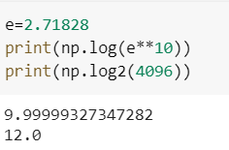
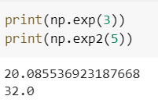
Logarithmic functions
.log(), .log2(), .log10()
.exp(), .exp2()

Slide 23
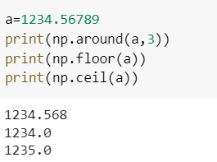
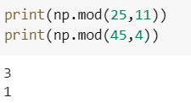
Additional functions
.around(), .floor(), .ceil()
.mod(a,b)
Modulo function, prints remainder of elements in a with those in b element wise.

Slide 24
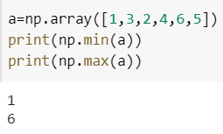
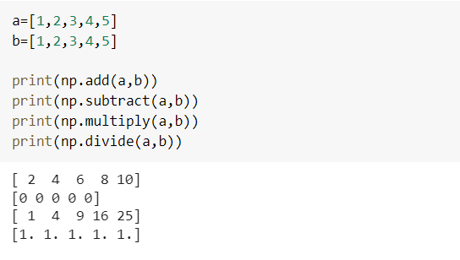
.max(), .min()
The maximum/minimum element in an array.
.add(), .subtract(), .multiply(), .divide()
Add, subtract, multiply, or divide two numpy arrays element wise.

Slide 25
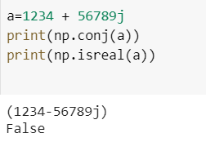
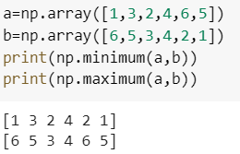
.conj(), .isreal()
.maximum, .minimum

Slide 26
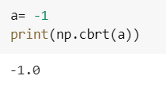
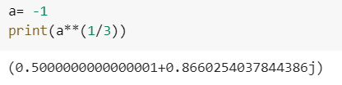
A few interesting functions
.cbrt() - returns the cube root of a number.
It is one of the few ways in python that allows you to take the real cube root of a negative number - Most functions return the complex root instead.

Slide 27
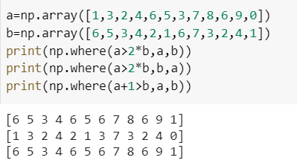
.where()
Allows you to set your own conditions and returns result from the first array if true, else returns the value from the second array.

Slide 28
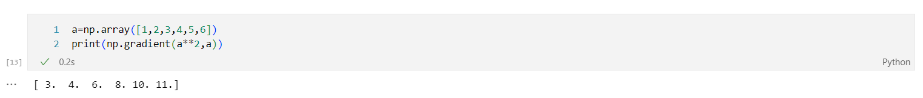
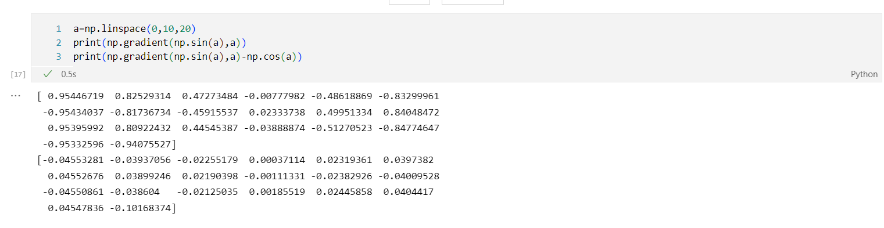
Gradients
np.gradient(fx,x) will output the approximate gradient calculated using numpy arrays of f(x) and x.

Slide 29
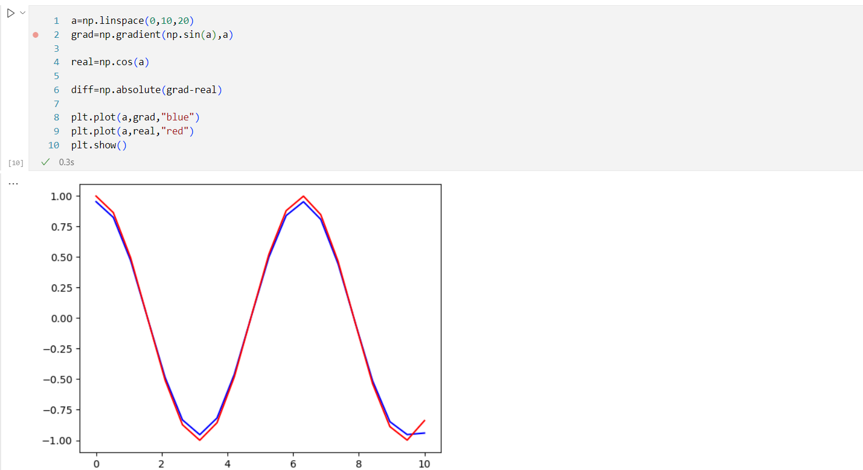

Since gradients are calculated mathematically, they do have inaccuracies - but thankfully, they are rather low.

Slide 30
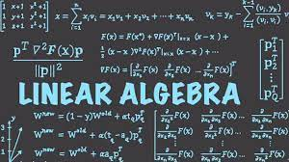
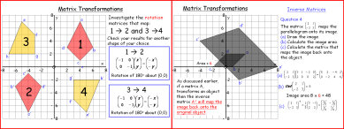
Matrix Operations and Transformations

Slide 31
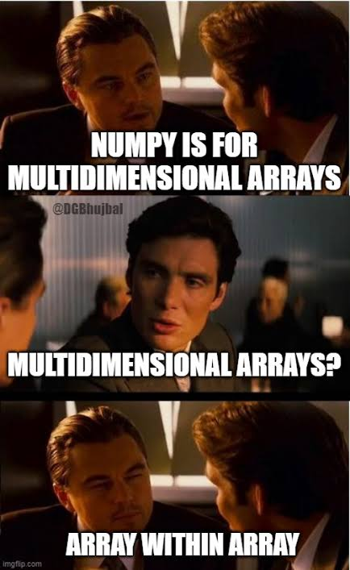
Matrices or Multi-Dimensional Arrays
Let's cover some basic functions to create numpy matrices
Matrices from 2D or 3D or ND Lists.
Ones, Zeros,and Identity.

Slide 32
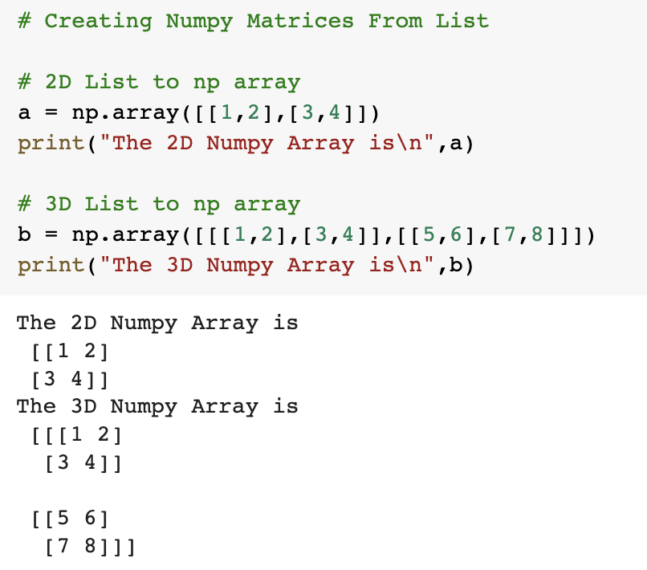
Creating Matrices using NumPy array method
array() Method:
It takes a 2D or 3D or ND List and returns a Numpy Multidimensional Array or Matrix.

Slide 33
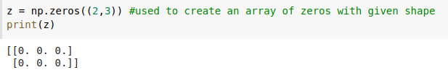
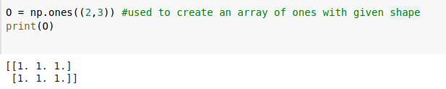
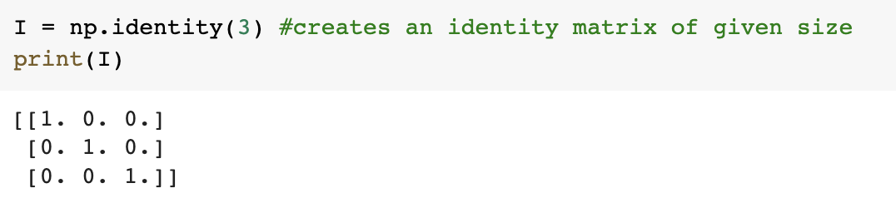
Creating Matrices using NumPy Functions
zeros():
Returns a Numpy Array of all zeros of given shape.
ones():
Returns a Numpy Array of all ones of given shape.
identity():
Returns a 2D Identity Square Matrix of given Rows, Columns.

Slide 34
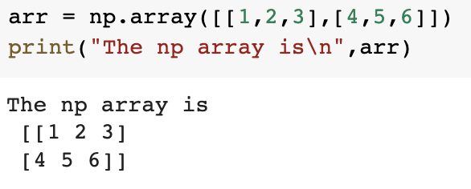



Shape of np array
shape:
Returns the number of elements in each dimension of the np array.
ndim:
Returns the Number of Dimensions of the np array.

Slide 35
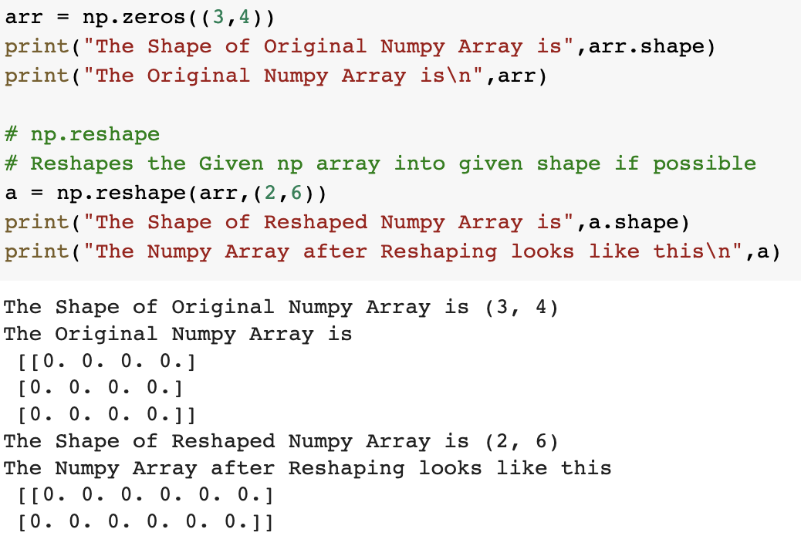
Reshaping np arrays
reshape():
Returns the reshaped np array if possible.

Slide 36
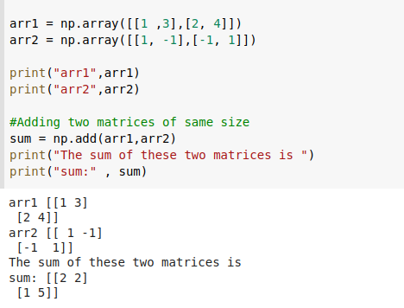
Matrix Transformations : Addition
Now we will look at a function to add two matrices:
add() method : Takes Two numpy matrices of same size and adds them.

Slide 37
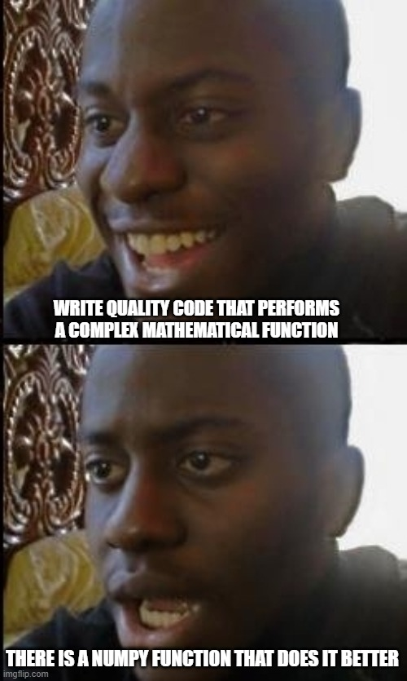
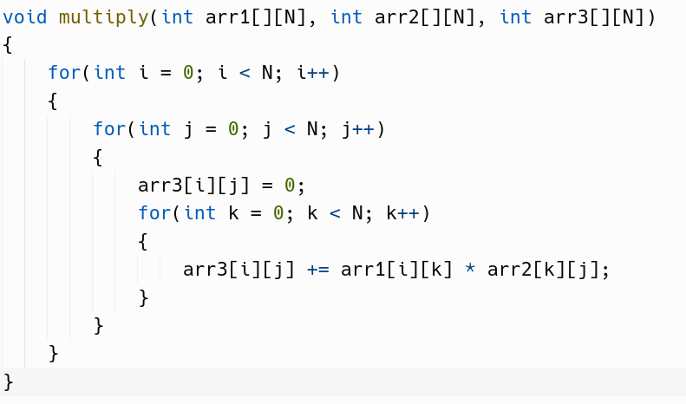
C vs NumPy for matrix multiplication

Slide 38

Matrix Transformations : Multiplication
Now we will look at a function to multiply two matrices:
element wise matrix multiplication : Multiplies matrices element by element just as add() does

Slide 39

Matrix Multiplication - 1
matmul() method : Multiplies matrices just like you did in your JEE !

Slide 40


Matrix Multiplication - 2
Another way of multiplying : :::;matrices: @ operator

Slide 41

Matrix Transformations : Trace
trace() method takes np array as input and outputs its trace.

Slide 42

Matrix Transformations : Determinant
linalg.det() method takes np array as input and returns its determinant

Slide 43


Matrix Transformations : Transpose
T attribute returns a matrix which is the transpose of the given Matrix.

Slide 44

Numpy’s Reaction when you calculate inverse of a matrix on your own

Slide 45

Matrix Transformations : Inverse
linalg.inv() method takes matrix as input and return a matrix which is its inverse

Slide 46

Matrix Transformation : Matrix Power
linalg.matrix_power() takes a matrix and an integer as input and returns matrix raised to the power integer.

Slide 47

Solving Linear Equation
Quick Exercise!
Given matrices A and B, can you calculate X such that AX = B using functions used so far ?

Slide 48

Solving A linear equation
Solving a linear equation can be cumbersome when the number of equations increases, numpy gets it done efficiently!

Slide 49


Matrix Transformations : Stacking
Stacking matrices in a new dimension has many uses. This can be implemented with the numpy stack() method

Slide 50
Other Functions
There are still a lot functionalities that NumPy offers like:
Important Statistical Functions:
mean(), median(), var()[For variance] ,std() [Standard Deviation]
Functions for expanding and squeezing dimensions:
squeeze(), expand_dims()
These are left for you to explore !!!

Slide 51
Resources!
Python Documentation
NumPy Documentation
Matplotlib Documentation

Slide 52




Social Media - Epoch
Follow our social media handles for regular updates
Instagram
Twitter
YouTube
WhatsApp

Slide 53


Social Media - GDSC
Follow our social media handles for regular updates
Instagram
Twitter

Slide 54
Any Questions or Suggestions?

Slide 55
Thank You!

