Slide 1
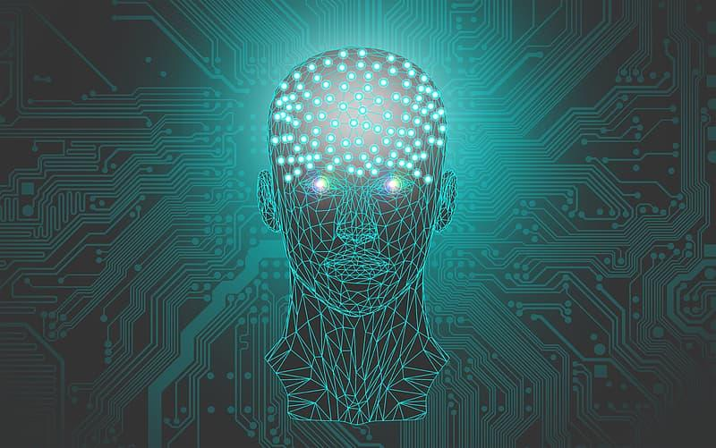
Pie & AI
Date: 26-09-2021
Theme: Introduction to Machine Learning
Host: Sriniketh J
Level: Beginners and Intermediate
Agenda:
15 mins - Introduction
60 mins - Hands-On
10 mins - Quiz
5 mins - Q&A

Slide 2
Pie & AI is a series of DeepLearning.AI meetups independently hosted by community groups. This event is hosted by Sriniketh J. Special thanks to their support!
It is a complete beginner and intermediate-friendly workshop to get hands-on with ML. By the end of the session, they would have a basic knowledge of ML and have developed an ML Model on their own.
Event Agenda & Speakers:
15 mins - Introduction to Machine Learning
60 mins - Hands-On
10 mins - Quiz
5 mins - Q&A, Conclusion
https://www.linkedin.com/in/sriniketh-jayasendil
___________
For Beginners and Intermediate learners, All are Welcome to gain Knowledge😊!!

Slide 3

What is Machine Learning?

Slide 4
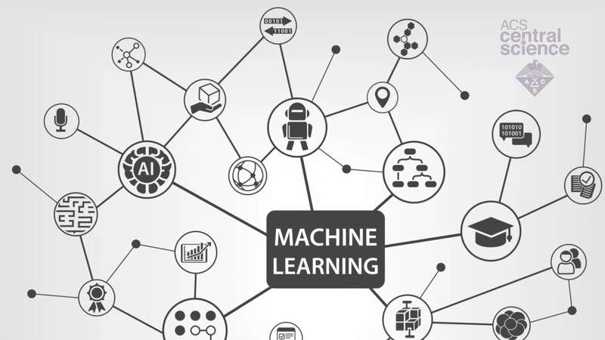
Machine Learning
Machine learning (ML) is the process of using mathematical models of data to help a computer learn without direct instruction. It uses algorithms to identify patterns within data and those patterns are then used to create a data model that can make predictions.

Slide 5
Spam or Ham
Image Recognition
Real World Examples
Next Word Predictor
Weather Forecasting

Slide 6
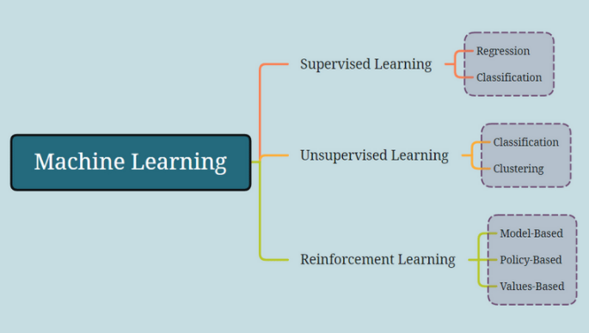

Slide 7
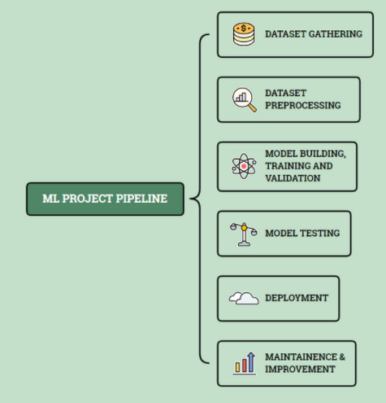

Slide 8

Hands-On
Code:
https://github.com/srini047/PieAndAI

Slide 9
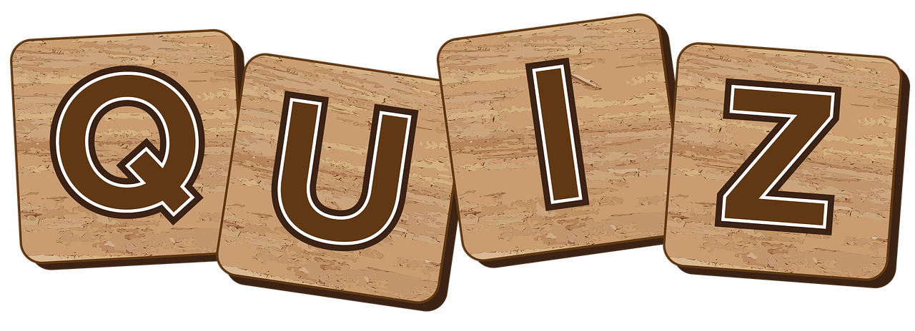

Slide 10


Slide 11
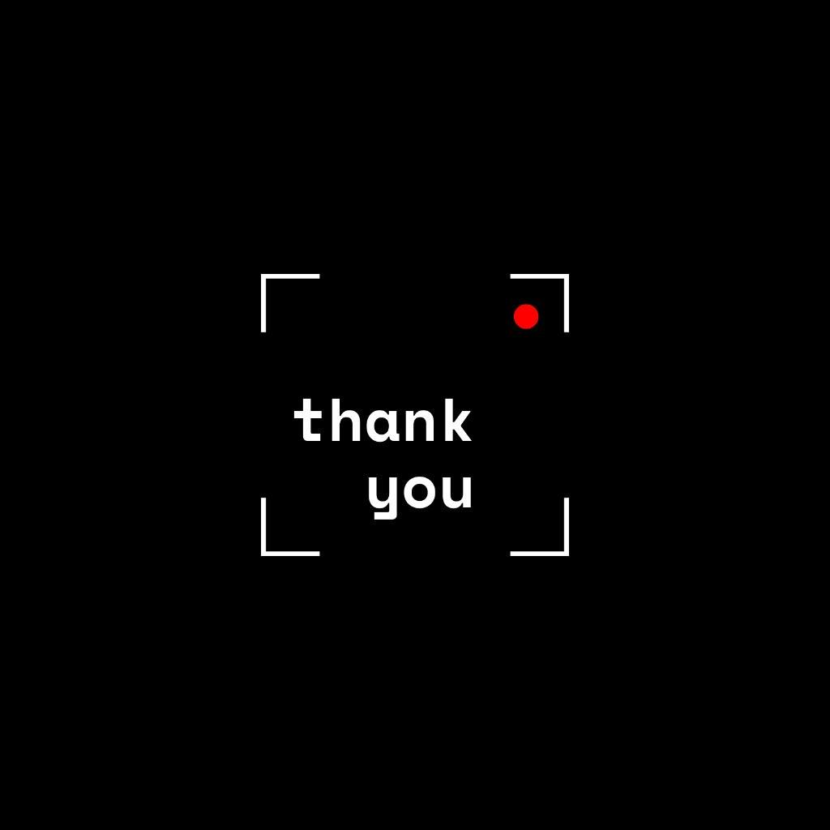
Fill the Feedback form which you will be receiving post the event to be eligible for the Certificates.

