Slide 1

Cryptology

Slide 2
Introduction
Cryptology, the science of encoding and decoding information, has evolved significantly through three primary phases: ancient, modern, and fluid cryptography.

Slide 3
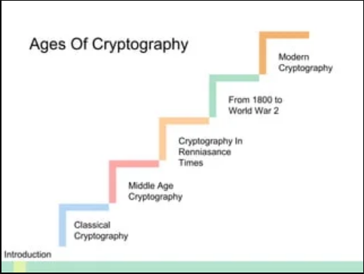
Age of Cryptography

Slide 4
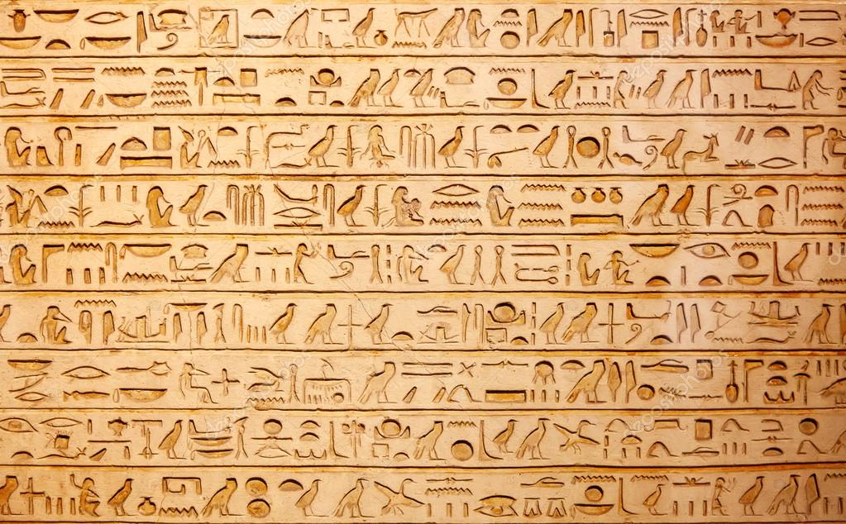
Cryptology in ancient era
Ancient Egypt and Greece developed cryptography with non-standard hieroglyphs and the Scytale, while Polybius created the Polybius square for fractionating plaintext characters around 400 BCE.

Slide 5

Cryptography in modern era
Claude Shannon's information theory laid the foundation for modern digital cryptography. Public Key Cryptography, introduced in the 1970s, allows secure communication without prior secret sharing. AES, adopted in 2001, is a symmetric encryption standard.

Slide 6
Conclusion
Cryptology has transformed from simple manual techniques in ancient times to complex, mathematically driven methods in the modern era, and now to adaptive, cutting-edge technologies in the fluid phase. This evolution reflects the growing importance of securing information in an increasingly digital and interconnected world.

Slide 7
Thank You

