Slide 1
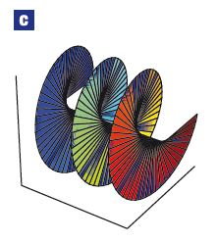

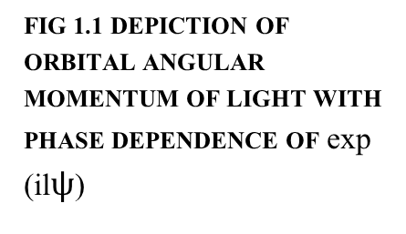
TITLE: Generation of OAM of Light (Twisted Photons) in mm Wavelength Region and Investigating their Properties
NAME: Srinidhi Rajagopalan SUPERVISOR: Dr. Pavel Karataev
INDEX
Introduction to OAM of Light
Theory – Gaussian and Laguerre Gaussian Beams
Experiment – Interferometry
Conclusion
FIG 1.1 DEPICTION OF ORBITAL ANGULAR MOMENTUM OF LIGHT WITH PHASE DEPENDENCE OF exp (il$ψ$)

Slide 2
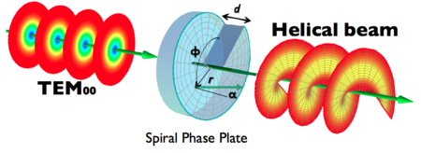


THEORY
Gaussian Beam:
A gaussian beam is represented as,
G = Ψ (x, y,0) = exp -$[\frac{x^{2}+y^{2}}{w^{2}}]$
Laguerre Gaussian Beam:
LG = Ψ (x, y) = $\frac{2}{\sqrt{п }}\frac{1}{w^{2}}\sqrt{x^{2}+y^{2}}$exp -$\left[x^{2}+y^{2}\right]$exp -$[\frac{x^{2}+y^{2}}{w^{2}}]$
Phase shift in a Laguerre Gaussian Beam,
$$∆φ_{1}= \frac{4π}{λ}b\left(n−1\right)\cos\left(\frac{ψ}{4}\right)$$
Phase shift between a Gaussian Beam and Laguerre Gaussian Beam,
$$∆φ_{2}= \frac{4πL}{λ}$$
Resultant phase shift
$$Δφ=\frac{4Π}{λ}b\left(n−1\right)\cos\left(\frac{ψ}{4}\right)+\frac{4πL}{λ}$$
FIG2.1 ARTISTIC REPRESENTATION OF THE CHANGE IN PHASE OF A GAUSSIAN BEAM RESULTS IN A LAGUERRE GAUSSIAN MODE
Height of a Spiral Phase Plate
$S=\frac{lλ}{n−1}$

Slide 3
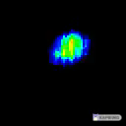
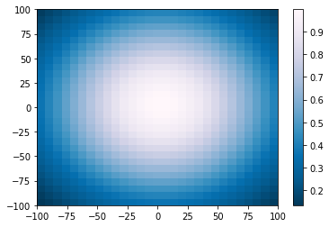
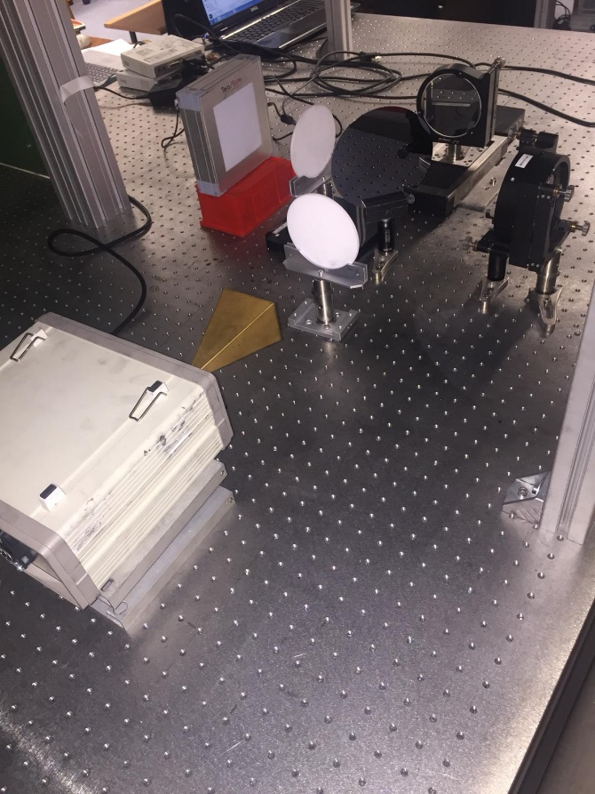


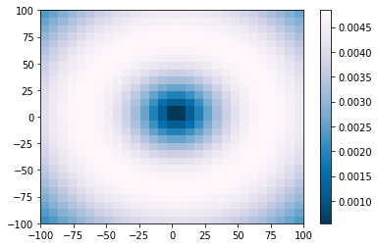
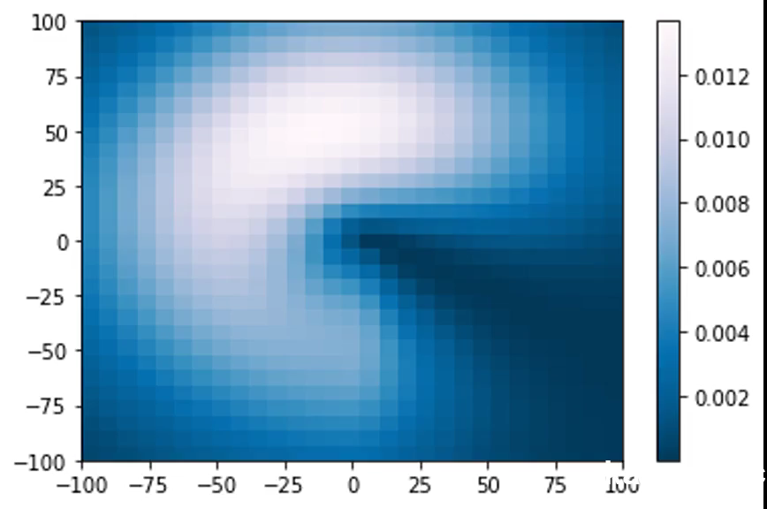
EXPERIMENT - INTERFEROMETRY
FIG 3.2 GAUSSIAN BEAM
FIG 3.4 EXPERIMENTAL INTERFERENCE
FIG 3.3 LAGUERRE GAUSSIAN BEAM
FIG 3.1 INTERFEROMETER SETUP
FIG 3.5 THEORETICAL INTERFERENCE

