Slide 1
ReadIt: A Multilingual Text to Speech Tool for OCR and Text Summarization Models
Srinidhi Shukla,
Nithin Teja Reddy Gottam,
Sandeep Srinivas Guthula,
Divyaj Reddy Nalla

Slide 2
Contents
Introdcution
1.1 Image-Text-Speech Conversion
1.2 Text Summarization and Speech Conversion
Related Work
Architecture
Proposed Model
Training
Results and Evaluation
Conclusion
References

Slide 3
Introduction
…
Textual data is booming in today's world and it's not practical for everyone to read the entire text and comprehend it.
So, what we need is a method to condense the text while maintaining the essence of the source text.
That Method should work even in the case of visually impaired and those with color blindness who are unable to interpret the text present in an image.

Slide 4
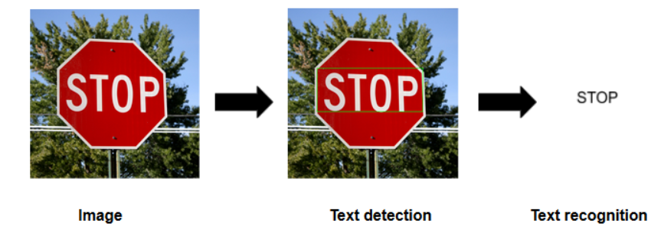
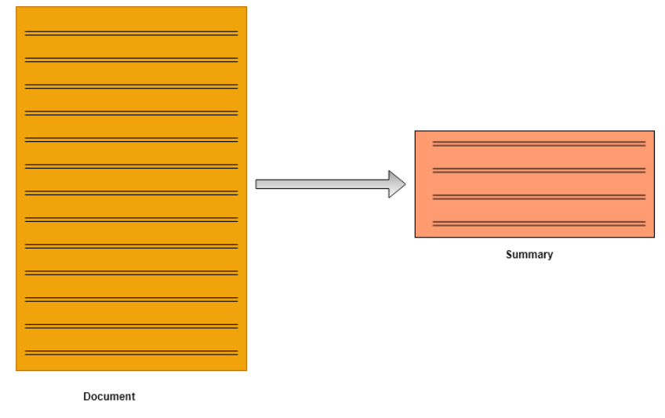
Introduction
Image-Text-Speech Conversion
Text Summarization and Speech Conversion

Slide 5
Related Work
Image Processing Based Scene-Text Detection and Recognition with Tesseract by Ebin Zacharias, Martin Teuchler and Bénédicte Bernier. The aim of this project is to detect and recognize words in natural photographs. The intended challenge is considerably more difficult than translating text from scanned papers. Because of the limited number of photographs available, the use case in focus makes it easier to detect the text field in natural scenes with greater precision.
Smart Summarizer For Blind People by Mona Teja K , Mohan Sai.S, H S S S Raviteja ,Sai Kushagra. This paper discusses an effective technique for condensing news into relevant keywords in order to avoid having to read the whole text each time. Many APIs and modules, such as tesseract and GTTS, are explored and introduced in depth in this article, as are many algorithms, such as Luhn's Algorithm, Latent Semantic Analysis Algorithm, and Text Ranking Algorithm.

Slide 6
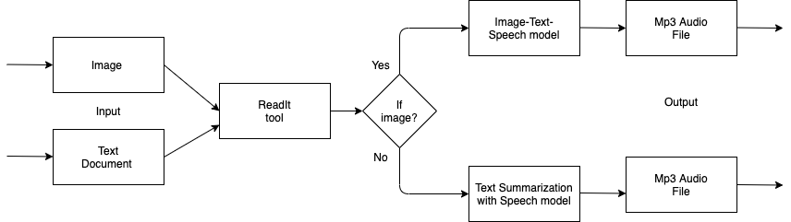
Architecture

Slide 7
Proposed Model
Image-Text-Speech Conversion
Text Summarization and Speech Conversion
Readit tool consisting of the following two models
Optical Character Recognition (OCR)
Translated into an audio file (mp3) using GTT
TextRank Algorithm
Translated into an audio file (mp3) using GTT

Slide 8
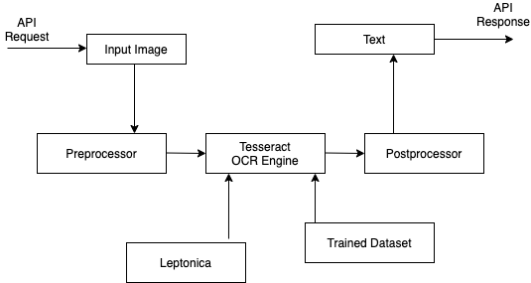
Image-Text-Speech Conversion
We used Optical Character Recognition (OCR) to enable listening to the text written on the image. It is a technique for extracting text from images and translating it to an electronic format.
OCR is typically split into many sub-processes.
Preprocessing of the Image
Text Localization
Character Segmentation
Character Recognition
Post Processing
JUPIER

Slide 9
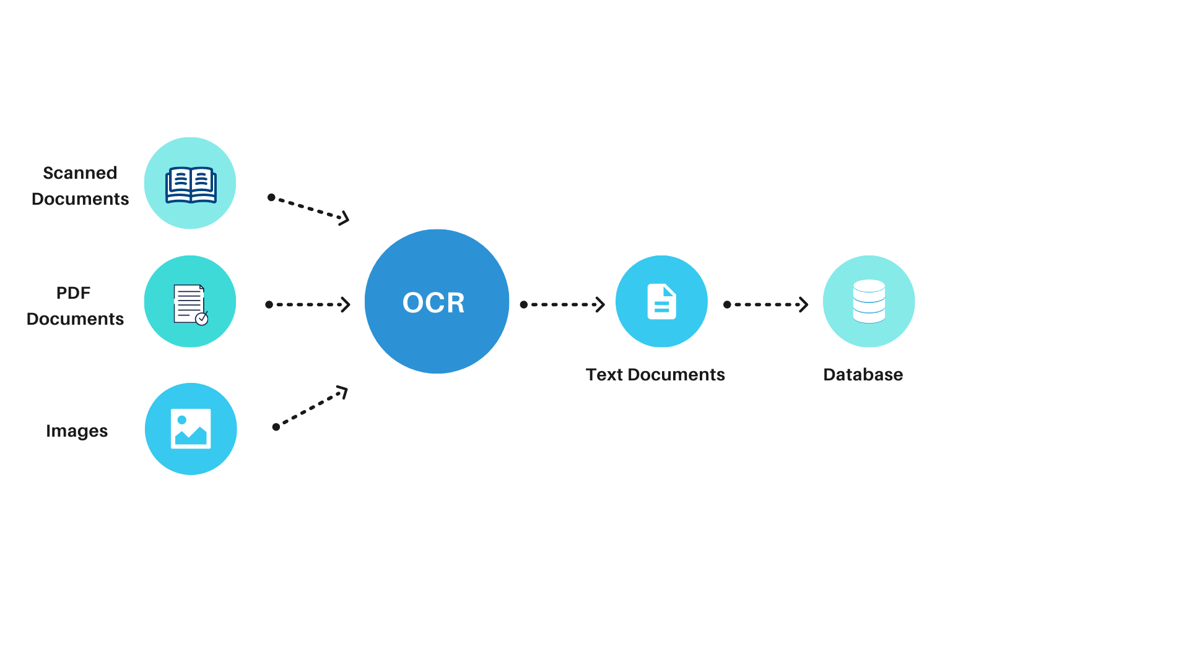
Image-Text-Speech Conversion
The system's module is the TESSERACT GOOGLE API, which is an optical character recognition (OCR) engine that supports Unicode and can identify several languages out of the box
It is adaptable and can be learned to recognize other languages as well.
The Tesseract can detect over 100 languages, and Google has boosted it with a neural network framework based on LSTM starting with version 4. (long short-term memory).
The Libraries we used in this model are Pytesseract, PIL, Nltk, Numpy, OS, GTT’s.

Slide 10
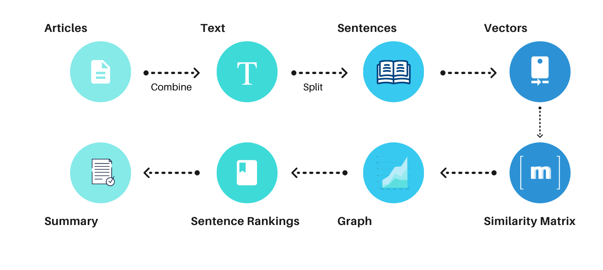
Text Summarization and Speech Conversion
TextRank is a graph-based text processing ranking model that can be used to find the most relevant sentences in a text as well as keywords.
Tasks involved in summarization
Relevant sentences identification
Relevant keywords identification

Slide 11
Text Summarization and Speech Conversion
The PageRank algorithm is applied to the resulting network to determine the importance of each expression.
Libraries used: Nltk, NetworkX, Langdetect

Slide 12
Training
Because of the libraries we used, the whole model does not require any data to be trained, and the results can be obtained simply by uploading an image or file and making a selection on the front-end interface.

Slide 13
The Front-end Execution
In the final stage, we use Tkinter, the only one that is used in the standard library, to create a GUI that incorporates all of these models and makes it simpler for the user.
Tkinter programs appear like they belong to the platform they're running on because visual elements are made using native operating system elements.
Tkinter makes it easy to make a graphical user interface using the steps below.
Import the Tkinter module to the project.
Build the main window for the GUI application.
In the GUI framework, add one or more of the above-mentioned widgets.
Enter the main event loop to respond to each user-triggered event.

Slide 14
Results and Evaluation
…

Slide 15
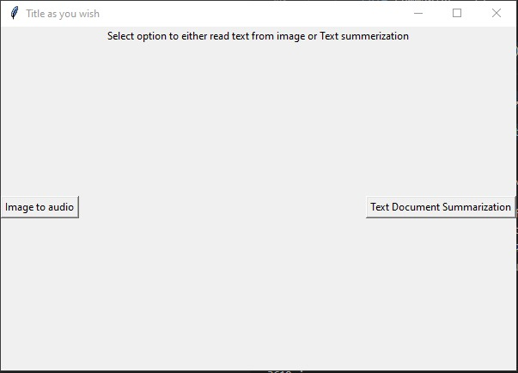
Results and Evaluation
The output of the code is shown below. It shows a front-end interface with two choices for the user to choose from:

Slide 16
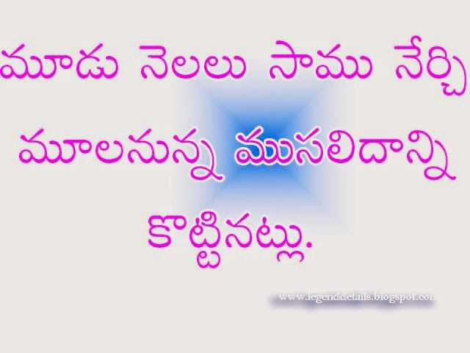
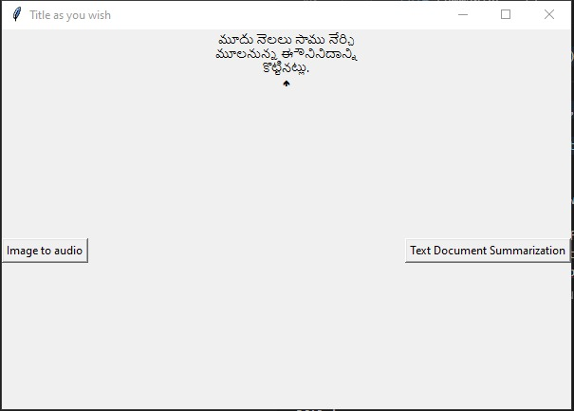
Results and Evaluation
Execution of Image-Text-Speech model:
Step 1: Uploading the images and converting of the text present on the image and displaying it
Input
Output

Slide 17
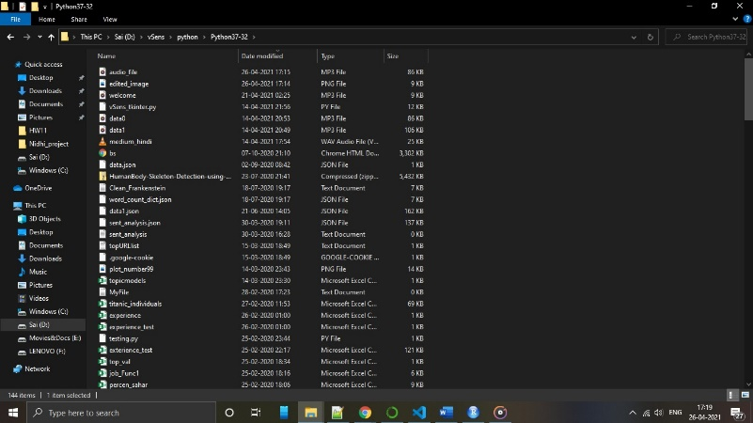
Results and Evaluation
Execution of Image-Text-Speech model:
Step 2: Saving the converted text into audio file to play.
Output 2

Slide 18
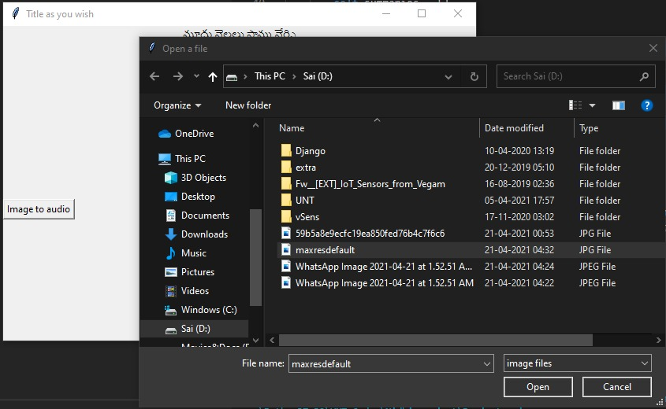
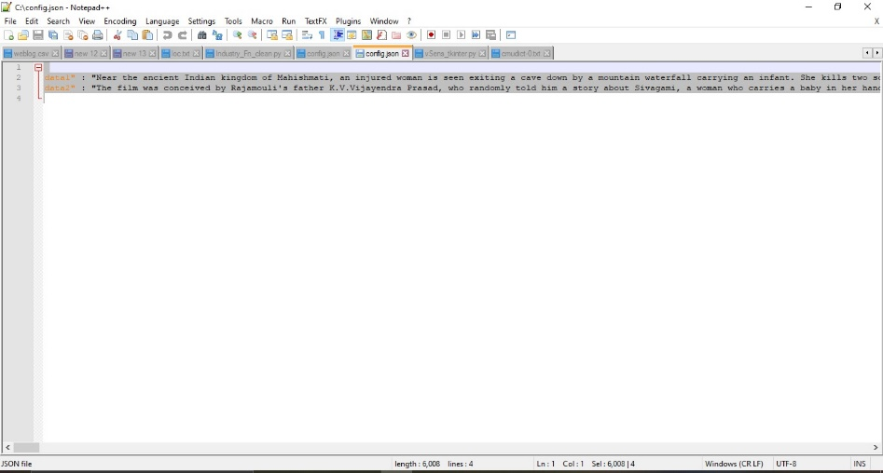
Results and Evaluation
Execution of Text DOCUMENT SUMMARIZATIOIN MODEL:
Step 1: Uploading the document and then getting the summarized text
Input

Slide 19
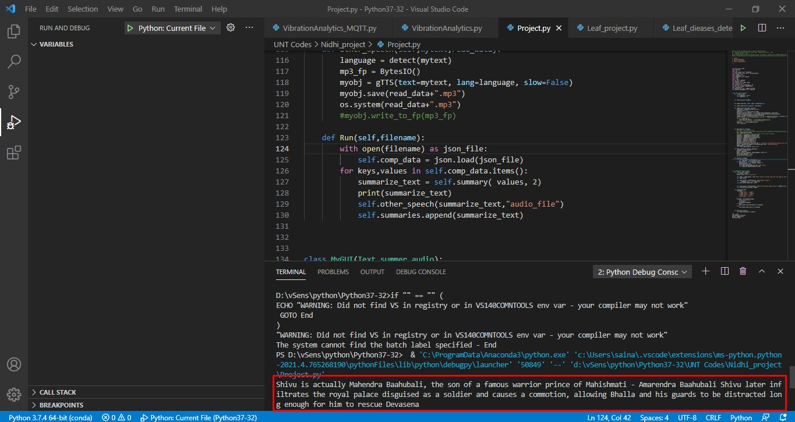
Results and Evaluation
Execution of Text DOCUMENT SUMMARIZATIOIN MODEL:
Step 1: Uploading the document and then getting the summarized text
Text Summarization Output

Slide 20
Results and Evaluation
Execution of Text DOCUMENT SUMMARIZATIOIN MODEL:
Step 2: Storing the file into audio Mp3 format to play it out:
Audio Output

Slide 21
Conclusion
Successfully developed a front-end interface that allows us to incorporate Image-text-speech and text summarization and speech conversion depending on the user's request.
This concept was mostly aimed at making it simple for everyone, even blind people, to convert text or image data to audio, and we plan to add more features in the future to make it more practical and reliable.
For fast conversions and convenient access for the disabled, this tool may also be used as a plug-in or add-on for applications or smart devices (such as a smart watch or Alexa).

Slide 22
References
1]Zacharias, E., Teuchler, M., and Bernier, B., “Image Processing Based Scene-Text Detection and Recognition with Tesseract”, 2020.
[2]Teja K, M., Sai. S, M., Raviteja D, H. S. S. S., and V, S. K. P., “Smart Summarizer for Blind People”, 2020.
[3]Bharath B, M., Gowtham B, A., and M, A., “Neural Abstractive Text Summarizer for Telugu Language”, 2021.
[4]Galatolo, F. A., Cimino, M. G. C. A., and Vaglini, G., “Generating images from caption and vice versa via CLIP-Guided Generative Latent Space Search”, 2021.

Slide 23
Thanks
Do you have
any questions?
Srinidhi Shukla,
Nithin Teja Reddy Gottam,
Sandeep Srinivas Guthula,
Divyaj Reddy Nalla

