Slide 1







How Gen AI is changing the Business Ecosystem
Generative AI is rapidly emerging as a transformative force, poised to unlock vast economic value and propel productivity to new frontiers across industries and business functions.
Gen AI
Market Potential
Economic Impact
Generative AI market size was valued at USD 43.87 billion in 2023 and is projected to grow from USD 67.18 billion in 2024 to USD 967.65 billion by 2032
Generative AI could raise global GDP by 7% (or almost $7 trillion) and lift productivity growth by 1.5 percentage points over 10 years
Industry Growth
Investments Made
Generative AI industry could grow at a CAGR of 40% over the next 10 years
Global VC/PE investment in Gen AI was $21.3 Billion for 2023
Efficiency
Sources: Bloomberg, Goldman Sachs, IBM, Fortune Business, EY
Majority of organizations focus on improving efficiency and cost reduction with Gen AI
Ascendion Confidential

Slide 2
How can enterprises productionize Gen AI
5
Pilot & ROI Evaluation
POC Implementation
Performance Metrics
ROI Analysis
6
Production
Validated business case with proven results
Integration into Ecosystem
Governance & Compliance
Security / Guardrails
Scaling up
4
Gen AI Strategy Creation
Objectives Visioning
Roadmap Development
Secure, compliant, and scalable Gen AI solutions
Actionable implementation roadmap with defined goals
Generative AI Adoption Stages
3
Identifying Use cases
Business Impact & Prioritization
Solution Design
1
Awareness & Education
Prioritized opportunities with measurable impact
Work & help you in understanding Gen AI
Workshops and trainings
2
Infrastructure Evaluation
Data Readiness
System Compatibility
Empowered workforce with practical Gen AI knowledge
Clear technical readiness assessment and requirements
Ascendion Confidential

Slide 3

Gen AI in Enterprise
As a Lens
As a Tool
As an Enabler
Find the Invisible Essence
Create and Innovate
Effortlessness Redefined
Client Enablement for delivering new experiences
Reimagining Business Processes
Empowering Process Reinvention
Recreating Data Infrastructure & Models
Gen AI led software engineering
Catalyzing Versatile Automation
AI Powered Workforce Efficiency
AI Enhanced Creative Empowerment
Unleashing Rapid Skill Development
Ascendion Confidential

Slide 4





Our playbook for enterprise-grade Gen AI solutions
Prioritize Evals before LLMs, Agents & Frameworks
SDLC considerations for Gen AI
Gen AI Experienced Talent
Well defined Use-case
Data & Domain expertise
Articulate the business problem
Identify desired outcomes of the Gen AI solution
Identify Quantifiable Metrics
Consider Existing Workflows
Establish robust data pipeline
Ensure data quality
Domain experts’ collaboration for real world challenges
Feature Engineering
Develop comprehensive evaluation framework
Map evals to business outcomes
Use SLMs for objective tests, LLMs for subjective / qualitative tests
Iterate on evals as the solution mature
Agile Methodology
Version Controlling
Transparency in decision making
Performance Monitoring
Feedback & System Stability
Security and Privacy measures
Gen AI Certified Developers
Experienced Gen AI Project Managers
Centre of Excellences for knowledge sharing & collaboration
What
Why
How
Build
Scale
Ascendion Confidential

Slide 5





Gen BI: A Business Perspective
We leverage Gen AI combined with traditional BI to empower users with an intuitive interface and automated insights, democratizing data analysis and accelerated decision-making.
Users | Key Benefits
Business Users | Natural Language Queries
 | True Self-service Analytics
 | Enhanced Decision making
 | User Friendly Interface
Technical Users | SQL + Python Code Generation
 | Generate Visualizations Quicker
 | Optimized Querying
AI-Powered Analysis & Discovery
Natural Language Interaction
Query Generation & Self Correction
Summarization of Response Data
Conversational Data Analysis
Context Aware Responses
Gen BI
Adaptive Learning & Refinement
Automated Reporting & Visualizations
Interpret Live & Historical Data
User Feedback driven Improvements
Intelligent Visual Mapping
Effortless Ad-hoc Analysis & BI Tools Integration
© 2024 Collabera Digital | All Rights Reserved | collaberadigital.com
5

Slide 6








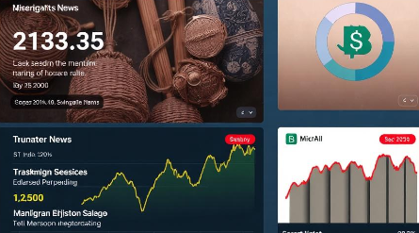

Intelligent Portfolio/Risk Tracker
The solution enables senior management to make decisions based on proactive risk monitoring of external developments.
Use case
Benefits
Tracking of portfolio news, extracting key regulatory updates, competitive threats, and emerging risks by conversing with chatbot for informed decision-making
AI-driven recommendations based on sentiment analysis/experts’ opinions, guiding executives on risk mitigation and strategic opportunities.
Identify potential points of exposure by mapping current portfolio details, market data and recent news/updates.
Efficient Risk Monitoring
Customizable insights
Enhanced Decision-Making
Top news snippets
Competitors & Regulatory updates
AI-generated consolidated summary
AI-based recommendations
Experts’ Opinions summarized
Custom NoSQL Data Model
Gen AI Agents
News Sources
Dashboard
Ascendion Confidential

Slide 7






The basics of Prompt Engineering
No human traits
LLMs don't think or possess worldviews or have experiences
Stochastic parrots – on steroids
Token prediction
Next token prediction on loop + RLHF
Compressed average intelligence of the internet
Appropriate LLM for your job
The right LLM is the one that works for you
Make it part of your life
Recognize good answers
Know what a good answer looks like
Identify when LLMs go off track
Hype vs Reality
Refine prompts
Field is evolving as we speak
Watch out for snake oil sellers
Prompts are a language of LLMs
Iterate and refine
Not a search engine
© 2024 Collabera Digital | All Rights Reserved | collaberadigital.com
7

Slide 8





Business Context
Improving sales lead conversion is essential for maximizing revenue and strengthening market position in the financial capital services sector
Customer Targeting
Follow-up Processes
Targeting the right audience enhances lead quality, significantly improving conversion rates
Effective and timely follow-ups maintain engagement, reducing lead drop-off mid-funnel.
Lead Qualification
Accelerated Decisions
Qualified leads optimize resource use, enhancing conversion rates and sales effectiveness.
Addressing customer concerns promptly accelerates decision-making, leading to increased sales opportunities.
© 2024 Collabera Digital | All Rights Reserved | collaberadigital.com
8

Slide 9


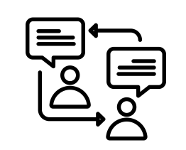


Proposed Approach – Let’s Discuss
We recommend the following approach for the problem statement
Implement Lead Scoring System
Personalized Outreach
Automated Response Management
Sales Process Optimization
Advanced
Analytics
Steps
Implement AI-powered lead scoring to qualify high-potential leads
Customize communication and follow-ups based on customer segmentation
Automate follow-ups for faster response times to leads
Redesign the sales funnel to focus on the most effective touchpoints
Utilize predictive analytics to forecast lead potential & provide actionable insights
Focus resources on high-value prospects
Improve lead qualification efficiency exponentially
Prioritize sales efforts for better ROI
Boost conversion rates with targeted engagements
Enhance customer experience with tailored messaging
Elevate engagement through individualized communication
Increase response rates with customized follow-ups
Foster deeper connections, driving long-term relationships
Accelerate lead follow-up with instant communication
Maximize efficiency by streamlining outreach processes
Reduce lead response time, boosting conversion potential
Optimize workflow, ensuring no lead goes unattended
Streamline sales funnel for higher efficiency
Eliminate bottlenecks, enhancing deal closure speed
Align sales efforts with customer journeys seamlessly
Improve revenue predictability through process refinement
Unlock actionable insights for data-driven decisions
Predict trends, refining strategy with precision
Optimize lead targeting with predictive modeling
Empower teams with real-time performance dashboards
Benefits
© 2024 Collabera Digital | All Rights Reserved | collaberadigital.com
9

Slide 10


















Reference Architecture Diagram - AWS
Feedback DB
Feedback
(Positive/ Negative)
Domain Knowledge DB
Titan Embeddings (Convert to Embeddings)
Catalog
Output
Meta-Data (schema) / TableDesc / TableNames
AWS Glue Crawler
Data Sources
Databases
Response
Graph
FAISS (Domain KB)
FAISS (Feedback)
FAISS (Schema)
Input
Follow up Questions
Context (KB)
Context (Meta-Data)
Aurora DB
Claude 3.5 Sonnet
Modify Question
SQL Query
Execute
Claude 3.5 Sonnet
Queries
Modify Question
Error Message
RDS
SQL Result / User Query
Generate NLP Response
AWS Bedrock
AWS Athena
Data Lake
NLQ + Context (Meta-Data)
Error
SQL Query
Generate Graph if applicable
Claude 3.5 Sonnet
Chat History
Generate SQL Query
Rectify SQL Queries
S3
Parquet Files
© 2024 Collabera Digital | All Rights Reserved | collaberadigital.com
10

Slide 11









Patient Healthcare Summary
Rachel is a nurse accessing patient records
She has to read and synthesize multiple patient medical records in the Care21 system which is a time-consuming task because it includes doctor’s prescriptions and previous medical records including test reports.
Rachel wishes there was a way to get a comprehensive healthcare summary of the patients, at any point in time – before appointments, procedures etc.
Azure
Solution Approaches
AI – Using Natural language Processing and Large Language Models to summarize relevant data for the end user
Medical Records
Nurse
Data Engineering – Fetch data from multiple records in the Data Layer, aggregating it to a staging layer
Or
AI Agent
Doctors’ Prescriptions
Comprehensive Healthcare Summary
Data required from the client
Care 21 schemas, sample anonymized patient records, and clinical workflow insights
Hospital Staff
Notes
© 2024 Collabera Digital | All Rights Reserved | collaberadigital.com
11

Slide 12
Patient Healthcare Summary
Rachel is a nurse accessing patient records
She has to read and synthesize multiple patient medical records in the Care21 system which is a time-consuming task because it includes doctor’s prescriptions and previous medical records including test reports.
Rachel wishes there was a way to get a comprehensive healthcare summary of the patients, at any point in time – before appointments, procedures etc.
Azure
Solution Approaches
AI – Using Natural language Processing and Large Language Models to summarize relevant data for the end user
Medical Records
Nurse
Data Engineering – Fetch data from multiple records in the Data Layer, aggregating it to a staging layer
Or
AI Agent
Doctors’ Prescriptions
Comprehensive Healthcare Summary
Data required from the client
Care 21 schemas, sample anonymized patient records, and clinical workflow insights
Hospital Staff
Notes
© 2024 Collabera Digital | All Rights Reserved | collaberadigital.com
12

Slide 13
Patient Healthcare Summary
Rachel is a nurse accessing patient records
She has to read and synthesize multiple patient medical records in the Care21 system which is a time-consuming task because it includes doctor’s prescriptions and previous medical records including test reports.
Rachel wishes there was a way to get a comprehensive healthcare summary of the patients, at any point in time – before appointments, procedures etc.
Azure
Solution Approaches
AI – Using Natural language Processing and Large Language Models to summarize relevant data for the end user
Medical Records
Nurse
Data Engineering – Fetch data from multiple records in the Data Layer, aggregating it to a staging layer
Or
AI Agent
Doctors’ Prescriptions
Comprehensive Healthcare Summary
Data required from the client
Care 21 schemas, sample anonymized patient records, and clinical workflow insights
Hospital Staff
Notes
© 2024 Collabera Digital | All Rights Reserved | collaberadigital.com
13

Slide 14
Our proposition for Globe Telecom
Engagement designed to help Globe Telecom adopt Gen AI widely to drive innovation & efficiency across operations enabled through a comprehensive analysis of the existing AI infrastructure, talent, and strategic roadmap to provide actionable insights and recommendations.
Objective(s)
Key Focus Areas
Our Value Adds
Identify gaps in current AI capabilities, adoption, and infrastructure.
Data readiness, current AI initiatives, operational bottlenecks
Expertise in analyzing AI readiness, deep knowledge of sector specific challenges, & the ability to uncover critical gaps
Gap Analysis
Assess current technology landscape related to AI and explore new technologies & solutions to enhance competitiveness
Generative AI tools, infrastructure, integration gaps, and potential technology investments.
Extensive partnerships with AI technology providers & experience in building cutting-edge solutions. tailored for telecom use cases.
Tech Landscape Assessment
Assess the readiness and skills of the workforce to adapt to AI technologies
AI skills gap, upskilling needs, talent acquisition, and training
Proven frameworks to identify skill gaps and recommend talent development strategies. Expertise in structuring AI training and upskilling programs
Talent Assessment
Defining a clear roadmap for AI growth, including partnership opportunities with tech providers & vendors
Short, medium, and long-term AI goals, partnership strategies, and implementation steps.
Experience in crafting AI strategies aligned with business goals to help develop a practical roadmap aligned with partnership strategies to deliver real results
Roadmap & Strategy Recommendations
© 2024 Collabera Digital | All Rights Reserved | collaberadigital.com
14

Slide 15







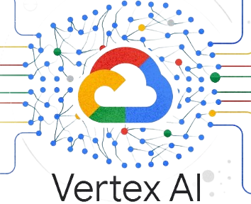



AI Services Suite
Value Propositions
1100+
Generative AI
Certified Professionals
25+
Solutions
Developed
Tailored AI for Business Growth - Custom AI strategies with gap analysis and risk assessment.
Seamless Integration & Data Security - AI solutions integrate smoothly with secure data governance
Faster, Smarter Development - AI-driven coding, auto-completion, and test automation for efficiency.
AI-Optimized Talent & Learning – AI based hiring, skill analysis, and personalized learning paths.
Improved Operational Efficiency – AI-enhanced user stories, test coverage, and process automation.
AI Consulting & Engineering
AI Led Business Process Reimagining
AI Assisted Software Engineering
AI Driven Talent Solutioning
AI Roadmap Development
AI Ecosystem Integration
Gen AI Solutions
Robotic Process Automation
LLM+SLM API led Applications
Process Optimization
Agile Story Creation
Test Case Generator
Code Assistance
AI Enhanced Talent Acquisition
Next Gen Tech-Talent Evolution
Gen AI Skilled Workforce
Our Partners
Amazon
Bedrock
Inhouse Generative AI
Certification Courses
Gen AI 101, 201, 301
Salesforce
Einstein
© 2024 Collabera Digital | All Rights Reserved | collaberadigital.com
15

Slide 16












End to end Data Flow diagram
User Preferences
Holding Company News
Agent 1
RSS Feed
Dashboard
Structured Data feeds
News Segregator Agent
Database
Competitor Company News
Company, Competitors and Regulatory News
Interactive & personalized – e.g. time frame, company, product, 'risk type' filters
Gen AI Chatbot
Agent 2
Public News
News Sources
Refresh & Pull
Regulatory News
Agent 3
News Summarizing Agents
Ascendion Confidential

Slide 17

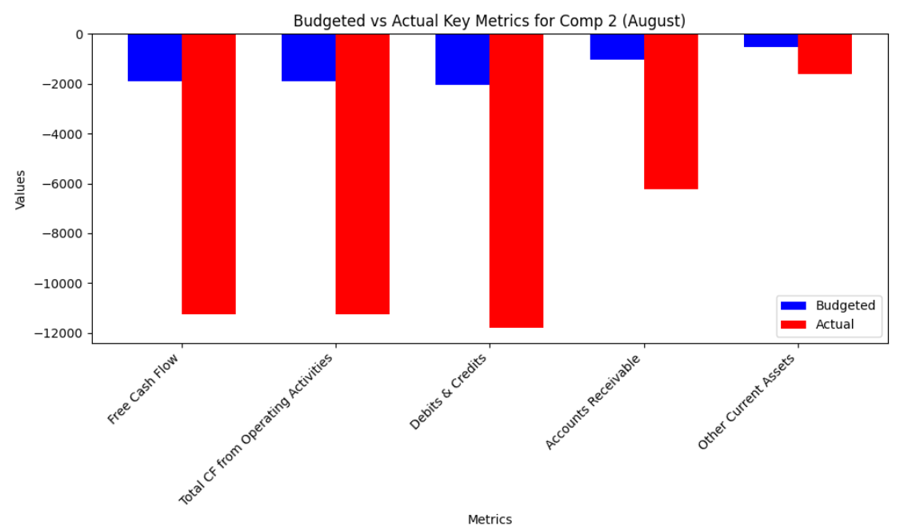

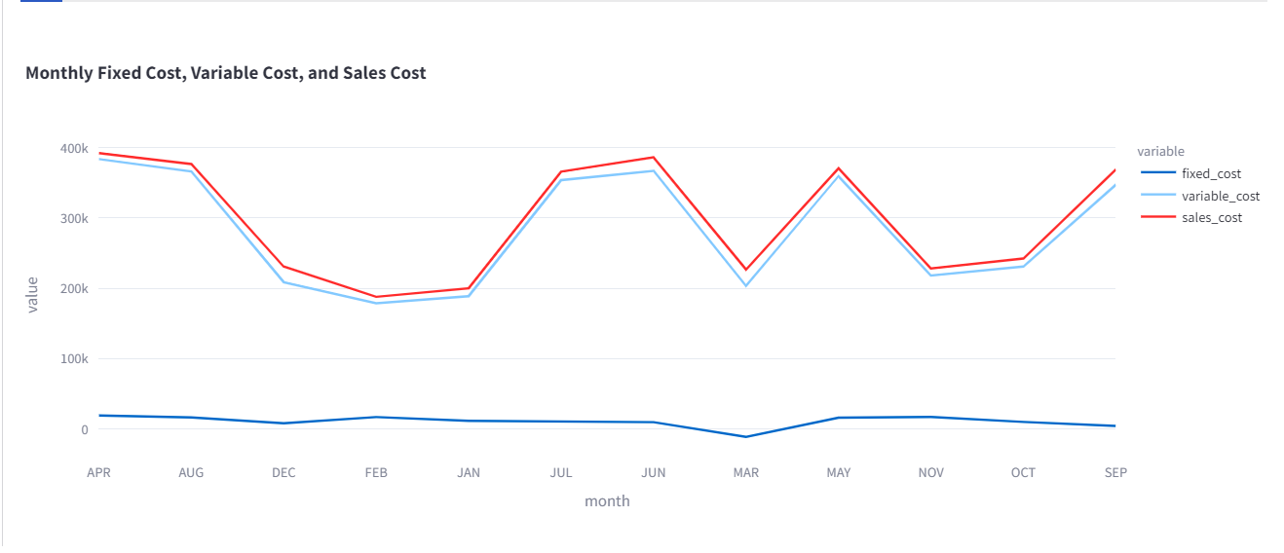





Project Overview : Generative AI x CFO Agent
SMBC has an aspiration to create a next gen value-added service for CFO Office to support data-driven decision making in a human friendly manner.
• AI-driven customer facing service specifically designed for CFO, Senior Management and Analysts to leverage the power of Generative AI to enable increasing situational awareness and fostering decision making on their daily operation.
• ASK questions, assumptions and/or requests related to the financial statements operations in natural language, and GET Answers + Insights promptly, with Visualizations.
Get Answers
Generate visualizations
Ask questions
The Budgeted free cash flow of Company X for May 2022 is $916.
“Can you give me the cashflow for Company X for July 2020?"
The monthly actual free cash flow of Company X for 2022 is as follows:
April: 3002
May: 1084
June: 8679
July: 2462
August: 1387
September: 464
October: 1529
November: 3644
December: 917
“Let’s go a little deeper, give me the monthly cashflow for Company X, generate a graph as well."
“What could be the reason for increase in depreciation and amortization expenses for the past quarter?"
Gen AI Dashboard
"The increase in depreciation and amortization costs in September 2023 was primarily due to the acquisition of new assets and changes in accounting estimates that led to accelerated depreciation schedules."
Build Integrations
Comprehensive Analysis
Dynamic Visualizations
Seamless Integration
© 2024 Collabera Digital | All Rights Reserved | collaberadigital.com
17

Slide 18




Understanding of Phase 1 scopes with Feature Backlogs
Deployment Readiness
LLM Functionality
Application Enhancements
Data Management
Clear abstracted code → Docker
Robust pipelines
Minimal integration
Flexible input formats
Feedback Mechanism
Implicit + Explicit
Follow up Questions
Fine Tuning
Robust Evals
Instruction-tuned LLMs
Specialized AI Agents calls
Independent Front & Back-end
Access Management
Comprehensive Monitoring
Safety guardrails
Dynamic Parsing
Multi-Format Ingestion
Keyword → Semantic search
Dedicated Vector DBs
Highest priority – Drop 1
Medium priority – Drop 1 + 2
High priority – Drop 1 + 2
Highest priority – Drop 1 + 2
© 2024 Collabera Digital | All Rights Reserved | collaberadigital.com
18
Notes:
Lesser words

Slide 19
Architecture Layers
Security
Frontend
Register
Login
Chat
Feedback
Favorite questions
Diagnostics
Chat History
Dashboard
User management
Knowledge Management
Instruction Management
Favorite Question Management
Dashboard Management
SSL &
Access Management
Key-based API access
User Roles for storage access
Guardrails for LLM responses
Error Handling and Logging
Backend
API Layer
Containerized Application
User: Add Favorite Questions, View Favorite Questions, Add Feedback (Instructions)
Admin: Instruction Management, Knowledge Management, User Management, Favorite Questions Management, Dashboard
Storage and User Management
Parallel Question Processing
Instruction and Domain Knowledge Retrieval
Evals for Instruction and Domain Knowledge Retrieval
SQL Query Generation
Evals for SQL Query Generation
Generation of Charts
Calculation Function
Follow back for more information
Query Processing
Storage Access (CRUD based on user role)
AI Layer
Agent
LLM
Deployable to SMBC’s Client Cloud Environment (Vector DB + Files / Data)
** Features highlighted in yellow are work in progress | * Others are in progress
© 2024 Collabera Digital | All Rights Reserved | collaberadigital.com
19
Notes:
Data and infrastructure

Slide 20









Project Governance & Communication Structure
A team structure to facilitate close collaboration and interaction with SMBC at every stage of delivery, from governance and controls, and design standards, through to seamless implementation and warranty.
Governance & Control
Communication Structure
Daily Updates
Delivery Leadership
Program Manager:
Srinidhi Ramanujam
Project Lead:
Suprotim Dutta
Daily cadence call with SMBC
Frequency: Daily
Participants: Internal team members & SMBC stakeholders
Agenda: Quick status updates, prioritization of tasks for the day, and addressing immediate concerns or dependencies
Delivery team
Weekly Updates
Periodic updates call with SMBC
Frequency: Weekly
Participants: Project leadership & SMBC stakeholders
Agenda: Summary of completed tasks, updates on key deliverables, action items & next week’s priority tasks
Business Analyst: Mukund Kaushal
Domain SME:
Vibhanshu Katiyar
UI/UX SME:
Rajat Dixit
Drop-end Updates
Milestone updates call with SMBC
Frequency: Monthly
Participants: Full project team & SMBC stakeholders
Agenda: Demo of completed functionalities for the drop, performance review of KPIs and project timeline & client feedback
Lead Data Scientist:
Roopa Hegde
Senior Data Scientist: Vishwas Poojary
Data Scientist:
Samuel Simon
Azure Architect:
Bukke Naik
Client Queries or Reviews
Data Scientist:
Nischita CN
Frequency: As needed
Participants: Relevant team members & SMBC stakeholders
© 2024 Collabera Digital | All Rights Reserved | collaberadigital.com
20

Slide 21


Roadmap & Timeline – Phase 2.0
Agentic AI Foundation
Deliverables
Manual pre-processing - a lightweight, human-in-the-loop interface/workflow for guiding the Mapping Agent
Mapping Agent - Capable of parsing files, dependent on manual pre-processing
Simple orchestration workflow
Feedback capture - Capture and store human guidance and mapping outcomes
Focus on self-learning & Automation capabilities
Automated Pre-processing Agent: Converts prior human steps into agentic logic
Self-improving Mapping Agent: Agent retrains on human corrections/feedback
Advanced Validation Agent: Automated field/type/consistency checks with robust fallback/error recovery.
Final testing & documentation
Comprehensive UAT (user acceptance testing) to validate all business scenarios, edge cases, complianceUAT & handover
Documentation and training materials (user guides, admin guides, onboarding SOPs)
Handover workshops (to client IT/ops teams)
Feedback Alignment
Focus towards more automation & scaling with less human intervention
Self correcting agents using learnings
Feedback Alignment
Showcase Agentic core engine with guidance
Set up system for capturing mapping challenges/edge cases.
6 weeks
8 weeks
2 weeks
MVPs
1
2
3
4
5
Go/No-Go
Check
Semi Automated Mapping with Feedback loop
Deliverables
Mapping Agent with early confidence scoring: Agent attempts mapping, scores confidence, and requests manual intervention if confidence is low.
Feedback loop: Store human corrections/inputs, with basic mechanisms for agent to “learn”
SQL Generation Agent: Early-stage agent that converts mapped data into SQL – DDL and DML scripts
Enhanced orchestration: Orchestrate manual, agentic, and feedback loop flows with basic error handling/retries.
6 weeks
Production deployment with monitoring
Full production deployment with monitoring
Operational runbooks and procedures
Performance dashboards and alerting
Feedback Alignment
Showcase agent-human collaboration.
Demonstrate AI’s ability to accelerate/augment onboarding (with manual help).
Show feedback is being captured for later iterations.
Feedback Alignment
Focus on full production readiness
Dashboards for real-time business & technical visibility
** UAT issues to be fixed in the MVP will be resolved in every subsequent MVP
6 weeks

