Slide 1


P1.2 Scope + timelines
General CFO Agent updates;
Data Layer redesign (8 weeks: M1 + M2)
Storage + Retrieval updates
Rebuild Data layer with facts and dims for data sources (CF/BS/PnL)
OLAP workloads
Semantic Layer redesign
Dedicated KPI library with SQL templates that map to DK and IS
Minimize LLM reliance on SQL query generation
Data source standardization
XLS template for all data sources (CF/BS/PnL)
Ingestion pipeline for ETL into CF Agent
Built on top of Phase 2 work
AI Layer redesign (4 weeks: M2)
Azure OpenAI API update
Chat completions to Responses API
Plan + tool calls with one pass
Reasoning effort per step
Generic Agent workflow updates
Redo 5 agents (Orchestrator, SQL, RIA, Graphs, Calculator,Response)
Token + Latency optimizations
P1.2 Specific changes
Domain workbook: Q&A set (4 weeks: M2)
Ground truth for 3 tiers of Q&A
KPIs required by customer
MS Fabric migration (4 weeks: M3)
SQL database for business data storage
Cosmos database for user and application data storage
OneLake + Lakehouse for file upload
UAT Prep (4 weeks: M3+M4)
Data Ingestion to Fabric (2 weeks: M4)
Prompt tuning for P1.2 Q&A (3 weeks: M4+M5)
SIT (3 weeks: M5)
UAT (2 weeks: M6)
Ascendion Confidential

Slide 2




Legacy System X-Ray & Navigator
AI-assisted understanding for mainframes and monoliths
From trapped SME knowledge → shared, governed system model → safer modernization
Traceable
Client-Controlled
Org-Wide Model
System X-Ray
Code Navigator
Modernization
Parse legacy code into a navigable system map with traceable references
Production-grade knowledge layer for daily engineering workflows
De-risk and accelerate migration using the knowledge layer

Slide 3



The Business Problem
Trapped Knowledge
Slow Onboarding
Individual, Not Org-Wide
Critical COBOL / FORTRAN / PL/SQL / Java monoliths run core business, but knowledge is trapped in a few SMEs
Onboarding new engineers and doing impact analysis takes weeks, slows releases, increases risk
"Just give 5 devs a copilot" helps individuals, but does not create org-wide understanding of the estate
Understanding is the constraint.

Slide 4
Why "Just Give the Team Copilot" Fails
Individual Augmentation
Estate Understanding
IDE + Copilot Suggestions
Persistent System Map
• Summaries live in chat history and local context only • Ephemeral — knowledge is lost when sessions end • No persistent model: call graphs, data flows, entity maps • Impact analysis remains SME-dependent
• Persistent system model shared across the entire organization • Call graphs, data flows, entity maps always up-to-date • Governed knowledge base for onboarding and impact analysis • Shared governance eliminates single-point SME dependency
vs
≈ Sticky Notes
≈ Engineering Atlas

Slide 5
Our 3-Tier Offering
1
2
3
Legacy System X-Ray
Legacy Code Navigator
Modernization Accelerator
2–4 weeks
Ongoing
Phased
Rapid assessment + system map + traceable Q&A demo
Production-grade knowledge layer for daily engineering work
De-risk modernization using the knowledge layer
MATURITY PROGRESSION
Understand
Daily Use
Modernize

Slide 6


Tier 1 — Legacy System X-Ray
2–4 weeks
System Map & Impact Analysis
"Ask Your Legacy System" Demo
• Parse legacy code, jobs, schemas into navigable system map • Modules, interfaces, key business entities identified • Entity-to-code impact maps (Customer / Account / Policy) • Hot-spot analysis reveals high-risk areas
• Query flows and business rules with natural language • Every answer includes traceable code references • Sources: file path + line numbers for full auditability • Lightweight demo — value visible in days, not months
DELIVERABLES
System Atlas
Impact Maps
Q&A Demo
Findings Readout

Slide 7
Tier 2 — Legacy Code Navigator
Team Copilot
Code / Jobs / Schemas
Ingestion Pipeline
Knowledge Layer
IDE / Web / API
Impact Analysis
Business Flow Tracing
Explain This Program
Data Lineage
Trace all code affected by a proposed change
Follow a business process through the codebase
Get a clear summary of what any module does
Track data from source to consumption point
Sources: file path + line #
Sources: file path + line #
Sources: file path + line #
Sources: file path + line #
GUIDED ONBOARDING
1. System Overview
2. Key Flows
3. Deep Dive
Deployed in client VPC • Optional IDE / web integration

Slide 8

Tier 3 — Modernization Accelerator
STRANGLER PATTERN
GENERATED ARTIFACTS
Monolith
Routing Layer
Services
Interface Specs
Candidate API contracts generated from existing flows
Sequence Diagrams
Visualize interactions between components
Test Suggestions
Gradually hollow out the monolith → route traffic → migrate to services
Ensure new code preserves legacy semantics
AI-assisted refactoring preserves legacy semantics while moving to modern stacks

Slide 9




















Data Pipeline Architecture
Databricks Lakehouse / Medallion Architecture
Source Systems
Ingestion
Raw Landing
Bronze
Silver
Gold
Consumption
SQL Server
Azure Data
Factory
ADLS Gen2
Raw Tables
Dedup /
SCD-2
Star Schema
Power BI
Oracle
Azure ML
Event Hubs
Schema on
Read
Schema
Enforced
KPI Marts
REST APIs
Delta Lake
(Raw)
Custom Apps
SAP / D365
Azure
Functions
Audit Trail
Data Quality
Feature
Store
REST APIs
Kafka
IoT Hub
Auto Loader
Schema
Registry
Partitioned
Conformed
Dims
SQL Views
Purview
Sharing
Governance & Security Microsoft Purview · Key Vault · Entra ID · RBAC · Unity Catalog · Data Lineage
Monitoring & Observability Azure Monitor · Log Analytics · App Insights · Databricks Workflows · CI/CD

Slide 10
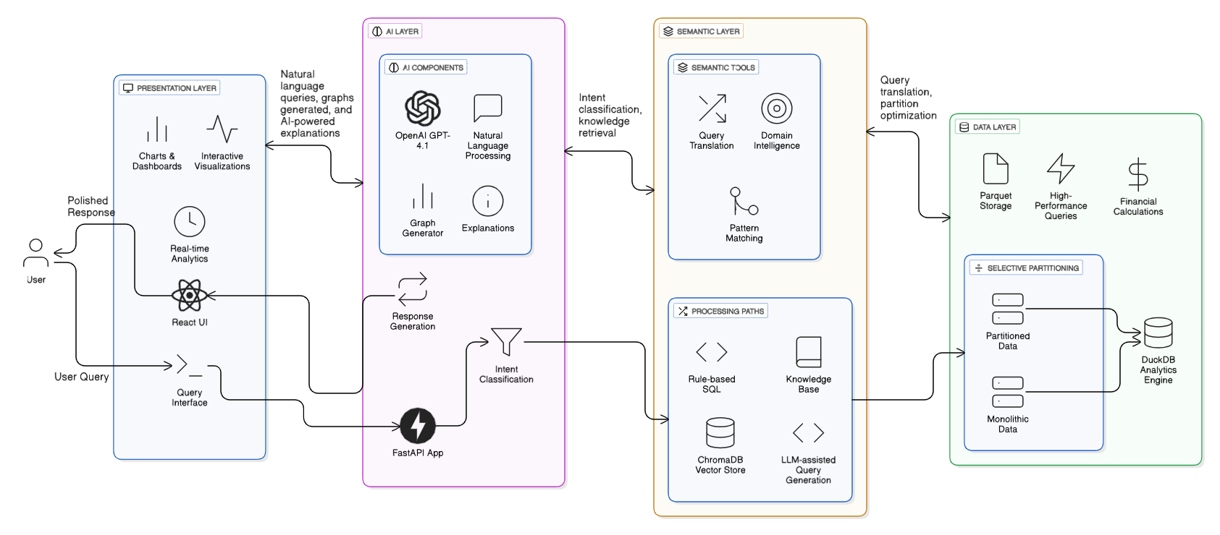
Reference Architecture

Slide 11






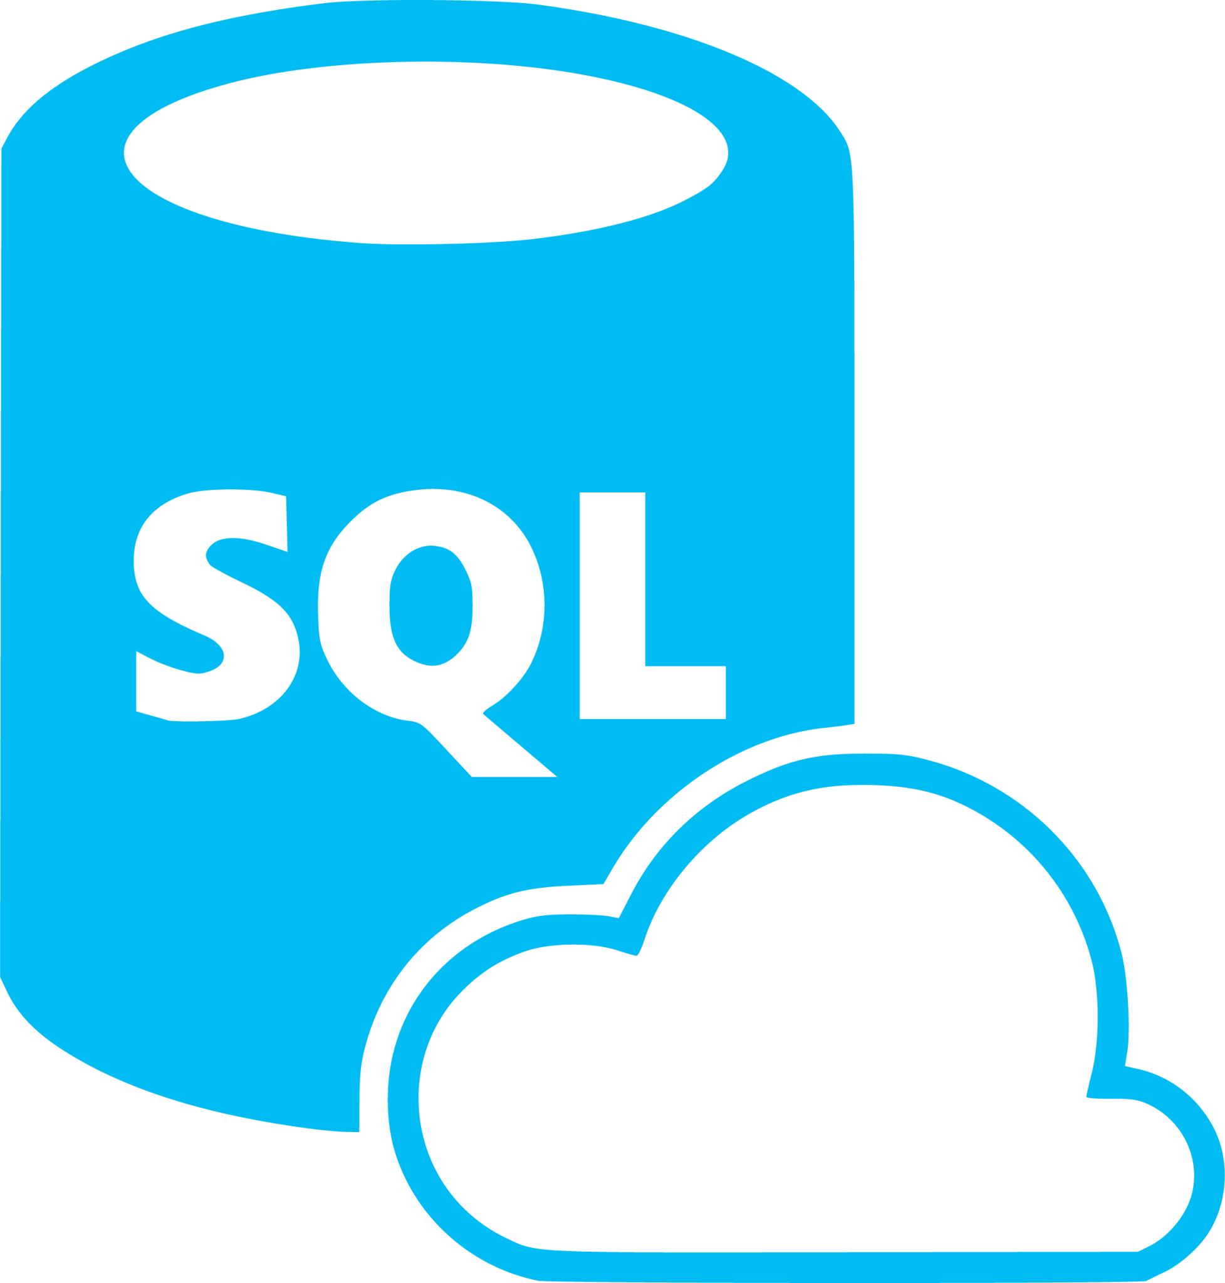


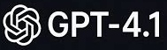


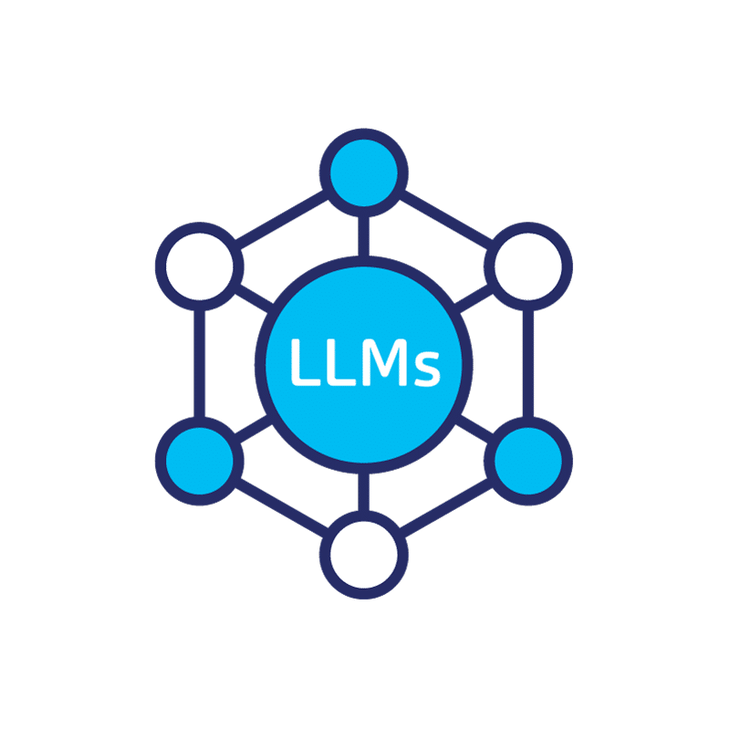


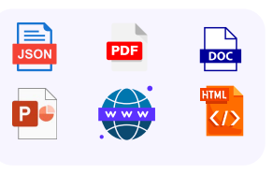
Solution Architecture
Feedback DB
Feedback
(Positive/ Negative)
Domain Knowledge DB
OpenAI Embedding (Convert to Embeddings)
Output
Meta-Data (schema) / TableDesc / TableNames
Azure Data Factory
Catalog
Cosmos (Domain KB)
Cosmos (Feedback)
Cosmos (Schema)
Data Layer
Data Stores
Response
Graph
Input
Preconfigured Personas UI
Follow up Questions
Azure Cosmos NoSQL DB
Context (KB)
Context (Meta-Data)
Integration Layer
OpenAI GPT-4.1
Modify Question
SQL Query
Azure SQL Database
Execute
OpenAI GPT 4.1
Queries
Modify Question
Azure Open AI
Error Message
Generate NLP Response
Azure Blob storage
SQL Result / User Query
Presentation Layer
NLQ + Context (Meta-Data)
Error
SQL Query
OpenAI GPT-4.1
Generate Graph if applicable
Generate SQL Query
Rectify SQL Queries
Chat History
Application Layer
Documents [PDF, Presentation, CSV/Excels]

Slide 12

How This Differs from Tool Licenses
Dimension
Tool License
X-Ray & Navigator
Knowledge Model
Ad-hoc file summaries that are ephemeral and individual
Persistent system model: call graphs, data flows, entity maps
Governance
Individual use with no shared context across teams
Shared across teams: onboarding tours, impact reports, dashboards
Deployment
Cloud-hosted, vendor-controlled infrastructure
Client environment (on-prem / VPC) with full audit trail
NON-NEGOTIABLES
Traceable
Auditable
VPC / On-Prem

Slide 13
Business Outcomes
Months
→
Weeks
Days
→
Hours
High
→
Lower
Onboarding Time on Legacy Systems
Impact Analysis Effort for Changes
Dependency on Legacy SMEs
Tailor to client baseline
Tailor to client baseline
Tailor to client baseline
KNOWLEDGE FLYWHEEL
Learn → Document → Query → Improve → Modernize
Create a living knowledge base for future modernization

Slide 14
Engagement Approach
Typical Timeline
Week 0
Weeks 1–2
Weeks 3–4
Setup
Build
Deliver
Scope, access, success criteria, guardrails (security, audit, residency)
Ingestion + initial system map + first impact maps
Traceable Q&A demo + findings readout + tiered roadmap
RISK CONTROLS
Data Residency
Access Control
Audit Logs
DELIVERABLES — STARTER KIT
System Atlas
Impact Maps
Query Recipes
Deployment Plan

