Slide 1

TAKENMIND GLOBAL DATA ANALYTICS INTERNSHIP
EMPLOYEE ATTRITION CASE
PROOF-OF-CONCEPT
Created by:
Srinidhi Devan

Slide 2
OBJECTIVE
Providing a data-driven solution to the company on the following questions:
What type of employees are leaving?
To determine which employees are prone to leave next.

Slide 3
METHODOLOGY
To understand the dataset provided to us: This will help us determine which of the variables are of importance pertaining to our problem statement.
Data Analysis: This is done using univariate and multivariate analysis.
Suggestions and Insights to the company.

Slide 4
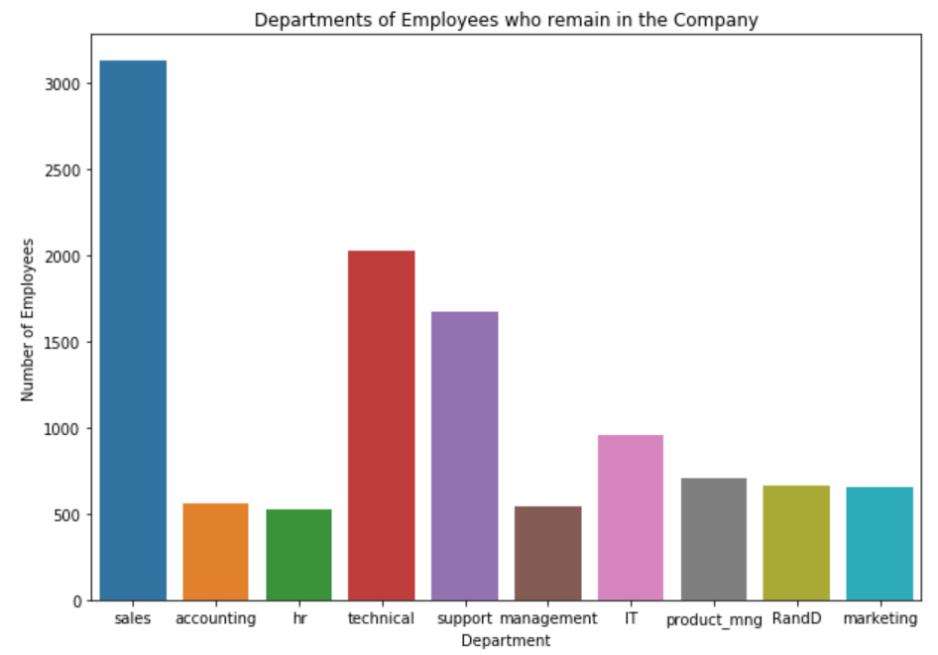
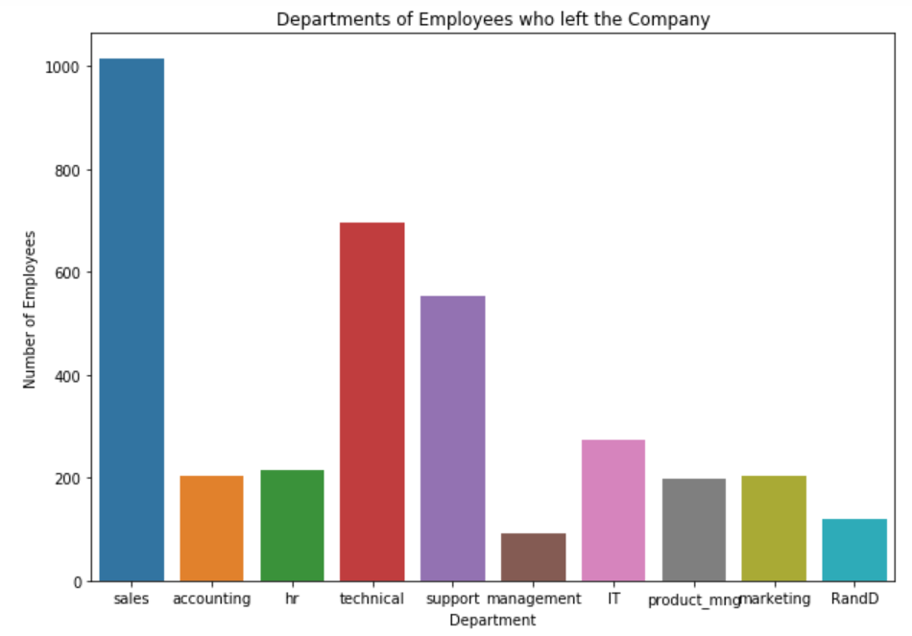
Department & attrition
The highest number of attrition is in Sales department followed by Technical and Support departments.
The lowest number of attrition is observed in the Management department.
However, from here, we can further extend the analysis to the percentage of attrition in each department.

Slide 5
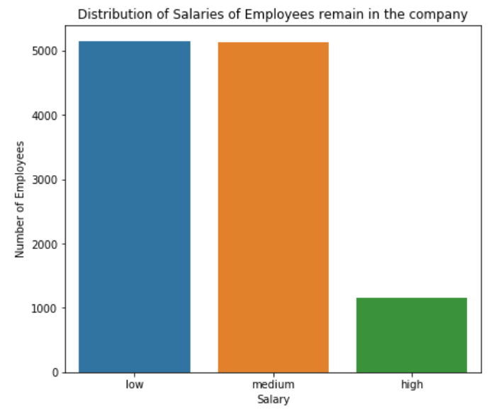
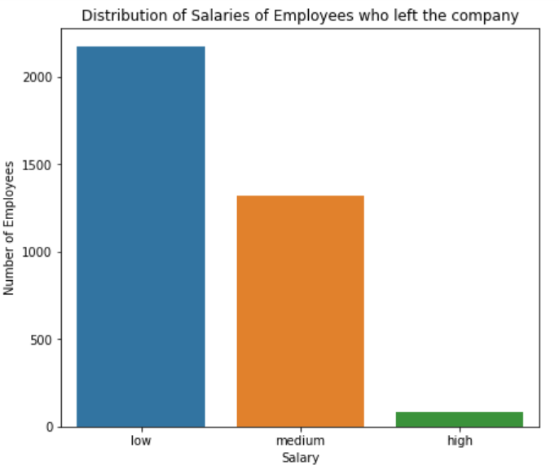
SALARY & ATTRITION
The proportion of high salaried employees leaving the company is much lesser compared to low and medium salaried employee.
This is an important aspect as salary plays as the decision-maker for whether or not the employees stay in the company or not.

Slide 6
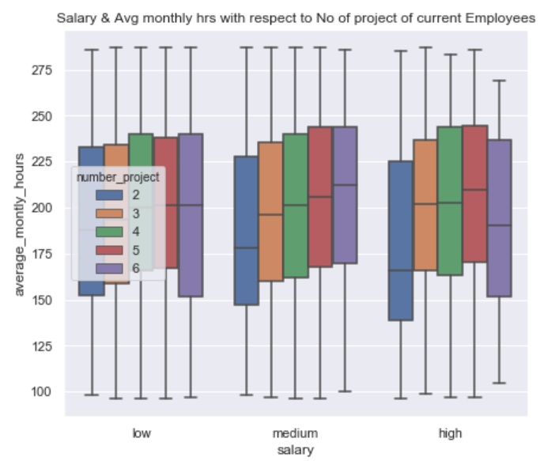
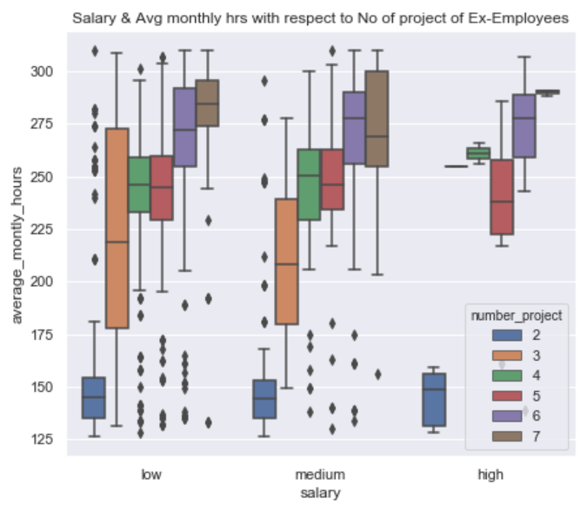
Salary, Average monthly Hours & Number of projects
If the average monthly hours for the ex-employees working on 2 projects is between 130 and 160, they tend to leave; for 3 projects it is 175 to 270 hours; for 7 projects it is 255 to 290 hours.
Therefore the higher the number of hours and the number of projects allocated, higher are the chance of the employees to leave the company.

Slide 7
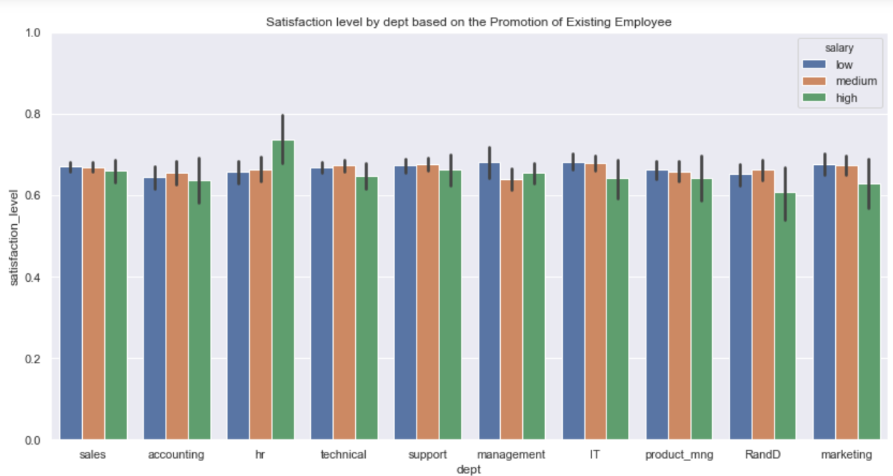
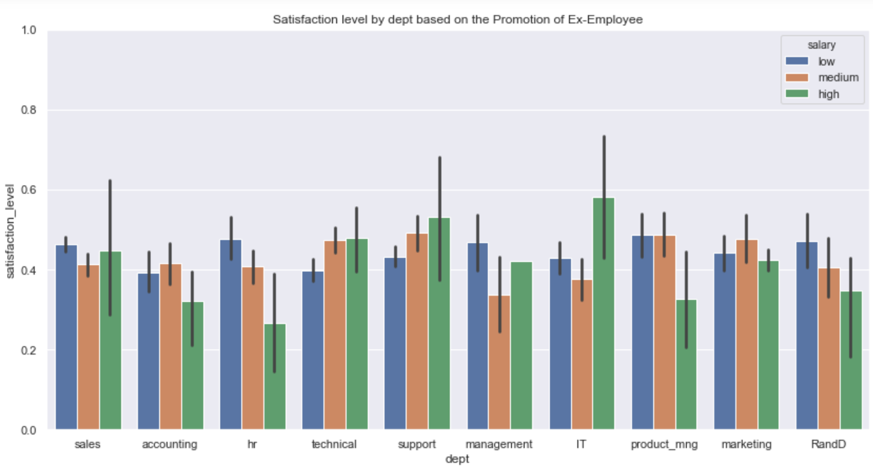
SATISFACTION LEVEL, DEPARTMENT & SALARY
It is interesting to observe that highest salaried have the highest satisfaction in the HR department and highest salaried have the lowest satisfaction level in the same department.
Highest salaried IT department with satisfaction level less than 0.6 are more prone to leave the company.
Amongst the medium salaried with less than 0.4 satisfaction level are more prone to leave.
So it is observed that the cut-off for the satisfaction level is therefore 0.6, above which the employees are less likely to leave the company.

Slide 8
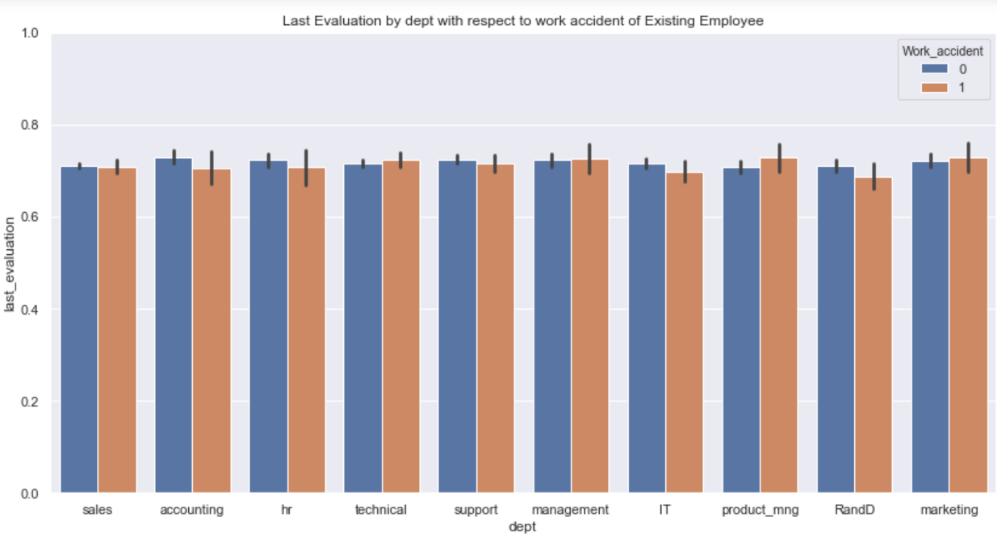
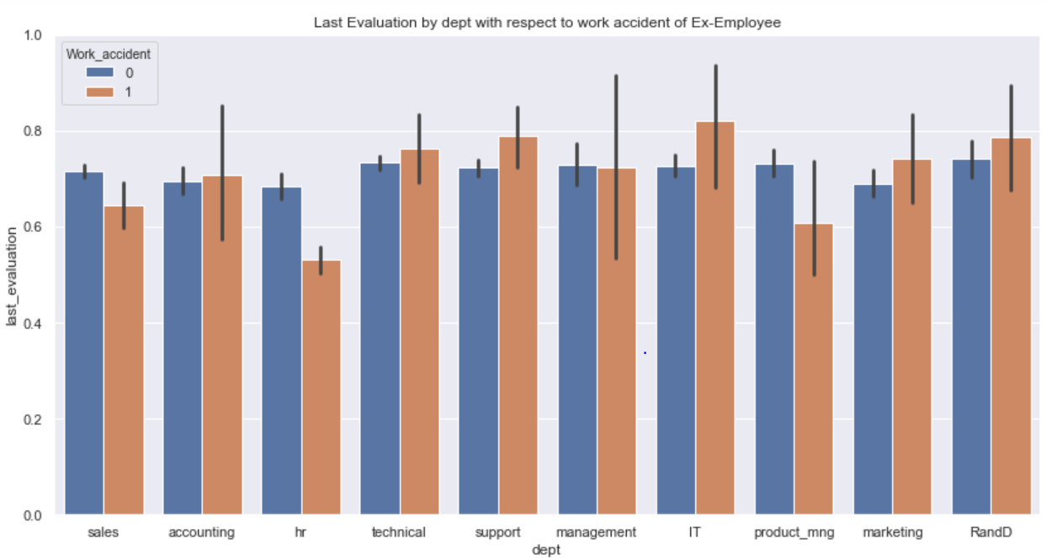
LAST EVALUATION, DEPARTMENT & WORK ACCIDENT
Of the employees who left the company, the HR department has the least last evaluation with work accident.
The IT department with work accident and highest last evaluation are more prone to leave their jobs.
Therefore, with last evaluation ranging between 0.5 to 0.85, the employees are more prone to leave the company vis-à-vis the last evaluation ranging between 0.6 and 0.8

Slide 9
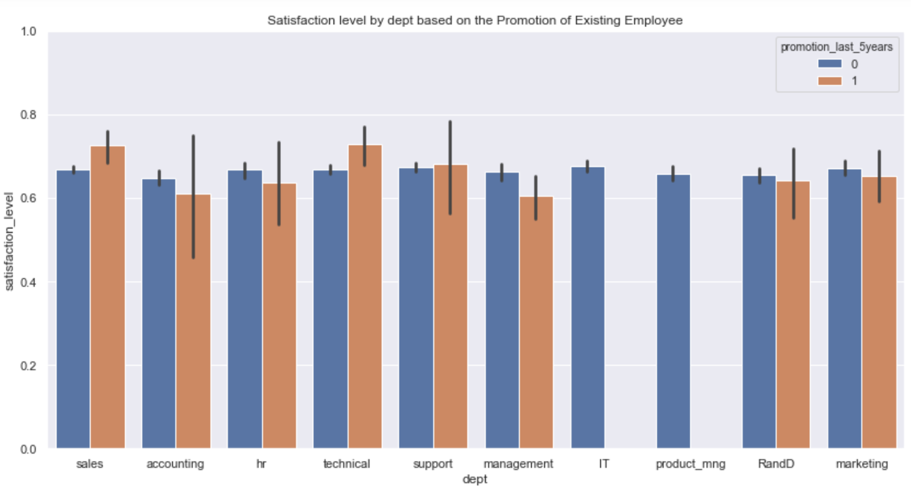
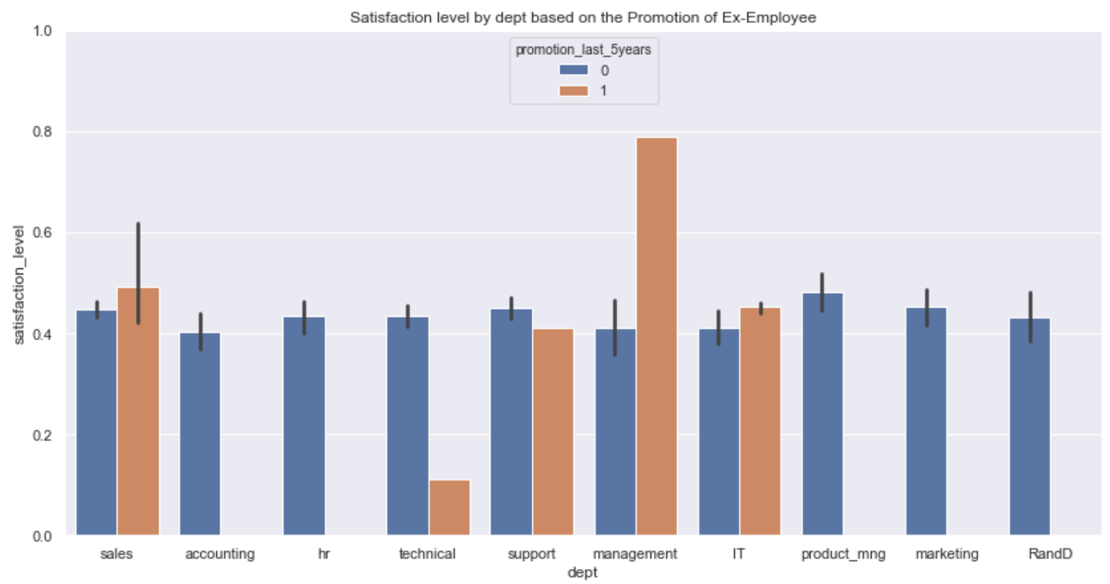
SATISFACTION LEVEL, DEPARTMENT & PROMOTION IN LAST FIVE YEARS
With no promotion in the last five years, employees from almost all the departments are prone to leave the company.
It is however very interesting that Management department with around 0.8 satisfaction level and employees being promoted in the last five years are also prone to leave the company.
Therefore with low satisfaction level and no promotion in the last five years suggests that the employees are more likely to leave the company.

Slide 10
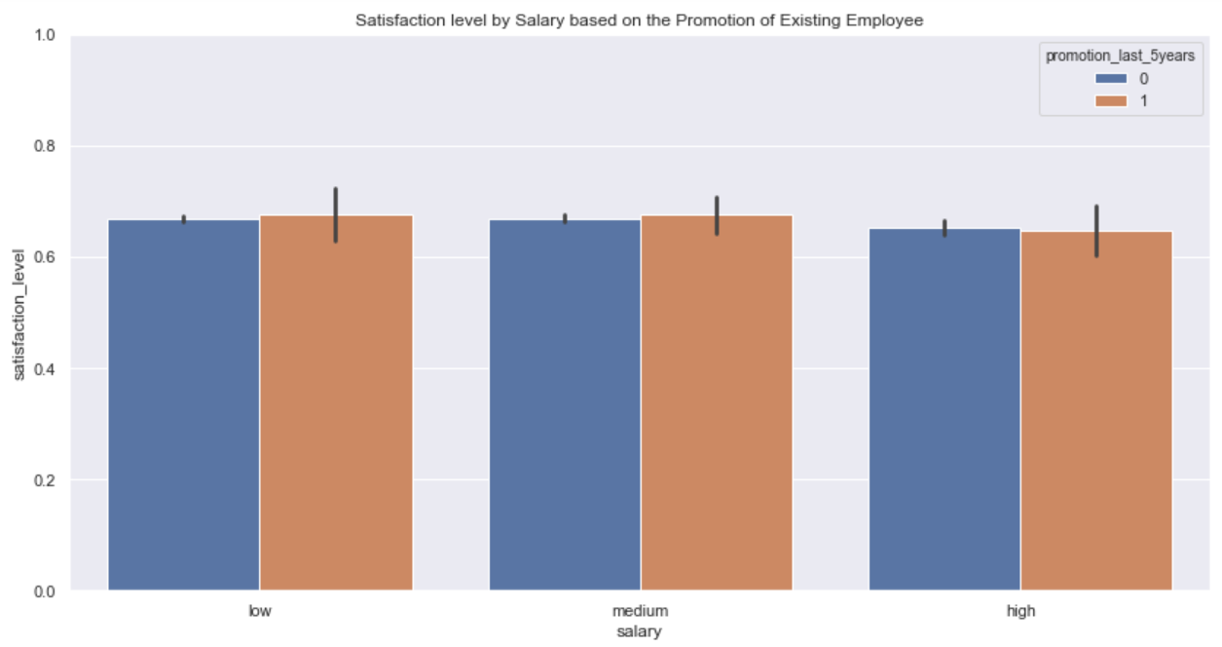
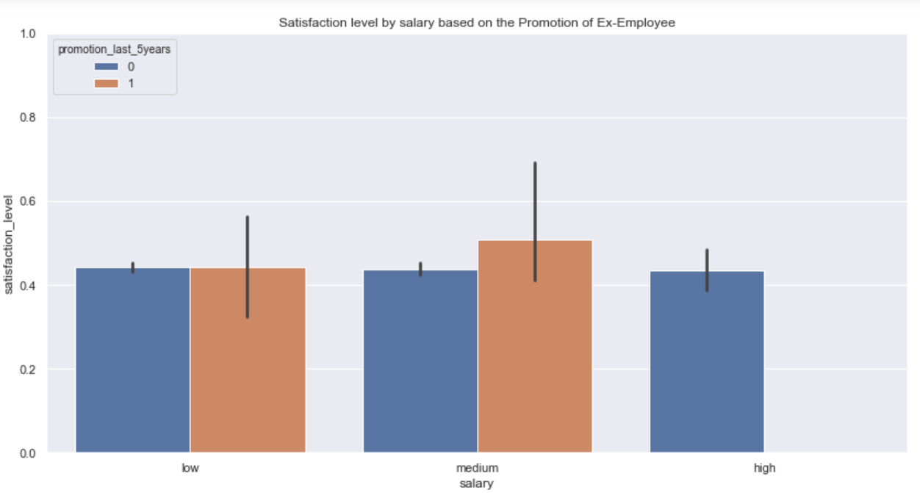
Satisfaction level, salary & PROMOTION IN LAST FIVE YEARS
With satisfaction level above 0.6 for all the salary ranges with or without promotion in last 5 years, the employees are less likely to leave the company.
With satisfaction level around 0.4 for all the salary ranges without promotion in last 5 years, the employees are more likely to leave the job.
Hence satisfaction level, salary range and promotion in the last five years plays an important decisional role in determining whether or not the employee will leave the job or not.

Slide 11
FACTORS CONTRIBUTING TO ATTRITION
The main factors which are driving the employees out of the company are:
Satisfaction level
Time spent at the company
Average monthly hours
Number of projects
Last evaluation
The employees with lowest satisfaction level, least number of projects and poor last evaluation are more prone to leave the company.

Slide 12
Insights to the company
Since we saw that satisfaction level plays a major role in attrition, it is very essential for the company to maintain high level of satisfaction amongst its employees.
This can be done through multiple ways: Offering promotion at least once every 2 years in this dynamic market situation, increase in salary of the employees and conducting few employee boosting activities which will make them more loyal and dedicated towards the company.
An increase in the number of projects allocated to each employees can also help reduce the attrition rates.
The company also needs to improve its last evaluation rates, if this is poor, the employees are prone to leave the company and reducing this will build a more loyal workforce.
Also if the average number of monthly hours spent by the employees are high, they should be compensated well for the same, this will also be one of the boosting factors for the employees considering the monetary aspect.ng, which may in turn lead to them leaving the company.

Slide 13


