Slide 1
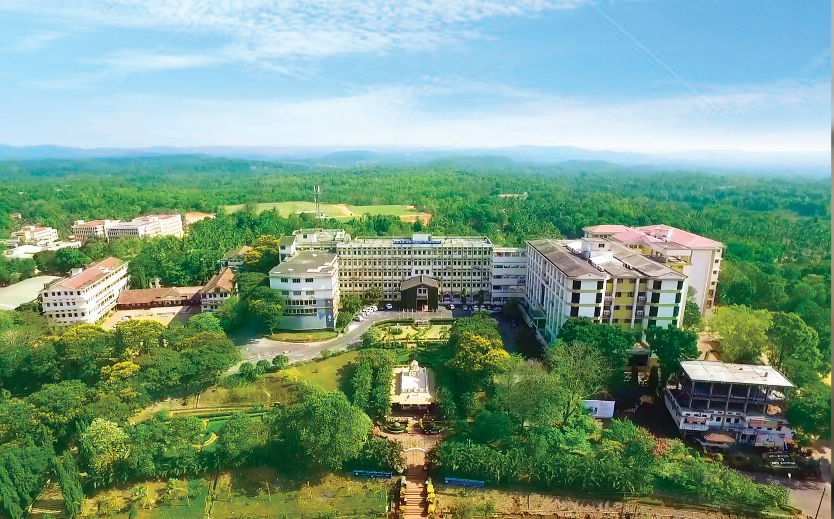

Nitte, Karkala, Udupi (Dist.) Karnataka, India
Department of Information Science and Engineering

Slide 2
Machine Learning Based Lifecycle Intelligence System for Non-Biodegradable Automotive Materials
Team 53
Prajwal B T (NNM23IS128), Srinidhi D S (NNM23IS185), Swaroop Sathish Y (NNM23IS191), V K Ronith (NNM23IS203)
Guide: Pratheeksha Hegde N

Slide 3
AGENDA
Phase 2 Recap and Diagnosis
Problem Statement and Objectives
Why the Dataset Was Rebuilt
Methodology
Implementation of the Modules
Results and Discussion
Model Comparison and Hyperparameter Tuning
Feature Importance and SHAP
Key Findings
Limitations and Future Work
References
Department of ISE
01

Slide 4
Phase 2 Recap and Diagnosis
Where Phase 2 Ended
Best model: hybrid stacking ensemble — 57.8% test accuracy
Every algorithm plateaued near 56%, regardless of family or tuning
Open issues: minority “Dispose” class under-predicted; overfitting past ~20 boosting rounds
Phase 3 Diagnosis — the data, not the models
Random Forest 5-fold cross-validation reached 58.4% against a 45.0% majority-class baseline
Only 13 points above baseline from 19 features — the labels were near-independent of the features
“Vehicle Type” and “Manufacturing Year” had exactly 0.0000 mutual information with the target
Physically impossible values: Copper Alloy part mass, mean 15.1 kg with standard deviation 100.1 kg
Conclusion: all five Phase 2 hybrids converging on 0.556 was a noise floor, not a tuning problem
Department of ISE

Slide 5
Problem Statement and Objectives
Problem Statement
End-of-life vehicles accumulate faster than current waste-management practice can assess them, and no intelligent tool decides whether a non-biodegradable automotive material should be reused, recycled or disposed of, or how much environmental risk it carries if mishandled
Objectives and Status
Obj 1 — Analyse lifecycle data; preprocessing and feature extraction → Completed
Obj 2 — Supervised ML classification into reuse / recycle / disposal → Completed
Obj 3 — Evaluate and compare models on Accuracy, Precision, Recall, F1, Confusion Matrix → Completed
Obj 4 — Best model plus a lifecycle intelligence system with a usable interface → In progress
Models, dual prediction heads and saved artefacts are complete; the user interface remains
Environmental risk prediction, required by the synopsis methodology, is now implemented as a second output
Department of ISE

Slide 6
Why the Dataset Was Rebuilt
The synopsis permits simulation-based data
Methodology states data may come from “publicly accessible sources, datasets, and simulation-based lifecycle data”
New foundation — physics-grounded, not random
12 materials × 12 components built from published property tables: Ashby, Argonne GREET 2023, EU ELV Directive 2000/53/EC, US EPA WARM v16
Part mass derived from density and component geometry; embodied energy and CO₂ follow from mass, so features are physically consistent rather than independently random
Degradation model: thermal, photo-oxidative and corrosive dose accumulated across service life
Labels from a documented multi-criteria (MCDA) decision rule, calibrated to the EU ELV stream (~20% reuse / 50% recycle / 30% dispose)
Stated limitation
The dataset is simulated: models learn a surrogate of the decision rule, so accuracy measures surrogate fidelity rather than field disposition accuracy
Measured ceiling: no model using only the exported features can exceed 89.12% — every result is read against that, not against 100%
Department of ISE

Slide 7
Methodology
LCA-Grounded Data Generation
12 materials × 12 components from published property tables; mass, energy and CO₂ derived from physics
Preprocessing & Feature Engineering
Rows with missing values removed (9,000 → 8,440); ordinal and one-hot encoding; 6 engineered circularity features
Dataset Splitting
Stratified 70% train (5,007) / 20% test (1,430) / 10% validation (716), plus an extrapolation set
Model Training
13 models per target including LSTM and Transformer; explicit epoch loops with learning-rate search
Validation & Evaluation
Validation loss and accuracy tracked every epoch; early stopping on validation loss; cost-sensitive scoring
Best Model Selection
Transformer — 88.67% test accuracy, at the measured 89.12% ceiling
Department of ISE
01

Slide 8
Implementation of the Modules (1/2)
Module 1: Data Generation and Provenance
material_properties.py — 12 materials with published density, embodied energy, GWP, recycling rate, recyclate value and hazard class, each source cited
simulator.py — degradation physics, MCDA labelling, and unobserved heterogeneity representing hidden internal damage, market conditions and operator judgement
A dataset card records provenance, method and limitations alongside the data
Module 2: Preprocessing and Feature Engineering
Rows with missing values removed per evaluator instruction: 9,000 → 8,440 (6.2%); all three policies measured and compared
Ordinal encoding preserves order (Poor < Fair < Good < Excellent); one-hot for nominal features
6 engineered features: value per dismantling cost, strength retention ratio, carbon intensity, recoverable energy, annual duty and CO₂ avoided per cost
Module 3: Dataset Splitting
Stratified 70 / 20 / 10 — train 5,007, test 1,430, validation 716
Separate extrapolation set of 1,287 rows: a whole material (Polyvinyl Chloride (PVC)) and a whole component (Battery Casing) withheld from training entirely
Department of ISE

Slide 9
Implementation of the Modules (2/2)
Module 4: Model Training — 13 models per target
Classical: Random Forest, Extra Trees, XGBoost, LightGBM, CatBoost and SVM (RBF), tuned with GridSearchCV at 3-fold cross-validation
Deep learning in PyTorch: MLP, LSTM and Transformer, each trained with an explicit epoch loop
LSTM — bidirectional, reading the feature-token sequence; Transformer — encoder with a [CLS] token and self-attention across feature-tokens
Activation functions stated explicitly: ReLU (MLP), Sigmoid and Tanh (LSTM cell gates), GELU (Transformer feed-forward), Softmax on every output
Learning rate searched per architecture; the full grid is recorded, not only the chosen value
4 hybrid ensembles: three stacking variants and one soft-voting ensemble
Module 5: Evaluation and Explainability
Validation loss and accuracy recorded every epoch for 8 models; early stopping monitors validation loss and restores the best-epoch weights
Asymmetric cost matrix: releasing a hazardous part into the reuse stream costs 8.0, against 1.5 for over-cautiously disposing of a recyclable part
SHAP global importance and per-part explanations, so each decision can be justified
Department of ISE

Slide 10
Results and Discussion — Disposition
Target 1 — Disposition: top 5 of 13 models (validation)
Transformer — 88.55% accuracy, 0.8679 macro F1, validation loss 0.3066
Random Forest — 88.55% accuracy, 0.8668 macro F1, validation loss 0.3095
SVM (RBF) — 88.41% accuracy, 0.8667 macro F1, validation loss 0.3291
LightGBM — 88.41% accuracy, 0.8645 macro F1, validation loss 0.3270
LSTM — 88.13% accuracy, 0.8641 macro F1, validation loss 0.3225
Best Model — Transformer
Test accuracy 88.67%, macro F1 0.8690, ROC-AUC 0.9693
Against a 53.37% majority-class baseline and the measured 89.12% ceiling
Per class F1 — Reuse 0.78 | Recycle 0.93 | Dispose 0.90
Class imbalance resolved: Dispose reaches 0.90 precision / 0.89 recall, against the under-prediction flagged in Phase 2
Department of ISE

Slide 11
Results and Discussion — Environmental Risk
Target 2 — Environmental Risk (new in Phase 3)
The synopsis methodology requires the system to “determine the environmental risk level”; this was not implemented in Phase 1 or Phase 2
Four tiers: Low / Moderate / High / Critical
Top 4 models (validation)
Extra Trees — 87.71% accuracy, 0.8737 macro F1, validation loss 0.3219
SVM (RBF) — 87.43% accuracy, 0.8724 macro F1, validation loss 0.3508
Transformer — 87.29% accuracy, 0.8710 macro F1, validation loss 0.3095
LSTM — 86.87% accuracy, 0.8672 macro F1, validation loss 0.3168
Best Model — Extra Trees
Test accuracy 85.94%, macro F1 0.8561, ROC-AUC 0.9724, against a 34.33% baseline
Per class F1 — Low 0.85 | Moderate 0.86 | High 0.79 | Critical 0.92
Department of ISE

Slide 12
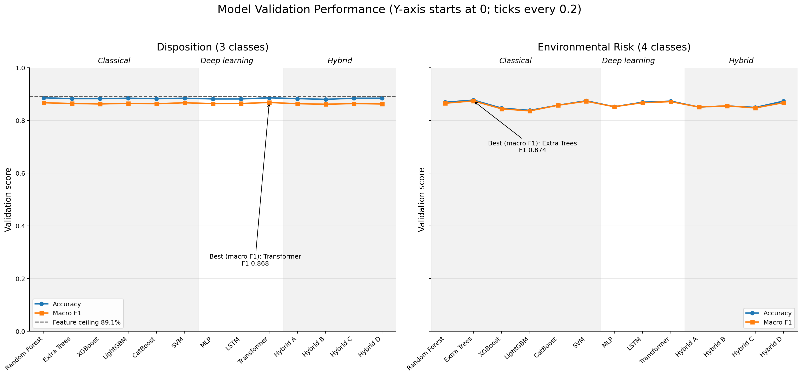
Model Comparison — Accuracy and Macro F1
Disposition: all 13 models fall within 0.861–0.868 macro F1, just below the 89.1% feature ceiling. Transformer is highest (0.868), but the data limit matters more than the choice of algorithm
Environmental Risk: Extra Trees is highest (0.874); untuned XGBoost (0.844) and LightGBM (0.836) are lowest — they overfit (next two slides)
Classification task, so accuracy, macro F1 and log loss are reported; R², RMSE and MAE apply only to regression
Department of ISE

Slide 13
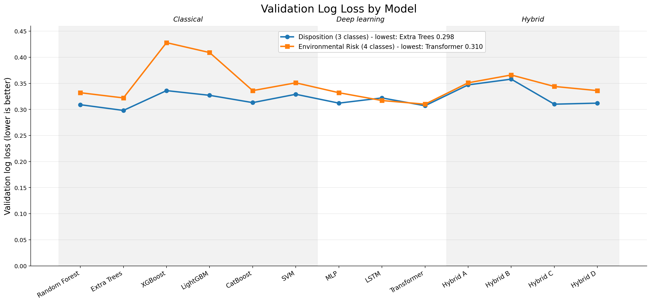
Model Comparison — Validation Loss
Log loss measures how well the predicted probabilities fit; it has a different scale from accuracy, so it is plotted separately
Lowest validation loss: Extra Trees 0.298 (Disposition), Transformer 0.310 (Environmental Risk)
XGBoost (0.428) and LightGBM (0.409) on Risk: over-confident probabilities, addressed by the tuning study on the next slide
Department of ISE

Slide 14
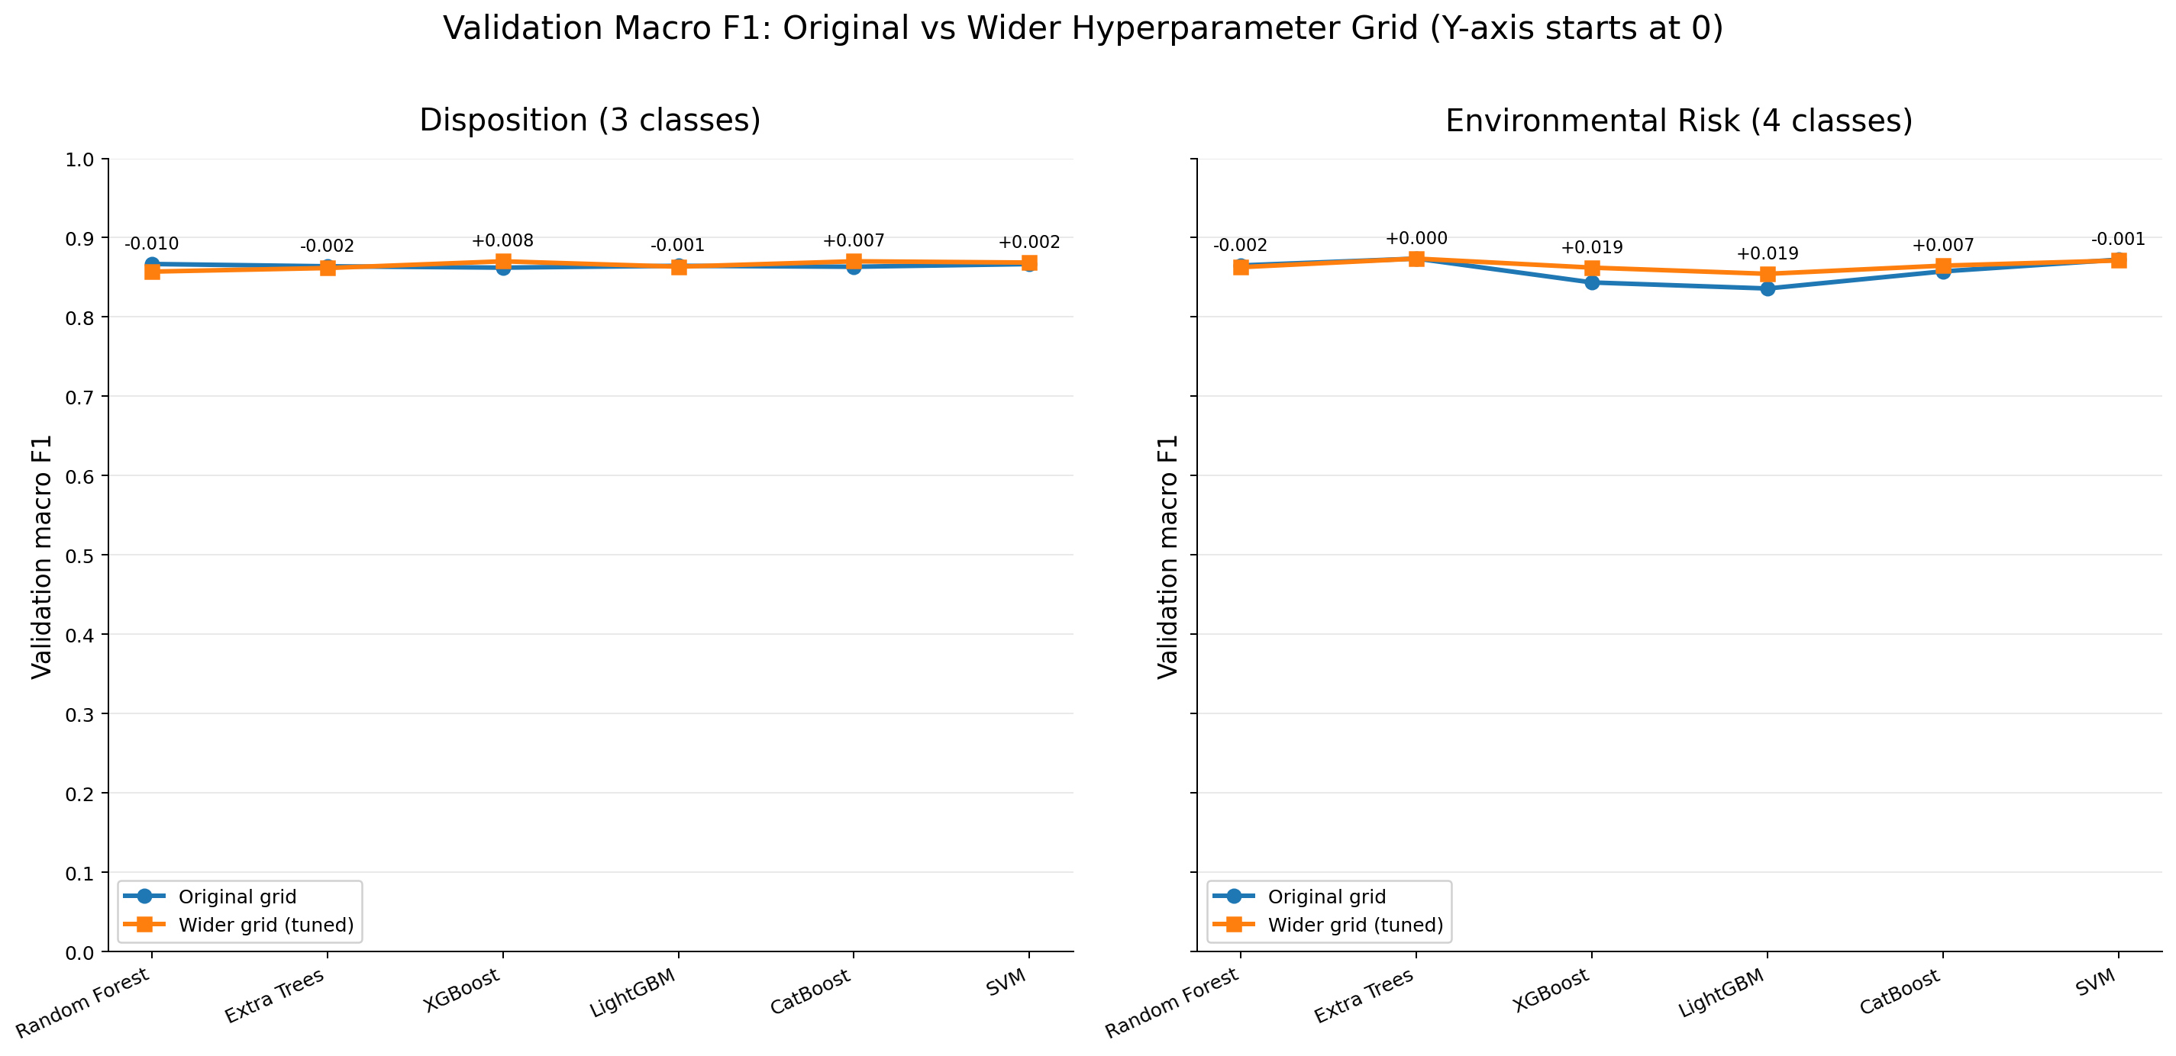
Hyperparameter Tuning — Original vs Tuned
Wider GridSearchCV grids (3-fold CV, macro F1) on the same splits; chosen by CV, scored on validation
Boosting gains most on Risk — XGBoost F1 0.844 → 0.862 (loss 0.428 → 0.329), LightGBM 0.836 → 0.854, CatBoost 0.857 → 0.865: slower learning rate (0.03) and shallower trees reduce overfitting
Random Forest, Extra Trees and SVM: no validation gain — the original settings were already adequate
Activations compared: GELU confirmed for the Transformer on both targets; LSTM head — Tanh was weakest (GELU best on Disposition, ReLU on Risk); MLP — LeakyReLU lowest loss on both (marginal over ReLU on Disposition)
Department of ISE

Slide 15
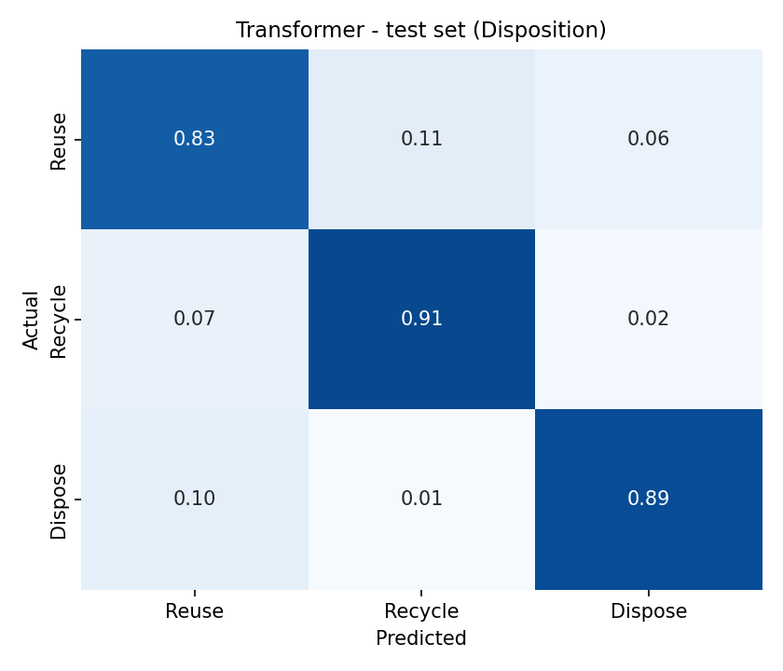
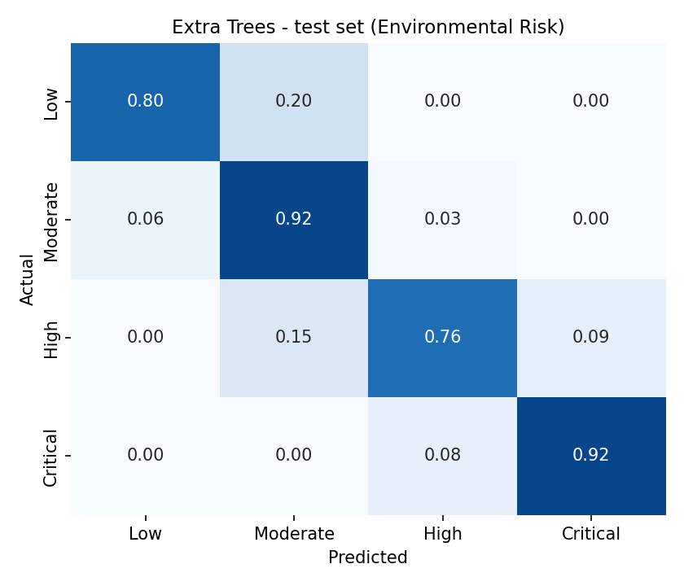
Confusion Matrices — Test Set
Disposition — Transformer (row-normalised)
Environmental Risk — Extra Trees (row-normalised)
Department of ISE
01

Slide 16
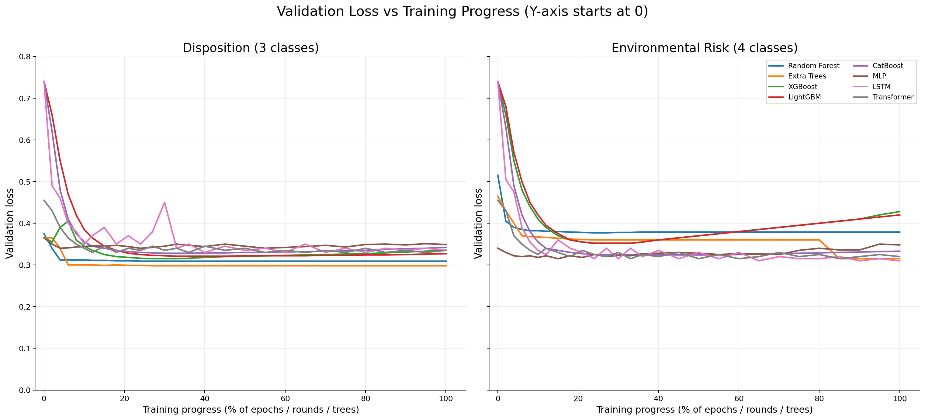
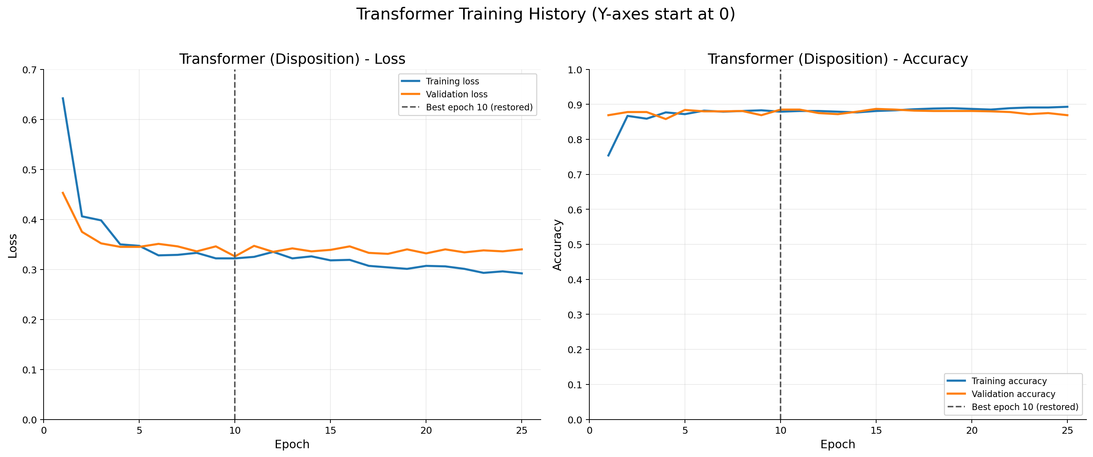
Validation Loss per Epoch
Department of ISE
01

Slide 17
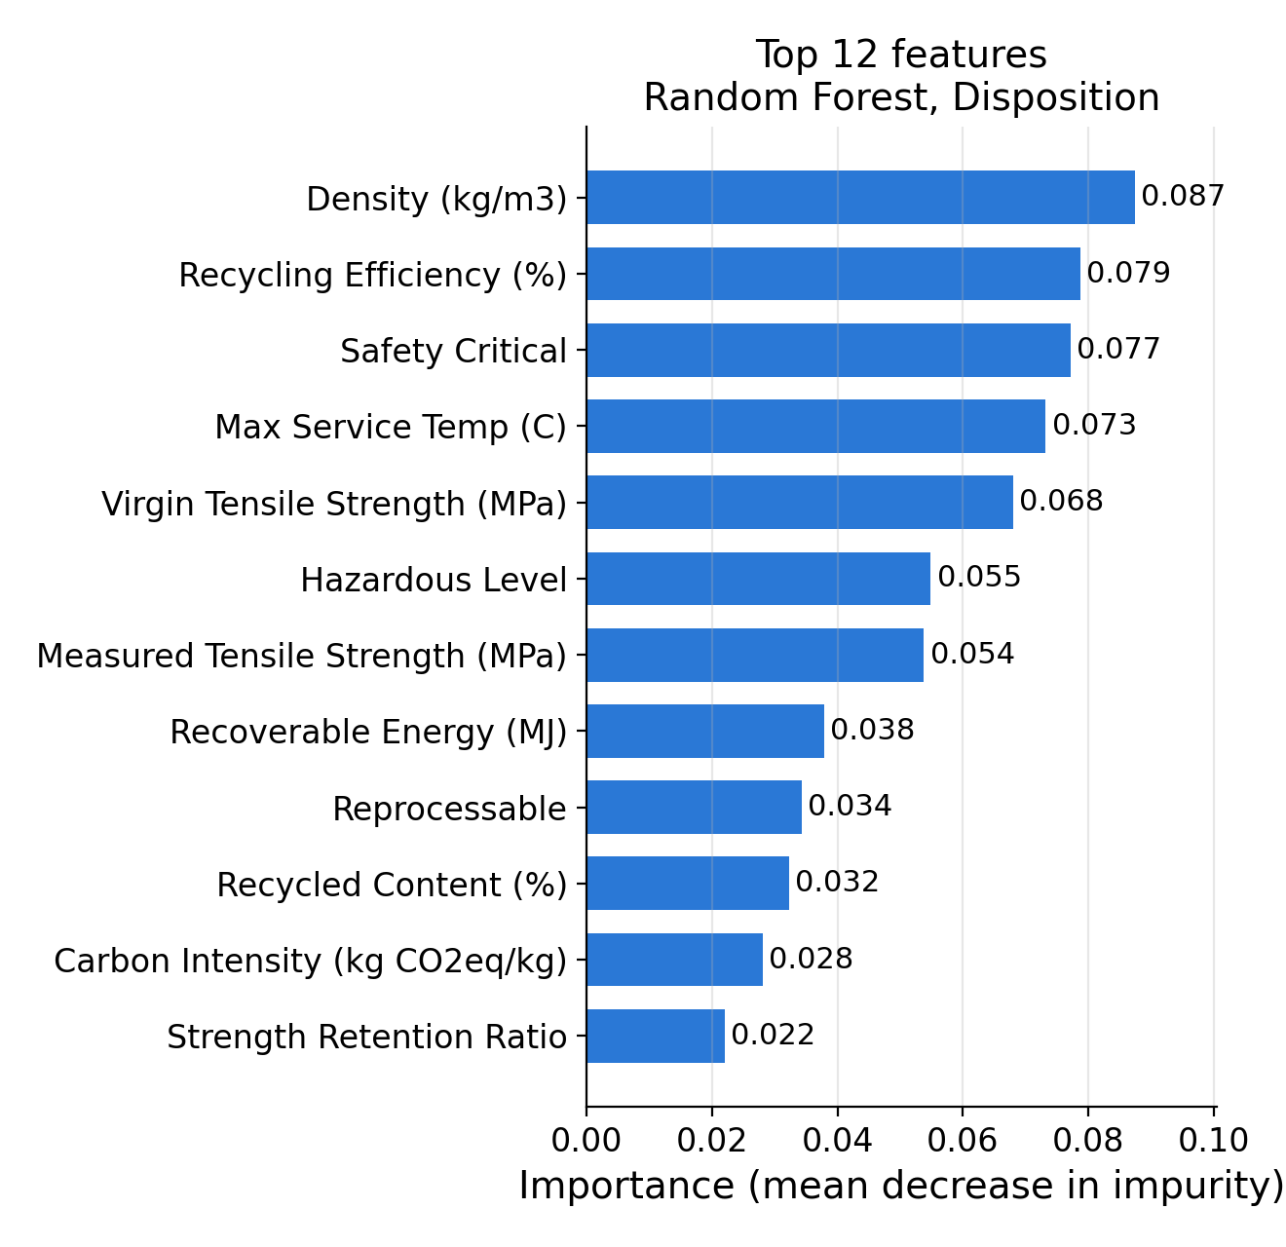
Feature Importance
What it is
How much each input feature contributes to a model's predictions across the dataset
Why it is useful
Shows what drives the Reuse / Recycle / Dispose decision and checks that the model relies on physically sensible properties
How it is measured
Random Forest mean decrease in impurity: total Gini reduction from splits on a feature, averaged over its 300 trees
Random Forest is used because the best model (Transformer) is not tree-based
Key findings
Material properties lead: density, recycling efficiency, safety-critical status, max service temperature
Condition signals (measured tensile strength, strength retention) are also in the top 12
Risk target (Extra Trees): Hazardous Level and Reprocessable rank highest
Importance shows association with predictions, not cause
Department of ISE

Slide 18
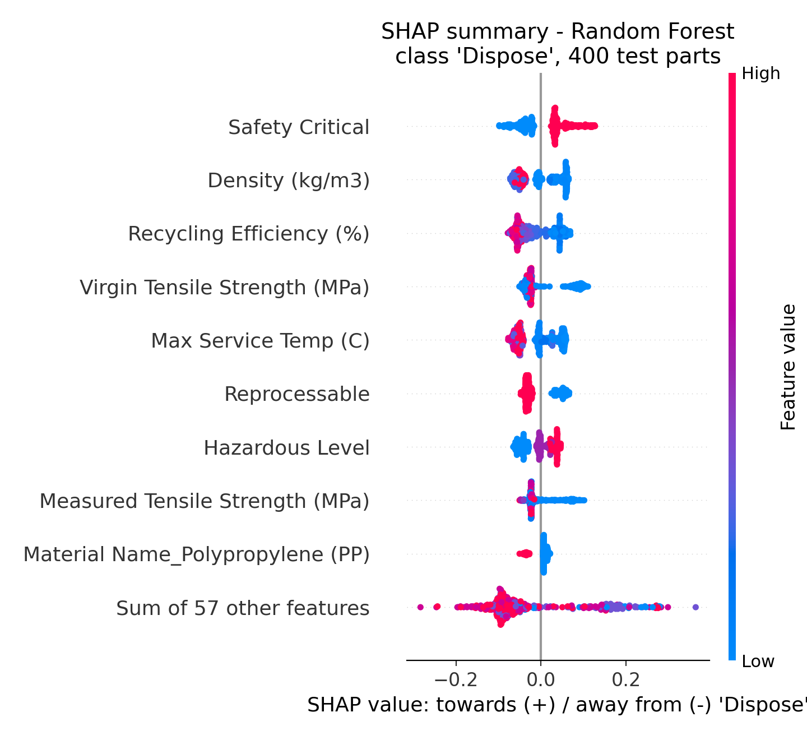
SHAP — Explaining Model Predictions
What SHAP is
SHapley Additive exPlanations: splits each prediction into per-feature contributions, based on Shapley values from game theory
Why it is used
Gives the direction as well as the size of each feature's effect, for every individual part
Reading the plot
Each dot is one test part; right of zero pushes towards 'Dispose'; red = high value, blue = low
What it reveals
Towards Dispose: safety-critical parts, higher hazard level, lower measured strength
Away from Dispose: reprocessable parts, higher recycling efficiency, higher max service temperature, better condition
SHAP explains how the model uses features; it does not establish causation
Department of ISE

Slide 19
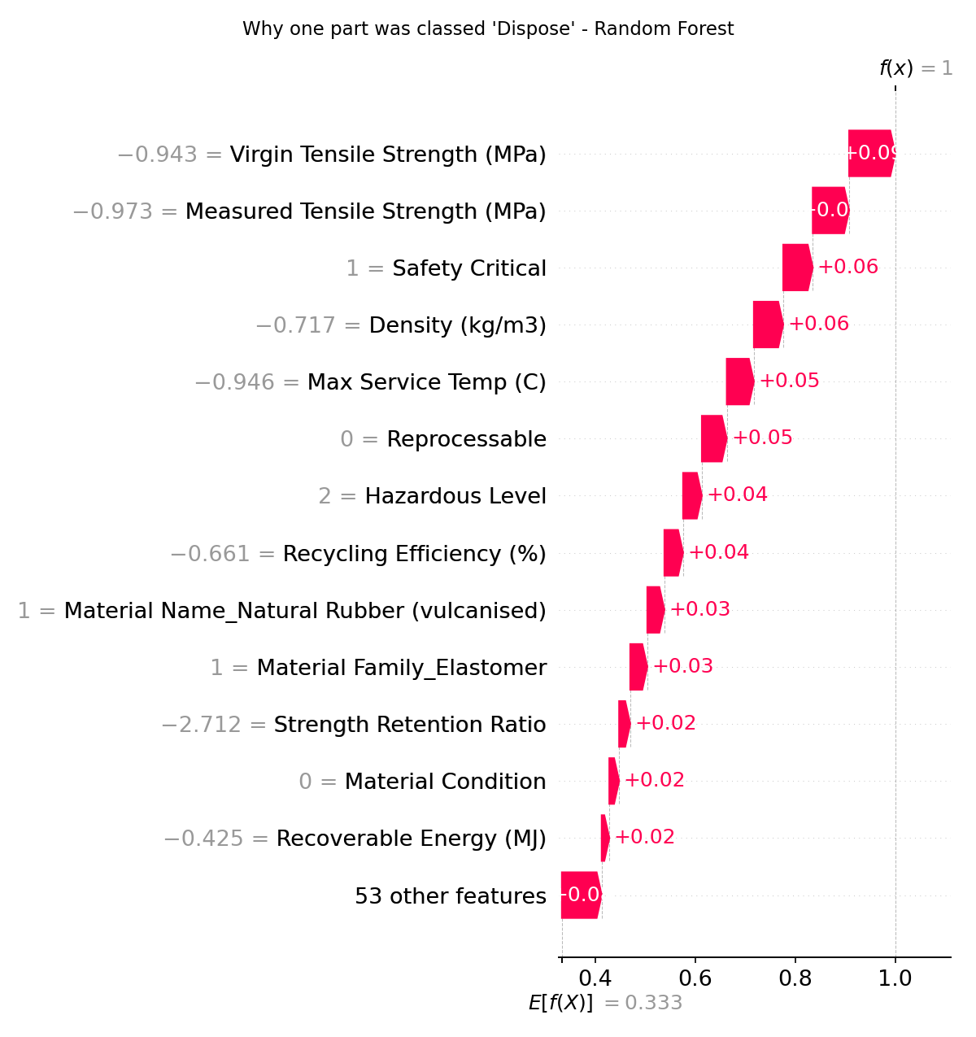
SHAP — One Part Explained
Feature contributions for one prediction
A test part the Random Forest classed 'Dispose': contributions start from the average prediction, E[f(X)] = 0.333, and add up to the model's output f(x)
Largest pushes towards Dispose: low virgin and measured tensile strength, safety-critical, low density, low max service temperature, not reprocessable, high hazard level
Values are standardised (numeric) or encoded (categorical), as the model sees them
Why this matters
A dismantler can see why a part was flagged before acting on it, rather than trusting a bare label
Department of ISE

Slide 20
Key Findings
1. Every model sits at the information-theoretic ceiling
88.67% against a measured 89.12% limit, so the remaining error is irreducible rather than a tuning failure
2. Validation loss caught a defect accuracy could not see
Unregularised LightGBM reached 86.6% accuracy while its validation loss was 0.7386, more than double every other model — overfitting into overconfident probabilities
Regularising cut the loss to 0.3270 and raised accuracy to 88.41% at the same time
3. The Transformer outperforms the LSTM, and the architecture explains why
Feature order here is arbitrary: self-attention is permutation-equivariant and fits, whereas the LSTM's sequential bias assumes an ordering that does not exist
The LSTM also needed roughly three times as many epochs to converge (34 against 10)
4. Hybrid ensembles still do not beat the best single model
Reproducing the Phase 2 finding on data that now carries real signal: the base learners make highly correlated errors, leaving little for a meta-learner to combine
Department of ISE

Slide 21
Limitations and Future Work
Limitations — stated, not hidden
The dataset is simulated; models learn a surrogate of a documented decision rule rather than observed field disposition behaviour
The models do not extrapolate: on an unseen material and component, disposition accuracy falls from 88.67% to 69.70%, and risk accuracy from 85.94% to 50.12%
The system interpolates within known materials and must be retrained before use on a new material class
Future Work — completing Objective 4
Streamlit lifecycle intelligence interface: single-part prediction and batch CSV upload
Whole-vehicle teardown mode, aggregating a bill of materials into a recovery rate and checking it against the EU ELV 95%-by-mass target
Confidence-based abstention, routing low-confidence parts to manual inspection — the honest response to the extrapolation limitation above
Counterfactual explanations and circularity KPIs: CO₂ avoided, mass recovered, value recovered
Department of ISE

Slide 22
References
Core References (Synopsis)
[1] R. Kumar and S. Patel, “Automotive composite materials and environmental impact,” Journal of Sustainable Engineering, vol. 12, no. 3, pp. 45–53, Mar. 2021
[2] A. Sharma and P. Verma, “Machine learning approaches for material classification,” International Journal of Computer Applications, vol. 180, no. 25, pp. 12–18, Jul. 2020
[3] International Energy Agency, “End-of-life vehicle management,” IEA. [Online]. Available: https://www.iea.org
Phase 3 — Data Foundation and Model Architecture
[4] M. F. Ashby, Materials and the Environment: Eco-informed Material Choice, 3rd ed. Butterworth-Heinemann, 2021
[5] Argonne National Laboratory, GREET Model 2023 — Greenhouse gases, Regulated Emissions and Energy use in Technologies, vehicle-cycle module
[6] Directive 2000/53/EC of the European Parliament on End-of-Life Vehicles, incl. Art. 7(2) reuse/recovery target and Annex II heavy-metal restrictions
[7] U.S. Environmental Protection Agency, Waste Reduction Model (WARM) v16, 2023
[8] A. Vaswani et al., “Attention is all you need,” Advances in Neural Information Processing Systems (NeurIPS), 2017
[9] S. Hochreiter and J. Schmidhuber, “Long short-term memory,” Neural Computation, vol. 9, no. 8, pp. 1735–1780, 1997
[10] Y. Gorishniy et al., “Revisiting deep learning models for tabular data,” NeurIPS, 2021
[11] S. M. Lundberg and S.-I. Lee, “A unified approach to interpreting model predictions,” NeurIPS, 2017
[12] L. Breiman, “Random forests,” Machine Learning, vol. 45, no. 1, pp. 5–32, 2001
Department of ISE

Slide 23
THANK YOU
Department of ISE
39

