Slide 1
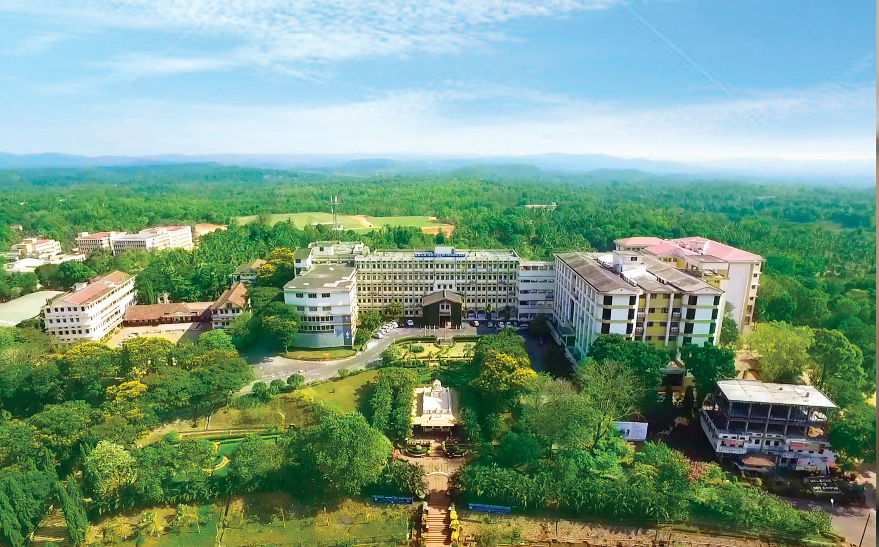

Nitte, Karkala, Udupi (Dist.) Karnataka, India
Department of Information Science and Engineering

Slide 2
Machine Learning Based Lifecycle Intelligence System for Non-Biodegradable Automotive Materials
Team 53
Prajwal B T (NNM23IS128), V K Ronith (NNM23IS203), Srinidhi D S (NNM23IS185), Swaroop Sathish Y (NNM23IS191)
Guide: Pratheeksha Hegde N

Slide 3
AGENDA
Introduction
Literature Gap
Motivation
Problem Statement
Objectives
Methodology
References
Department of ISE
01

Slide 4
INTRODUCTION
Modern automobiles increasingly use non-biodegradable materials, such as composite fibers, reinforced plastics, and polymer-based materials, to boost performance
These materials become a major environmental hazard once vehicles reach their end-of-life (EOL) stage
Improper handling at EOL causes soil pollution and loss of reusable resources
The rising number of end-of-life vehicles is outpacing the intelligence of current waste-management practices
Proposed solution: an ML-based software application that analyzes automotive material lifecycle data for intelligent, sustainable waste management
Department of ISE
01

Slide 5
LITERATURE GAP
Existing research is siloed: composite recycling, ELV policy compliance, lifecycle assessment (LCA), and ML-based material classification are studied independently
No integrated system combines material identification, environmental risk prediction, and lifecycle decision support in one real-time tool
Current ELV systems are reactive, processing materials first and assessing consequences afterward
Limited use of ML specifically for pre-processing risk prediction; most ML use targets shredding efficiency and metal recovery only
No dynamic, rule-based decision support system that links ML predictions to actionable processing recommendations
Few fully functional prototypes exist, as most current work is theoretical or small-scale simulation
Department of ISE

Slide 6
MOTIVATION
Non-biodegradable materials, such as composite fibers, reinforced plastics, and polymer-based materials, are increasingly used in automobiles to enhance performance
At the end-of-life stage, if these materials are not properly handled, soil pollution and loss of reusable resources take place
The rising number of end-of-life vehicles surpasses the intelligence of current waste management practices
Current practices are inadequate for analyzing waste materials and determining environmental risks
This motivates the need for an efficient, intelligent waste management practice using a machine learning-based software application
Department of ISE
01

Slide 7
PROBLEM STATEMENT
Current waste-management systems lack intelligent tools to classify non-biodegradable automotive materials and predict their environmental risk before mechanical processing, leading to inappropriate disposal and environmental damage.
Department of ISE
01

Slide 8
OBJECTIVES
Analyze lifecycle data of non-biodegradable automotive materials; perform data preprocessing and feature extraction
Implement supervised ML algorithms to classify materials into recyclable, reusable, or disposal categories
Evaluate and compare model performance using Accuracy, Precision, Recall, F1-Score, and Confusion Matrix
Identify the best-performing model and develop a simple lifecycle intelligence system supporting sustainable decision-making
Department of ISE
01

Slide 9
METHODOLOGY
Automotive Material Data Collection
Publicly accessible sources, datasets, simulation-based lifecycle data
Data Preprocessing
Handle missing values, normalize features, select important material features
Machine Learning Model Building
Classify material type & determine environmental risk level
Model Evaluation
Accuracy, Precision, Recall, Error Rate
Best Model Selection
Selection & improvement via hyperparameter tuning
Unified Lifecycle Intelligence System
Integrated system with an easily usable interface
Department of ISE
01

Slide 10
REFERENCES
Core References (Synopsis)
  [1] R. Kumar and S. Patel, “Automotive composite materials and environmental impact,” Journal of Sustainable Engineering, vol. 12, no. 3, pp. 45–53, Mar. 2021
  [2] A. Sharma and P. Verma, “Machine learning approaches for material classification,” International Journal of Computer Applications, vol. 180, no. 25, pp. 12–18, Jul. 2020
  [3] International Energy Agency, “End-of-life vehicle management,” IEA. [Online]. Available: https://www.iea.org. [Accessed: Jan. 2026]
Objective-Wise Supporting References (Literature Review)
  [4] Obj 1 (Data preprocessing & feature extraction): Rajan, K. (2015) Materials informatics: Data-driven materials science. Annual Review of Materials Research, 45, pp. 153–169
  [5] Obj 2 (ML classification of materials): Abdallah, M., et al. (2019) Waste classification using machine learning techniques. Waste Management
  [6] Obj 3 (Model evaluation: Accuracy/Precision/Recall/F1): Breiman, L. (2001) Random forests. Machine Learning, 45(1), pp. 5–32
  [7] Obj 4 (Lifecycle intelligence & sustainable decision-making): Guinée, J.B. (2002) Handbook on life cycle assessment. Dordrecht: Kluwer Academic Publishers
Department of ISE
01

Slide 11
THANK YOU
Department of ISE
39

