Slide 1
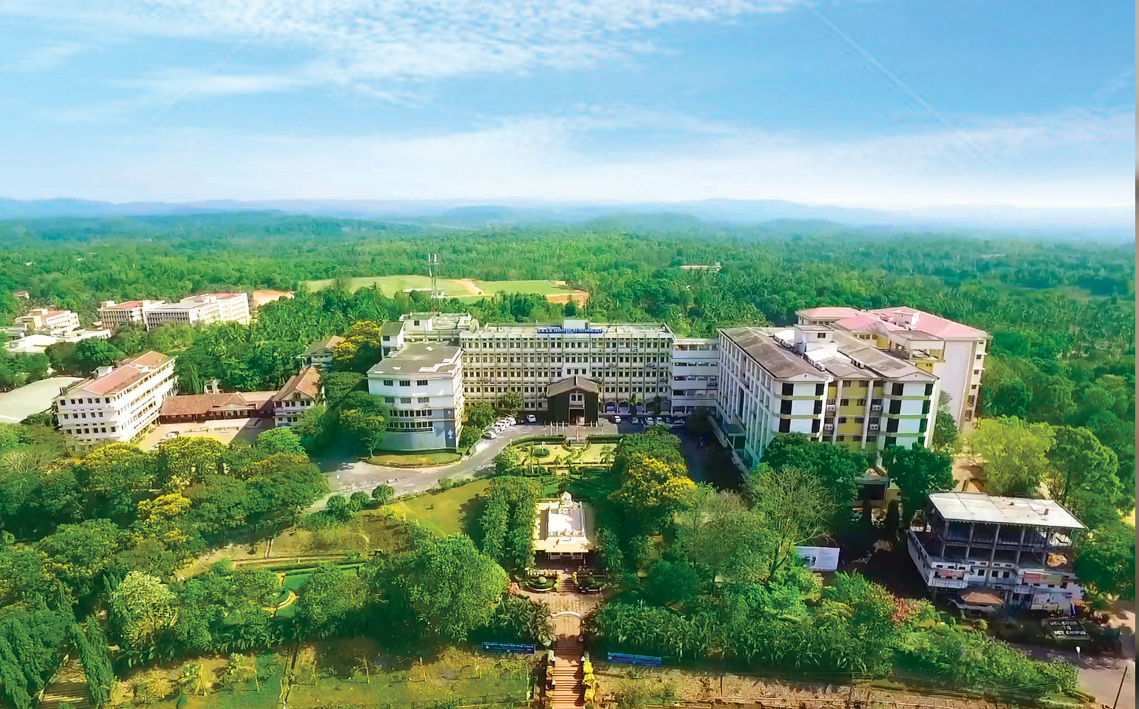

Nitte, Karkala, Udupi (Dist.) Karnataka, India
Department of Information Science and Engineering

Slide 2
Machine Learning Based Lifecycle Intelligence System for Non-Biodegradable Automotive Materials
Team 53
Prajwal B T (NNM23IS128), Srinidhi D S (NNM23IS185), Swaroop Sathish Y (NNM23IS191), V K Ronith (NNM23IS203)
Guide: Pratheeksha Hegde N

Slide 3
AGENDA
Problem Statement
Objectives
Methodology
Implementation of the modules
Results and Discussion
References
Department of ISE
01

Slide 4
Problem Statement
There is a need for a machine-learning-based lifecycle intelligence system that classifies non-biodegradable automotive materials and predicts their environmental risk before mechanical processing (crushing/shredding).
Department of ISE
01

Slide 5
Objectives
Analyze lifecycle data of non-biodegradable automotive materials; perform data preprocessing and feature extraction
Implement supervised ML algorithms to classify materials into recyclable, reusable, or disposal categories
Evaluate and compare model performance
Identify the best-performing model and develop a simple lifecycle intelligence system supporting sustainable decision-making
Department of ISE

Slide 6
Methodology
Data Collection & Cleaning
1,800-row automotive material lifecycle dataset; 201 rows with missing values removed
Preprocessing & Encoding
Categorical features label-encoded; 70% train / 20% test / 10% validation stratified split
Model Training
Random Forest, XGBoost, SVM trained; hyperparameters tuned via GridSearchCV (3-fold CV)
Hybrid Ensemble
Stacking classifier: RF + XGBoost base learners → Logistic Regression meta-learner
Validation & Evaluation
Accuracy, Precision, Recall, F1, Log Loss tracked per model; XGBoost tracked per boosting round
Best Model Selection
Hybrid model selected — 57.8% test accuracy; next: fix class imbalance & overfitting
Department of ISE
01

Slide 7
Implementation of the modules
Module 1: Data Preprocessing
Removed rows with missing values (201 of 1,800 rows affected across 6 numeric columns)
Encoded categorical features (Material Name, Vehicle Type, Component, Hazardous Level, Material Condition, Corrosion Resistance) using Label Encoding
Module 2: Dataset Splitting
Stratified split into 70% training, 20% testing, and 10% validation sets
Module 3: Model Training
Random Forest and XGBoost tuned via GridSearchCV with 3-fold cross-validation
XGBoost trained with explicit learning-rate search and per-boosting-round (epoch) validation tracking
SVM (RBF kernel) trained as a baseline comparison model
Hybrid stacking ensemble: Random Forest + XGBoost as base learners, Logistic Regression as meta-learner
Module 4: Model Evaluation
Accuracy, Precision, Recall, F1-Score, Log Loss, and Confusion Matrix computed on validation and test sets
Department of ISE

Slide 8
Results and Discussion
Validation Results by Algorithm
Random Forest — Validation Accuracy: 50.6%
XGBoost — Validation Accuracy: 54.4%
SVM — Validation Accuracy: 43.1%
Hybrid (RF + XGBoost Stacked) — Validation Accuracy: 56.3% (best)
Best Model
Hybrid stacking ensemble selected as best model — 57.8% accuracy on the held-out test set
Discussion
The model under-predicts the minority “Dispose” class, frequently confusing it with “Recycle”
XGBoost's validation loss curve shows overfitting past ~20 boosting rounds
Next steps: class-weighting/resampling for imbalance, early stopping to address overfitting
Department of ISE

Slide 9
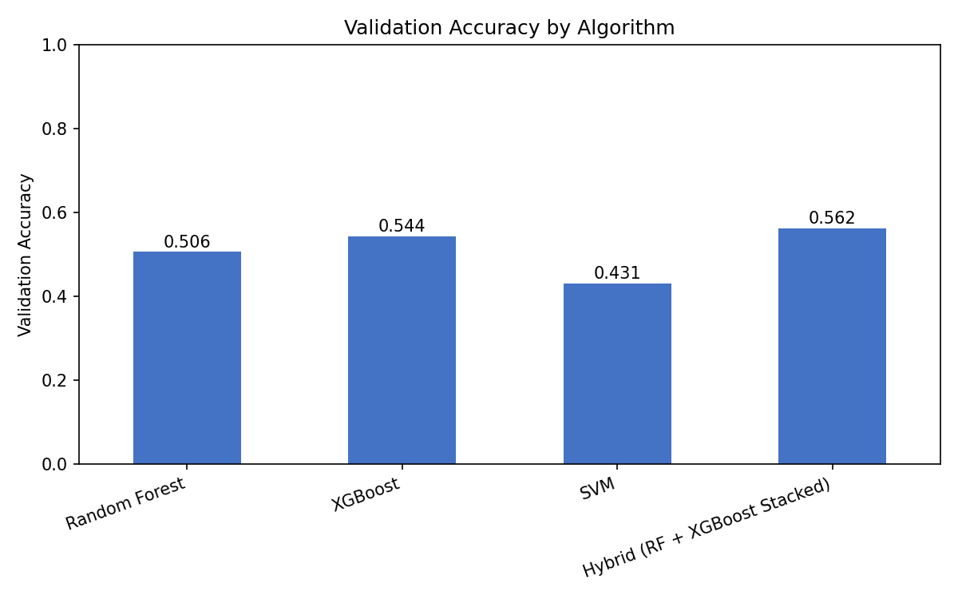
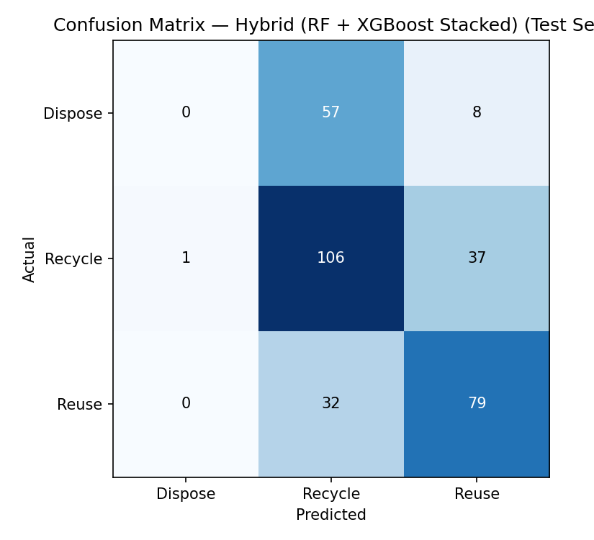
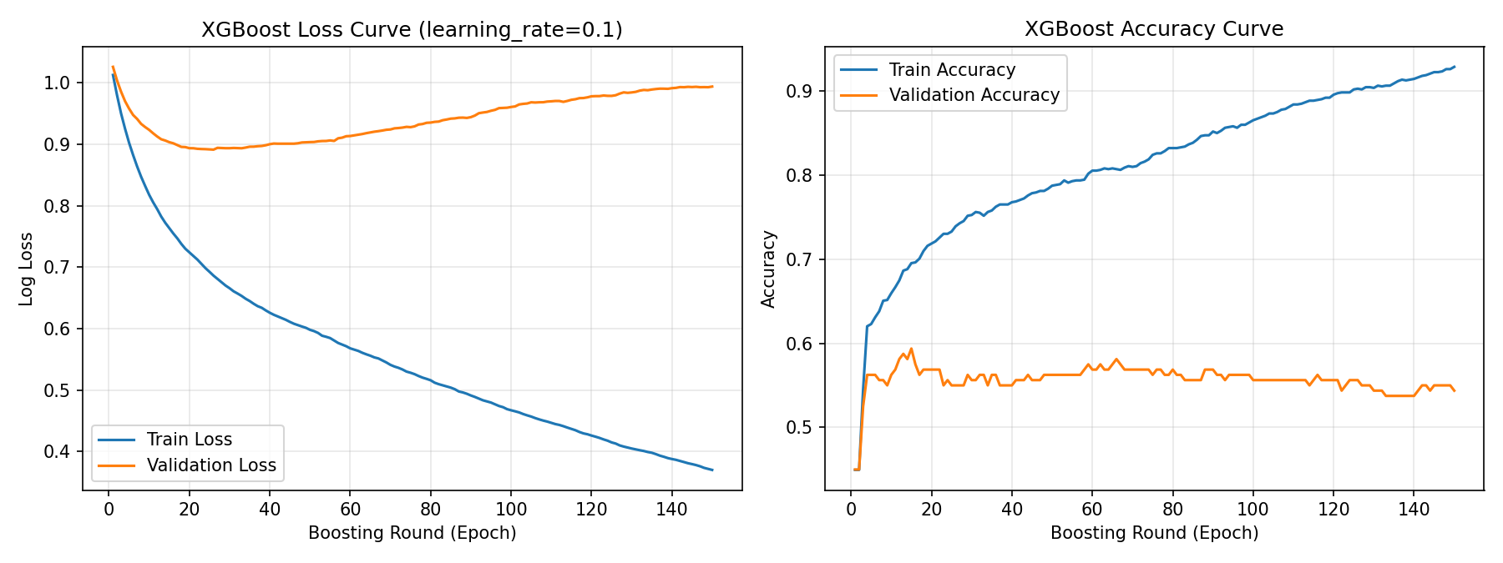
Results and Discussion (contd.)
Department of ISE
01

Slide 10
References
Core References (Synopsis)
  [1] R. Kumar and S. Patel, “Automotive composite materials and environmental impact,” Journal of Sustainable Engineering, vol. 12, no. 3, pp. 45–53, Mar. 2021
  [2] A. Sharma and P. Verma, “Machine learning approaches for material classification,” International Journal of Computer Applications, vol. 180, no. 25, pp. 12–18, Jul. 2020
  [3] International Energy Agency, “End-of-life vehicle management,” IEA. [Online]. Available: https://www.iea.org. [Accessed: Jan. 2026]
Objective-Wise Supporting References (Literature Review)
  [4] Obj 1 (Data preprocessing & feature extraction): Rajan, K. (2015) Materials informatics: Data-driven materials science. Annual Review of Materials Research, 45, pp. 153–169
  [5] Obj 2 (ML classification of materials): Abdallah, M., et al. (2019) Waste classification using machine learning techniques. Waste Management
  [6] Obj 3 (Model evaluation): Breiman, L. (2001) Random forests. Machine Learning, 45(1), pp. 5–32
  [7] Obj 4 (Lifecycle intelligence & sustainable decision-making): Guinée, J.B. (2002) Handbook on life cycle assessment. Dordrecht: Kluwer Academic Publishers
Department of ISE

Slide 11
THANK YOU
Department of ISE
39

