Slide 1
Faceted Recommendation for Biomedical Scientific Articles
Information Retrieval Term Project
Animesh Mukherjee
Pawan Goyal
Mayank Singh
Project Id 15 Group Id: 25 | Tushar Gupta(13CH30023) Lovekesh Garg(13CS30020) Srinidhi Goud(13EC10042) Suraj Kumar(13CS10051) Kushal Gaikwad(13CS30012) Shubham Soni(13CS30032) Akash Borkar(13CS10005)

Slide 2
Outline
Aim of the project
Dataset
Recommendation Method
Experimental Results

Slide 3
Aim of the project:
A smart recommendation engine to be able to organize the recommended papers for the query paper into multiple facets:
Introduction
Alternative Approaches
Methods
Conclusion

Slide 4
Dataset:
Source: PUBMED Link: http://www.ncbi.nlm.nih.gov/pubmed
Consists of Bio medical research papers in perfectly validated .nxml files
1,13,073 research paper files
Parsed and converted to .txt format using Python’s BeautifulSoup library
The text file contains
Citer id | Cited id | Citation Context | Section

Slide 5
Parameters used for recommendation:
Citation network was built using the citerId citedId relationship. These ids are unique to each document
Cosine Similarity
Each NXML document was converted to TXT format using XAPIAN module of Python
The files are named PMID.txt, where PMID is each document’s unique id
These documents were used to compute cosine similarity
Rank aggregation
Cosine similarity and Random Walk rankings were aggregated to obtain the final ranking for each facet

Slide 6
Initial Observations
Introduction | Alternative Approaches | Methods | Conclusion | Total
306747 | 99565 | 538707` | 420336 | 1365355
22.46% | 7.3% | 39.44%` | 30.77% | 100%

Slide 7
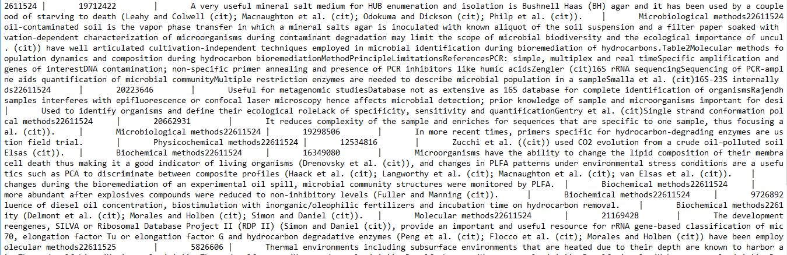
Data set

Slide 8
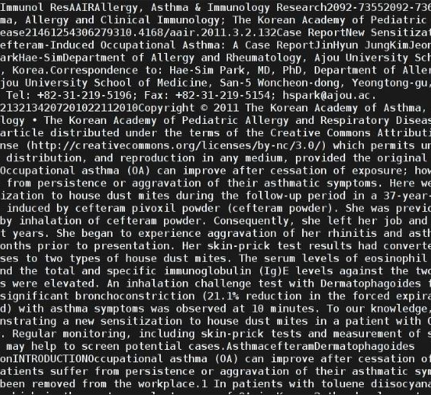
Sample text file

Slide 9
Flat Recommendation
This system was implemented using Python module XAPIAN
The system initially indexes all the Text files
Then a XAPIAN Database is created which can be
A function is defined to parse our query using the generated indices and XAPIAN’s query semantics and finally return results from the database

Slide 10
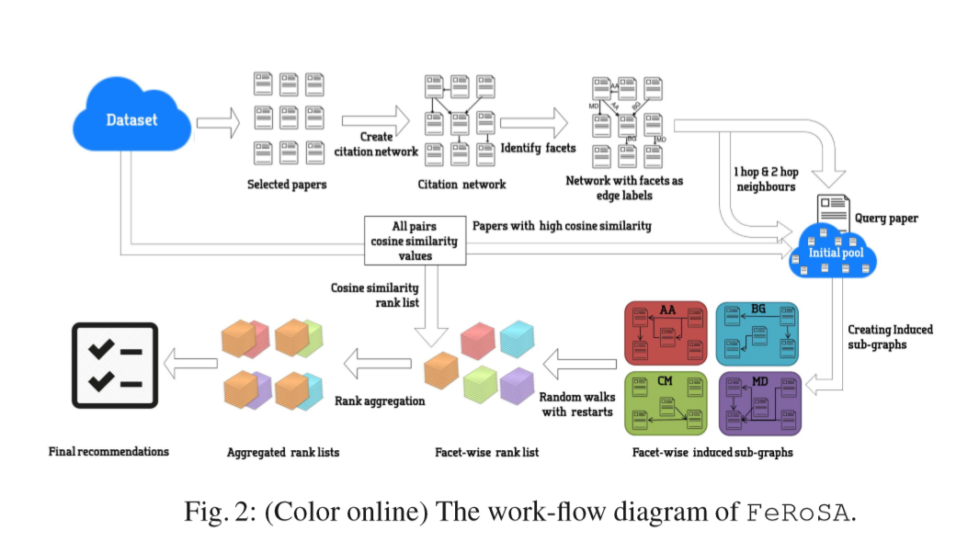
Recommendation Method:

Slide 11
Implementation
The citation network
An edge may be tagged with multiple facets, if a paper cites another paper in multiple sections
Directed graph, G = (V, E)
V = set of papers
E = set of facets
P
IN,AA
R
CN, MD
Q
S

Slide 12
The Induced subgraph
For each query paper, we consider
1- hop and 2-hop neighbors
Create Induce subgraph for each facet individually
P
IN,AA
P
AA
R
R
MD,CN
AA
Q
S
S

Slide 13

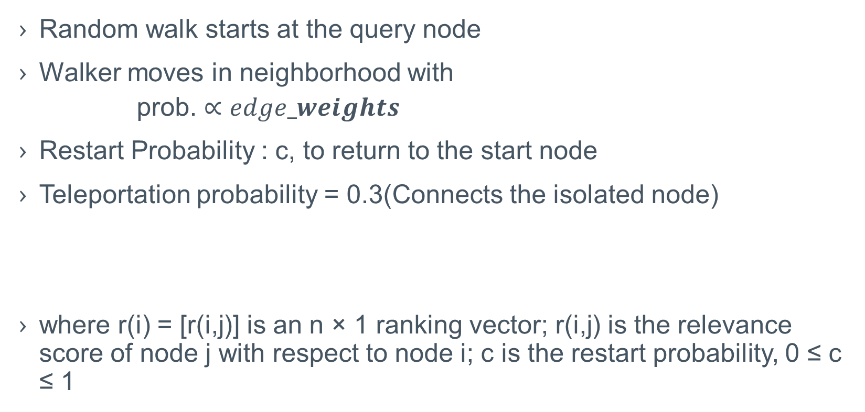
Random Walk with Restarts(RWR)
Random walk starts at the query node
Walker moves in neighborhood with
prob. $∝edge_weights$
Restart Probability : c, to return to the start node
Teleportation probability = 0.3(Connects the isolated node)
where r(i) = [r(i,j)] is an n × 1 ranking vector; r(i,j) is the relevance score of node j with respect to node i; c is the restart probability, 0 ≤ c ≤ 1

Slide 14
Definitions
r[nx1]: ranking vector
e[nx1]: restart vector
c: restart probability
A[nxn]: weighted adjacency matrix, each row normalized with total row degree
Initial values:
c=0.4
e[i]: 1/N ,all others zero, r[i]: random values(0,1)
where i:query node, j: nodes to compute relevant score

Slide 15
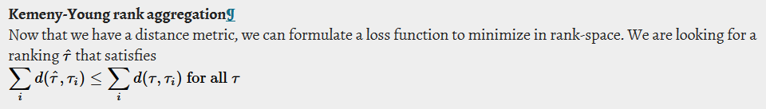
Rank Aggregation
Two rank lists for each facet; RWR, Cosine Similarity
Four rank lists, one for each facet
One rank list of cosine similarity
Rank aggregation of facet ranks and cosine ranks were performed on each facet to produce a single rank list
KendallTau method used to obtain distance between two lists .
The algorithm returns final aggregated list minimising the tau score

Slide 16
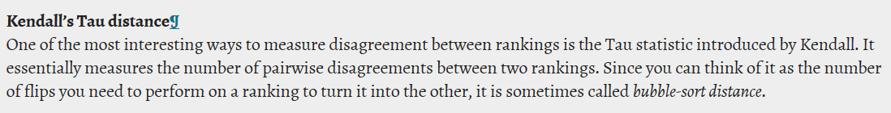
Kendall Tau score

Slide 17
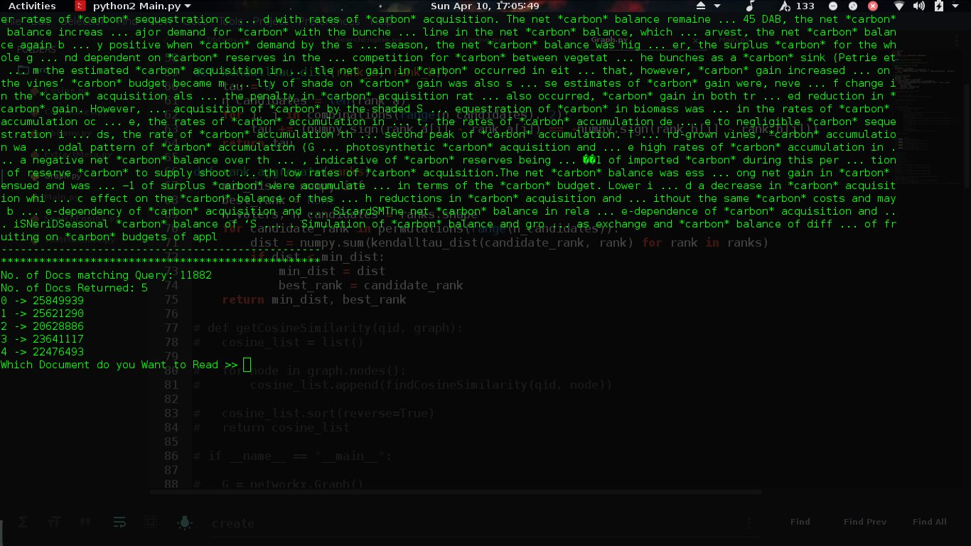
Experimental results

Slide 18
