Slide 1
ExpenseCodeModule
Group 3
Mentor: Vaishali Srivastava

Slide 2

Objectives
Project Understanding
Approach Used
Project Execution
Modules
Learning
Best Practices
Demo Code and Walkthrough
Q&A

Slide 3
Project Understanding
ExpenseCodeModule is one of the microservices in Expense Management System
Here the user can Create, Read, Update, Delete (CRUD)& View all the expense details.
Create: Insert the values into database table with appropriate validations.
Read: Based on existing expense code, expense details are displayed.
Update: Based on existing expense code, update the respective fields.
Delete: Based on existing expense code, delete the record.
View all: Displays all the expense details.

Slide 4
Approach Used
Front End & Web Components:
Postman
Business Logic Components and Services :
Java Beans, Spring, REST Web Service
Application Servers :
Eureka
Databases:
MongoDB

Slide 5
Project Execution
We’ll start the main server.
We’ll start the expense-module(MS).
We’ll send all the CRUD requests through the controller.
By the help of Postman, we will perform all the CRUD operations.
Here the postman acts as the UI.
Postman interacts with the database and saves the changes made.

Slide 6
Module
Create: We insert the following expense details expenseCode, expenseType, expenseDescription according to their validations.
Read: To view the details of any expense type, expenseCode is required.
ViewAll: All existing details in the database is displayed.
Update: Existing expense details can be changed using expenseCode.
Delete: Expense details can be removes based on existing expenseCode.

Slide 7
Learning
@SpringBootApplication: Annotation is equivalent to using @Configuration, @EnableAutoConfiguration and @ComponentScan .
@RestController: Spring RestController annotation is used to create RESTful web services using Spring MVC.
@RequestMapping: This annotation maps HTTP requests to handler methods of MVC and REST controllers.
@Autowired: Annotation is used to auto wire bean on the setter method, constructor or a field.
@Repository: Indicates that class is connected to database.

Slide 8
Learning
@ControllerAdvice: Used for global error handling in the Spring MVC application.
@ExceptionHandler: Used to annotate the method(s) in the controller class for handling the exceptions raised during the execution of the controller methods.
@ComponentScan: This is used with the @Configuration annotation to tell Spring the packages to scan for annotated components.
@Service: Used for automatic bean detection using classpath scan in spring framework.

Slide 9
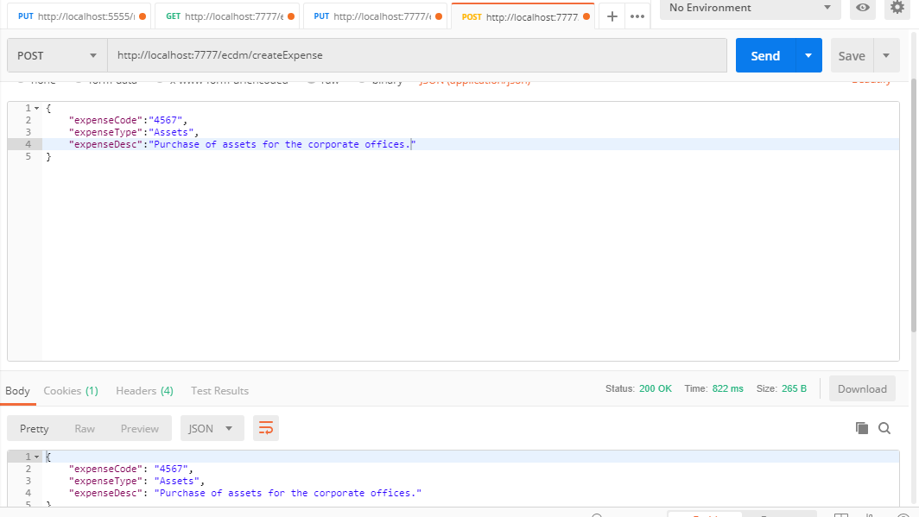
Best Practices
Create:

Slide 10
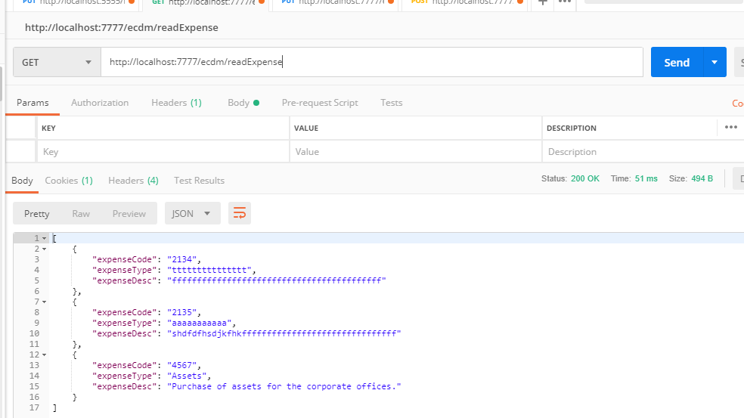
Read:

Slide 11
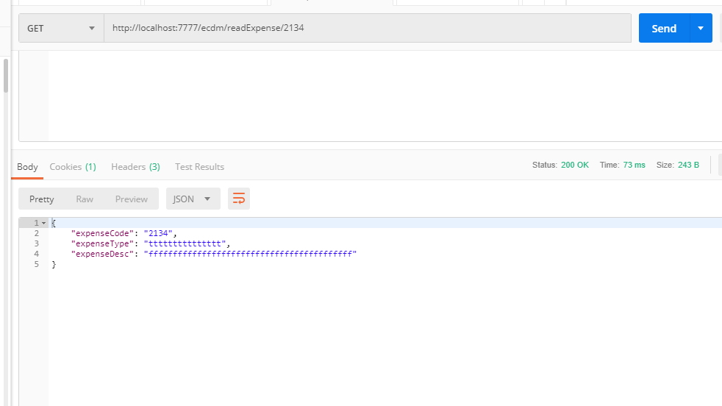
ViewById:

Slide 12
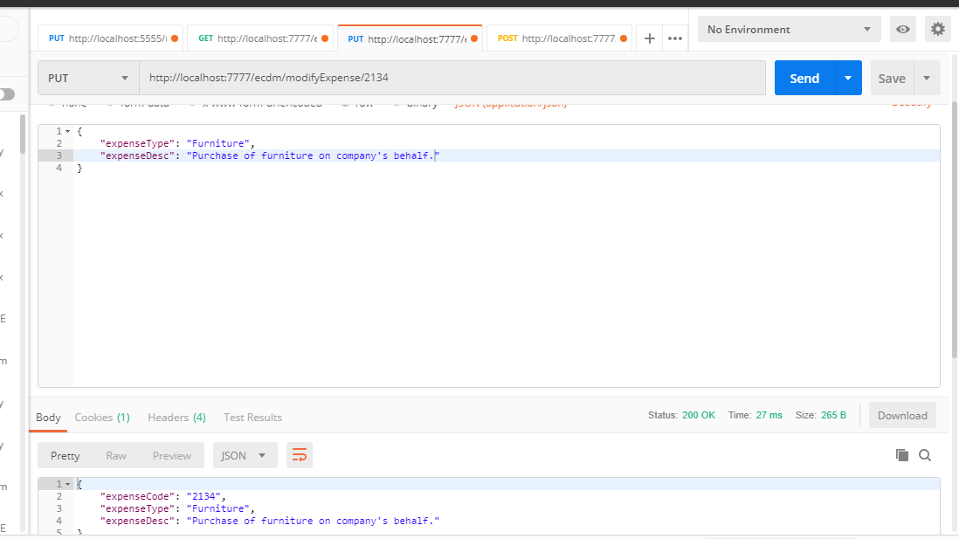
Update:

Slide 13
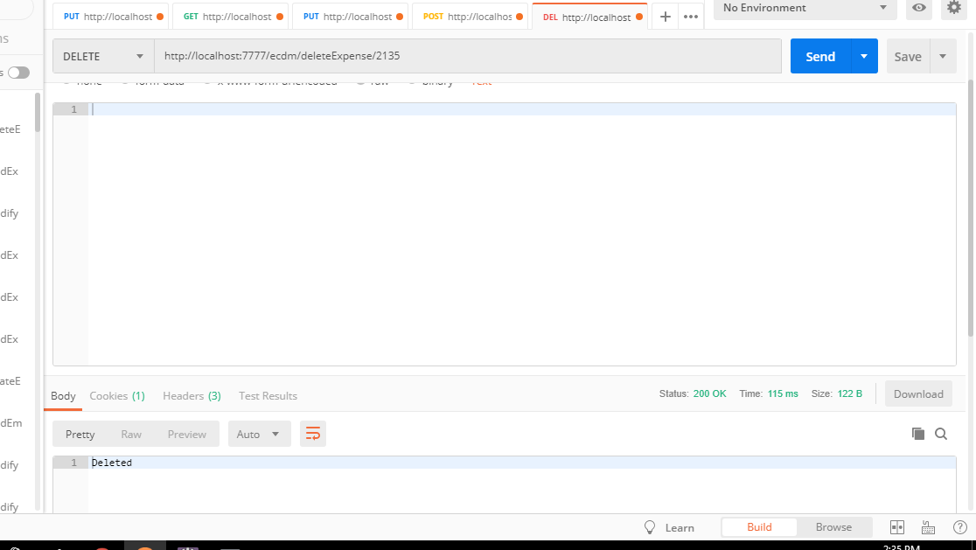
Delete:

Slide 14
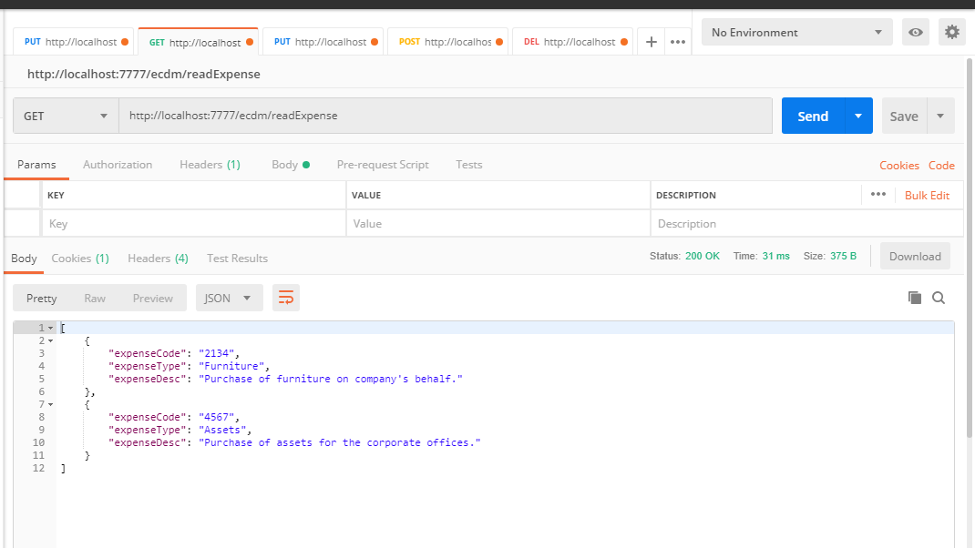
ViewAll:

Slide 15
Demo and Code Walkthrough

Slide 16
THANK YOU

