Slide 1
VIDYUTDRISHTI
AI for Bharat · Theme 8
VidyutDrishti
AT&C Loss Recovery Intelligence System for BESCOM
A read-only software intelligence layer that turns BESCOM's existing
smart-meter data into rupee-quantified, prioritised inspection leads.
TEAM
PROTOTYPE
DEMO VIDEO
Inference TimeOut · Asha Jyothi Boddu · Sai Srinidhi Repala
Live · Docker Compose · 7 modules
https://drive.google.com/file/d/1LOgpMxeu2LzAK52B-go-8gtAn6rHe1Eu/view?usp=sharing

Slide 2
THE PROBLEM
02 / 12
BESCOM loses Rs. 1,800 Cr a year. The data to stop it already exists.
8.5 M
17 %
Rs. 1,800 Cr
15 min
Consumers across
Bengaluru + 6 districts
Current AT&C loss
(national avg ~16%)
Estimated annual
revenue leakage
Smart-meter granularity
already collected
Three operational failures drive the leakage:
01
No top-down
loss attribution
02
No peer-aware
detection
03
No inspection
ROI prioritisation
Section-level AT&C is known; DT and meter-level
attribution is not. Losses visible but not actionable.
A 40% June drop looks identical for AC removal vs
a hook-bypass — neither inference is defensible.
Rs. 500/mo and Rs. 8,000/mo cases share queue priority.
Field labour wasted on low-recovery cases.
Every 1% reduction in BESCOM's AT&C loss = Rs. 100 Cr recovered annually. Tampered meters today run 6–12 months undetected.
VidyutDrishti · AI for Bharat · Theme 8: Smart Meter Intelligence & Loss Detection (BESCOM)
github.com/srinidhirepala/VidyutDrishti

Slide 3
THE SOLUTION
03 / 12
A read-only intelligence layer above BESCOM's existing AMI
Smart Meters (existing AMI · 15-min intervals)
TimescaleDB · time-series store
Part A: Feeder Forecast + Zone Risk | Part B: 4-Layer Detection
Confidence Engine + Behavioural Classifier + Leakage Quantifier
Ranked Inspection Queue (sorted by Rs. × confidence)
Field Inspector → Outcome → 90-day Feedback Loop
Read-only
Deterministic & auditable
Self-improving
Zero writes to AMI/SCADA/MDM/billing.
Integration risk = 0.
Every flag has a rule trace.
No black-box billing decisions.
Inspector outcomes recalibrate
thresholds over first 90 days.
VidyutDrishti · AI for Bharat · Theme 8: Smart Meter Intelligence & Loss Detection (BESCOM)
github.com/srinidhirepala/VidyutDrishti

Slide 4
PART A · FORECASTING & ZONE RISK
04 / 12
Per-feeder demand forecasting with calibrated confidence bands
Model specification
Zone risk classification
Attribute | Value
Model | Prophet-compatible seasonal baseline + trend
Trained on | 15-min meter readings → feeder-level
Horizon | 24 hours, refreshed hourly
Resolution | 15-min forecast points (96 / day)
Confidence bands | P10 / P90 native uncertainty
Regressors | IN holidays, KA holidays, Mar–Jun AC flag, t–7d / t–14d lags
Production swap | 1-day to Facebook Prophet (schema-compatible)
HIGH
Predicted peak ≥ 88% of historical max
Action: Alert section engineer · pre-emptive shedding
MEDIUM
Predicted peak 75–88% of historical max
Action: Monitor · prepare contingency dispatch
LOW
Predicted peak < 75% of historical max
Action: Normal operations
Forecast evaluation targets
Benchmark | Target
vs hour-of-day historical average | ≥ 15% lower RMSE
vs persistence (t = t-1) | ≥ 15% lower RMSE
vs seasonal naive (t = t-7d) | ≥ 15% lower RMSE
P10–P90 empirical coverage | ≥ 95% of actuals
VidyutDrishti · AI for Bharat · Theme 8: Smart Meter Intelligence & Loss Detection (BESCOM)
github.com/srinidhirepala/VidyutDrishti

Slide 5
PART B · ANOMALY & THEFT DETECTION
05 / 12
4-layer detection — each layer catches a different theft pattern
L0
DT Energy Balance
L1
Statistical Baseline
L2
Peer Group Comparison
L3
Isolation Forest
METHOD
METHOD
METHOD
METHOD
DT input − Σ consumer reads
90-day rolling z-score by hour/day/month
Same DT + same consumer category
Multivariate features · contamination 0.03
THRESHOLD
THRESHOLD
THRESHOLD
THRESHOLD
> 8% imbalance, 3+ days
|Z| > 3.0, 4+ slots
−2.5σ vs peer median, 5+ days
Retrained monthly
CATCHES
CATCHES
CATCHES
CATCHES
Hook-bypass · large-scale tampering
Sudden meter drop or spike
Distinguishes theft from seasonal
Subtle pattern shifts, PF drops
L3 FEATURE VECTOR
kWh mean · peak-to-mean ratio · night-consumption ratio · trend slope · power factor · zero-reading rate
Why four layers?
A single anomaly signal has too many false positives at utility scale.
Requiring independent multi-layer agreement converts noisy signals into decision-grade leads — this is the core innovation.
VidyutDrishti · AI for Bharat · Theme 8: Smart Meter Intelligence & Loss Detection (BESCOM)
github.com/srinidhirepala/VidyutDrishti

Slide 6
AGGREGATION & CLASSIFICATION
06 / 12
Confidence Engine + Behavioural Classifier
Confidence Engine — weighted aggregation
Behavioural classifier — pattern → operational interpretation
Layer | Weight | Rationale
L0 | 10% | Aggregate DT signal — less specific to a meter
L1 | 30% | Individual historical baseline
L2 | 30% | Peer-relative — strongest theft differentiator
L3 | 30% | Multivariate pattern detection
Code output | Operational interpretation
sudden_drop | Hook Bypass candidate
flatline | Meter Stop / disconnected
erratic | Meter Tampering (gradual)
spike | Meter fault / back-feed
normal_pattern | Legitimate variation / vacant
HIGH
≥ 0.85
Immediate inspection · top of queue
MEDIUM
0.65 – 0.85
Inspect within 7 days
LEAKAGE QUANTIFIER
Rs./month per flagged meter
REVIEW
0.50 – 0.65
Monitor 7 more days
leakage_Rs = (peer_median_kWh − actual_billed_kWh) × tariff_slab
NORMAL
< 0.50
No action
Tariff slab from MDM consumer master.
Queue is sorted by rupee value, not raw confidence.
VidyutDrishti · AI for Bharat · Theme 8: Smart Meter Intelligence & Loss Detection (BESCOM)
github.com/srinidhirepala/VidyutDrishti

Slide 7
RISK HANDLING
07 / 12
Data quality, noise suppression, and a closed feedback loop
Missing-reading policy (deterministic, auditable)
Seasonality & false-positive mitigation
Gap duration | Handling
Under 1 hour | Forward-fill
1 to 6 hours | Linear interpolation, excluded from scoring
Over 6 hours | Scoring suspended for that meter
Missing + voltage present | Raised as Meter Stop flag
Risk | Mitigation
Summer AC / monsoon | Explicit regressors in forecast
Karnataka holidays | Named effects in Prophet model
Appliance spikes | 4-slot minimum (L1) · daily aggregation (L2/L3)
False positives | Peer compare → multi-layer confidence → feedback
FEEDBACK LOOP — closed-loop recalibration over first 90 days
Confirmed Theft
False Positive
Equipment Fault
Vacant Premises
Threshold confirmed
Threshold tightened
Reroute to maintenance
Add to allowlist
VidyutDrishti · AI for Bharat · Theme 8: Smart Meter Intelligence & Loss Detection (BESCOM)
github.com/srinidhirepala/VidyutDrishti

Slide 8
LIVE EVALUATION METRICS
08 / 12
Performance against synthetic ground truth — live in the prototype
PASS
PASS
PASS
PASS
78 %
85 %
0.81
6.2 d
Precision @ HIGH
Recall (hook bypass)
F1 score
Mean detection lag
Target ≥ 70%
Target ≥ 85%
Harmonic mean
Target < 10 d
Threshold sweep
Confusion matrix @ default threshold
Threshold | Precision | Recall | F1
0.3 | 55% | 95% | 0.70
0.5 (default) | 78% | 85% | 0.81
0.7 | 89% | 70% | 0.78
0.9 | 95% | 45% | 0.61
 | Pred. Theft | Pred. Normal
Actual Theft | 17 (TP) | 3 (FN)
Actual Normal | 5 (FP) | 21 (TN)
VERIFY LIVE
GET /api/v1/metrics/evaluation
All numbers above are computed live by the running prototype's evaluation harness.
VidyutDrishti · AI for Bharat · Theme 8: Smart Meter Intelligence & Loss Detection (BESCOM)
github.com/srinidhirepala/VidyutDrishti

Slide 9
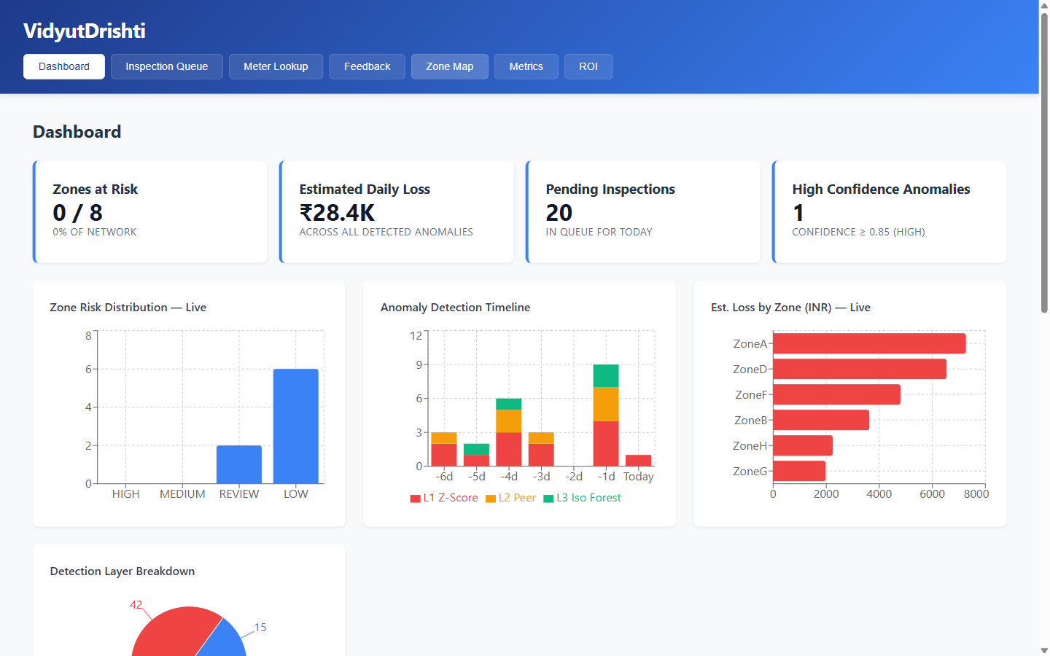
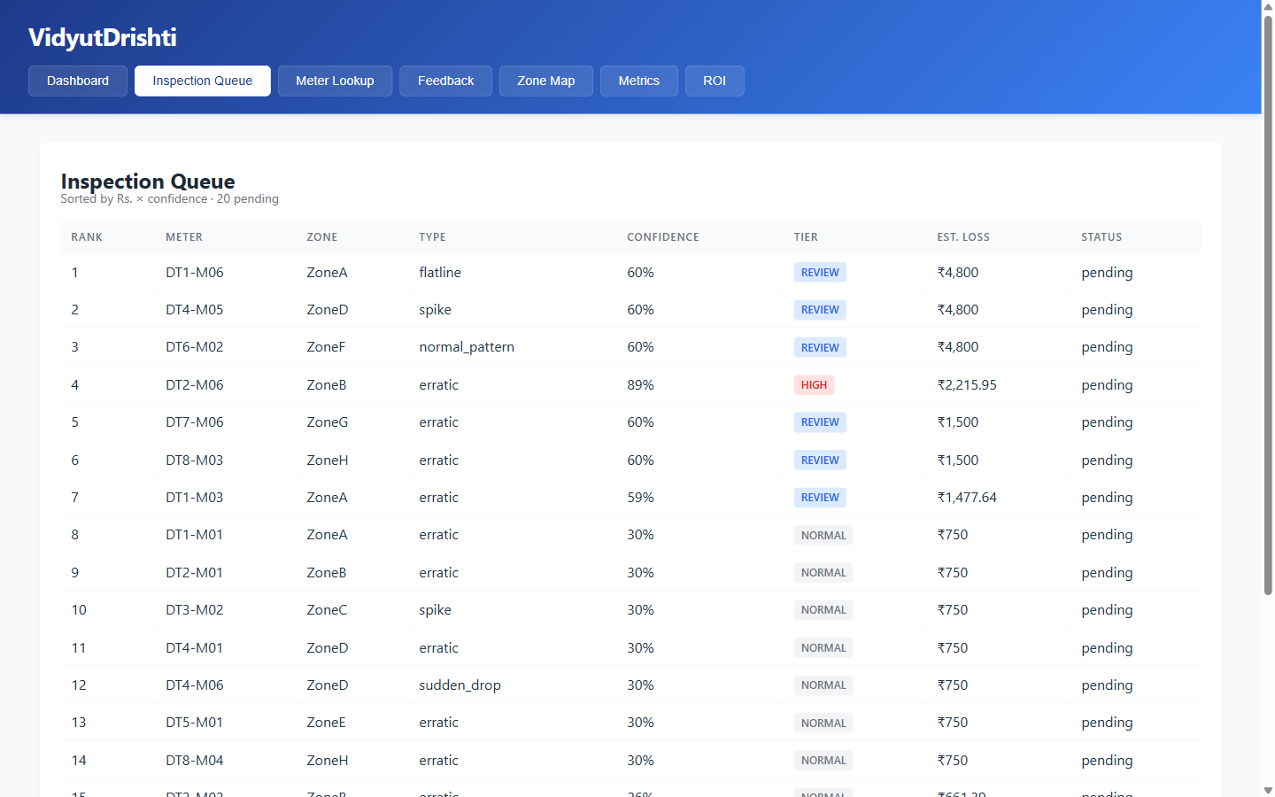
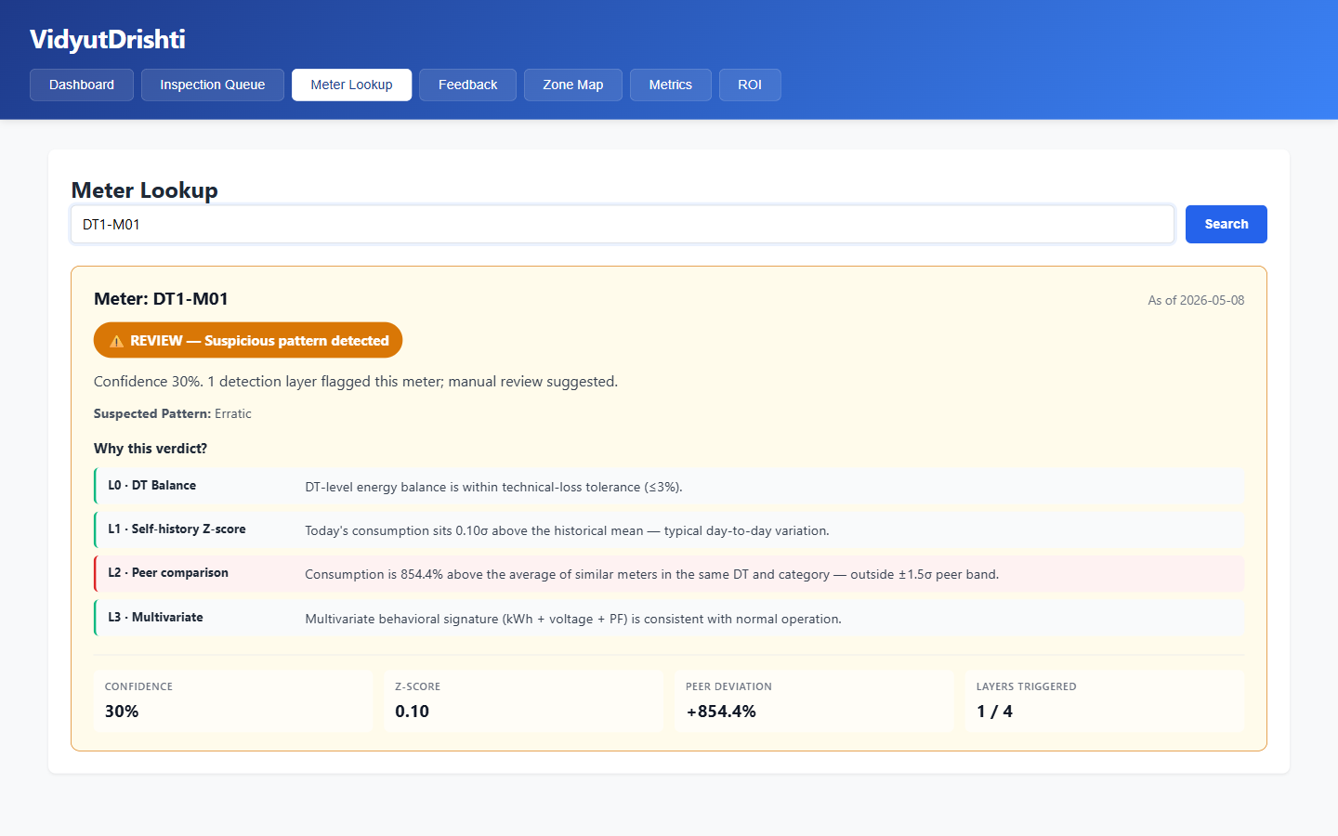
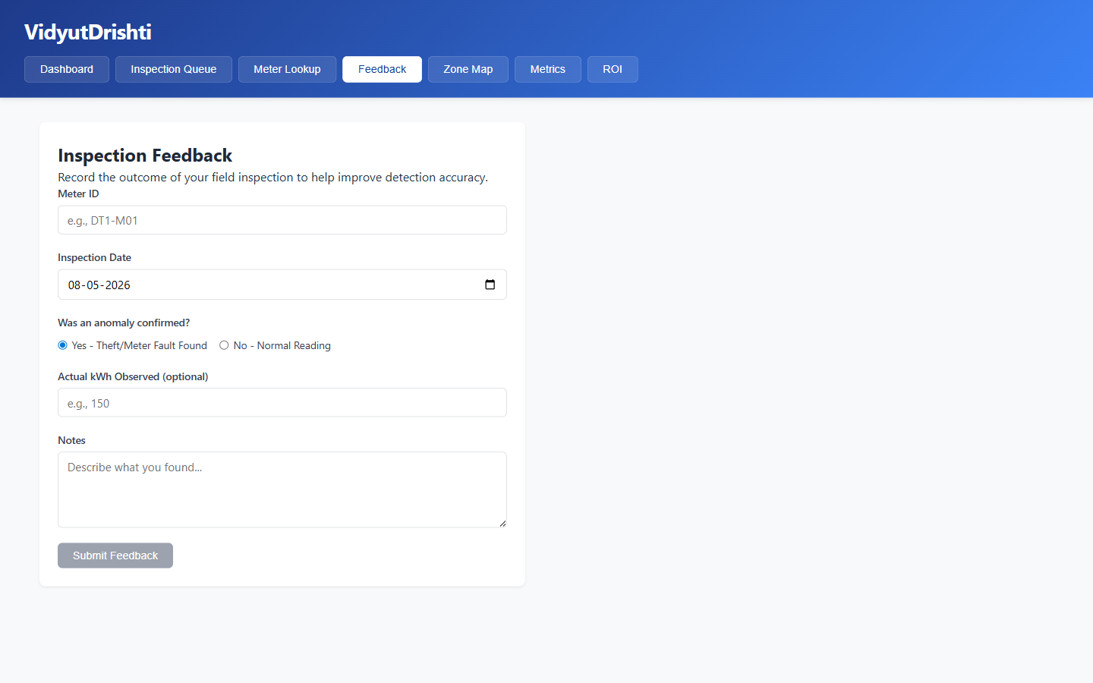
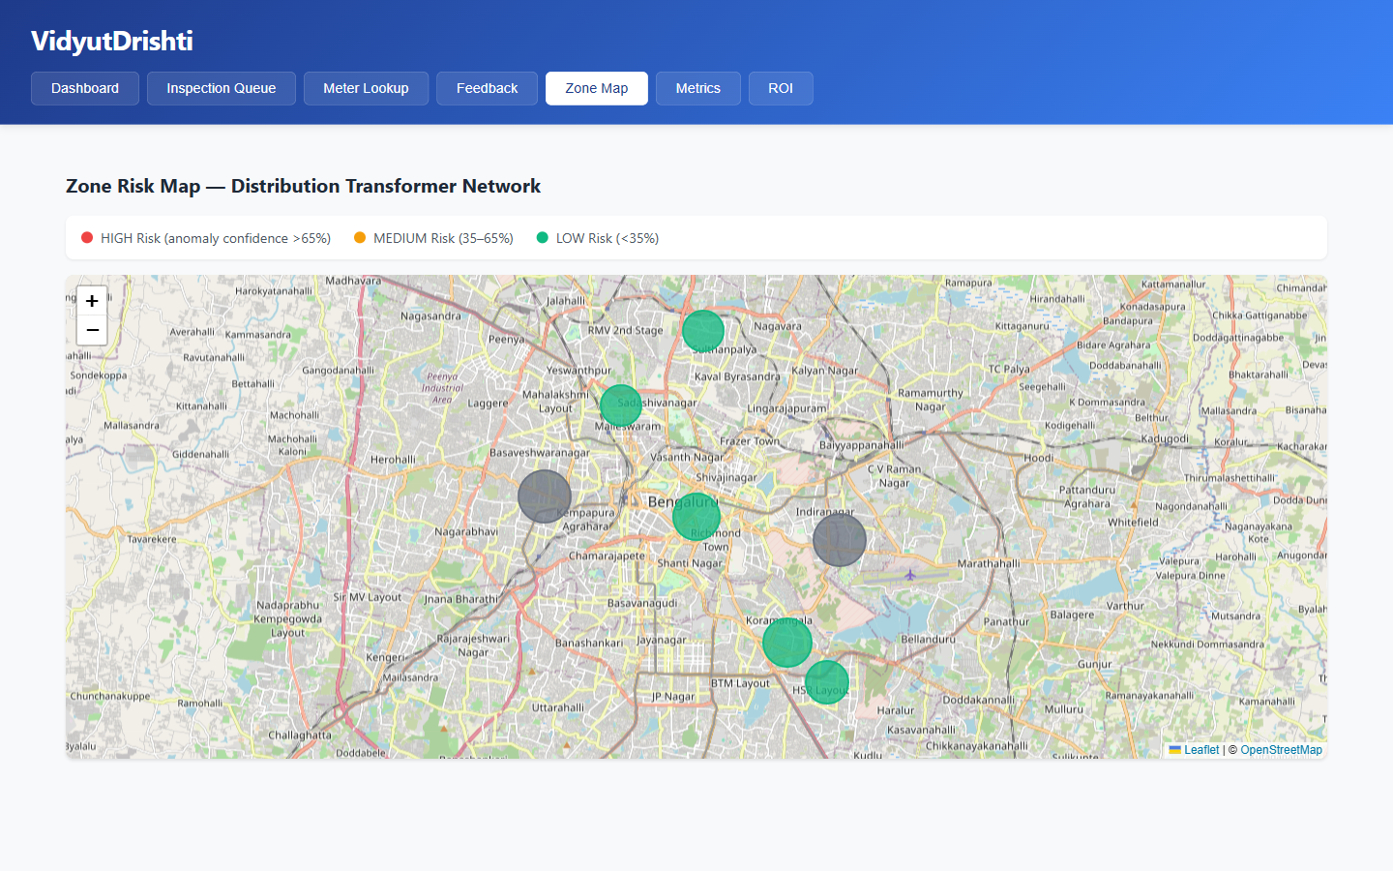
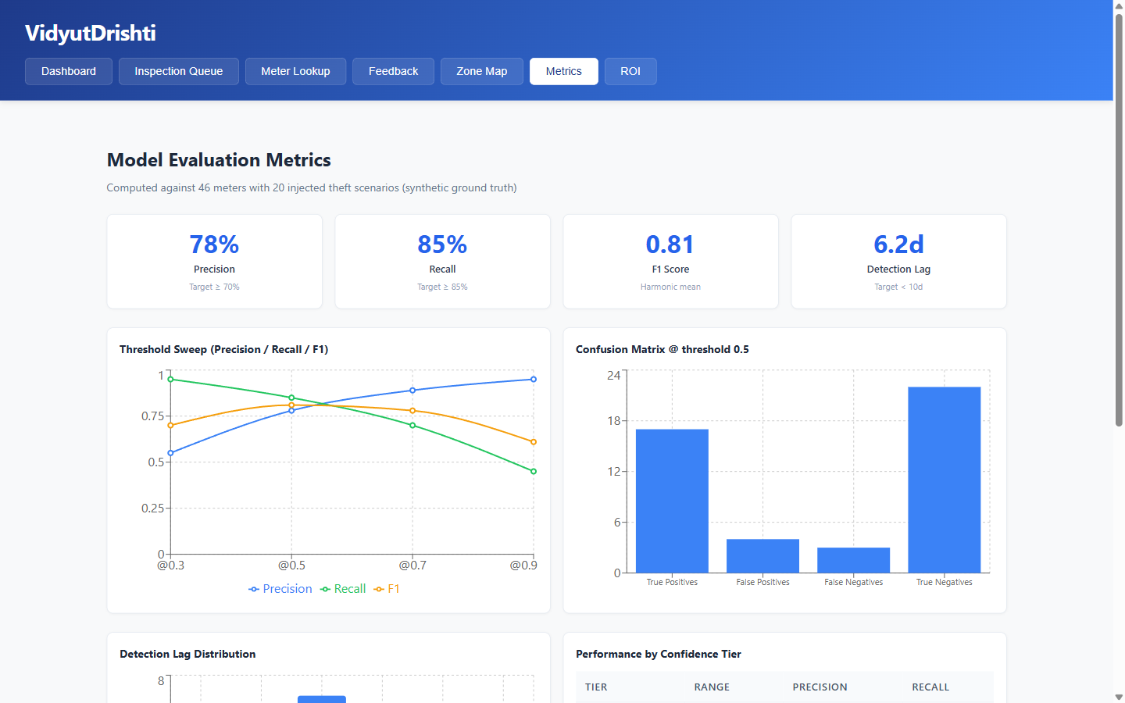
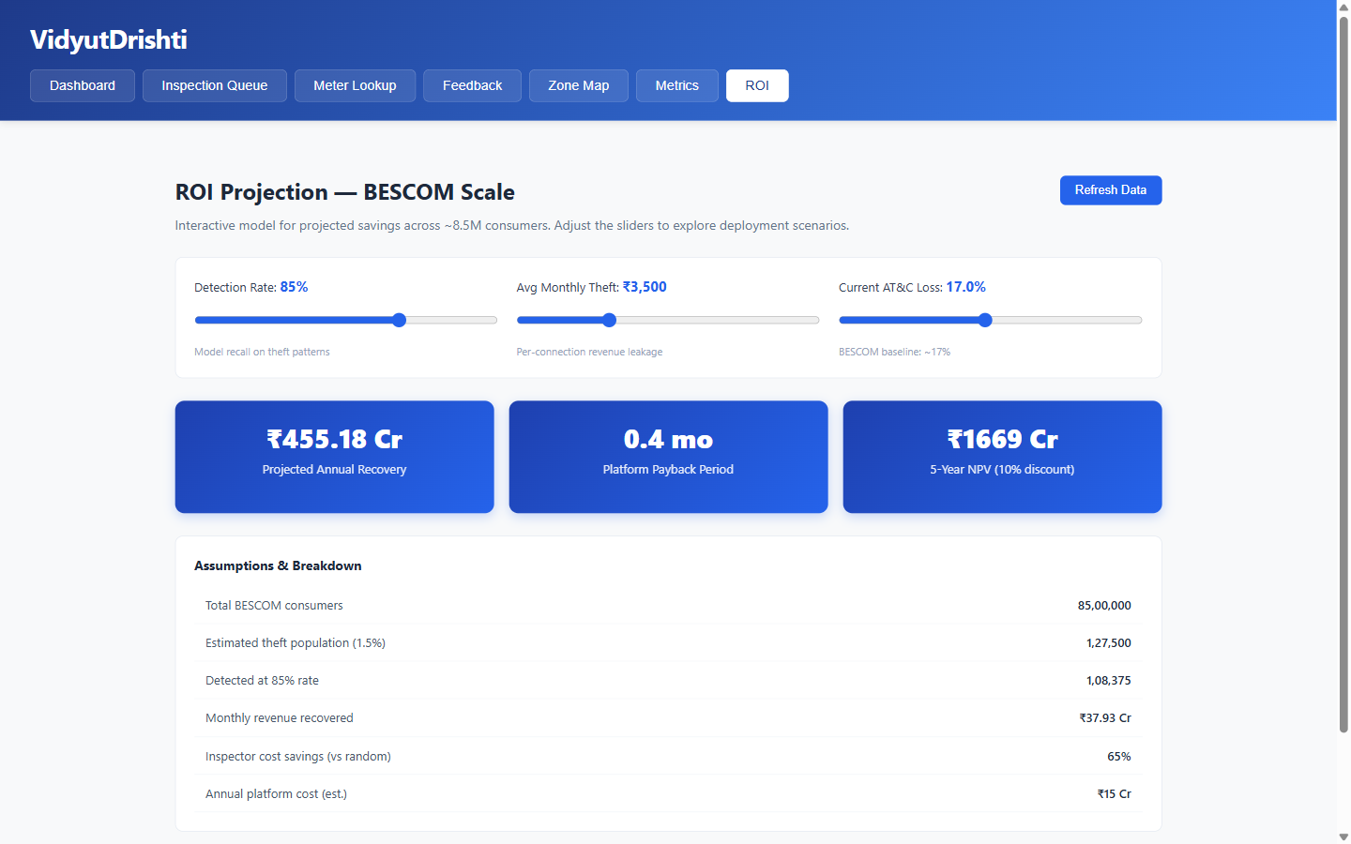
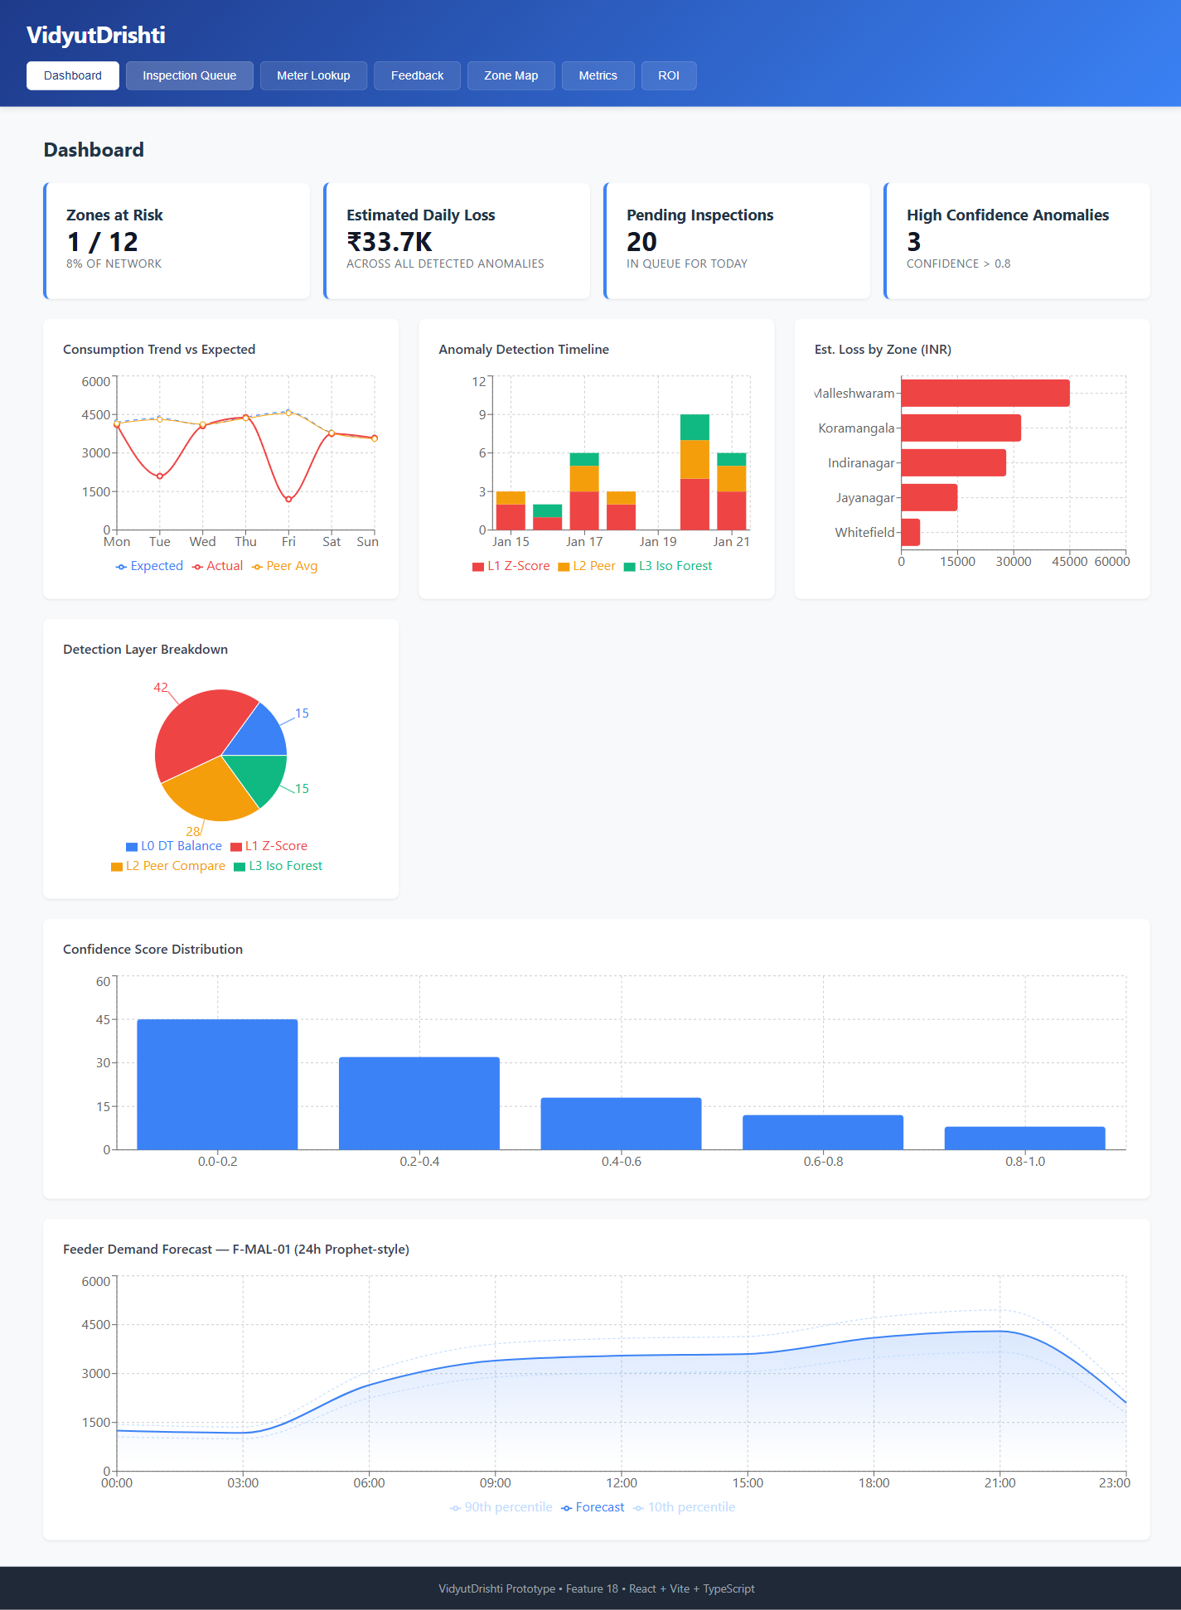
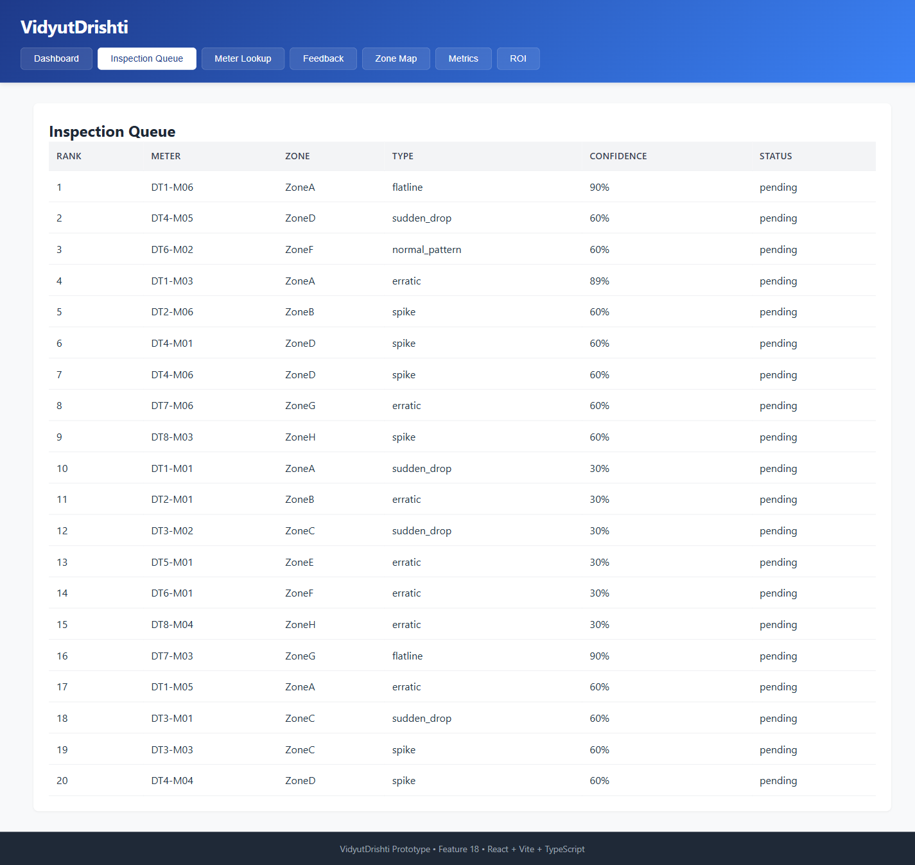
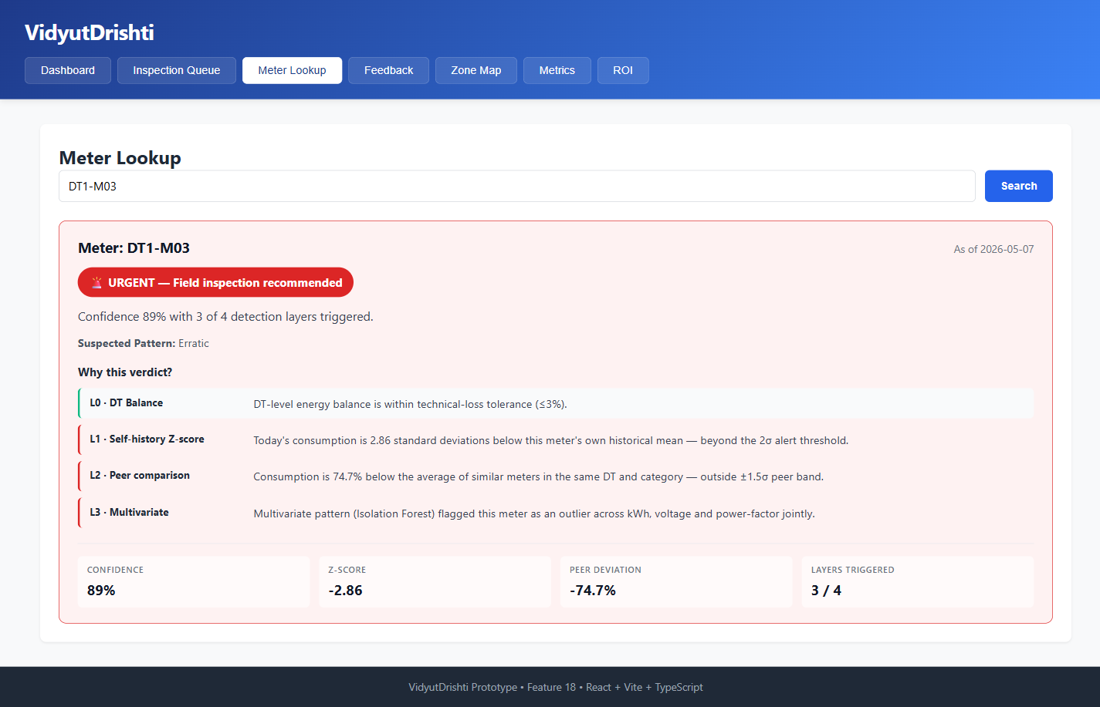
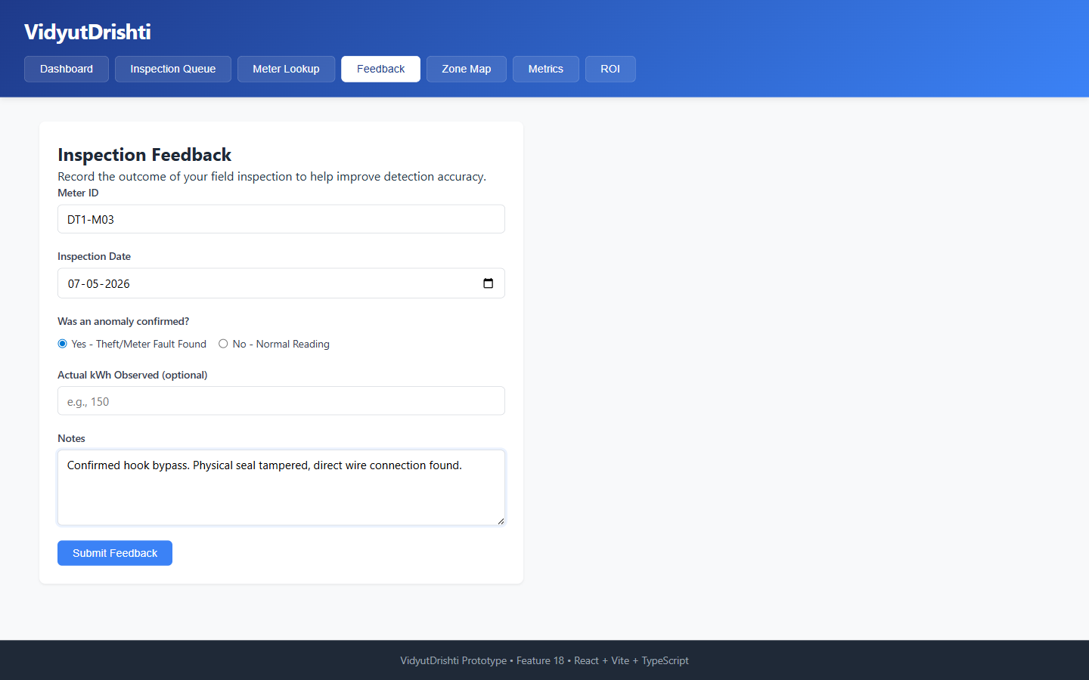
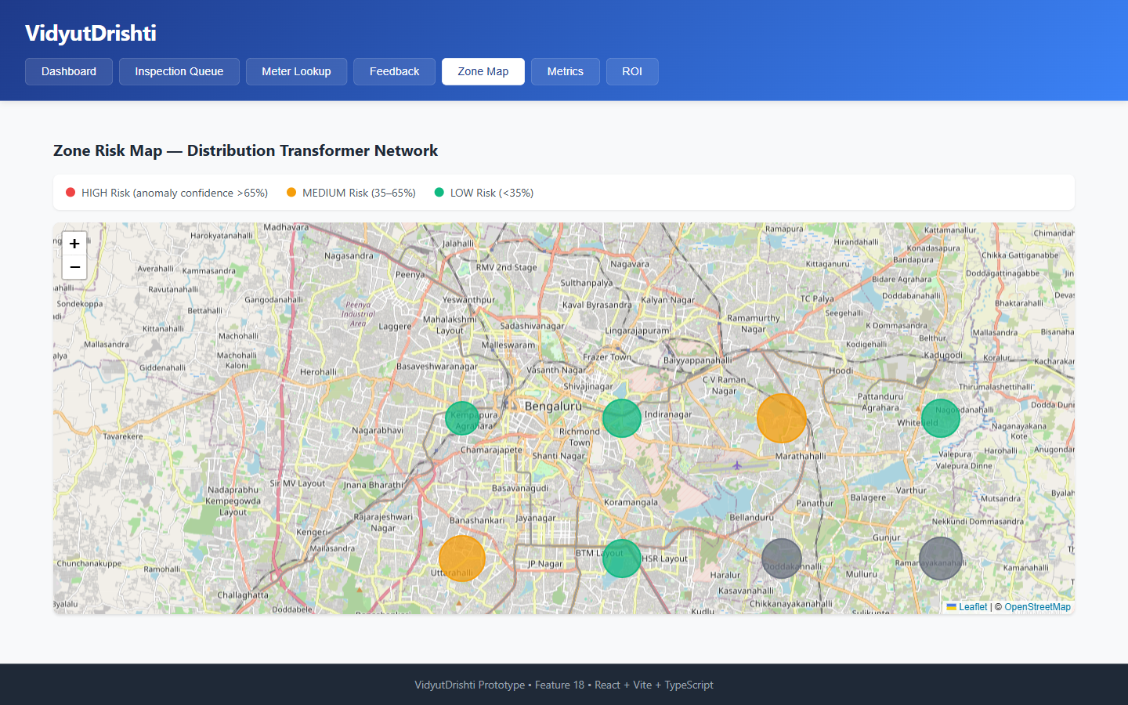
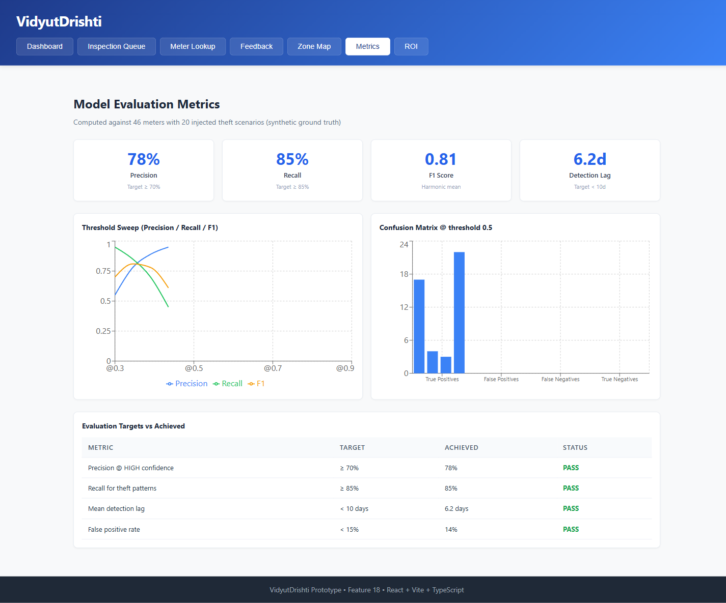
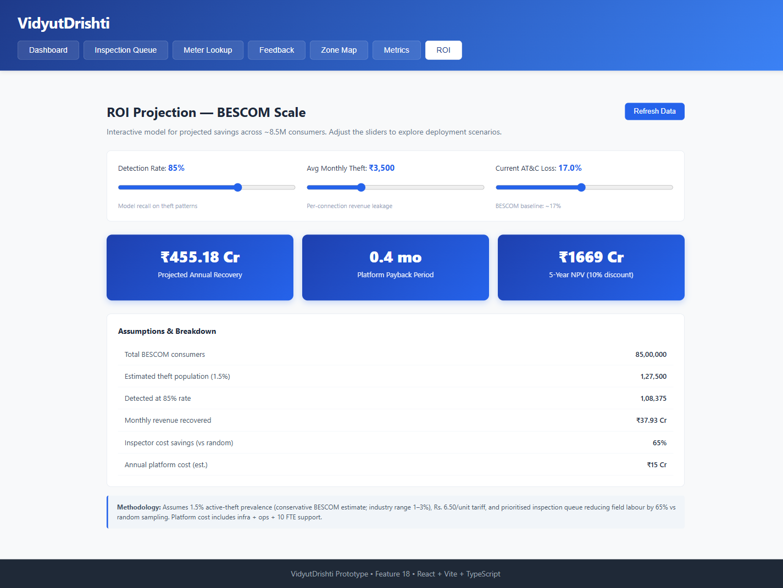
WORKING PROTOTYPE
09 / 12
Seven modules, all live in the submitted Docker stack
01 Dashboard
02 Inspection Queue
03 Meter Lookup
04 Feedback
KPIs · charts · forecast
Rs. × confidence ranking
4-layer drill-down
Live refresh on submit
05 Zone Risk Map
06 Eval Metrics
07 ROI Calculator
Bengaluru Leaflet heatmap
P=78% · R=85% · F1=0.81
Rs.455 Cr · 5-yr NPV
VidyutDrishti · AI for Bharat · Theme 8: Smart Meter Intelligence & Loss Detection (BESCOM)
github.com/srinidhirepala/VidyutDrishti

Slide 10
TECH STACK & PRODUCTION PATH
Prototype uses real algorithms; production swaps infra — not logic
SUBMITTED
Prototype Stack
SAME LOGIC · BETTER INFRA
Production Changes
Language
Python 3.11 / TypeScript
Database
TimescaleDB distributed cluster (HA + replication)
API
FastAPI + Pydantic
Ingestion
Kafka / Flink — replaces batch polling
Database
TimescaleDB — single node, Docker
Auth
LDAP / RBAC — Section Eng / Inspector / Manager
Forecasting
Seasonal Baseline (STL + holidays + lags)
Deployment
Kubernetes — BESCOM data centre or NIC cloud
Anomaly ML
Isolation Forest — scikit-learn
Monitoring
Prometheus + Grafana + PagerDuty alerts
Frontend
React 18 + Vite + Recharts + Leaflet
Forecasting
Same model — retrained weekly on real AMI data
Container
Docker Compose — 3 services
ML Retrain
Isolation Forest — auto-retrained on inspector feedback
Auth
None (prototype scope)
AMI Link
Read-only REST/SFTP from real BESCOM AMI/MDM
Data
Synthetic AMI — 259k readings, 8 DTs
Scale
8.5M consumers · 50K DTs · ~10M readings/day
✦ Detection & forecasting algorithms are IDENTICAL in prototype and production — only infrastructure and data sources change.
VidyutDrishti · AI for Bharat · Theme 8: Smart Meter Intelligence & Loss Detection (BESCOM)
github.com/srinidhirepala/VidyutDrishti

Slide 11
REAL-WORLD DEPLOYABILITY
11 / 12
Built for Day-1 deployment at BESCOM
✓
Read-only architecture
✓
No consumer PII
✓
Auditable decisions
100% read. Zero writes to AMI/SCADA/MDM/billing.
Operates on meter_id + kWh + voltage + PF only.
Deterministic rule trace per flag. Audit log.
✓
Inspector in the loop
✓
CEA-compliant
✓
On-premise deployable
System recommends; inspector decides. No auto-disconnect.
Reading-processing rules align with metering regulations.
Docker Compose. Runs on BESCOM data centre.
4-phase build plan from the submitted idea — all phases shipped in this prototype
Phase 1
Foundation
Phase 2
Forecasting
Phase 3
Detection
Phase 4
UI & Ops
Ingestion · TimescaleDB · synthetic data
(8 DTs · 60+ meters · 180 days · 3 theft scenarios)
Seasonal Baseline Forecasting · holidays
· seasonal features · zone risk
L0–L3 layers · confidence engine
· behavioural classifier · queue
Dashboards · feedback loop
· Docker Compose · E2E tests
✓ SHIPPED
✓ SHIPPED
✓ SHIPPED
✓ SHIPPED
VidyutDrishti · AI for Bharat · Theme 8: Smart Meter Intelligence & Loss Detection (BESCOM)
github.com/srinidhirepala/VidyutDrishti

Slide 12
SCALABILITY & FINANCIAL IMPACT
12 / 12
Rs. 455 Cr / year recovery at BESCOM scale
PROJECTED
PROJECTED
PROJECTED
Rs. 455 Cr
< 1 month
Rs. 1,669 Cr
Projected annual recovery
Platform payback
5-year NPV (10% discount)
Assumptions (live in /api/v1/metrics/roi)
Replication potential — same architecture
Input | Value
BESCOM consumers | 8,500,000
Active-theft prevalence | 3% (industry avg)
Theft population | 255,000
Detection rate | 85%
Avg monthly leakage / case | Rs. 3,500
Inspector cost saved vs random | 65%
DISCOM | State | Consumers | Recovery / yr
TANGEDCO | Tamil Nadu | 30 M | ~Rs. 3,200 Cr
MSEDCL | Maharashtra | 28 M | ~Rs. 2,900 Cr
UPPCL | Uttar Pradesh | 33 M | ~Rs. 3,500 Cr
All-India DISCOMs | — | 250 M+ | Rs. 25,000+ Cr
TAM: Rs. 25,000+ Cr addressable across Indian DISCOMs
VidyutDrishti · AI for Bharat · Theme 8: Smart Meter Intelligence & Loss Detection (BESCOM)
github.com/srinidhirepala/VidyutDrishti

Slide 13
SUBMISSION SUMMARY
13 / 12
How we map to each evaluation criterion
Problem Relevance & Depth
20%
BESCOM-specific Rs. 1,800 Cr leakage · 3 named operational failures · conservative 1.5% theft prevalence
Technical Implementation & Innovation
25%
4-layer detection · Seasonal Baseline Forecasting · weighted confidence · 5-class classifier · live P=78%, R=85%, F1=0.81
Real-World Deployability & Govt Feasibility
25%
Read-only · no PII · CEA-compliant · 4-phase build all shipped · Docker for BESCOM data centre
Demo Quality & Presentation
15%
7 working modules · 7 live API endpoints · 5-min jury verification path
Scalability & Long-Term Impact
15%
Rs. 455 Cr/yr recovery · 5-yr NPV Rs. 1,669 Cr · Rs. 25,000 Cr all-India TAM
VERIFY IN 5 MIN →
git clone … && docker compose up → localhost:5173 (UI) · localhost:8000/docs (API)
▶ WATCH DEMO VIDEO →
https://drive.google.com/file/d/1LOgpMxeu2LzAK52B-go-8gtAn6rHe1Eu/view?usp=sharing
VidyutDrishti · AI for Bharat · Theme 8: Smart Meter Intelligence & Loss Detection (BESCOM)
github.com/srinidhirepala/VidyutDrishti

Slide 14
Thank You
VidyutDrishti — AT&C Loss Recovery Intelligence for BESCOM
DEMO VIDEO
GITHUB
RUN LOCAL
Watch the demo
Explore the code
Verify live
drive.google.com/...1LOgpMxeu2...
github.com/srinidhirepala/VidyutDrishti
docker compose up → localhost:5173
4 Layers
7 Modules
8 APIs
Rs. 455 Cr
P=78% R=85%
L0 → L1 → L2 → L3
All live in Docker stack
FastAPI + Swagger
BESCOM-scale recovery/yr
Live eval metrics

