Slide 1

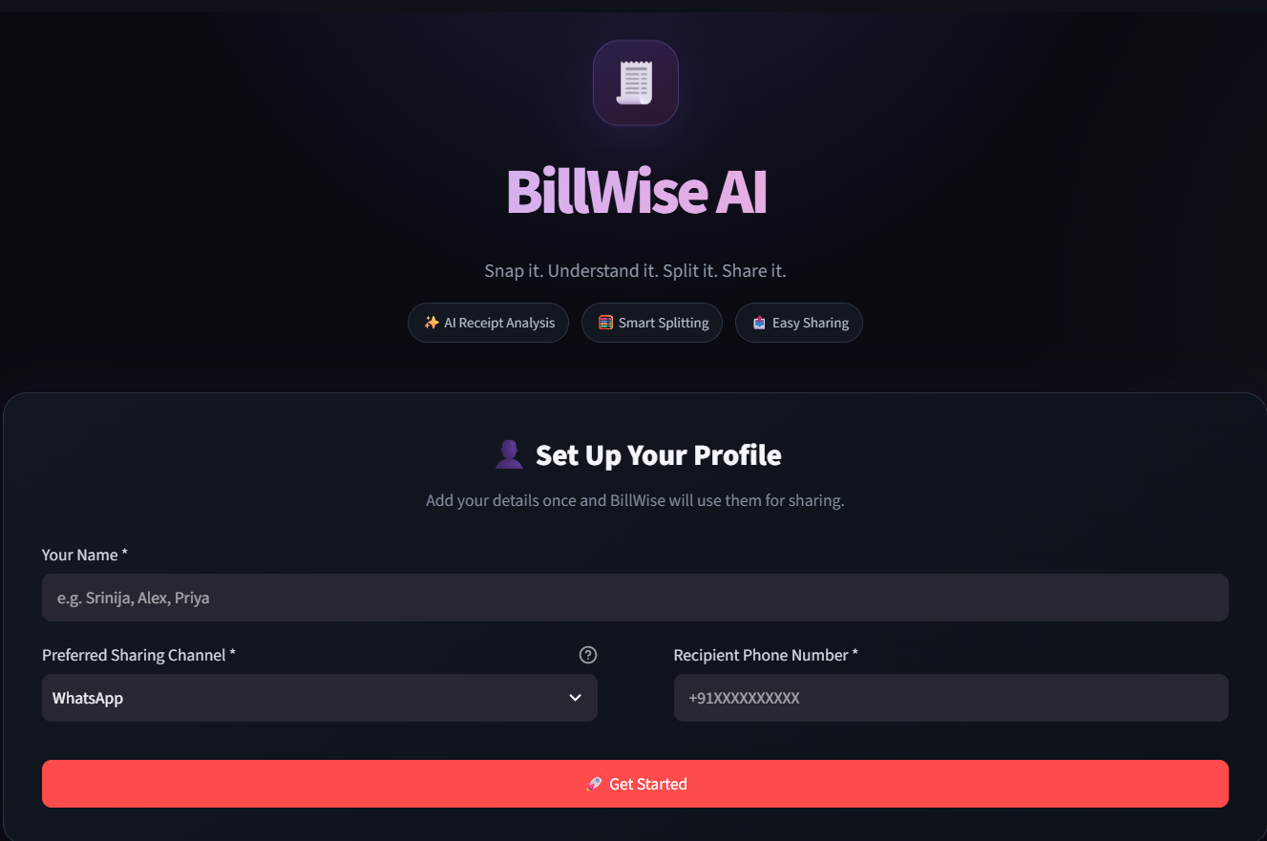
BillWise AI
AI-Powered Receipt Analyzer & Smart Bill Splitting Assistant
“Snap it. Understand it. Split it. Share it.”
B.Tech Project Presentation
Presented by: [Your Name] | Guide: [Guide Name]
Notes:
Introduce BillWise AI: an AI-powered receipt analyzer and bill-splitting assistant. Tagline: Snap it. Understand it. Split it. Share it.

Slide 2
Abstract & Problem Statement
ABSTRACT BillWise AI is an AI-powered application that simplifies receipt understanding and group expense management. It analyzes receipt images using Google Gemini, extracts structured bill data, and verifies calculations in Python. It then enables bill splitting among participants and sharing of expense summaries.
PROBLEM
AI-POWERED SOLUTION
Manual receipt entry is time-consuming
→
Automatic AI receipt analysis
Receipt data is hard to extract
→
Structured bill information
Manual calculations cause errors
→
Python-based bill verification
Splitting among people is inconvenient
→
Equal and item-based splitting
Individual shares get confusing
→
Per-person share calculation
Sharing summaries takes extra effort
→
Email / WhatsApp sharing
Notes:
Read the abstract briefly, then walk down the table: each manual problem maps to a feature that solves it.

Slide 3









Objectives & Proposed Solution
Analyze receipt images automatically
Extract structured bill information
Verify bill calculations
Simplify expense splitting
Calculate individual participant shares
Provide AI-based receipt assistance
Generate expense summaries
Enable convenient sharing
PROPOSED SOLUTION PIPELINE
1
2
3
4
5
6
7
8
›
›
›
›
›
›
›
Receipt Image
AI Analysis
Information Extraction
Bill Verification
Smart Bill Splitting
Participant Shares
Summary
Sharing
Notes:
Eight objectives, one pipeline. Every step in the pipeline is implemented in the project.

Slide 4




System Workflow
1
2
3
GEMINI AI
4
5
PYTHON
→
→
→
→
User
Upload Receipt
AI Receipt Analysis
Extract Bill Info
Verify Bill
Sets up profile in the app
Upload or capture a receipt image
Gemini reads the image
Merchant, items, tax, total
Arithmetic checked in Python
6
7
8
PYTHON
9
GEMINI AI
10
→
→
→
→
Manage Participants
Split Expenses
Individual Shares
AI Chat / Summary
Share
Add names, email, phone
Equal or item-based
Per-person totals, reconciled
Ask questions, get a summary
Email or WhatsApp
Notes:
Follow the numbered cards. Gemini AI handles reading and chat; Python handles verification and share calculation.

Slide 5



System Architecture & Technologies
User
Streamlit Interface
Image Preparation
Gemini Processing
→
→
→
Browser
app.py UI
Pillow
google-genai + prompts
↓
Email SMTP
Sharing Layer
Verification & Splitting
Structured Bill Data
←
←
←
WhatsApp Message / Twilio
Summary + shares
Python logic
Pydantic schema
TECHNOLOGIES USED
Python
Streamlit
Google Gemini API
Pydantic
Pandas
Pillow
Requests
Twilio
SMTP (Email)
Notes:
Walk the diagram: UI, image preparation, Gemini extraction into a typed schema, Python verification and splitting, then sharing.

Slide 6


Key Features
AI Receipt Analysis
Information Extraction
Bill Verification
Gemini reads receipt images
Items, tax, discount, total, merchant
Python checks the arithmetic
Smart Bill Splitting
Participant Management
AI Receipt Chat
Equal or item-based split
Name, email, phone and share
Ask questions about the receipt
Expense Summary
Email Sharing
WhatsApp Sharing
Complete bill summary
Send individual shares by email
Prepare WhatsApp messages
Notes:
Nine capabilities, all described in the project README and visible in the application.

Slide 7
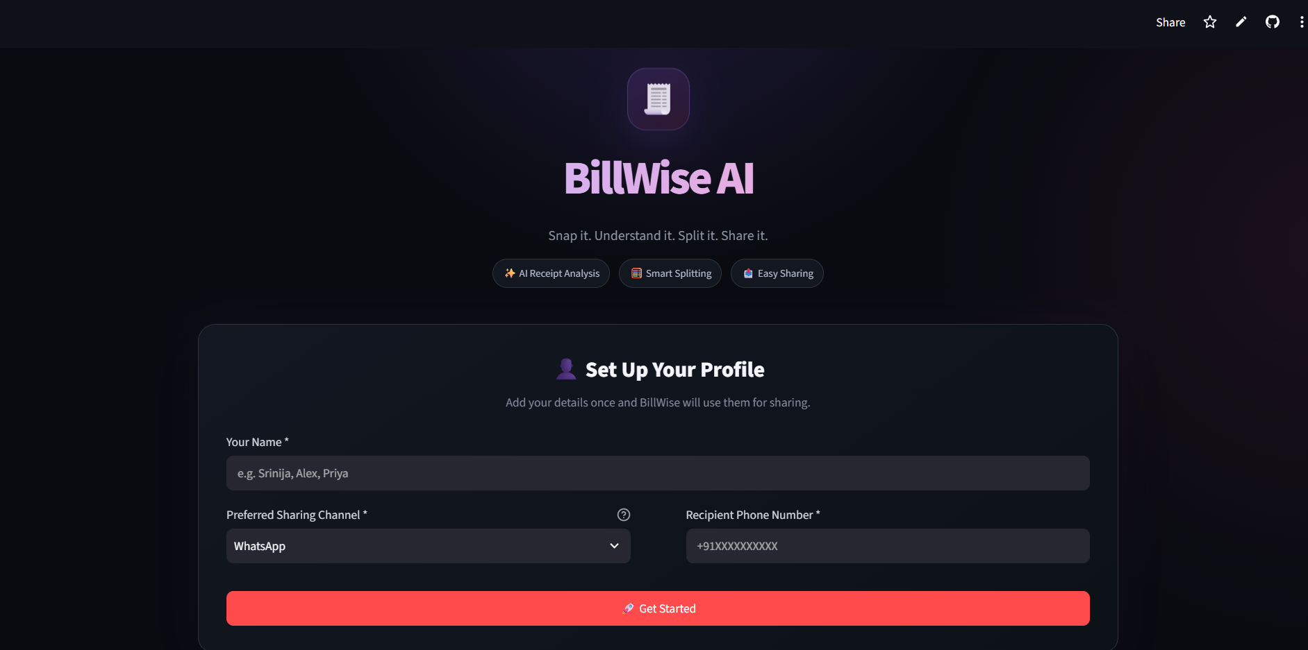
Application UI & Requirements
SOFTWARE REQUIREMENTS
Python 3.x
Streamlit and packages from requirements.txt
Google Gemini API access
Internet connection and web browser
API credentials / secrets (Gemini; Twilio and email for sharing)
1
2
3
4
5
6
7
HARDWARE REQUIREMENTS
Laptop / desktop
Minimum 4 GB RAM (suggested)
Internet connectivity
1
BillWise AI branding
5
Preferred Sharing Channel
2
Tagline: Snap it. Understand it. Split it. Share it.
6
Recipient Phone Number
3
Feature pills: Analysis, Splitting, Sharing
7
Get Started button
4
User profile setup
Notes:
Point to each numbered element on the real screenshot. Requirements are on the right; hardware figures are suggested minimums.

Slide 8











Advantages & Applications
ADVANTAGES
APPLICATIONS
Reduces manual effort
Restaurant / group dining
Faster receipt processing
College student expenses
Helps reduce calculation errors
Friends and roommates
Simplifies group expense management
Travel expenses
Provides AI-powered assistance
Team expenses
Makes expense sharing easier
Small events
User-friendly interface
Group activities
Notes:
Keep these qualitative; the project does not report benchmark numbers.

Slide 9



Future Enhancements
PLANNED – NOT PART OF CURRENT IMPLEMENTATION
NEAR TERM
MID TERM
LONG TERM
Expense history
Personal expense dashboard
Support for more receipt formats
Improved OCR fallback
Multi-language receipt understanding
Spending insights and analytics
Additional payment / sharing integrations
Dedicated mobile application
Secure cloud-based accounts
Recurring expense tracking
Advanced AI financial insights
Notes:
Stress that none of these are implemented yet; they are realistic next steps on top of the current system.

Slide 10

Conclusion & References
BillWise AI combines AI-powered receipt understanding, bill verification, intelligent expense splitting and convenient sharing in a single user-friendly application, reducing manual effort in group expense management.
RECEIPT
UNDERSTAND
VERIFY
SPLIT
SHARE
→
→
→
→
REFERENCES
THANK YOU
BillWise AI GitHub Repository: github.com/srinijaagangulaa-lab/BillWiseAI
Google Gemini API Documentation
Streamlit Documentation
Python Documentation
Twilio Documentation
Pydantic Documentation
Questions & Discussion
billwise-ai1.streamlit.app
Notes:
Close with the five-step flow, then thank the audience and invite questions.

