Slide 1

AIR QUALITY ANALYSIS AND VISUALISATION
Final Project Review | Department of CSE | KL University
TEAM MEMBERS
2420030387 – J. NIKHILA
2420030617 – S. SRINIKA
Guide: Dr. N. Sunanda
Academic Year: 2026–2027
Notes:
Title slide. Replace all bracketed text. Use the full project title, list every team member with registration number, and name your guide. Insert the institution logo in the dashed box.

Slide 2
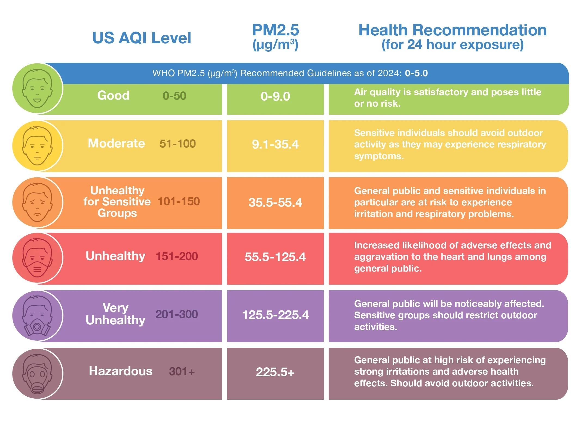



Introduction & Problem Statement
Background
Air pollution affects human health and the environment. AQI and pollutant levels help us understand air quality.
Problem Statement
Raw air-quality data is difficult to interpret and compare. Data visualization helps identify pollution patterns and trends.
Motivation / Need
We aim to make air-quality data easier to understand through analysis and visualization. This helps identify highly polluted areas, AQI trends and relationships between pollutants.
Notes:
State the domain, the exact problem and why it matters. Keep it to about 2 minutes. Add one real-world statistic if you can, with a citation.

Slide 3


Objectives & Scope
Objectives
1
Collect and organize air-quality data containing pollutant and AQI values.
2
Clean the dataset by handling missing values and duplicates.
3
Analyze pollution levels and AQI using statistical techniques.
4
Visualize pollution trends and compare air quality across locations.
Notes:
Objectives should be measurable and start with action verbs. The scope slide tells the panel what you did and did not attempt.

Slide 4

Literature Survey
S.No | Author(s) & Year | Method / Technique | Key Findings | Limitation / Gap
1 | Huan Li et al. | Data cleaning and visualization | Explored AQI and PM2.5 patterns. | Focused mainly on Beijing.
2 | Priyank Jain et al. | Machine learning and visualization | Analyzed Indian air-quality data. | Focused on COVID-19 analysis.
3 | Priyank Jain et al. | Clustering and ML | Studied AQI variations across cities. | Complex predictive approach
4 | Aneesh Mathew et al. | ML-based PM2.5 modelling | Analyzed Hyderabad air quality. | Focused mainly on PM2.5.
Research Gap
Existing studies focus on specific pollutants, locations or complex prediction techniques. Our project analyzes multiple pollutants and AQI across locations using simple statistical analysis and visualization.
Notes:
Summarise four to six relevant papers or existing systems. End with the research gap, because that gap justifies your project.

Slide 5





Proposed System & Methodology
STEP 1
STEP 2
STEP 3
STEP 4
STEP 5
Define Problem
Collect Data
Design
Implement
Test & Evaluate
Perform data preprocessing, EDA and generate graphs using Pandas, Matplotlib and Seaborn.
Identify air-quality analysis requirements and project objectives.
Collect air-quality data containing PM2.5, PM10, NO₂, SO₂, CO, O₃ and AQI.
Plan data cleaning, statistical analysis and visualization using Python libraries.
Evaluate pollution patterns, AQI trends and relationships between pollutants.
Key Novelty / Contribution
Analyzes multiple pollutants and AQI together, providing location-wise comparisons and meaningful insights through simple and effective visualizations.
Notes:
Walk through the five steps left to right. Rename the steps to match your project (for example, Requirement Analysis, Design, Coding, Testing, Deployment). End with your novelty.

Slide 6
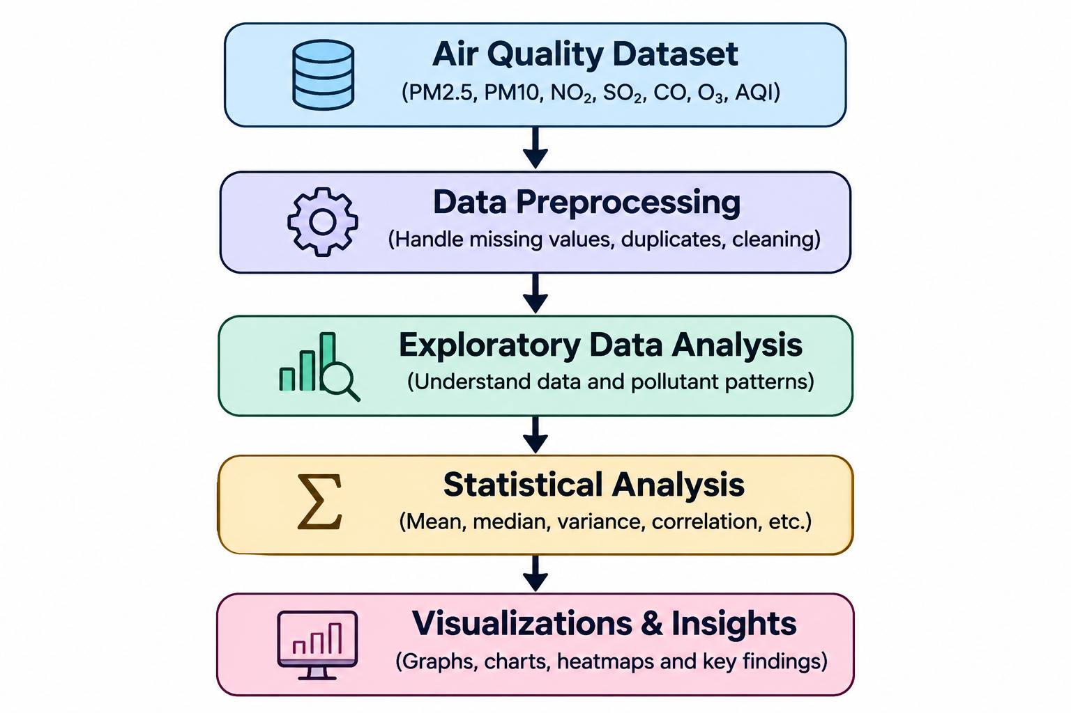
System Architecture
[Insert system architecture / block diagram
(Input → Processing → Output)]
Components
1
Data Collection
Collects raw air-quality data containing pollutant and AQI values.
2
Data Preprocessing
Handles missing values, duplicates and unnecessary data.
3
Data Analysis
Performs statistical analysis and explores pollutant patterns.
4
Data Visualization
Displays results using graphs, charts and correlation heatmaps.
Notes:
Insert a clear block diagram: input, processing, storage, output. Number each block and explain them on the right. Redraw the figure yourself rather than copying it.

Slide 7


Hardware & Software Requirements
Hardware
Software & Tools
Libraries / Frameworks
Processor: Intel Core i3 / i5 or above
RAM: 4 GB or above
Storage: 256 GB or above
Standard laptop / PC
Operating System: Windows 10/11
Programming Language: Python
IDE: Jupyter Notebook / Google Colab
Version Control: Git and GitHub
Pandas – Data manipulation
NumPy – Numerical calculations
Matplotlib – Data visualization
Seaborn – Statistical visualization
Deployment / Platform: Google Colab / Jupyter Notebook (Local Environment)
Notes:
List only what you actually used, with versions. For a pure software project, shorten the hardware list and add cloud or deployment resources.

Slide 8
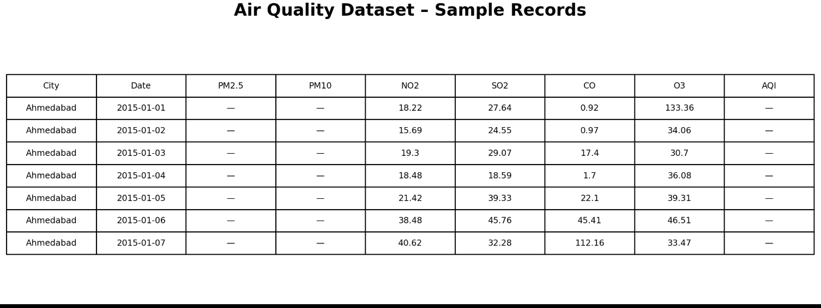
Dataset / Data Understanding
[Insert screenshot of the dataset
(head / info / sample records)]
[10,000]
[14]
Records (rows)
Features (columns)
[0]
[2]
Missing values
Target classes
Source:Air-quality dataset containing pollutant concentrations and AQI values.
Features: PM2.5, PM10, NO₂, SO₂, CO, O₃ and AQI.
Quality: Dataset is examined for missing values, duplicate records and inconsistent data.
Notes:
Explain where the data came from and what it contains. Show a screenshot of the first rows or the info summary. For non-data projects, replace this slide with “Requirement Analysis” or “Input Specification”.

Slide 9
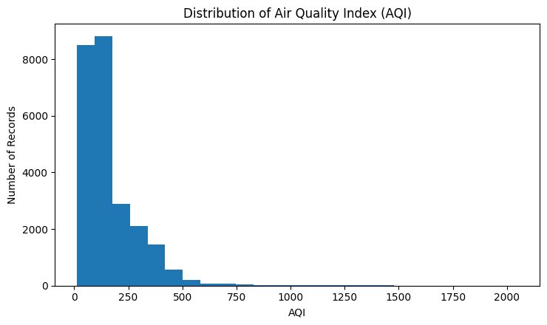
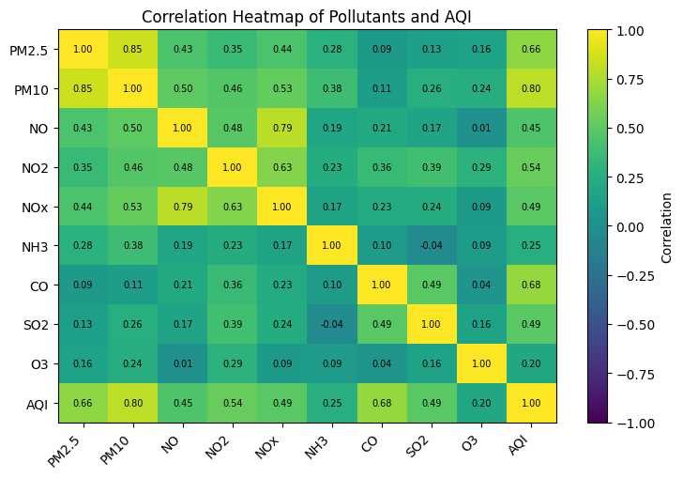



Data Preprocessing & Exploratory Analysis
Cleaning
Transformation
Feature Selection
Identify and handle missing values, remove duplicates and eliminate unnecessary data.
Organize pollutant values into a structured format suitable for statistical analysis and visualization.
Selected features: PM2.5, PM10, NO₂, SO₂, CO, O₃ and AQI for air-quality analysis.
Notes:
Show two or three plots that tell a story: distributions, correlations, outliers. Explain what each plot told you and what you did about it.

Slide 10
Module-wise Description
1
Data Collection
2
Data Preprocessing
Purpose: Collect air-quality data from the dataset.
Input → Output: CSV file → Raw dataset.
Developed by: J. Nikhila
Purpose: Clean and prepare the dataset.
Input → Output: Raw data → Cleaned dataset.
Developed by: S. Srinika
3
Exploratory Data Analysis
4
Data Visualization
Purpose: Analyze pollutant levels and AQI patterns.
Input → Output: Cleaned data → Statistical insights.
Developed by: J. Nikhila
Purpose: Generate graphs and identify pollution trends.
Input → Output: Analyzed data → Charts and visual insights.
Developed by: S. Srinika
Notes:
Divide the project into three to five modules. For each, state its purpose, inputs, outputs and who built it. Duplicate a card if you have more modules.

Slide 11

Algorithms & Technologies Usedorrela
Statistical Analysis
Correlation Analysis
Data Visualization
Why chosen
To summarize pollutant levels and AQI patterns.
Key parameters
Mean, median, mode, variance and standard deviation.
Why chosen
To identify relationships between different pollutants.
Key parameters
Pearson ction coefficient and correlation matrix.
Why chosen
To present pollution patterns clearly.Key parameters
Histograms, bar charts, line graphs, box plots and heatmaps.
Selection criteria: Selected based on simplicity, accuracy, ease of interpretation and suitability for exploratory data analysis.
Notes:
Name each model, algorithm or technology, say why you chose it, and list the key settings. Then explain how you picked the final one.

Slide 12
Implementation / Model Building
Feature Selection
Code snippet / pseudocode
Selected PM2.5, PM10, NO₂, SO₂, CO, O₃ and AQI for analysis.
import pandas as pd
df = pd.read_csv("data/city_day.csv")
print(df.head())
print(df.info())
df = df.drop_duplicates()
df = df.dropna()
print(df.describe())
Preprocessing Pipeline
Load CSV data, handle missing values, remove duplicates and prepare data for analysis.
Data Splitting
Not applicable. The project uses the complete dataset for exploratory data analysis.
Configuration
Python, Pandas, NumPy, Matplotlib, Seaborn and Streamlit.
Notes:
Describe the build in the order you did it. Paste only the most important code or pseudocode, not entire files. For hardware projects, show the circuit or wiring summary instead.

Slide 13
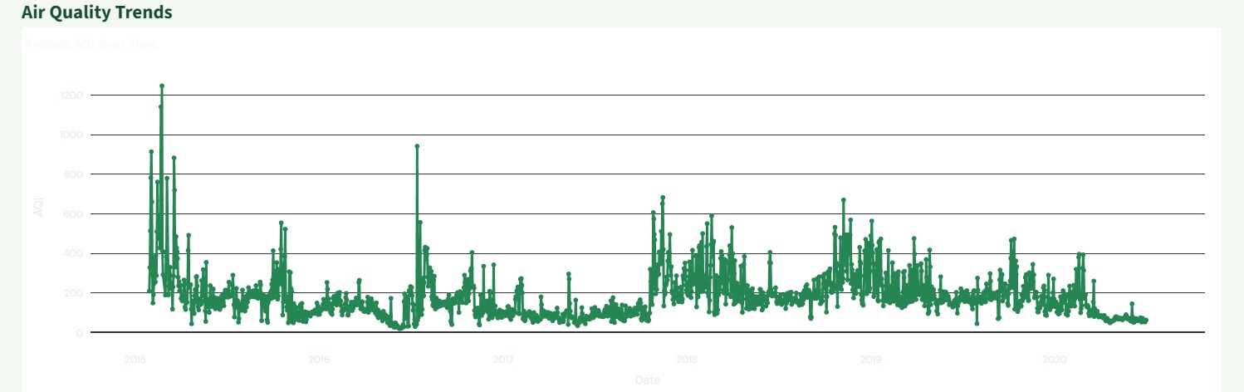
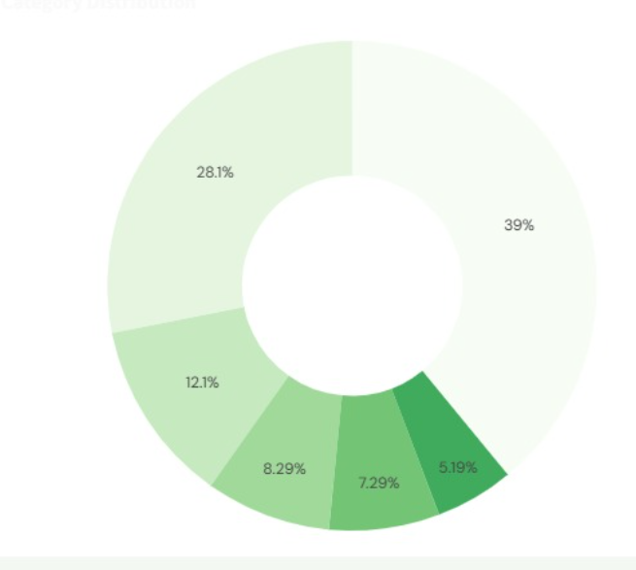
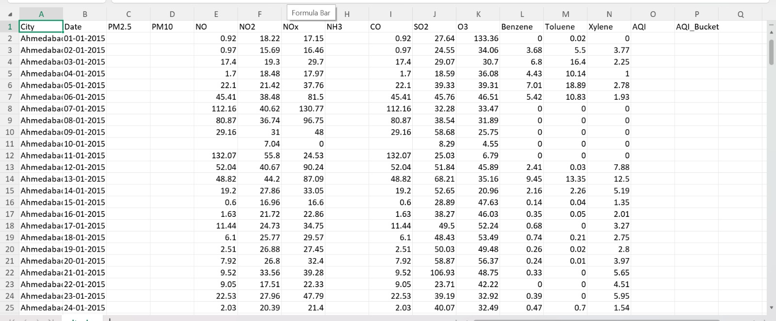
Working Prototype / Output Screens
[Screenshot / photo 2]
[Screenshot / photo 3]
Dataset Preview
Displays the air-quality dataset with pollutant values and AQI records.
Data Analysis
Shows statistical analysis of pollutant levels and air-quality patterns.
Data Visualization
Displays graphs and charts to compare pollutants and understand AQI trends.
Notes:
Show real screenshots, photos of the hardware or a short demo video link. Caption each one with what the viewer should notice.

Slide 14
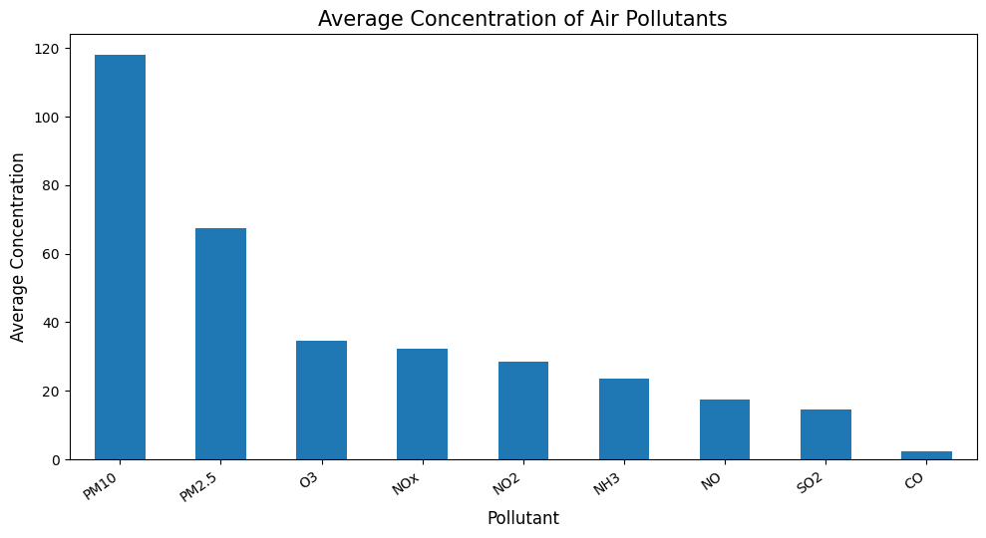
Results & Performance Comparison
Metric | Statistical Analysis | Correlation Analysis | Visualization
Method | Descriptive Stats | Pearson Correlation | Graphical EDA
Purpose | Summarize data | Find relationships | Show patterns
Output | Statistical values | Correlation matrix | Charts
Result | AQI summary | Pollutant links | Visual insights
Best: Visualization – Helps identify pollution patterns and compare air-quality levels easily.
Source: Air Quality Dataset (2015–2020); averages calculated using available values.
Notes:
Right-click the chart and choose Edit Data to enter your real numbers. Replace the metrics with the ones that fit your project (accuracy, latency, power, throughput, user rating). State clearly which option performed best.

Slide 15
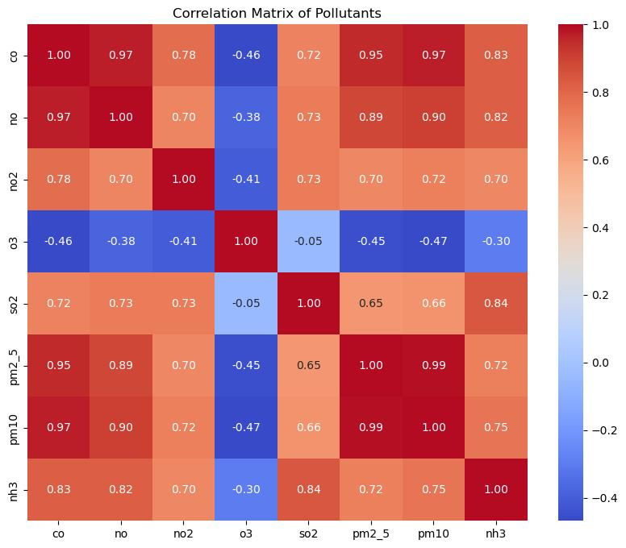
Analysis & Key Findings
[Insert confusion matrix / feature importance /
ROC curve / output comparison]
Key Insight
PM10 shows a strong positive correlation with AQI (0.80).
Interpretation: PM10 and PM2.5 show strong positive relationships with AQI.
Error Analysis: Missing values may affect the analysis.
Key Drivers: PM10, PM2.5 and CO show relatively strong correlations with AQI.
Notes:
Explain what the numbers mean. Use a confusion matrix, ROC curve, feature-importance chart or output comparison. Be honest about weak results; panels value that.

Slide 16

Testing & Validation
Test Case | Expected Result | Status | Test Case | Expected Result
Dataset loading | Data loads successfully | Pass | Dataset loading | Data loads successfully
Missing values | Missing values handled | Pass | Missing values | Missing values handled
Duplicate records | Duplicates removed | Pass | Duplicate records | Duplicates removed
Graph generation | Charts displayed correctly | Pass | Graph generation | Charts displayed correctly
Functional Testing
Validation Method
Performance Testing
Verified dataset loading and preprocessing.
Checked data types and statistical results.
Verified graphs, labels and axes.
Notes:
List representative test cases with expected and actual outcomes. Name the validation methods you used. Delete rows you do not need.

Slide 17


Challenges & Limitations
Challenges Faced
Limitations
Missing values → Handled using data-cleaning techniques.
Duplicate records → Removed duplicate entries.
Large dataset → Analyzed using Pandas.
Complex data → Simplified using visualizations.
Analysis depends on the available dataset.
No real-time air-quality monitoring.
No future AQI prediction.
Notes:
Be candid. Pair every challenge with how you solved it, and list limitations that the panel would otherwise spot themselves.

Slide 18

Conclusion
Successfully analyzed air-quality data using Python.
1
Final Outcome
Studied pollutant concentrations and AQI variations.
Key Insight: PM10 shows a strong positive correlation with AQI (0.80).
2
[The project helps understand air-quality patterns and pollutant relationships through data analysis.
Used statistical analysis and visualizations to identify patterns.
3
Notes:
Revisit each objective and say whether you met it. Quote your headline result with numbers. Do not introduce new material here.

Slide 19



Future Scope & Applications
Improve Performance
Optimize analysis and visualization for better results.
Applications
Air-quality monitoring
Pollution awareness
Environmental research
Government and public health departments
Expand Data / Features
Include more cities, pollutants and updated datasets.
AQI Alert System
Develop AQI-based early warning alerts to notify users when pollution levels become unhealthy.
Scale & Secure
Ensure reliable data handling and secure access.
Notes:
Give concrete next steps, ideally tied to the limitations. Then name two or three real-world uses.

Slide 20
Team Contribution
Reg. No. | Team Member | Contribution
2420030387 | J. Nikhila | Data Collection and Exploratory Data Analysis
2420030617 | S. Srinika | Data Preprocessing and Visualization
Notes:
Show that work was planned and shared. Every member should be able to explain their own module.

Slide 21

References
Rohan Rao, Air Quality Data in India, Kaggle Dataset.
Huan Li et al., Research on Air Quality Data Analysis and Visualization.
Priyank Jain et al., Research on Air Quality Analysis in Indian Cities.
Aneesh Mathew et al., Research on PM2.5 Prediction and Analysis.
Project Links
GitHub: [URL]
Dataset: https://www.kaggle.com/datasets/rohanrao/air-quality-data-in-india
Notes:
Use IEEE style, numbered in order of first citation in the deck. Include datasets, documentation and code repositories.

Slide 22
THANK YOU
Questions & Discussion
Team Members:
J. Nikhila – 2420030387
S. Srinika – 2420030617
Project Guide:
Dr. N. Sunanda
Department of Computer Science and Engineering
KL University
Notes:
Leave this slide up during questions. Make sure every team member can answer questions about their own module.

