Slide 1

Good Morning
Welcome to Oyster Cafeteria
More than just a dining space, Oyster Cafeteria is designed to bring people together through fresh flavors, quality ingredients, and a comfortable atmosphere. Enjoy a diverse menu crafted to make every meal enjoyable and memorable.

Slide 2

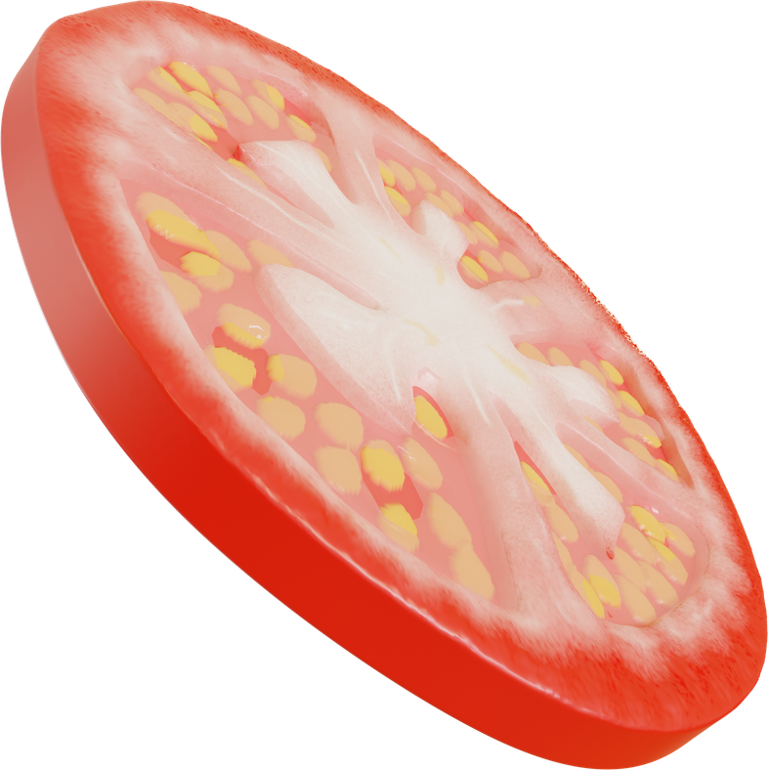

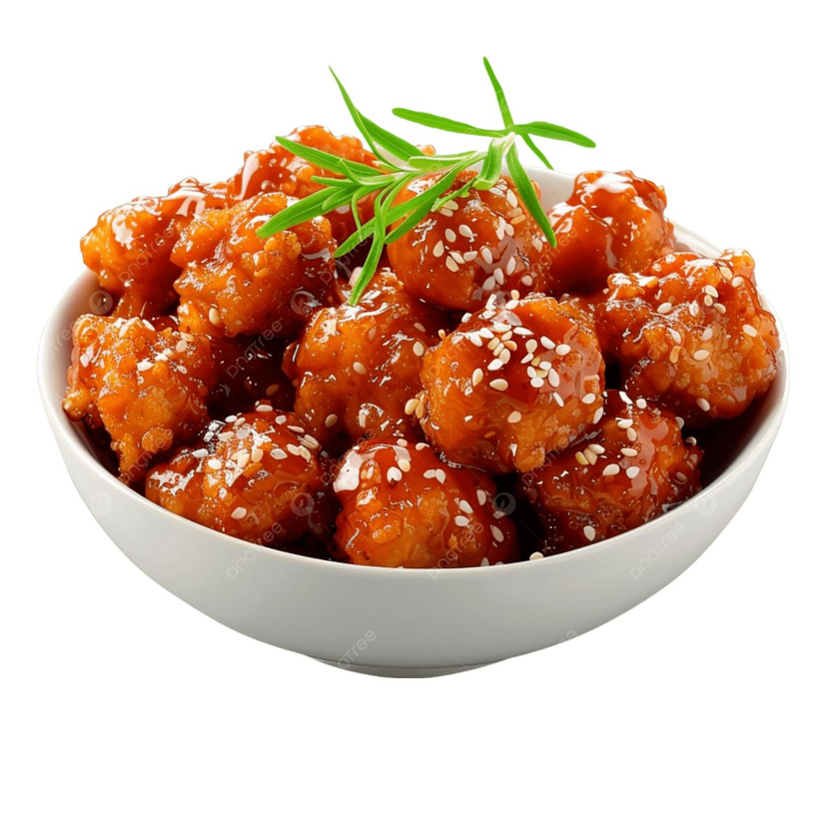


Lunch
Dish photo will conme here this is a border
CHILLY MANCHURIAN
NUTRITION FACTS
CALORIES
200-250 KCAL
PROTEIN
5-6 GRAMS
FATS
3-4 GRAMS
FIBRE
6 GRAMS

Slide 3

Meet the Team
Team photo will come here

Slide 4
Logo
Logo will cone here

