Slide 1

DOG BREEDS ANALYSIS
DOG BREDS ANA;YSIS
BY SRINIKHIL

Slide 2
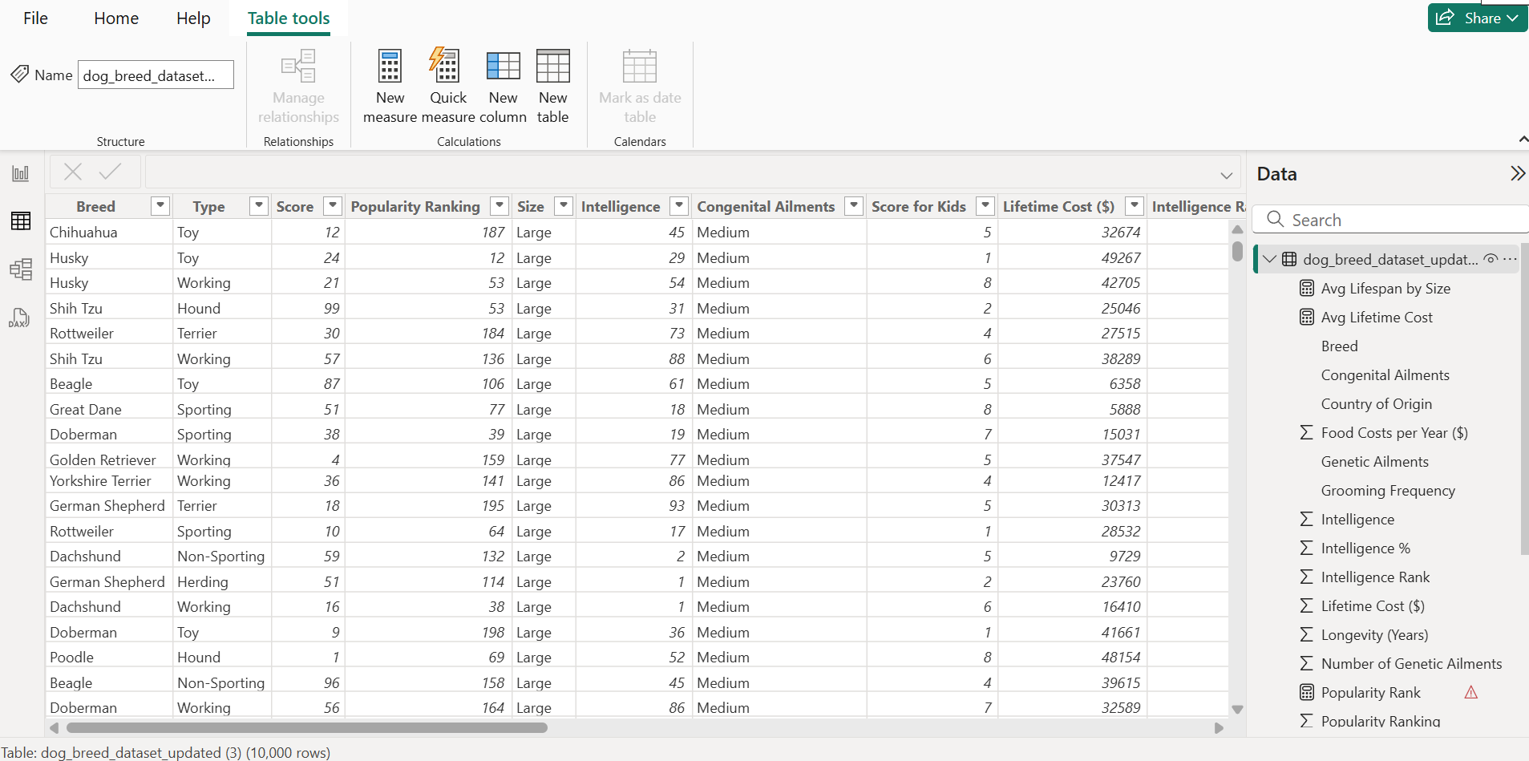

Slide 3
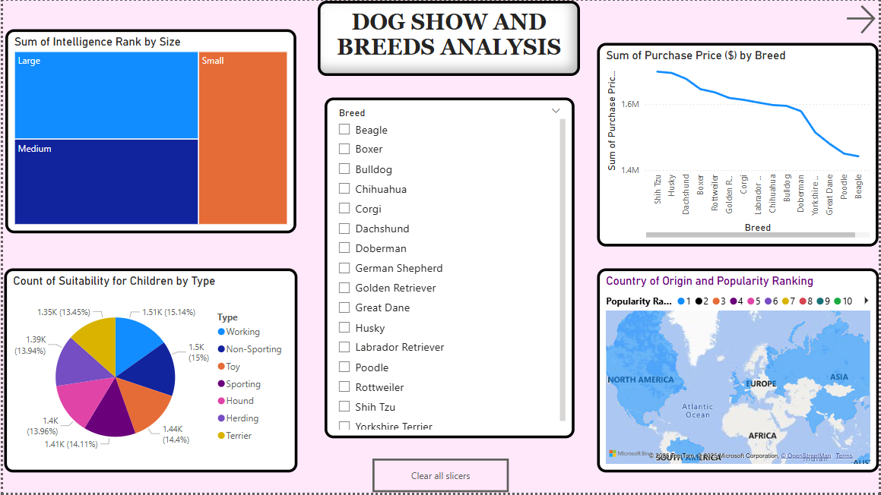

Slide 4
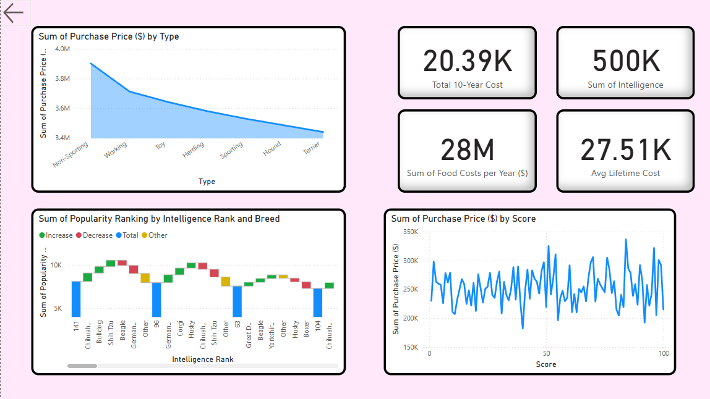

Slide 5
Key Insights & Summary
📌 Popularity vs. Intelligence vs. Cost
High-intelligence breeds are more popular, but cost doesn’t always reflect intelligence.
Expensive breeds often have higher grooming & healthcare costs.
📌 Cost & Longevity Trends
Long-living breeds (15+ years) generally have lower lifetime costs.
Shorter-lived breeds tend to have higher medical expenses.
📌 Best Breeds for Kids & Families
Golden Retrievers, Labradors, and Beagles are the most kid-friendly.
High-energy small breeds may be less suitable for young children.
📌 Grooming & Food Costs
Large breeds (Great Danes, Saint Bernards) have high food costs.
Low-maintenance breeds (Boxers) are more budget-friendly.
📌 Geographical Influence
Climate impacts breed popularity (e.g., Huskies in cold regions).
Countries with strict breeding laws have healthier but pricier breeds.

