Slide 1
USD Index Trade Recommender System
Kevin Glynn (mentor)
Srinivas Krishnaswamy (Student)

Slide 2
What is the Dollar Index ?
It is a weighted geometric mean of the United States dollar (USD)’s value relative to following select currencies
- Euro (EUR), 57.6%
- Japanese yen (JPY), 13.6%
Pound sterling (GBP),11.9%
Canadian dollar (CAD), 9.1%
Swedish krona (SEK), 4.2%
Swiss franc (CHF) 3.6%
Established in 1973 with a value of 100. If it is above 100, USD is stronger than 1973, if below 100 then weaker than 1973 !

Slide 3
Factors influencing the U.S. Dollar
1. Daily prices of the U.S.Dollar Index
2. Federal Reserve Fund Rate
3. Oil prices
4. Personal Consumption
5. Consumer Prices
6. Home prices
7. Inflation
8. Stock Market Prices
9. Social Security
10. Employment Numbers
11. Payroll Data
12. Employment growth
13. Federal retirement benefits
14. Saving rate of the residents of the U.S.
15. Home construction
16. Return on Investment (ROI) on the SnP
And many, many more not Listed here ...........

Slide 4
WHO Cares and Why ?
Traders who trade in bond, currency and gold markets within the world’s capital market financial system.
The US Dollar is the world’s reserve currency and as such any change in it’s value can affect humans worldwide.

Slide 5
How Can Machine Learning BE used ?
If we can build a system to predict the next day’s closing price correctly, we can make a trade - i.e. buy / sell the dollar index if prediction says it is going up ( sell / buy if the dollar index goes down)

Slide 6
So let’s build one …
Here are the steps –
Acquire data from websites that provide financial data – quandl and investing.com
Split the data into train/test
Train model on the training dataset
Test the model on the testing dataset
Evaluate the test dataset
Operationalize the ML pipeline, either on a local computer or on the cloud
Usage -
Passing in the input dataset (features) should return the output price (label). The label in our case is the percentage gain or loss
If the percentage gain is within 1.5% +/-, then the user places a trade for the next day.
Close out the position by the close of business the next day (since we are using daily close prices as the label)

Slide 7
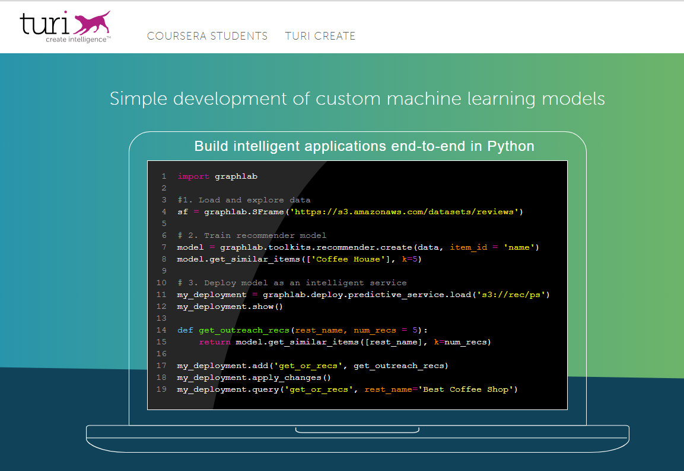
Local operationalization
Turi create

Slide 8


Cloud operationalization
Microsoft Azure ML

Slide 9
Which ML model should we pick ?
Turi create analyzes the dataset and picks the best model – in this case Gradient Boosted Decision Trees (GBMs).
In Azure ML 3 models were used, Boosted Trees, Neural Nets and Linear Regression. The results were then compared.

Slide 10
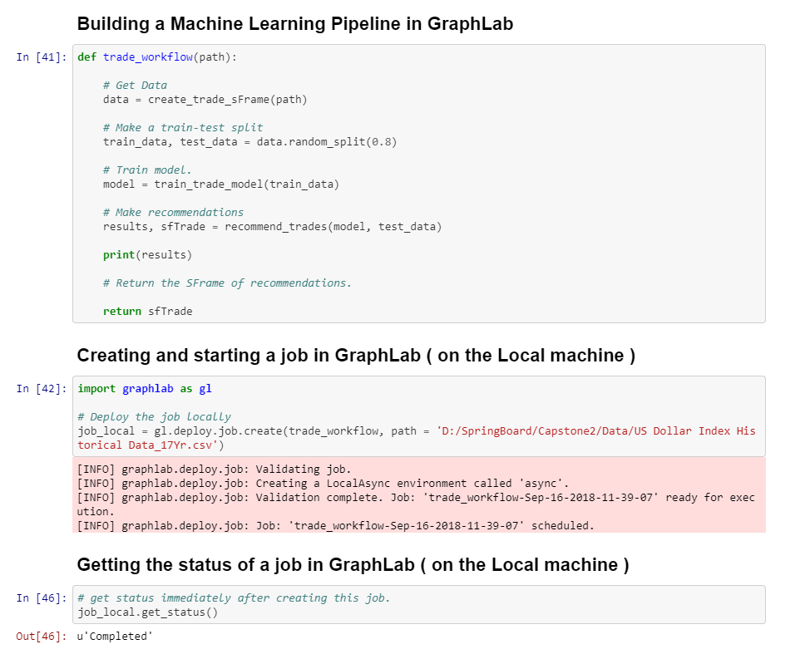
Local operationalization
Turi Create ( Graph Lab )

Slide 11
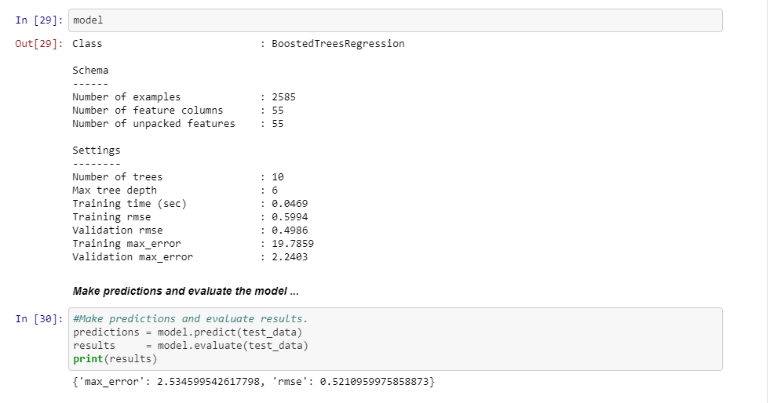

Slide 12
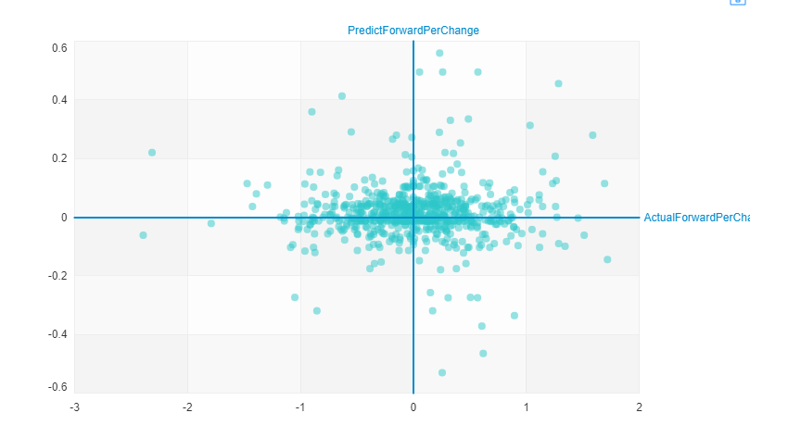
Turi Create

Slide 13
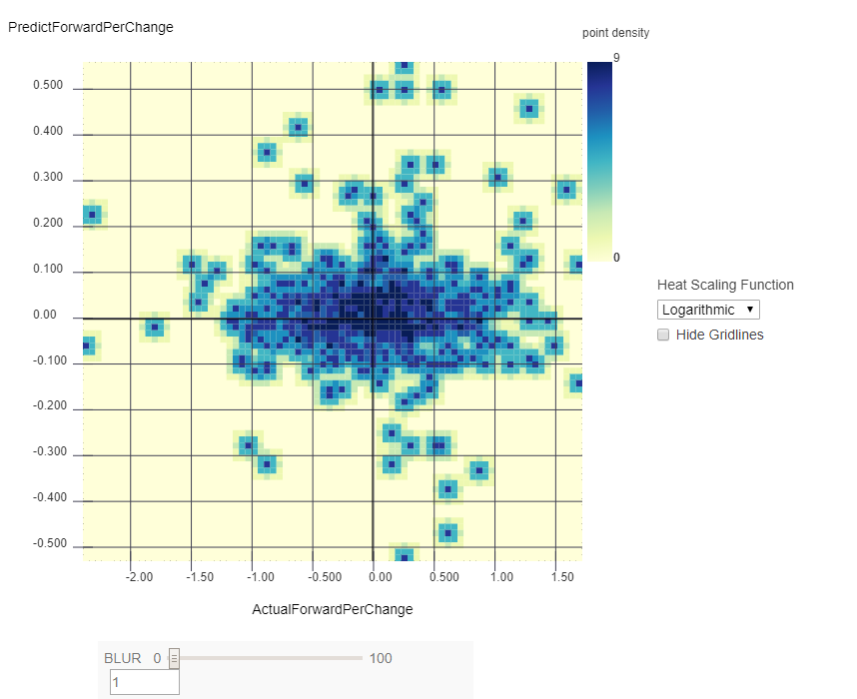
Turi Create

Slide 14
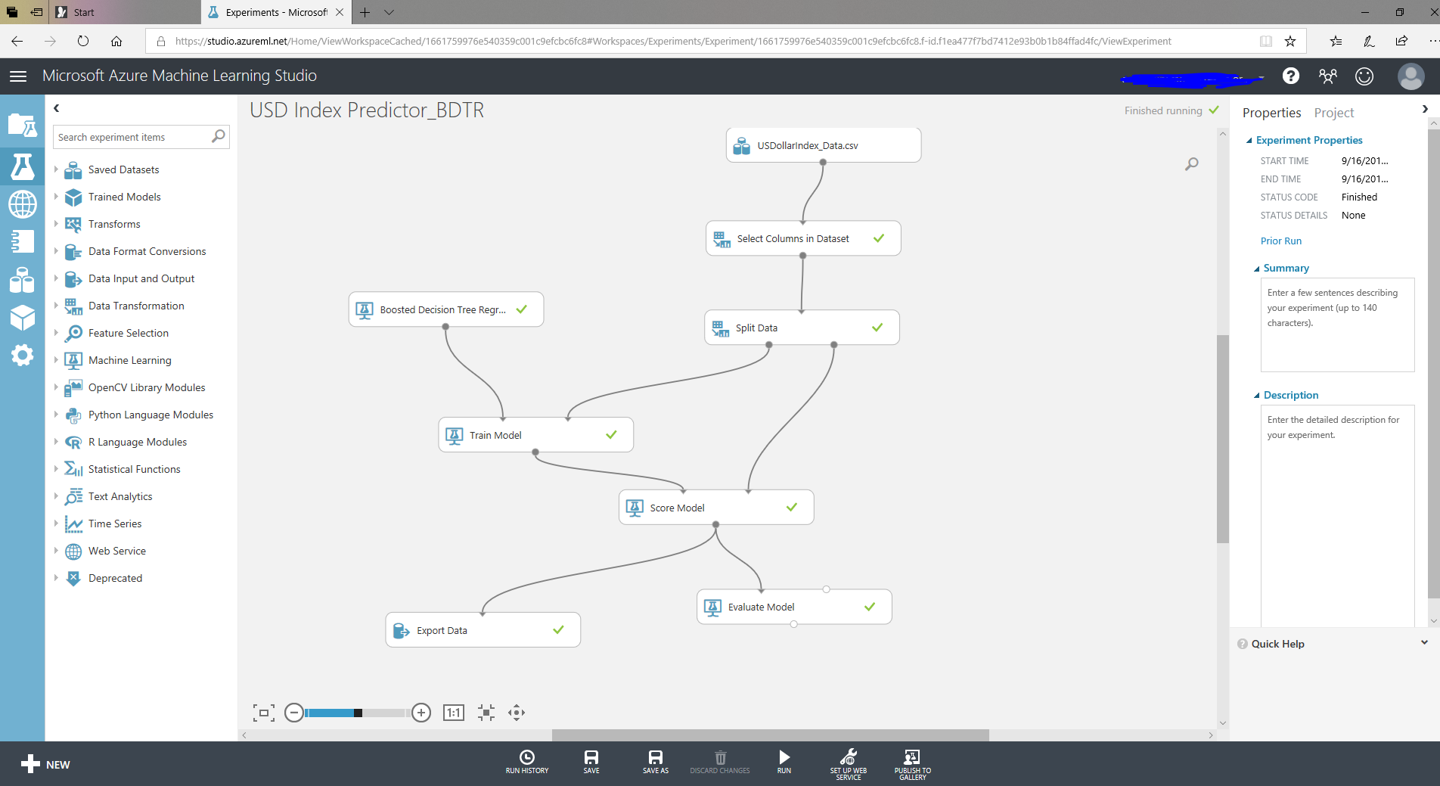
ClOUD OperationalizaTION
Azure ML – Boosted Decision Trees Regression

Slide 15
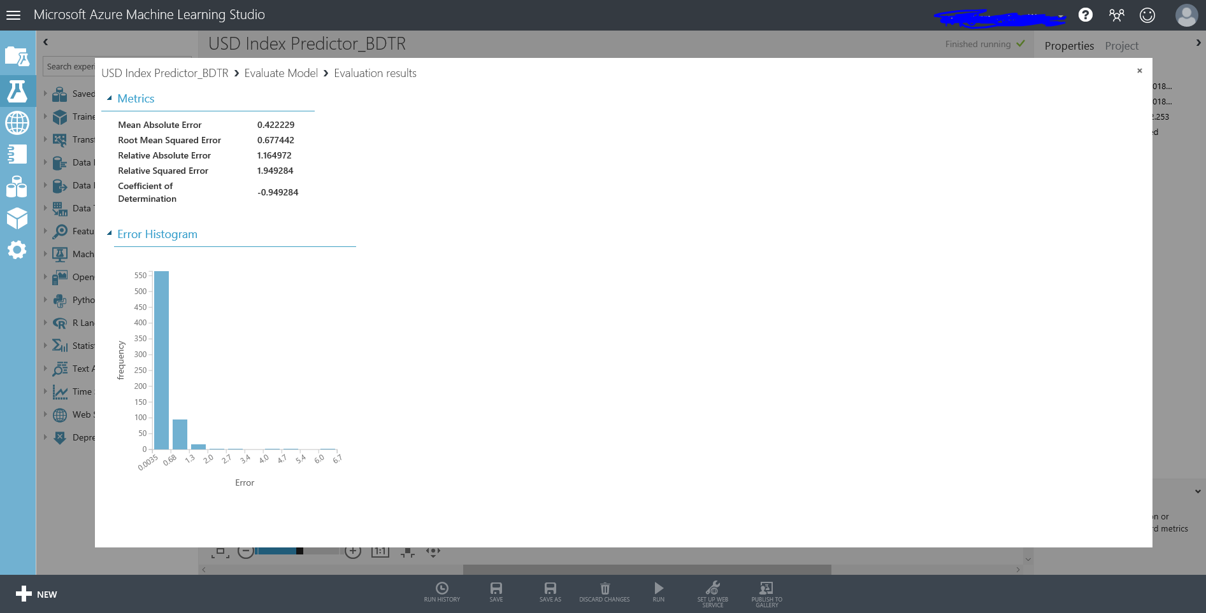

Slide 16
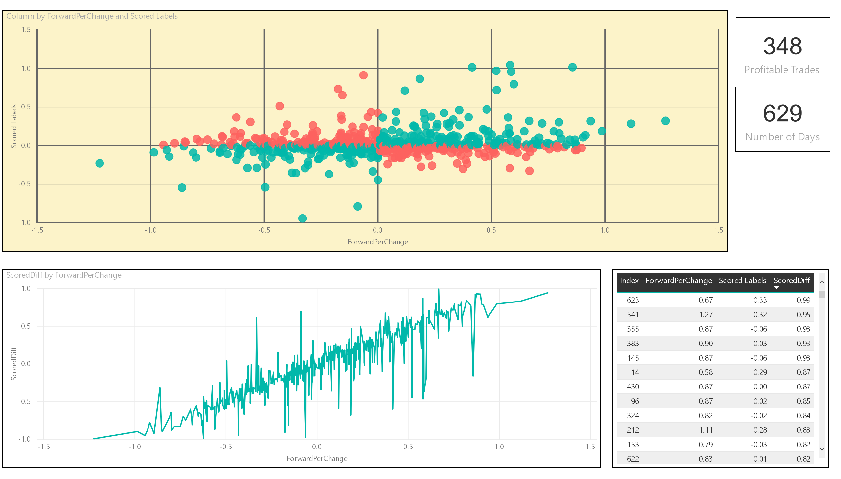
Boosted Decision Trees Regression

Slide 17
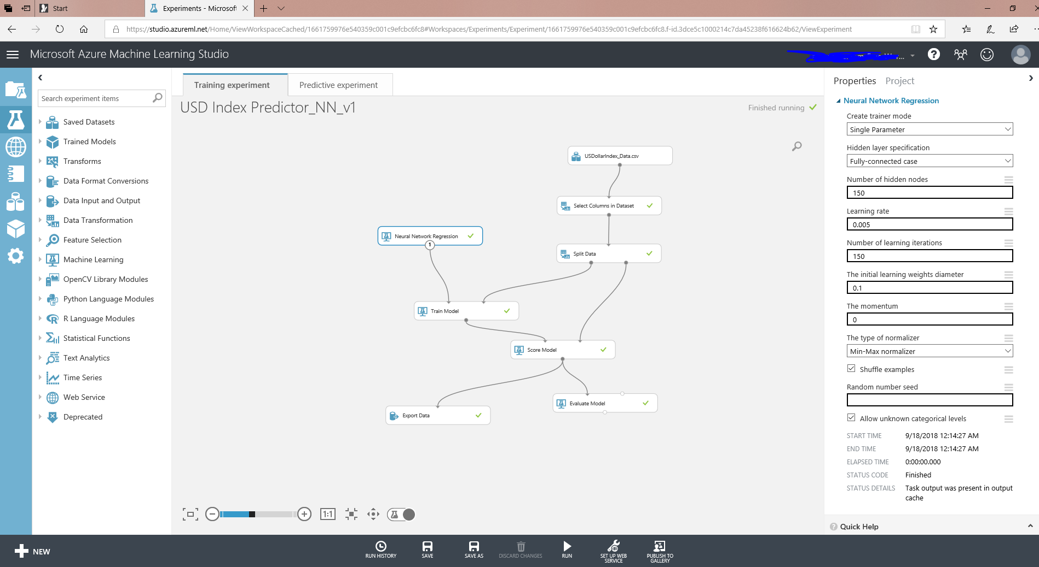
ClOUD OperationalizaTION
Azure ML – Neural Network Regression

Slide 18
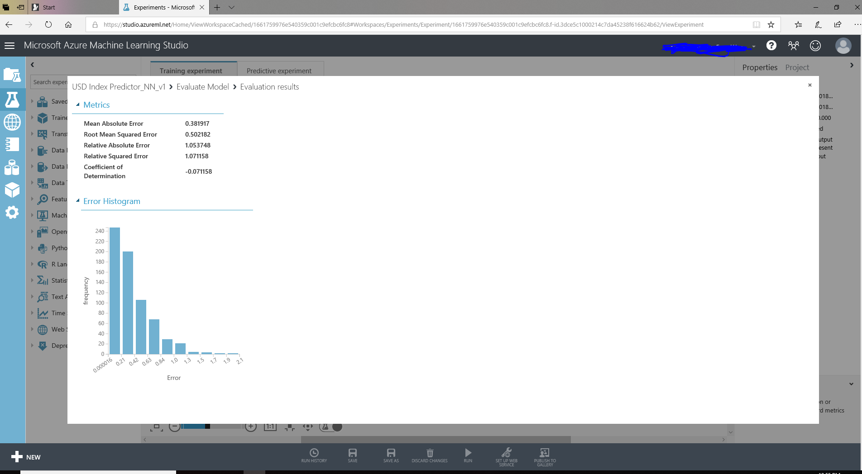

Slide 19
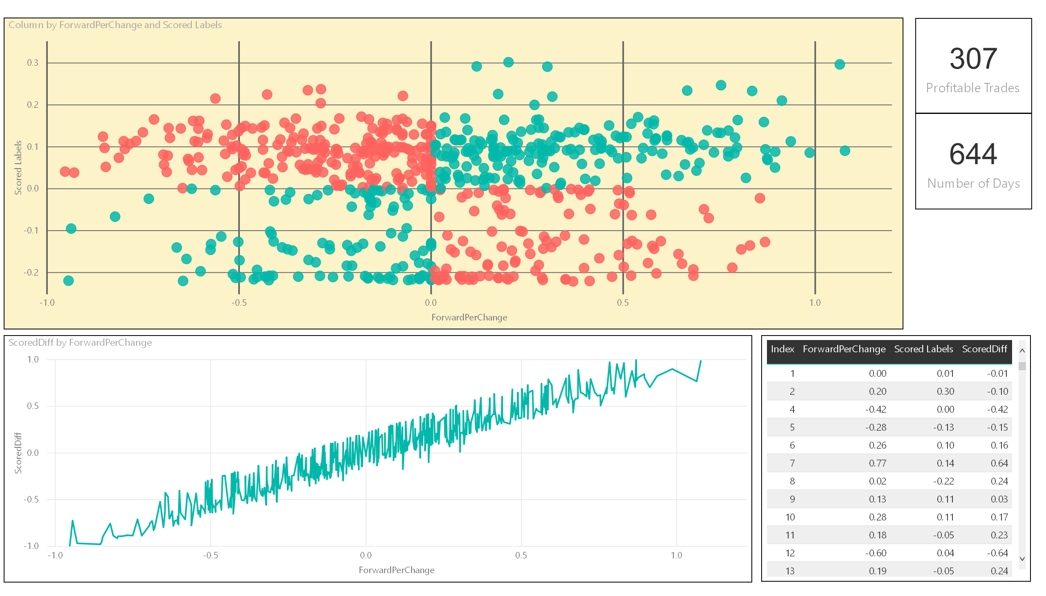
Neural Nets Regression

Slide 20
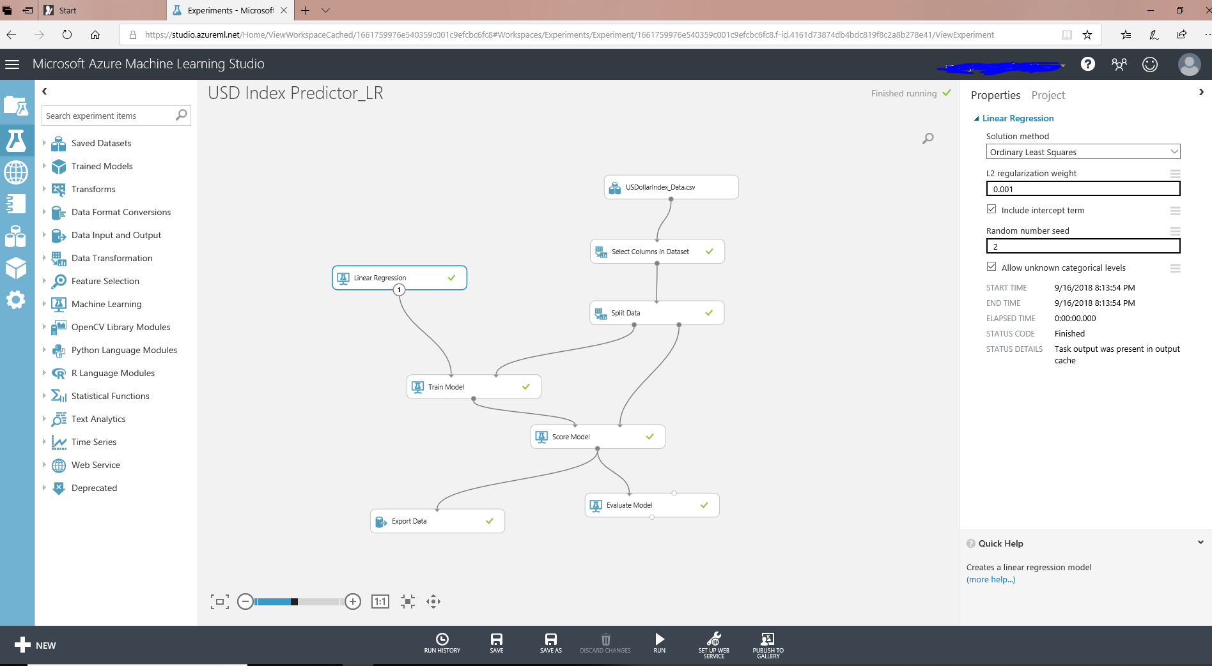
ClOUD OperationalizaTION
Azure ML – Linear Regression

Slide 21
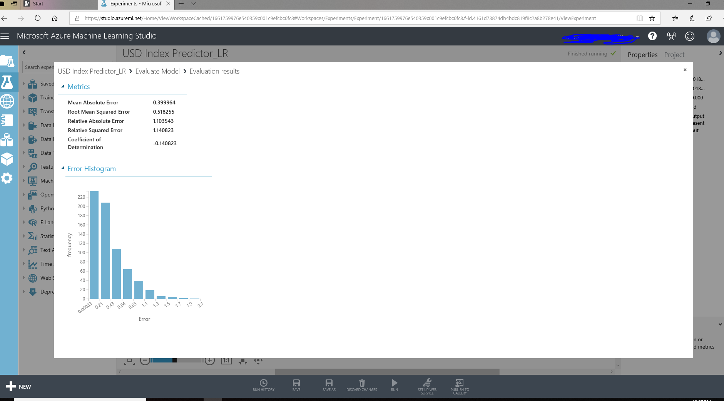

Slide 22
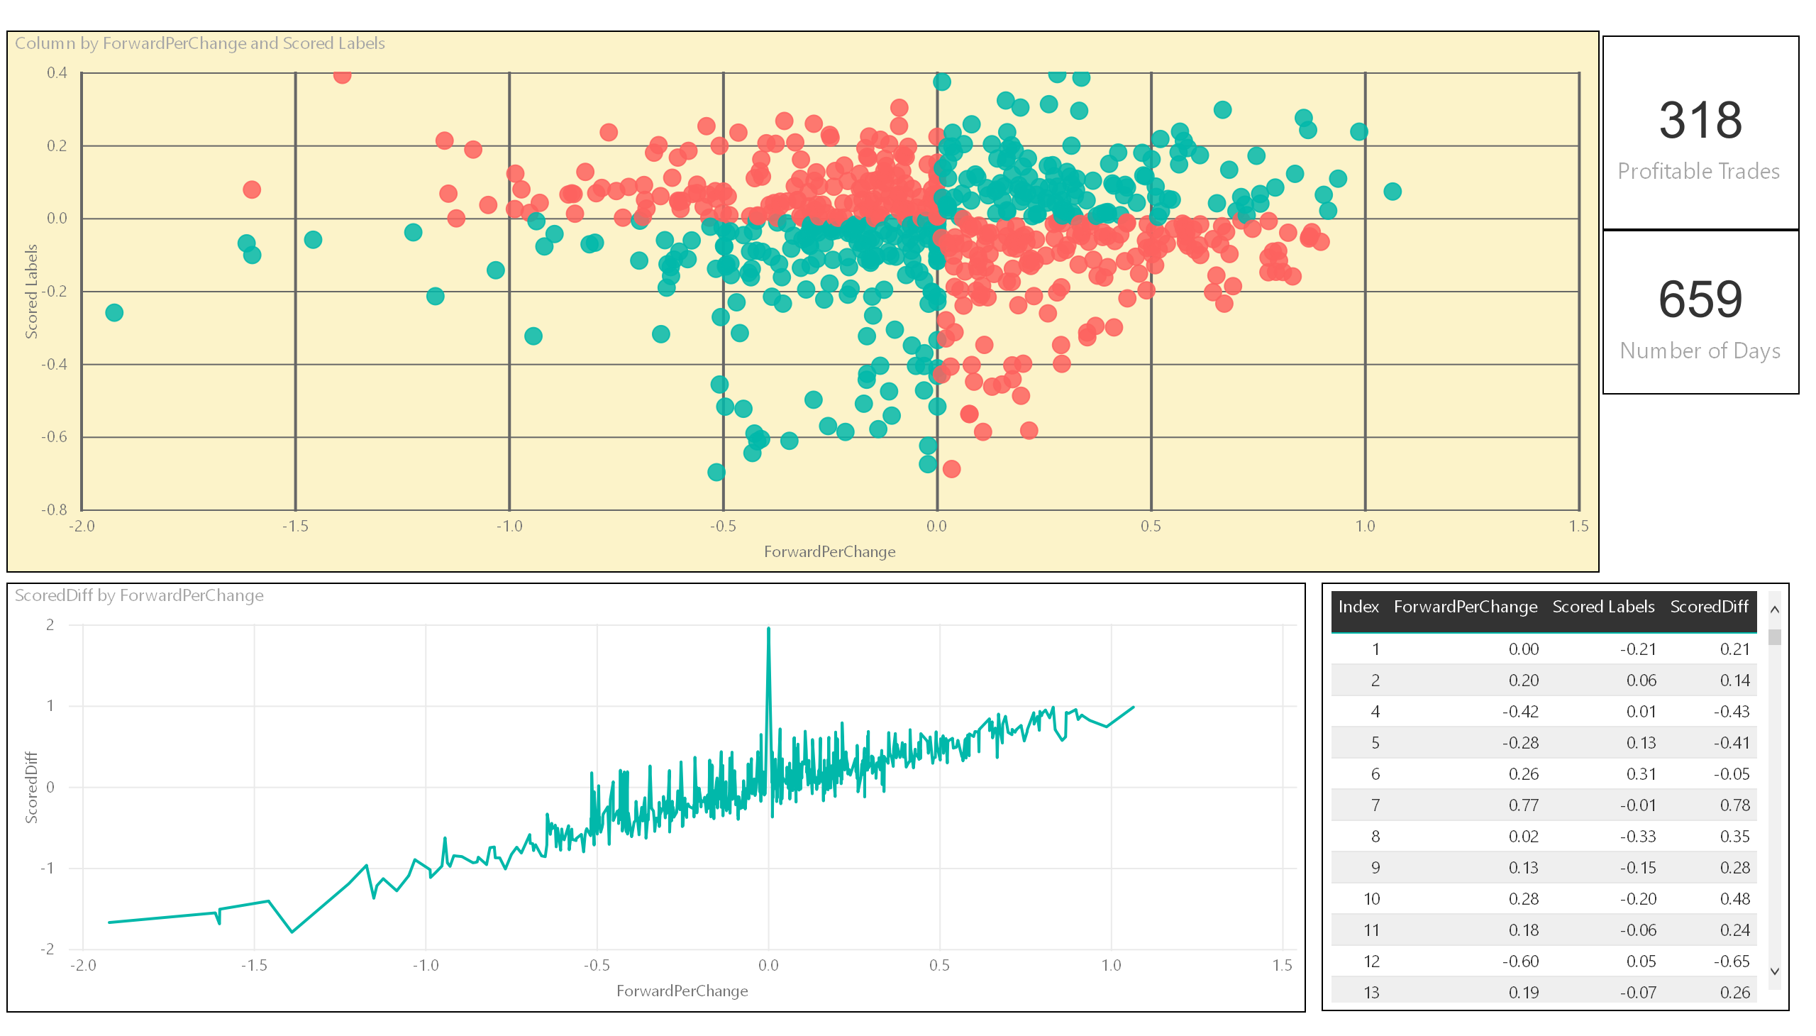
Linear Regression

Slide 23
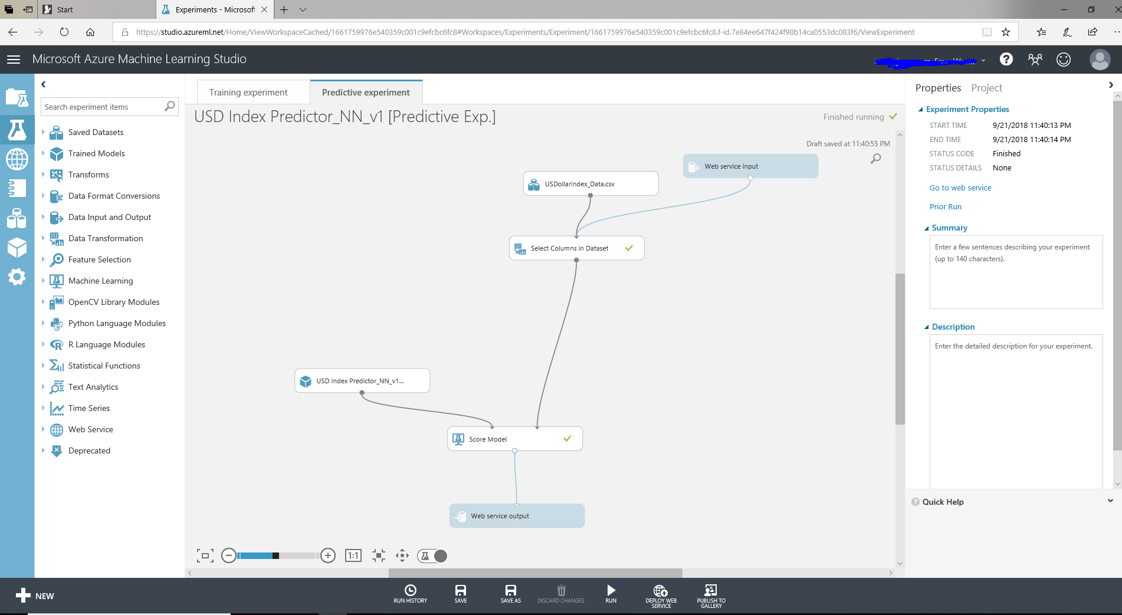
Using the trained model to create and deploy an Azure ML web service

Slide 24
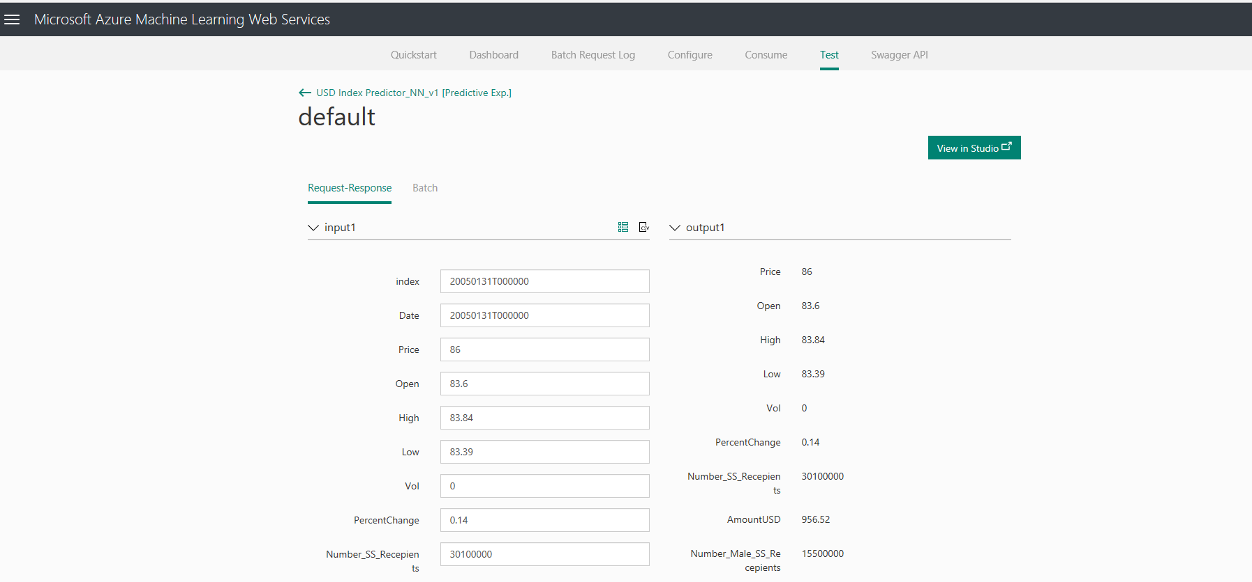
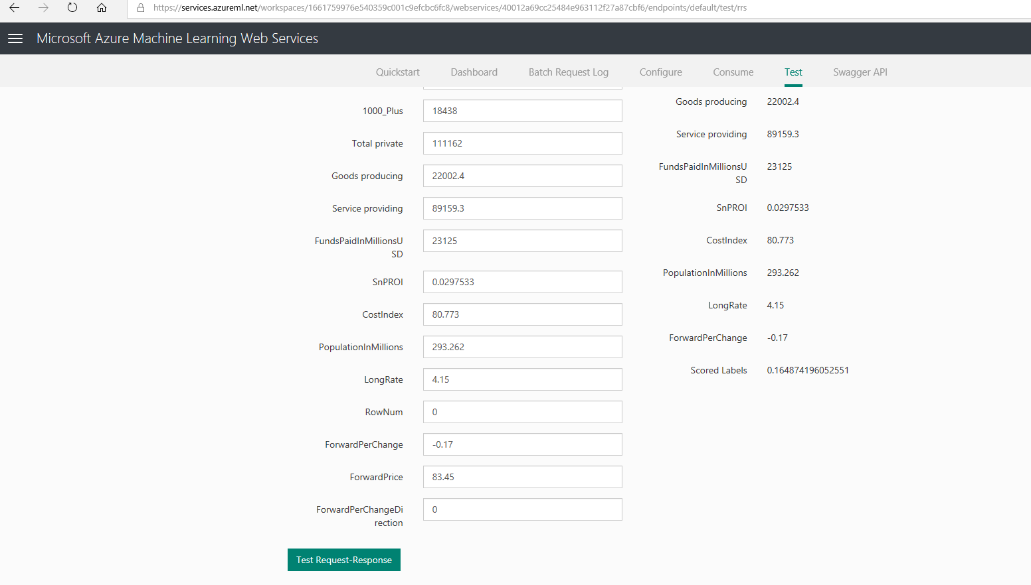
Testing the web service manually.
…………..

Slide 25
Conclusions
Both turi – create (GraphLab) and Azure ML gave the best results for boosted Decision Tree Models
If trades were made based on this system, it would be make a profit slightly more than 50% of the time ( Profitable trades are defined as those trades in which the sign +/- of the actual label is the same as the predicted label). This means that the system is only slightly better than a coin toss !

Slide 26
Links
Turi create (GraphLab) Jupyter Notebook and source data
https://github.com/srinikris/SpringBoard_Capstone_2
Azure ML Link
https://gallery.cortanaintelligence.com/Experiment/USD-Index-Predictor-NN-v1-Predictive-Exp

