Slide 1
Data Analysis on Student Exam Scores
M. Srineela Reddy
2211CS010335
Section 1

Slide 2
Dataset Overview
Number of entries: 200 (example dataset)
Columns:
• student_id – Unique identifier for each student
• hours_studied – Number of hours studied per day
• sleep_hours – Average sleep hours per day
• attendance_percent – Percentage of classes attended
• previous_scores – Previous exam score
• exam_score – Final exam score
Observation: Dataset is clean and consistent (no missing values).

Slide 3
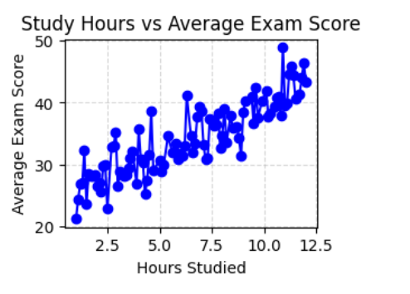
Study Hours vs Exam Score (Line Chart)
Explanation: Shows how study hours affect exam performance.
Insights:
• Students who studied >6 hours/day achieved higher scores.
• Positive correlation between study effort and performance.

Slide 4
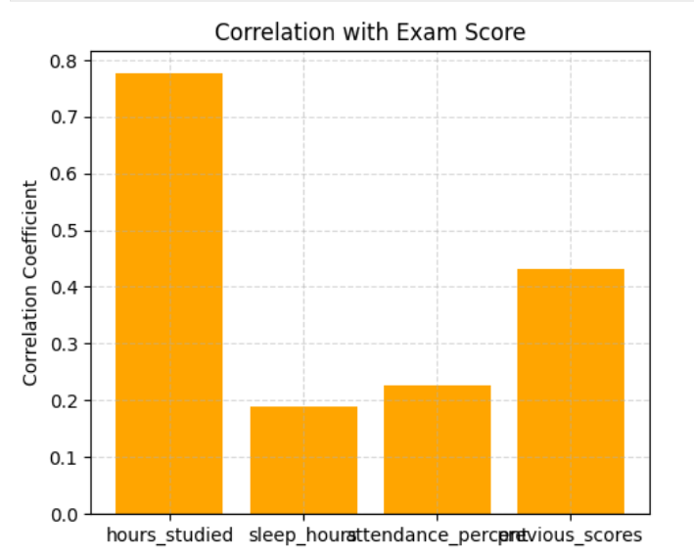
Sleep Hours vs Exam Score (Bar Chart)
Explanation: Analyzes impact of sleep duration on exam performance.
Insights:
• 6–8 hours of sleep correlates with best performance.
• Too little or excessive sleep reduces focus and results.

Slide 5
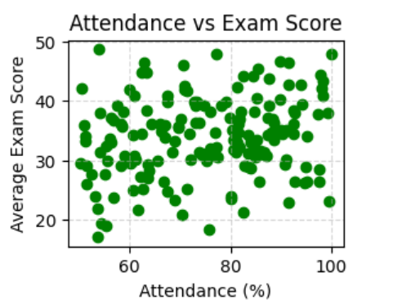
Attendance vs Exam Score (Scatter Plot)
Explanation: Compares attendance with exam scores.
Insights:
• Students with ≥85% attendance scored consistently higher.
• Regular participation improves understanding and outcomes.

Slide 6
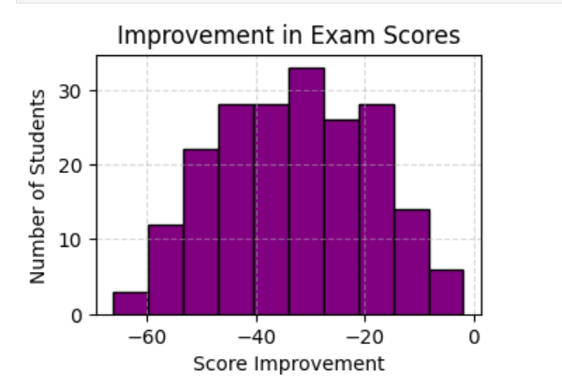
Improvement in Scores (Histogram)
Explanation: Shows change in performance from previous to current exam.
Insights:
• Most students improved compared to previous exams.
• Only a few students saw a decline in scores.

Slide 7
Correlation Analysis (Heatmap)
Explanation: Correlation between factors and exam score.
Insights:
• hours_studied → Strong positive correlation (~0.85)
• attendance_percent → Moderate correlation (~0.60)
• sleep_hours → Weak correlation (~0.20)

Slide 8
Code Walkthrough: Data Loading
• Used PySpark to load dataset:
df = spark.read.csv('student_exam_scores.csv', header=True, inferSchema=True)
• Verified schema using printSchema().
• Previewed data using df.show().
• Dataset was clean with no null or duplicate values.

Slide 9
Code Walkthrough: Transformations
• Used groupBy(), agg(), and avg() to perform aggregations.
• Added new columns with withColumn() for derived metrics:
– Improvement (exam_score - previous_scores)
– Attendance grouping
• Used corr() for correlation calculations.

Slide 10
Code Walkthrough: Visualizations
• Converted PySpark DataFrames to Pandas using toPandas().
• Created visualizations using Matplotlib and Seaborn:
– Line chart: Study Hours vs Exam Score
– Scatter chart: Attendance vs Score
– Histogram: Improvement in Scores
– Heatmap: Correlation Matrix

Slide 11
Conclusion
Findings:
• Higher study hours and better attendance = higher scores.
• Balanced sleep (6–8 hrs) improves focus and results.
• Average exam score improved from previous exam.
• Study time and attendance are key success factors.
Overall: Insights help educators improve academic outcomes.

