Slide 1
GIT (A version control system)
Srini Nagapuri

Slide 2
What is a Version control
Version control is a system that records changes to a file or set of files over time so that you can recall specific versions later.
If you are a graphic or web designer and want to keep every version of an image or layout (which you would most certainly want to), a Version Control System (VCS) is a very wise thing to use. It allows you to revert selected files back to a previous state, revert the entire project back to a previous state, compare changes over time, see who last modified something that might be causing a problem, who introduced an issue and when, and more.

Slide 3
Local Version Control Systems
Many people use version-control method of choice is to copy files into another directory (perhaps a time-stamped directory, if they are clever). This approach is very common because it is so simple, but it is also incredibly error prone. It is easy to forget which directory you're in and accidentally write to the wrong file or copy over files you don't mean to.
To deal with this issue, programmers long ago developed local VCSs that had a simple database that kept all the changes to files under revision control.

Slide 4
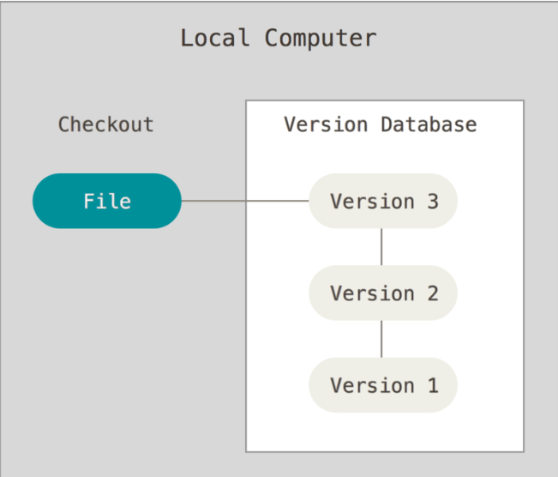
Local Version Control Systems

Slide 5
Centralized Version Control Systems:
The next major issue that people encounter is that they need to collaborate with developers on other systems. To deal with this problem, Centralized Version Control Systems (CVCSs) were developed. These systems (such as CVS, Subversion, and Perforce) have a single server that contains all the versioned files, and a number of clients that check out files from that central place. For many years, this has been the standard for version control.

Slide 6
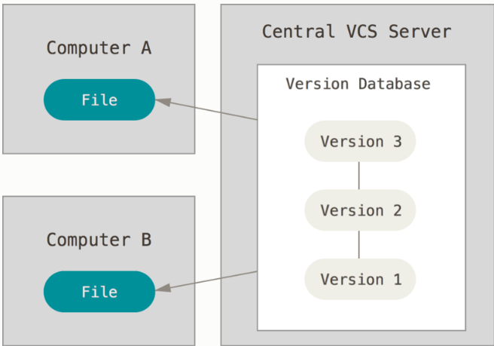
Centralized Version Control Systems

Slide 7
Distributed Version Control Systems
This is where Distributed Version Control Systems (DVCSs) step in. In a DVCS (such as Git, Mercurial, Bazaar or Darcs), clients don’t just check out the latest snapshot of the files; rather, they fully mirror the repository, including its full history. Thus, if any server dies, and these systems were collaborating via that server, any of the client repositories can be copied back up to the server to restore it. Every clone is really a full backup of all the data.

Slide 8
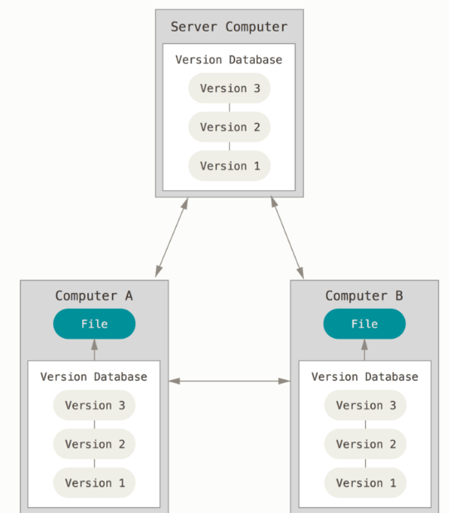
Distributed Version Control Systems

Slide 9
What is GIT?
Git is a version-control system for tracking changes in computer files and coordinating work on those files among multiple people. It is primarily used for source-code management in software development but it can be used to keep track of changes in any set of files. As a distributed revision control system, it is aimed at speed, data integrity, and support for distributed, non-linear workflows.

Slide 10
A Short History of Git:
The Linux kernel is an open source software project of fairly large scope. For most of the lifetime of the Linux kernel maintenance (1991-2002), changes to the software were passed around as patches and archived files. In 2002, the Linux kernel project began using a proprietary DVCS called BitKeeper.
In 2005, the relationship between the community that developed the Linux kernel and the commercial company that developed BitKeeper broke down, and the tools free-of-charge status was revoked. This prompted the Linux development community (and in particular Linus Torvalds, the creator of Linux) to develop their own tool based on some of the lessons they learned while using BitKeeper. Some of the goals of the new system were as follows:
Speed
Simple design
Strong support for non-linear development (thousands of parallel branches)
Fully distributed
Able to handle large projects like the Linux kernel efficiently (speed and data size)
Since its birth in 2005, Git has evolved and matured to be easy to use and yet retain these initial qualities. It’s amazingly fast, it’s very efficient with large projects, and it has an incredible branching system for non-linear development

Slide 11
Snapshots, Not Differences
The major difference between GIT and any other VCS (Subversion and Friends included) is the way Git thinks about its data. Conceptually, most other systems store information as a list of file-based changes. They store as a set of files and the changes made to each file over time. (this is commonly described as delta-based version control).
Git doesn't think of or store its data this way. Instead, Git thinks of its data more like a series of snapshots of a miniature filesystem. with Git, every time you commit, or save the state of your project, Git basically takes a picture of what all you files look like at that moment and stores a reference to that snapshot. To be efficient, if files have not changed. Git doesn't store the file again, just a link to the previous identical file has already stored. Git thinks about its data more like a stream of snapshots.

Slide 12
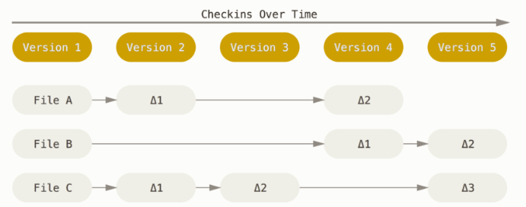

Slide 13
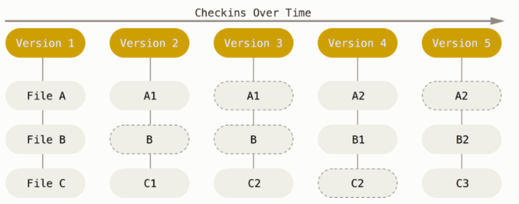

Slide 14
Git has Integrity:
Everything in Git is check summed before it is stored and is then referred to by that checksum. This means its impossible to change the contents of any file or directory without Git knowing about it.
The mechanism that Git uses for this check summing is called a SHA-1 hash. This is a 40-character string composed of hexadecimal characters (0-9 and a-f) and calculated based on the contents of a file or directory structure in GiT.
SHA-1 hash example:
24b9da6552252987aa493b52f8696cd6d3b00373

Slide 15
Git Generally only Adds Data
When you do actions in Git, nearly all of them only add data to the GIT database. It is hard to get the system to do anything that is not undoable or to make it erase data in any way. As with any VCS, you can lose or mess up change you haven't committed yet, but after you commit a snapshot into Git, it is very difficult to lose.

Slide 16
The Three States:
Git has three main states that your files can reside in: committed, modified, and staged:
Committed means that the data is safely stored in your local database.
Modified means that you have changed the file but have not committed it to your database yet.
Staged means that you have marked a modified file in its current version to go into your next commit snapshot.

Slide 17
Git directory, working tree, and staging area
The Git directory is where Git stores the metadata and object database for your project.
The working tree is a single checkout of one version of the project. these files are pulled out of compressed database in the GIT directory and placed on disk for you to use or modify.
The staging area is a file, generally contained in your GIT directory, that stores information about what will go into your next commit.

Slide 18
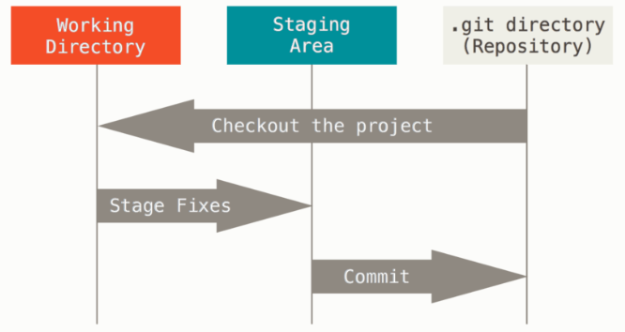

Slide 19
Git workflow:
You modify files in your working tree.
You selectively stage just those changes you want to be part of your next commit, which adds only those changes to the staging area.
You do a commit, which takes the files as they are in the staging area and stores that snapshot permanently to your Git directory.

Slide 20
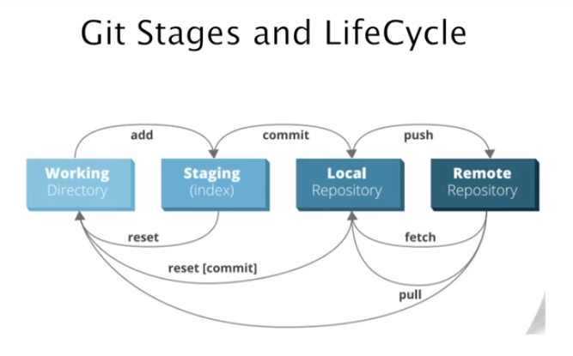

Slide 21
Git command line:
There are a lot of different ways to use Git. There are the original command-line tools, and there are many graphical user interfaces of varying capabilities. For one, the command line is the only place you can run all Git commands and GUI is only a partial subset of Git Functionality for simplicity.

Slide 22
Git installation:
To check if already installed
#git --version
To install on Redhat:
yum install git
To download TAR ball from internet:
https://github.com/git/git/releases

Slide 23
Git Branching
As we know that Git doesn't store data as a series of changesets or differences, but instead as a series of snapshots.
When you make a commit, Git stores a commit object that contains a pointer to the snapshot of the content you staged. This object also contains the author’s name and email address, the message that you typed, and pointers to the commit or commits that directly came before this commit (its parent or parents): zero parents for the initial commit, one parent for a normal commit, and multiple parents for a commit that results from a merge of two or more branches.

Slide 24
To visualize this, let’s assume that you have a directory containing three files, and you stage them all and commit. Staging the files computes a checksum for each one (the SHA-1 hash we mentioned in Getting Started), stores that version of the file in the Git repository (Git refers to them as blobs), and adds that checksum to the staging area:
git add README test.rb LICENSE
git commit -m 'the initial commit of my project'

Slide 25
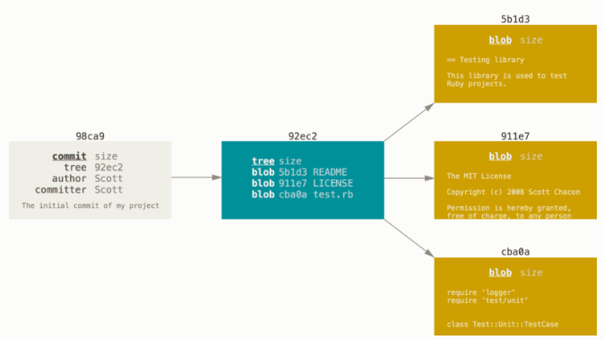
When you commit
Your Git repository now contains five objects: three blobs (each representing the contents of one of the three files), one tree that lists the contents of the directory and specifies which file names are stored as which blobs, and one commit with the pointer to that root tree and all the commit metadata. If you make some changes and commit again, the next commit stores a pointer to the commit that came immediately before it.

Slide 26
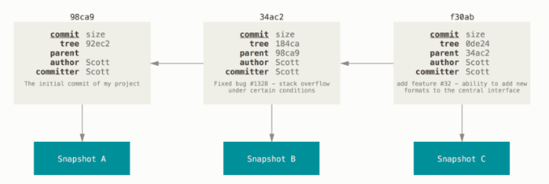
Commits and their parents
Notes:
If you make some changes and commit again, the next commit stores a pointer to the commit that came immediately before it.

Slide 27
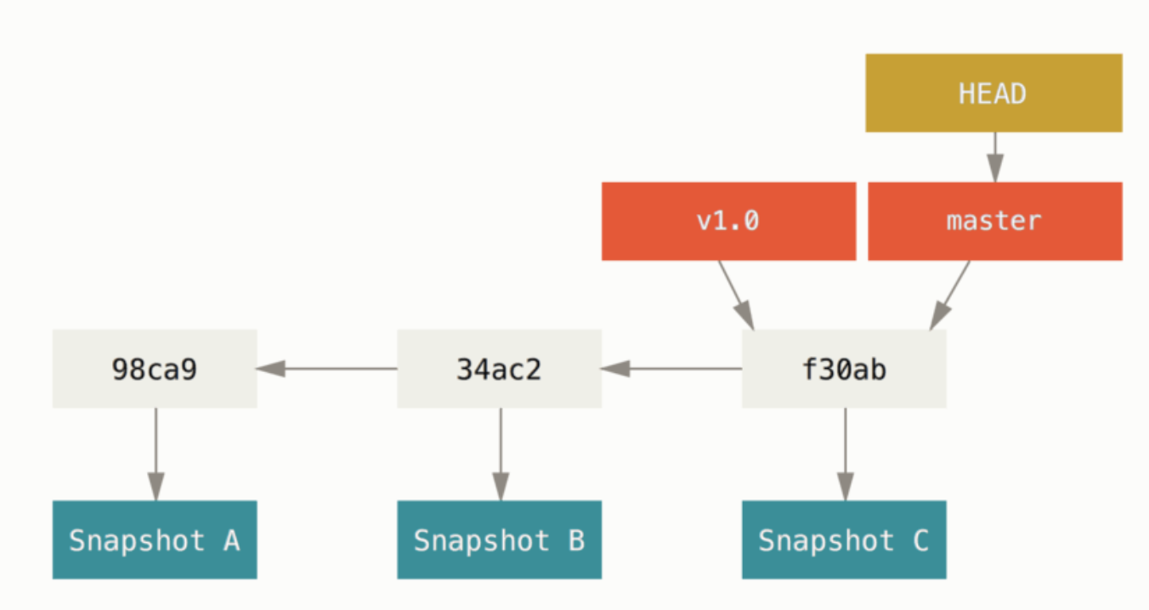
GIT Branching
A branch in Git is simply a lightweight movable pointer to one of these commits. The default branch name in Git is master. As you start making commits, you’re given a master branch that points to the last commit you made. Every time you commit, the master branch pointer moves forward automatically.

Slide 28
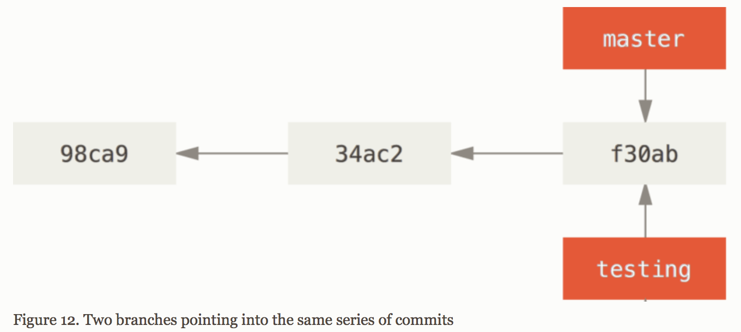
Creating a new branch
$ git branch testing

Slide 29
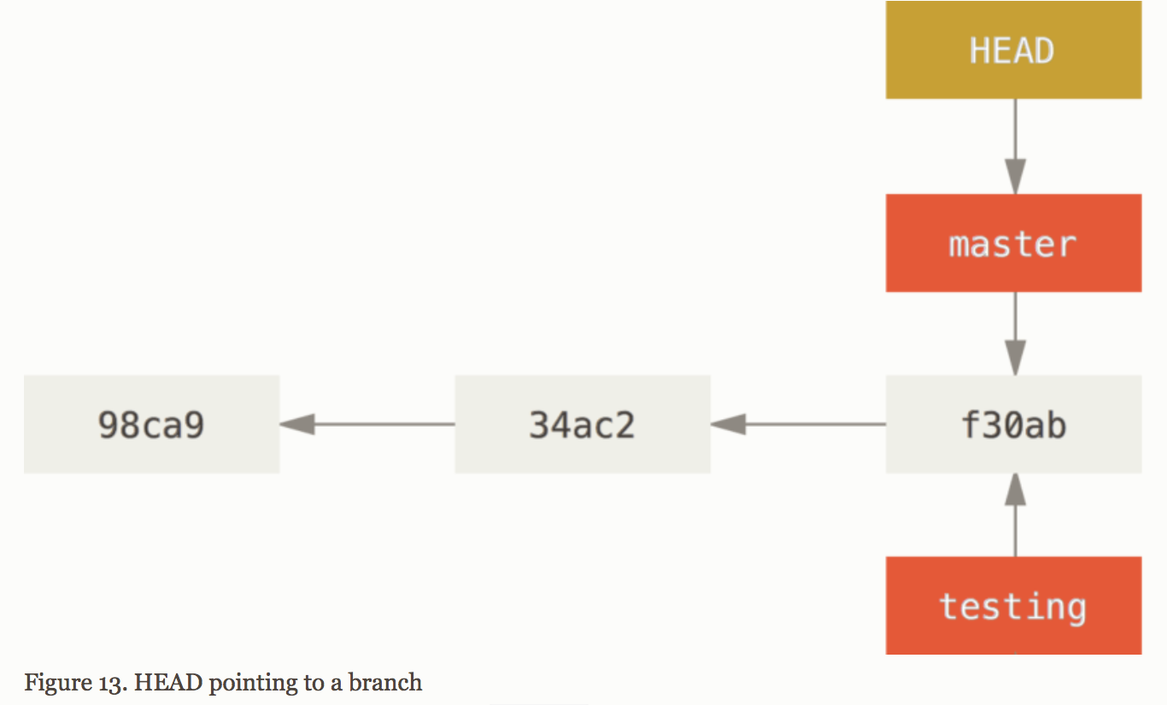
HEAD Pointer
How does Git know what branch you’re currently on? It keeps a special pointer called HEAD.
$ git log --oneline –-decorate
(shows where the HEAD pointer is pointing)

Slide 30
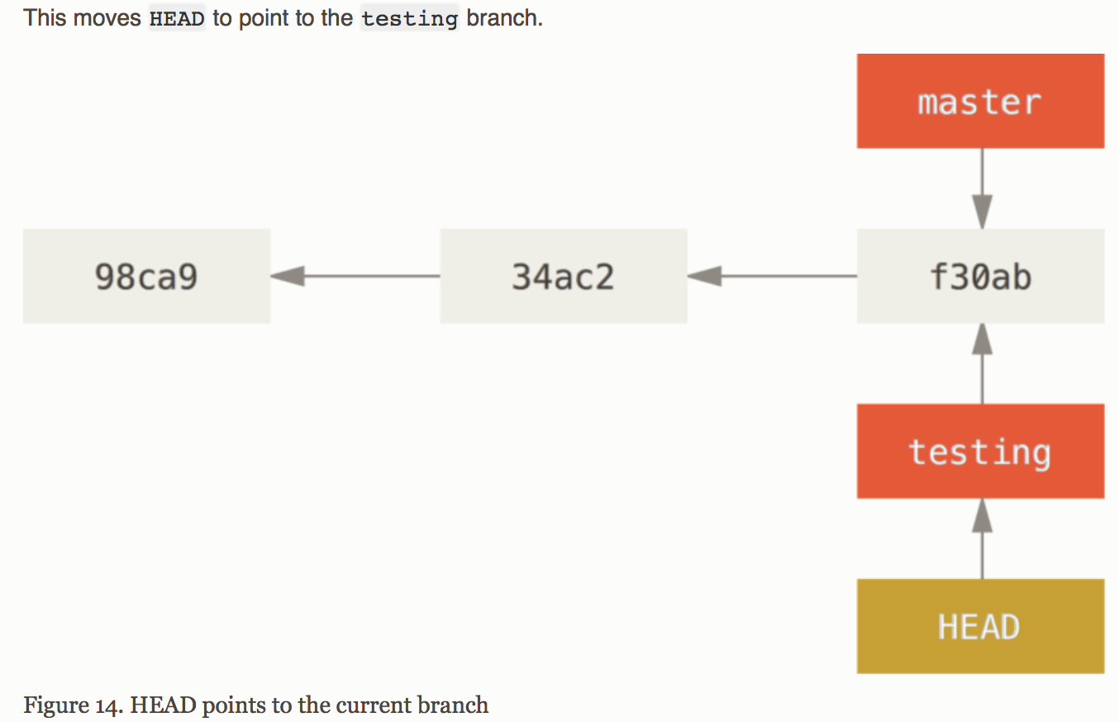
Switching Branches
$git checkout testing

Slide 31
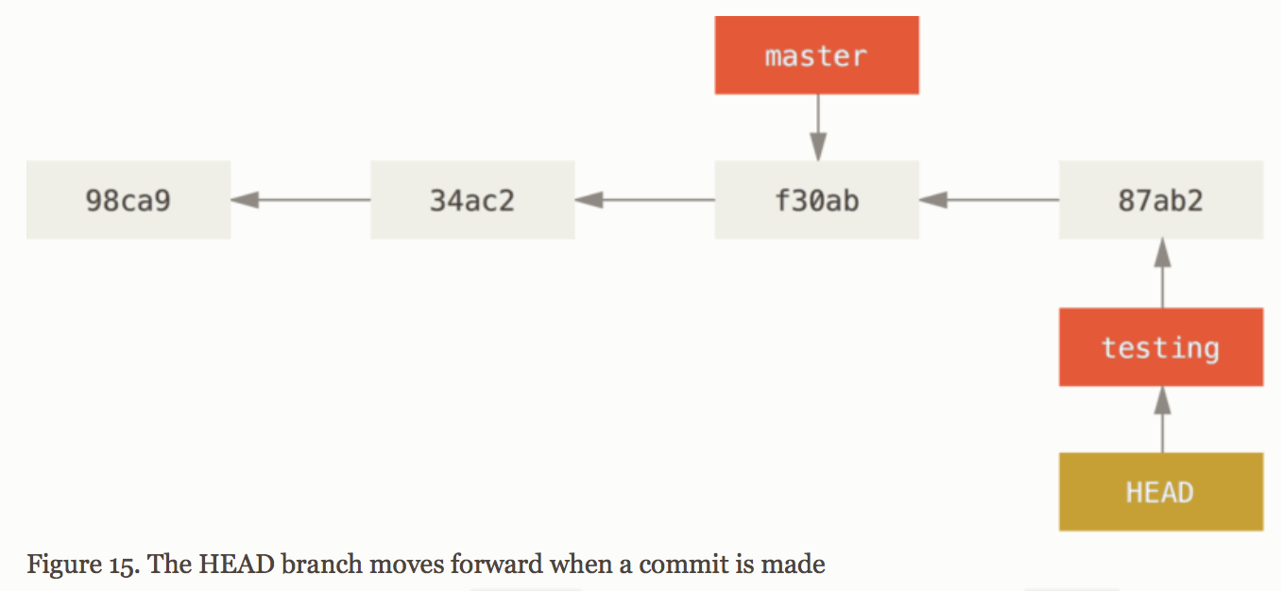
Another commit
$ vim test.rb
$ git commit -a -m 'made a change'

Slide 32
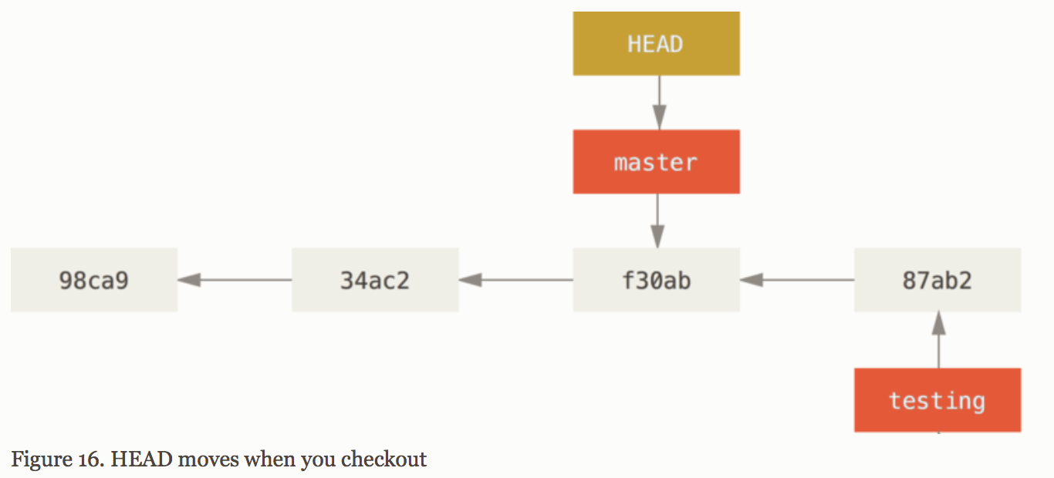
Moving HEAD to master
$git checkout master

Slide 33
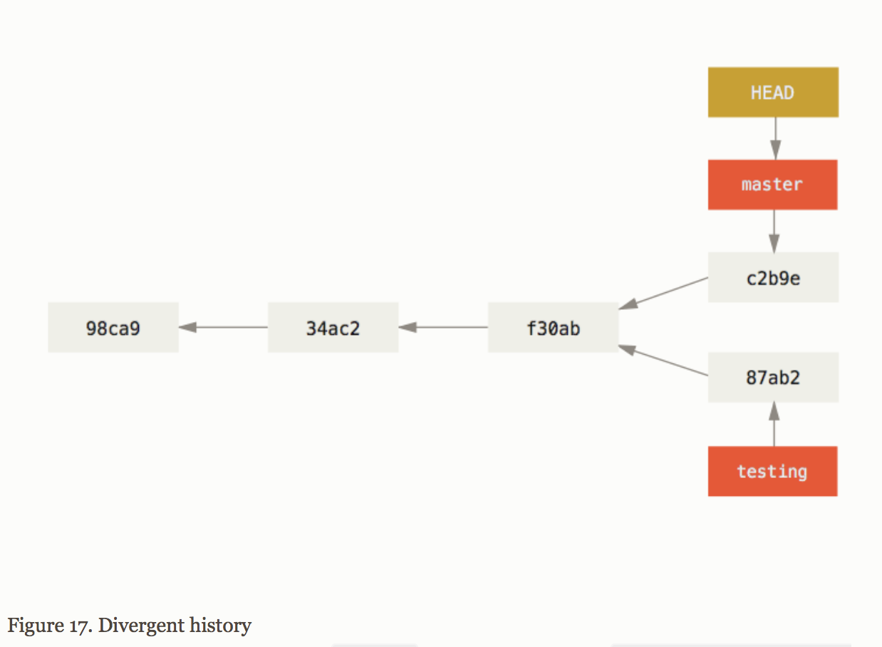
Other Commit while on MASTER
$ vim test.rb
$ git commit -a -m 'made other changes’
$ git log --oneline --decorate --graph –all
(To check the output for all the branches)

