Slide 1

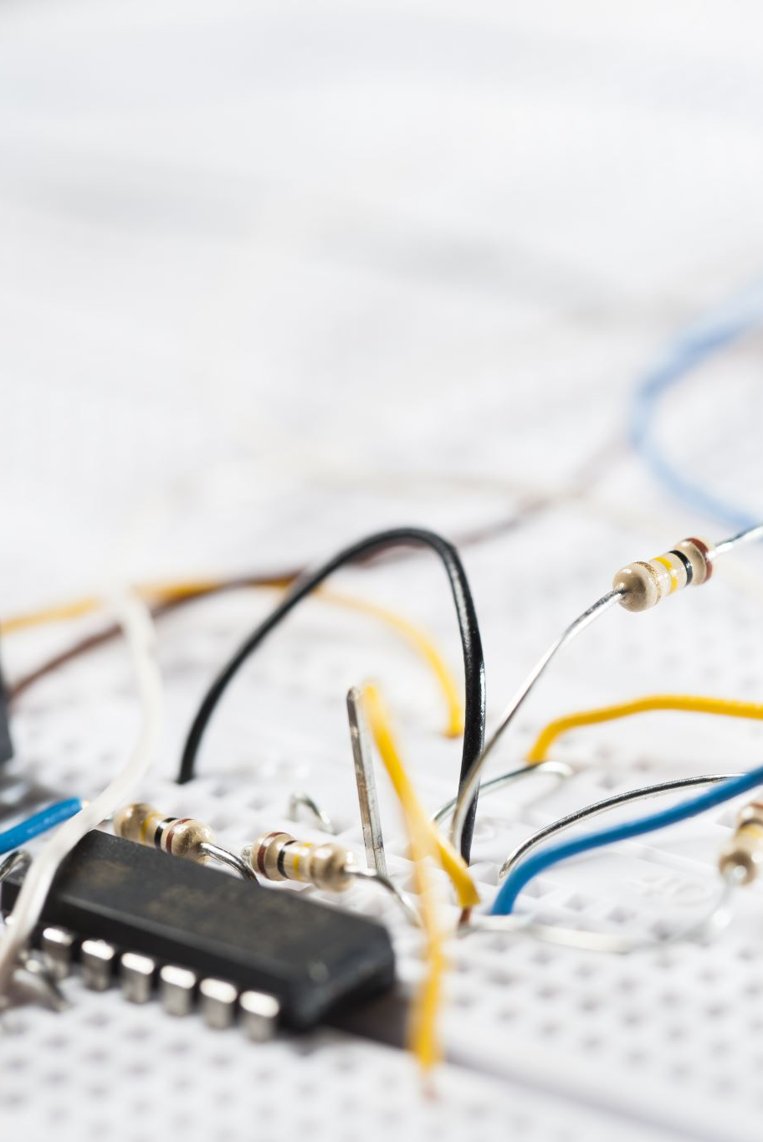
Transmission Line Fault Detection Using IoT and Machine Learning Algorithms
Team Members:
- Kaushik K (21MIS0332)
- Gopi Krishnan D (21MIS0368)
- Naresh R (21MIS0354)

Slide 2
Problem Statement
• Transmission lines require accurate and timely inspection.
• Current methods are expensive, slow, or ineffective.
• Delays lead to increased maintenance costs and downtime.
• Need for an IoT-based system with machine learning.

Slide 3
Objectives
• Develop an IoT-based real-time fault detection system.
• Detect faults such as short circuits, overcurrent, and overvoltage.
• Use machine learning for predictive maintenance.
• Notify maintenance teams instantly.

Slide 4
Existing Systems & Limitations
Manual Inspection: Time-consuming and error-prone.
SCADA: Expensive and complex.
Drones & Thermal Cameras: Costly and limited.
Limitations:
Delayed detection
High cost
Lack of predictive maintenance

Slide 5
Proposed System Overview
• IoT sensors, cloud technology, and machine learning.
• Automates the fault detection process.
• Improves safety, efficiency, and reliability.
• Sends real-time alerts for rapid response.

Slide 6
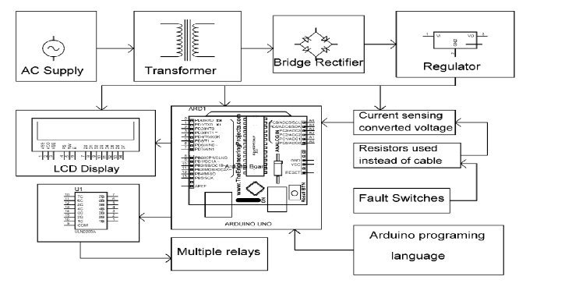
System Architecture
• Data Collection: Sensors gather real-time data.
• Processing: Microcontrollers preprocess data.
• Cloud Storage: ThingSpeak stores data.
• ML Model: Detects faults and predicts failures.
• Alerts: Notifies maintenance teams via email.

Slide 7

Hardware Components
• Sensors:
Current (ACS712)
Voltage (ZMPT101B)
Temperature (DHT22)
Ultrasonic
Flame
• Microcontrollers: ESP32/NodeMCU/Arduino.
• Relay Module: Controls load balance to prevent failures.

Slide 8
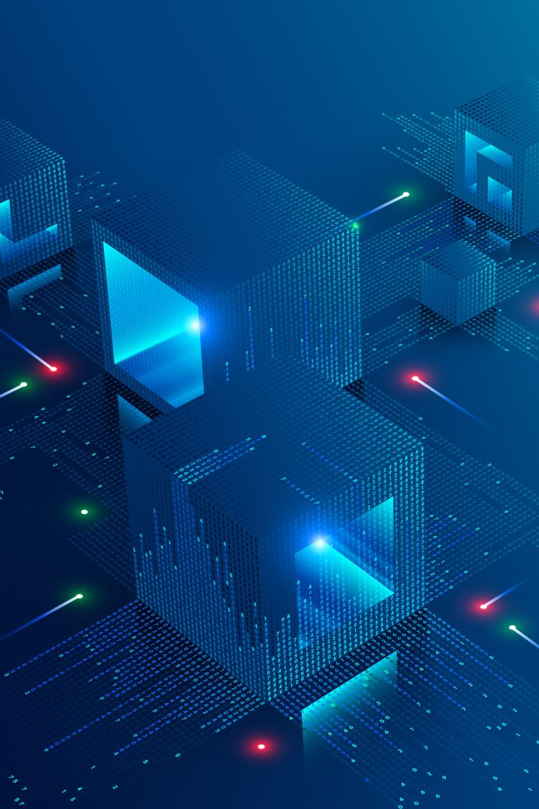
Software Components
• ThingSpeak Cloud: Stores and visualizes sensor data.
• Machine Learning Algorithms:
- Classifies fault types.
- Predicts faults in advance.
• Email Notifications: Secured via OAuth.

Slide 9
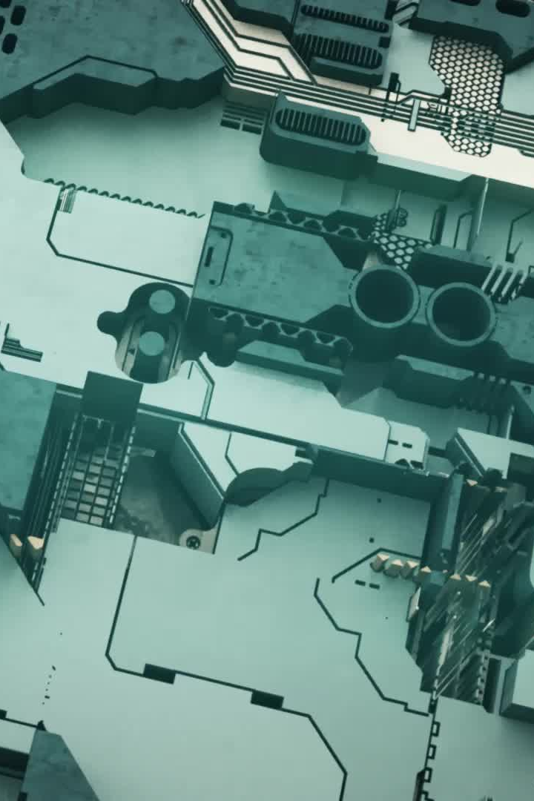
Working Mechanism
1. Sensors collect data.
2. Data processed by microcontrollers.
3. Sent to the cloud for analysis.
4. ML model detects faults.
5. Alerts sent to maintenance teams.

Slide 10

Advantages of the Proposed System
• Real-time Monitoring.
• Predictive Maintenance.
• Automated Alerts.
• Cost-Effective.
• Scalable for urban and rural grids.
• Disaster-Resistant.

Slide 11
Future Enhancements
• AI for better fault classification.
• Mobile App for monitoring.
• Integration with Smart Grids.
• More Sensor Types (humidity, wind speed).
• Blockchain Security for data protection.

Slide 12
Conclusion
• IoT and ML enable efficient fault detection.
• Automation minimizes human intervention.
• Faster response reduces downtime.
• Supports sustainable smart power grids.

