Slide 1
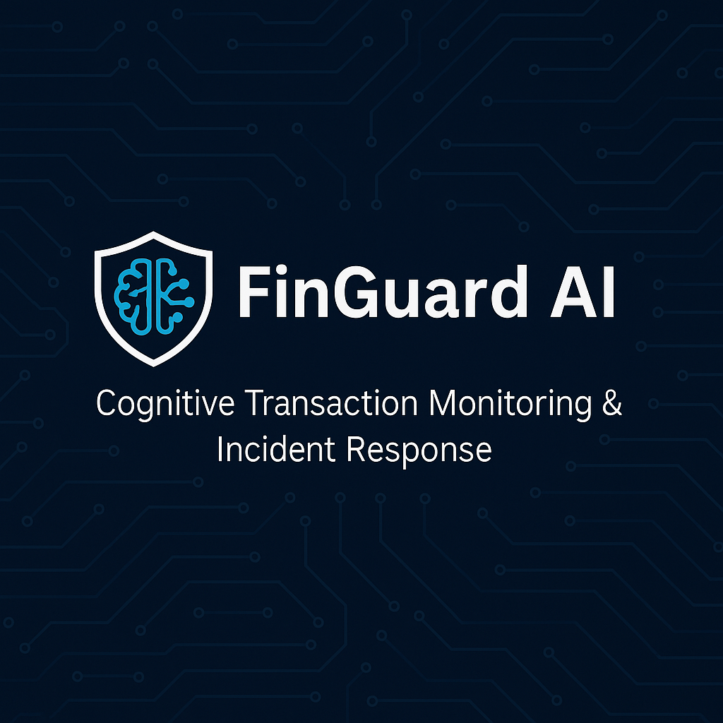

Slide 2
FinGuard AI – Cognitive Transaction Monitoring & Incident Response
Introduction:
Team Size | Team Members | Mentors and Coordinators
2 | Srinivasarao Palli Rajesh Kumber Birada | Rohan Shravan
A backend Agentic AI system that monitors real-time banking transactions, detects fraud, and interacts with customers for confirmation.
Built with MCP tools, LLM orchestration, and real-time event streaming.
Targets operational efficiency for fraud & customer support teams.
Milestone:
Week 1 (Aug2-Aug9) | Week 2 (Aug 10-16) | Week 3 (Aug17-Aug 23) | Week 4 (Aug 24-30)
Project Charter​ Architecture and flow design​. High-level and Low-level Design.​ | Project setup Multi-Agent Development Data Injection (Pipeline Setup) | UI Development Worked on Alerting system. (SMS/WhatsApp) | Optimized the Gen AI Model .​ Deployment Demo

Slide 3
Problem Statement & Solution
Problem Statement
Solution
Monitor and analyze real-time banking transactions to detect potential fraudulent activities before they are completed.
Reduce false positives in fraud alerts to avoid unnecessary customer inconvenience.
Automate customer verification and account actions to minimize operational delays and improve fraud resolution time.
This leads to financial losses, operational inefficiency, and reduced customer trust.
Real-Time Transaction Monitoring: Integrate with core banking APIs or streaming platforms (e.g., Kafka) to capture transactions as they happen.
AI-Based Fraud Scoring: Use ML & Gen AI models to detect anomalies and assign fraud risk scores.
Customer Notification & Verification: Securely contact customers via SMS/email/OTP to confirm suspicious transactions.
Automated Account Actions: Freeze or unfreeze accounts based on verified customer responses.
Case Logging & Analytics: Automatically log incidents in the CRM for audit and future model improvements.
Benefits
Faster Incident Resolution – Reduced turnaround time from detection to resolution.
Improved Detection Accuracy – Lower false positives and better fraud prevention rates.
Enhanced Customer Experience – Proactive communication with minimal service disruption.
Operational Efficiency – Reduced manual workload for customer support teams.
30%
Reduction

Slide 4



Proposed Architecture
Transaction System
Customer Does the transaction
Customer Transaction is injected into Kafka
Frond End
Customer Service Representative interact with UI
UI Shows all transaction fraud analysis results
API to pull the info DB
FinGuard Fraud Detection System
Read the transaction from Kafka
Identify Fraud Agent will identify the Fraud
Score Agent will provide the based Fraud rules
Customer Interaction send SMS
Incident Creation Agent create a Ticket depending for Tracking
FinGuard MCP Server:-
Tool1:ML Model to identify the risk
Tool2: Risk Score
Tool3: SMS System
Tool4: Ticket Mgmt System
FinGuard UI
Transaction System (Out of scope)
API
Data Injection
FinGuard Fraud Detection System
Read Transaction
Identify Fraud Agent
Score Agent
Customer Interaction Agent
Incident Create Agent
FinGuard MCP Server
MCP Server
ML Model to identify the Fraud
Risk Score Rules
SMS System
Ticket Mgmt System

Slide 5
FinGuard – MileStone 1
Milestone 1 Highlights:
Setup the Projects in Cursor.ai
Implementation of FinGuard Agent and MCP Server
Kafka setup
Artifacts:
# | Artifact | Type | Comment
1 | Data Injection | Excel | An excel file will customer transaction. Since Customer transaction is out of scope, taking data in excel file
2 | FinGuard Agent Code | Python Project
 | Transaction Reader, Fraud Identify agent, Risk Score Identifier, SMS System & Ticket Mgmt System | Python Code with LLM, ML, API | This completes the FinGuard AI Agent Process with MCP Server
3 | DB Setup | MongoDB | Send the Customer Analysis Result to Mongo DB

Slide 6
FinGuard AI - Overall Timeline
Week 1 (Aug2-Aug9) | Week 2 (Aug 10-16) | Week 3 (Aug17-Aug 23) | Week 4 (Aug 24-30)
Project Charter​ Architecture and flow design​. High-level and Low-level Design.​ | Project setup Multi-Agent Development Data Injection (Pipeline Setup) | UI Development Worked on Alerting system. (SMS/WhatsApp) | Optimized the Gen AI Model .​ Deployment Demo
Week | # | Task | POC | Status
Week1 | 1 | Git Project Creation | Srini Palli | Completed
 | 2 | Readme File | Srini Palli | Completed
 | 3 | Architecture Document | Srini Palli | Completed
Week2 |  | MCP Tools | Srini Palli
 | 4 | ML Model to Identify the Risk | Rajesh | Not Yet Started
 | 5 | Risk Level Score Identifier | Rajesh | Not Yet Started
 | 6 | SMS Agent | Srini Palli | Not Yet Started
 | 7 | Ticket Creation API Integrate with JIRA | Srini Palli | Not Yet Started
 |  | Agents
 | 8 | Identify Risk Agent | Rajesh | Not Yet Started
 | 9 | Risk Score Identifier Agent | Rajesh | Not Yet Started
 | 10 | Message Agent | Srini Palli | Not Yet Started
 | 11 | Ticket Creation Agent | Srini Palli | Not Yet Started
Week 3 | 12 | API to Retrieve the Transaction Analysis | Srini Palli | Not Yet Started
 |  | Agents
 | 13 | Message Agent | Rajesh | Not Yet Started
 | 14 | Ticket Creation Agent | Rajesh | Not Yet Started
 | 15 | FinGuard UI - React JS App | Srini Palli/Rajesh | Not Yet Started
Week 4 | 16 | Deployment to AWS | Rajesh | Not Yet Started
 | 17 | Kubernetes & Dockert (If possible) | Rajesh | Not Yet Started

Slide 7
FinGuard AI - Team
# | Member | Responsibility
1 | Srinivasarao Palli | Architect , GenAI Agent, API
2 | Rajesh Kumar Birada | Deployment in AWS, Front End,Agent Development

