Slide 1
Visualizing Sunburst Chart using Raw Tool and Microsoft Power BI
Presented by
Nishanth Reddy Kamballapalli
44-599 Introduction to Data Visualization
March 30, 2017

Slide 2
Outline
What is a Sunburst Chart?
What is Raw and Microsoft Power BI?
Features of Raw and Microsoft Power BI
Steps to use Raw and Microsoft Power BI
Goals
Demonstration
Lessons Learned

Slide 3
Dendrogram vs Sunburst Chart
Dendrogram:
A dendrogram is a tree diagram frequently used to illustrate the arrangement of the clusters produced by hierarchical clustering.
Sunburst Chart:
The circle in the center represents the root node, with the hierarchy moving outward from the center.
A segment of the inner circle bears a hierarchical relationship to those segments of the outer circle.

Slide 4
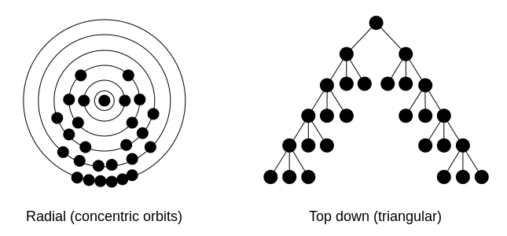
What is Sunburst Chart ?
A radial tree, or radial map, is a method of displaying a tree structure in a way that expands outwards, radially. It is one of many ways to visually display a tree.

Slide 5
What is Sunburst Chart (Cntd)
A sunburst chart is used to visualize hierarchical data, depicted by concentric circles.
It also known as a ring chart or a multilevel pie chart, Belt Chart, Radial Tree map.

Slide 6
What is RAW ?
Raw is an online web tool to create different visualizations
Developed by Mike Bostock and maintained by DensityDesign Research Lab (Politecnico di Milano)
It is built on D3.js
We can visualize different types of graphs and charts
Statistical Research
Data Processing
Data Science
Machine Learning

Slide 7
Features of RAW
Data is safe
Data is not sent or stored anywhere
We can use confidential data safely
Customizable
We can contribute to source code
You can add your custom layouts or edit the ones already available
Statistical Research
Data Processing
Data Science
Machine Learning

Slide 8
Advantages of RAW
User friendly
Does not require any registration
Drag and Drop functionality
We can drag and drop by categorizing them
Easy to import data
We can simply upload data into it
Statistical Research
Data Processing
Data Science
Machine Learning

Slide 9
Disadvantages of RAW
Hard to visualize complex and large data
Limited features
Color combinations are not good
We cannot download chart if there are many records
Statistical Research
Data Processing
Data Science
Machine Learning

Slide 10
What is Microsoft Power BI ?
Power BI is a cloud-based business analytics service
It enables anyone to visualize and analyze data with greater speed, efficiency, and understanding.
It connects users to a broad range of data through easy-to-use dashboards, interactive reports, and compelling visualizations that bring data to life.
Statistical Research
Data Processing
Data Science
Machine Learning

Slide 11
Features of Microsoft Power BI
Visualize data, wherever it is
Excel spreadsheets, cloud services, streaming data.
Be informed: always real time
If you signup updates are sent to your mail-id.
Ask questions, get answers
If you own a dataset, you can add your own featured questions to that dataset.
Statistical Research
Data Processing
Data Science
Machine Learning

Slide 12
Advantages of Microsoft Power BI
Available for free
Power BI support mobile devices
It is great for Excel users
Statistical Research
Data Processing
Data Science
Machine Learning

Slide 13
Disadvantages of Microsoft Power BI
Limitations in sharing
Only shared with users who have the same email domains or email domains listed with your Office 365 tenant.
It is pretty complex
It doesn’t have a solution for data quality
Microsoft Power BI assumes that the data you’re pulling has already been properly scrubbed and cleaned up.
Statistical Research
Data Processing
Data Science
Machine Learning

Slide 14
Goals
To visualize sunburst chart for categories of Wine (dataset1)
To visualize sunburst chart for the Oscars awards data that includes categories by year (dataset2)
best picture
best actor
best actress
Statistical Research
Data Processing
Data Science
Machine Learning

Slide 15
Dataset 1
Parent | Classification01 | Classification02 | Classification03 | Classification04
Wine | Aromas | Fruits White Wine | Citrus | Grapefruit
Wine | Aromas | Fruits White Wine | Tree Fruits | Pear
Wine | Aromas | Floral | Jasmine
Wine | Bouquet | Oak Aging | Coffee
Wine | Bouquet | Fortified Wine | Prune
Wine | Faults | Oxygen | Sherry
Wine | Faults | Sulfides | Ethyl Mercaptan | Onion
Statistical Research
Data Processing
Data Science
Machine Learning
Total records = 73
Data source: http://www.aculocity.com/Areas/Labs/Data/sunburst/WineTasting%20Wheel.json

Slide 16
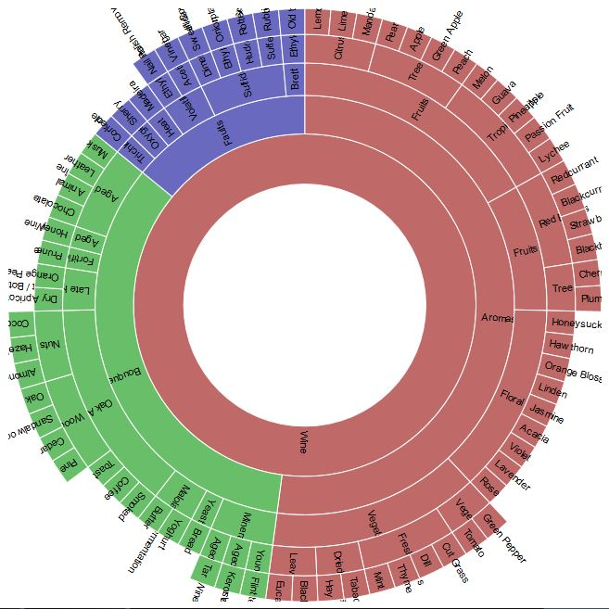
Solution of Goal1 using Raw tool
Notes:
Github Link: https://github.com/srinishanthreddy1991/SunburstChart

Slide 17
Dataset 2
Year | Category | Nominee | Winner/Looser
2017 | Best Picture | Moonlight | Winner
2017 | Best Picture | Arrival | Looser
2017 | Best Actor | Ryan Gosling | Looser
2017 | Best Actor | Casey Affleck | Winner
2017 | Best Actress | Ruth Negga | Looser
2016 | Best Picture | The Big Short | Looser
2016 | Best Actor | Leonardo DiCaprio | Winner
Statistical Research
Data Processing
Data Science
Machine Learning
Total records = 153
Data source: http://oscar.go.com/nominees

Slide 18
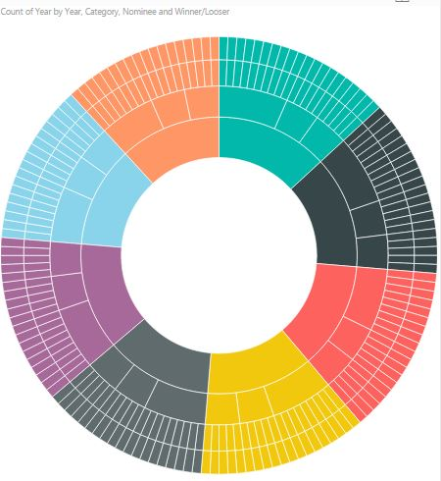
Solution of Goal2 using Microsoft Power BI
Statistical Research
Data Processing
Data Science
Machine Learning
Notes:
Github Link: https://github.com/srinishanthreddy1991/SunburstChart

Slide 19
Demonstration
Statistical Research
Data Processing
Data Science
Machine Learning

Slide 20
Lessons Learned
Researching and evaluating data visualization tools
Detail documentation of work sheet
Preparing slides for presentation
How to visualize data using sunburst diagram
What data should be used for sunburst charts
How to use RAW tool and Microsoft Power BI
Statistical Research
Data Processing
Data Science
Machine Learning

Slide 21
Statistical Research
Data Processing
THANK YOU
Data Science
Machine Learning

