Slide 1

Real-time locating system (RTLS) using Ultra-Wide Band
Ms. Beerelly Srinitha,
CS20B1004,
IIIT Raichur

Slide 2
Contents
Problem Statement
Introduction
Related Works
Ultrawide Band
Localization Techniques and Positioning Algorithms
Methodology
Proposed Architecture
Proposed Algorithm
Simulation
Localization Simulation
LOS and NLOS Scenarios
Importance of Number of Anchors
Trajectory Prediction Using LSTM Model
Optimal Anchors Position Recommendation System
Conclusion

Slide 3
Problem Statement
In an era where accuracy, precision and efficiency reign supreme, businesses and industries are constantly seeking innovative solutions to streamline their operations.
One such groundbreaking technology making waves in various sectors is RTLS. It is a sophisticated framework designed to accurately track and monitor the real-time location of assets, personnel, or any desired object within a defined space.

Slide 4
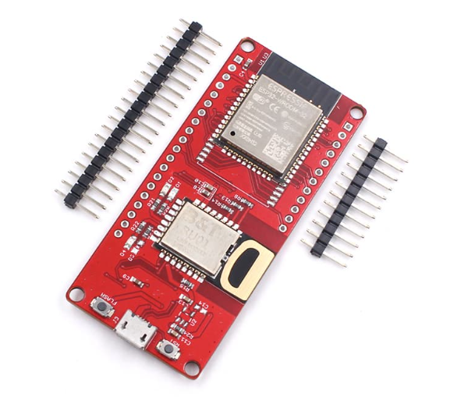
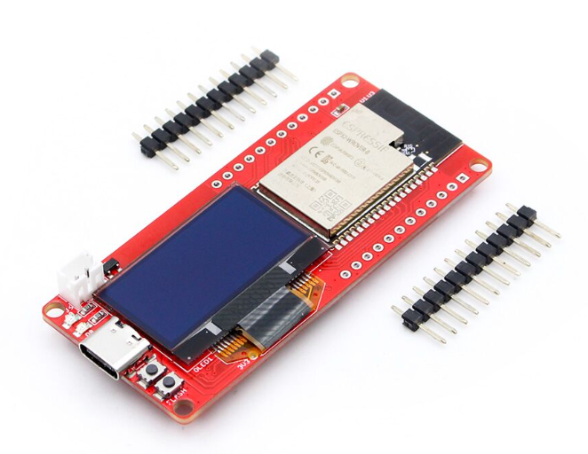
Introduction
Ultrawide Band
Bandwidth | 500 MHz
Data rate | 7 to 27 megabits per second
Frequency range | 3.1 and 10.6 GHz
Battery | Low consumption
Range | up to 200 meters (656 feet) based on the IEEE 802.15.4a standard(200 for ESP32 UWB PRO)
Accuracy | 10 cm (3.9 inches)
Cost | 2000 – 5000 INR
Best For | Proximity Marketing, Customer Analytics, Indoor Navigation, Smart Homes, Factory Automation, Asset-Tracking, Logistics
Fig 1. DW1000 UWB Module
Fig 2. DW3000 UWB Module

Slide 5
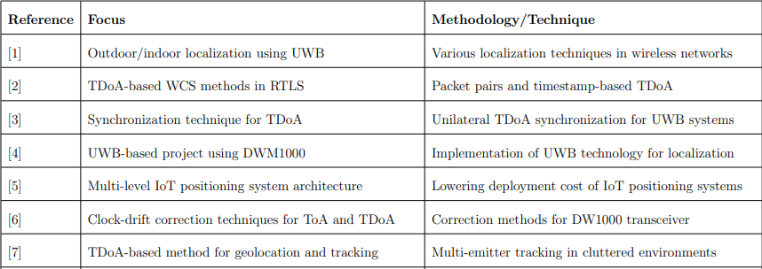
Related Works

Slide 6
Localization Techniques and Position Calculation Algorithms
Interpretation of Data
TOF - Using Two-way time-of-arrival(TW-TOA)
Time-difference-of-arrival (TDOA)
Position Calculation Algorithms
Trilateration
Triangulation

Slide 7
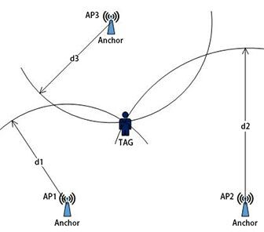
Time of Flight(TOF) -
Using Two Way Time Of Arrival(TW-TOA)
TOF is a method based on two way ranging.
Tag needs to send and receive signals of the anchor several times
Fig 3. TOF For Localization

Slide 8
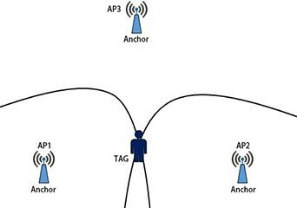
Time Difference Of Arrival (TDOA)
Fig 4. TDOA For Localization
The UWB tag will send out poll message and all the nearby UWB anchors will receive it and record the arrival time

Slide 9
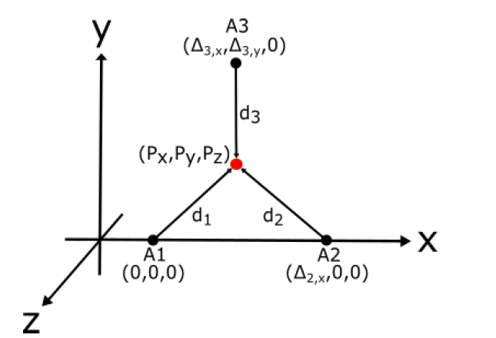
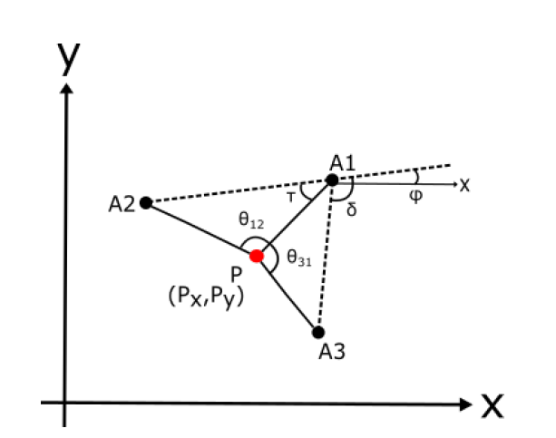
Position Calculation Algorithms
Trilateration
Triangulation
Fig 5. Trilateration
Fig 6. Triangulation

Slide 10
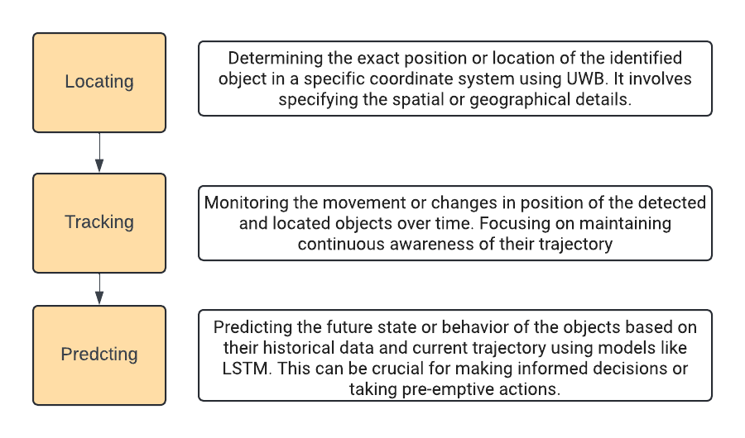
Methodology

Slide 11
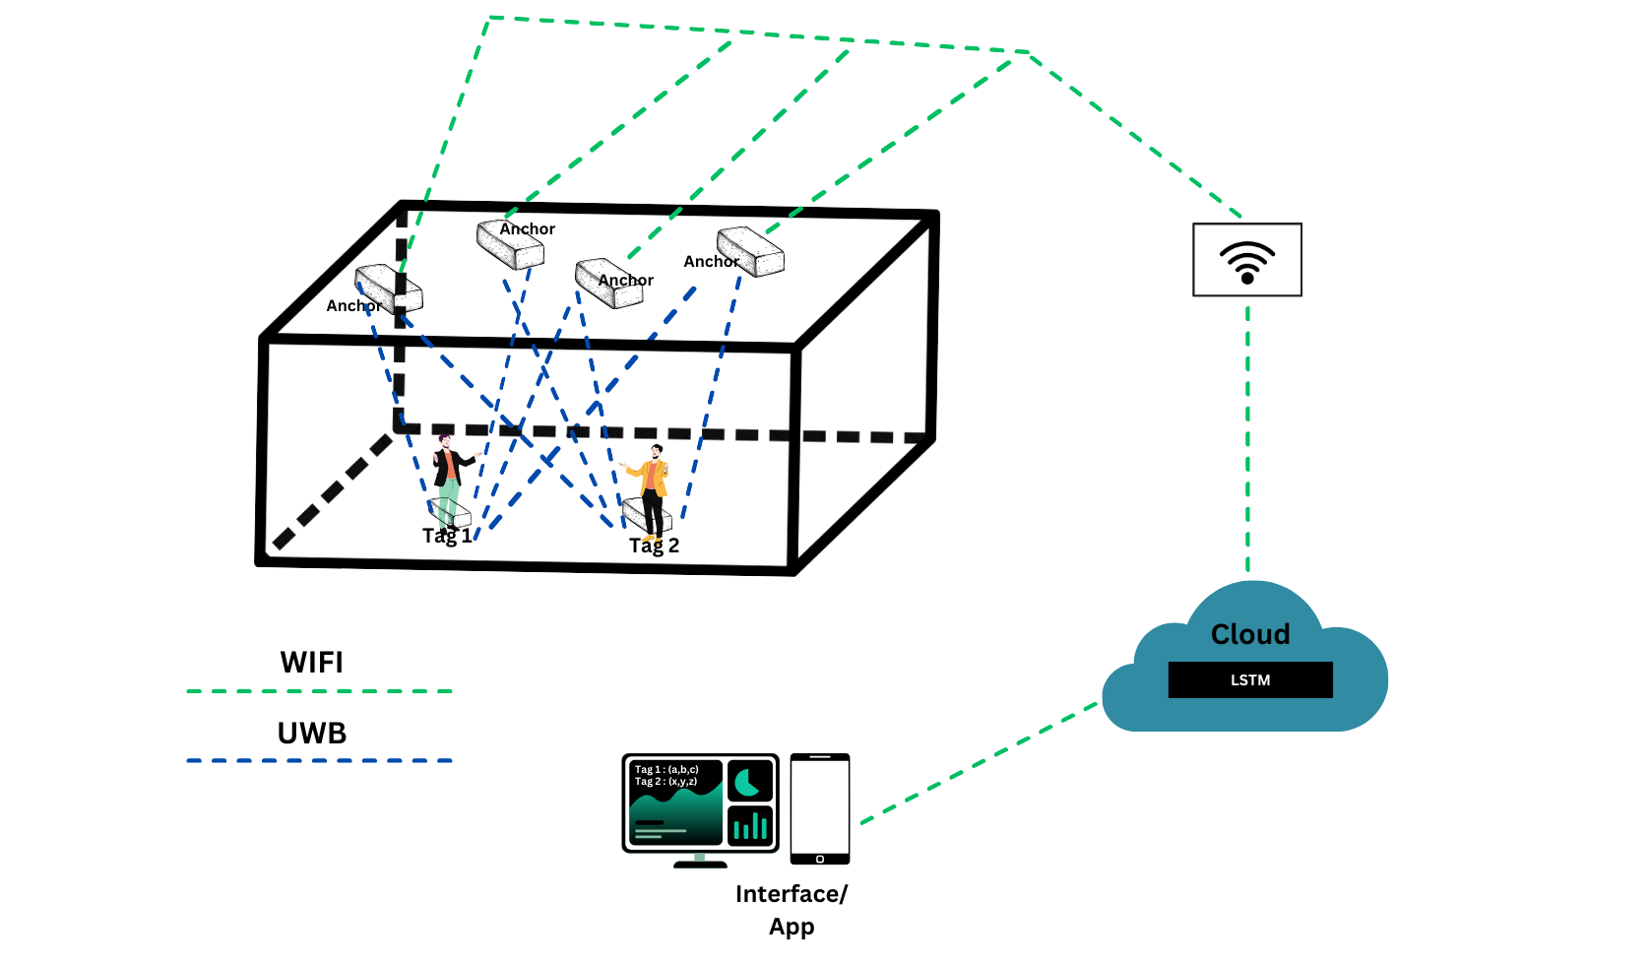
Proposed Architecture

Slide 12
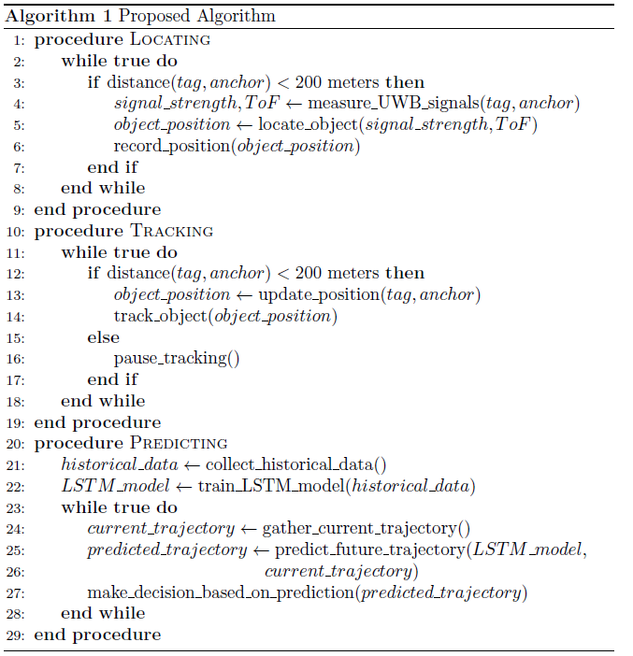
Proposed Algorithm

Slide 13
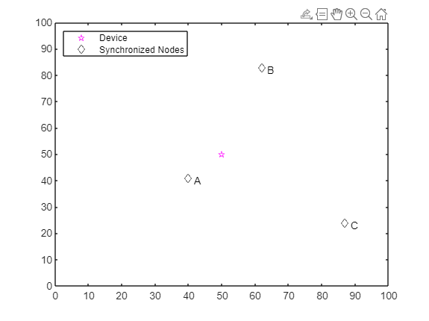
Simulation
The following is the simulation scenario of UWB localization using Matlab
TDOA is used in this simulation for localization.
Table 1. Simulation Parameters
Parameters | Values
Tag Initial Location | [50 50]
Anchor 1 Location | [40 41]
Anchor 2 Location | [62 83]
Anchor 3 Location | [87 24]
Tag Velocity | [0.5, 0.2]
Simulation Area | 100 x 100
Fig 7. Simulation Scenario (3 anchors and 1 tag).

Slide 14
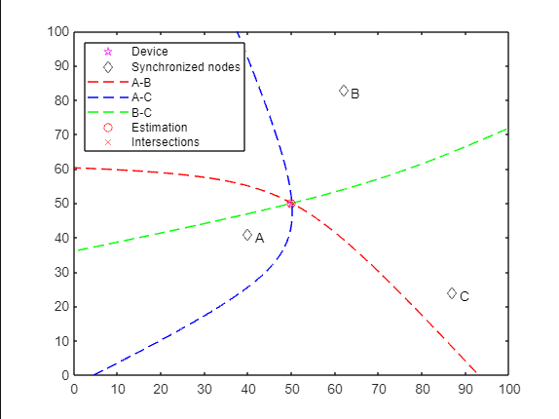
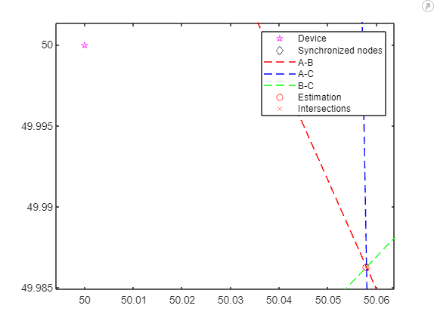

Case 1: Anchors and Tags are Fixed
Fig 8. Localization of the tag in static case using UWB
Fig 9. Zoomed in Version of Fig 11

Slide 15
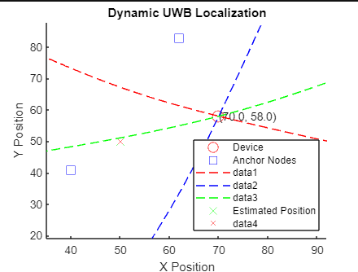
Case 2: Anchors are Fixed and Tag is Dynamic
Fig 10. Localization of the tag in dynamic case using UWB
Fig 11. Simulation of localization in dynamic case

Slide 16
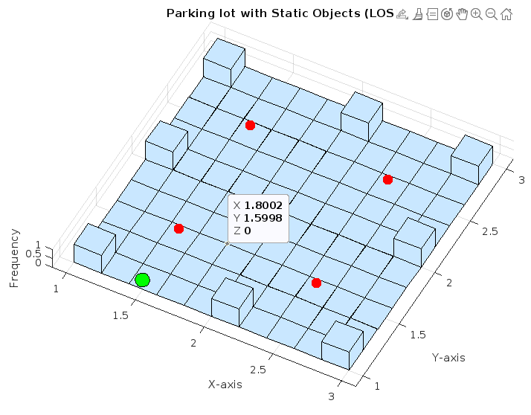
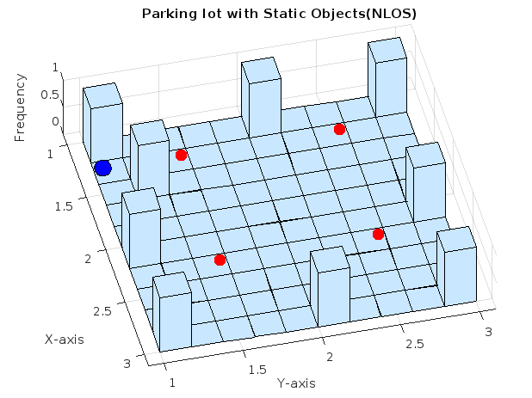
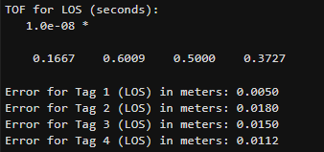
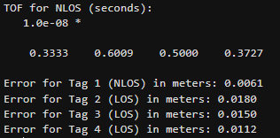
LOS and NLOS Scenario
Case 1: Line Of Sight
Case 2: Non Line Of Sight

Slide 17
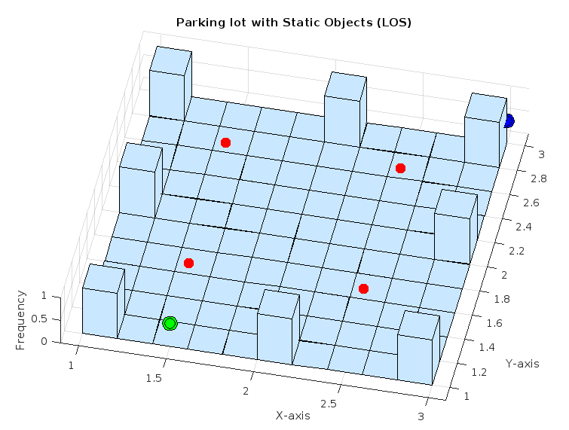
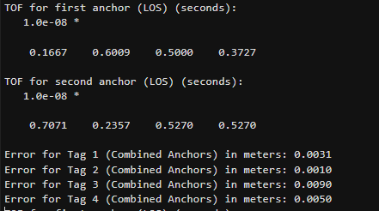
Importance of Number of Anchors
Case 1: One Anchor (LOS)
Case 2: Two Anchors (LOS)

Slide 18
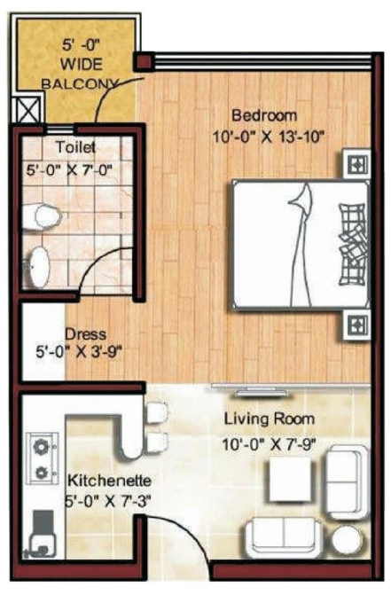
Optimal Anchor Position Recommendation System
Floor Map Features:
Table 2. Floor Map Characteristics
Parameters | Values
Size | 400 * 600 Sq.Ft
Map Type | 1BHK
Fig 13. Floor Map

Slide 19
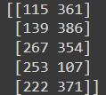
Cases:
Fixed:
Number of Tags : Fixed
Number of Anchors : Fixed
Tags positions : Randomly generated
Anchor positions : Predicted.
Table 3. Simulation Parameters
Parameters | Values
Number of Tags | 5
Number of Anchors | 3
Randomly Generated Tag Positions

Slide 20
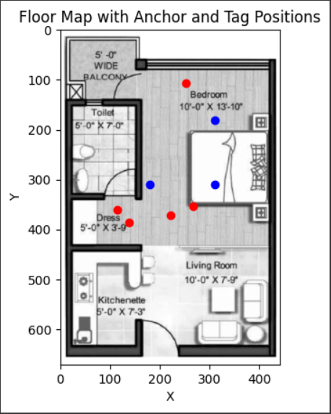

Anchor
Tag
Predicted Anchor Positions
Fig 14 . Floor Map with Tags and Anchors Positioned

Slide 21
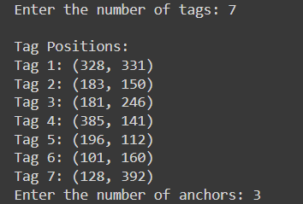
Cases:
2. On Demand:
Number of Tags : By the user
Number of anchors : By the user
Tags positions : Randomly generated
Anchor positions : Predicted.
Table 4. Simulation Parameters
Parameters | Values
Number of Tags | By user
Number of Anchors | By user
Input taken from User and Tag positions are Randomly generated

Slide 22
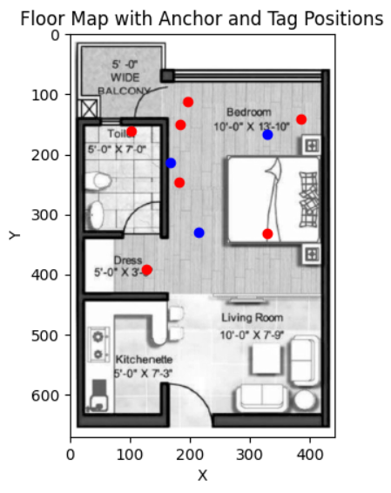

Anchor
Tag
Predicted Anchor Positions
Fig 15 . Floor Map with Tags and Anchors Positioned

Slide 23
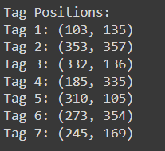
Cases:
3. No Demand:
Number of Tags : By the user
Number of anchors : Automatically assigned by the algorithm
Tags positions : Randomly generated
Anchor positions : Predicted.
Table 5. Simulation Parameters
Parameters | Values
Number of Tags | By user
Number of Anchors | By Algorithm
Input taken from User and Tag positions are Randomly generated

Slide 24
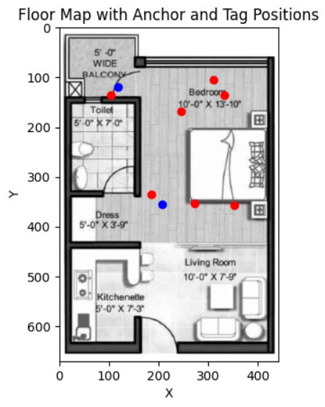

Anchor
Tag
Predicted Anchor Positions
Fig 15 . Floor Map with Tags and Anchors Positioned

Slide 25
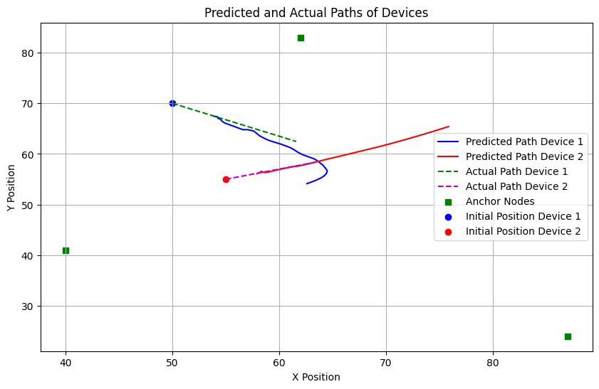
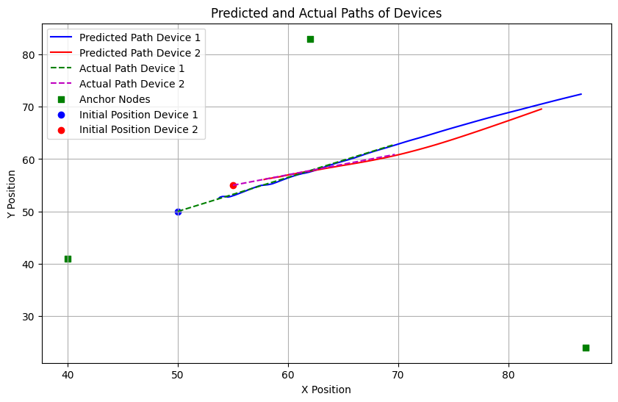
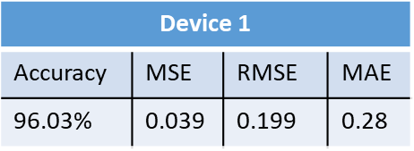
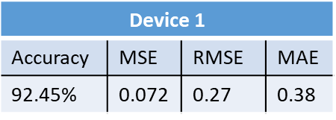
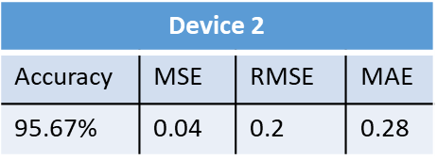
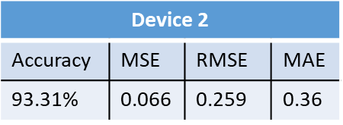
Trajectory Prediction Using LSTM Model
num_time_steps = 99
num_time_steps = 59

Slide 26
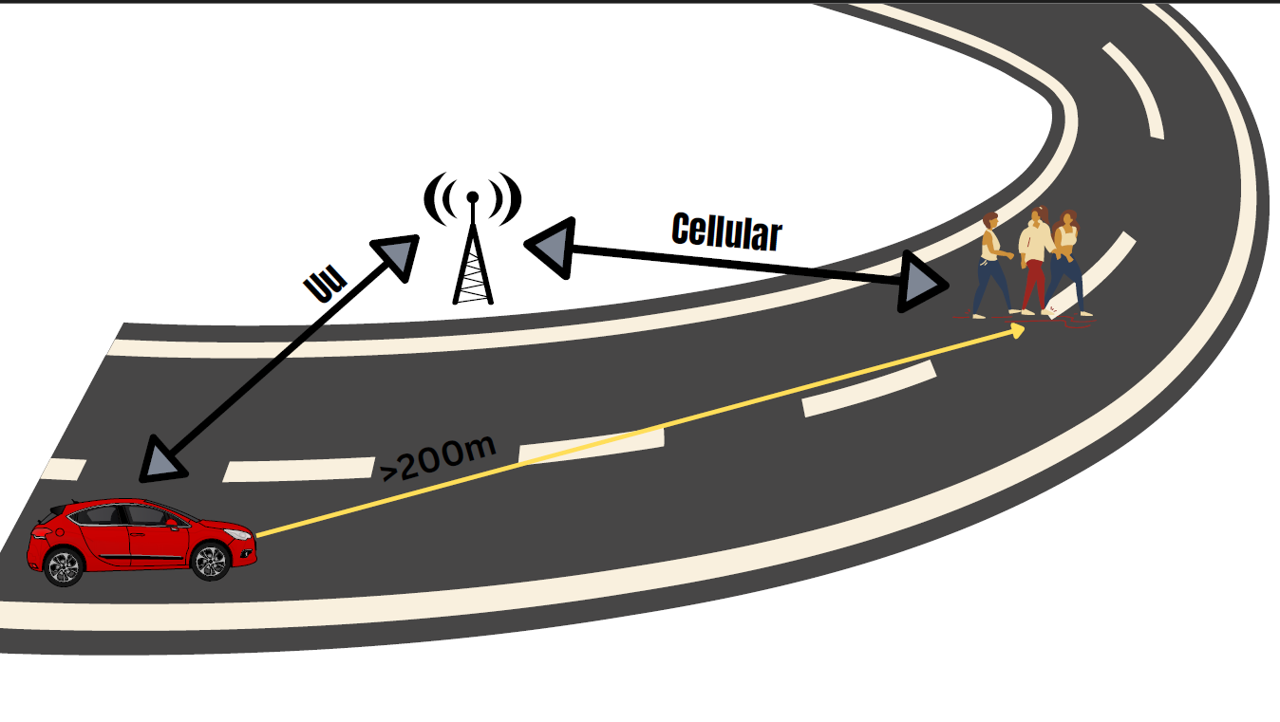
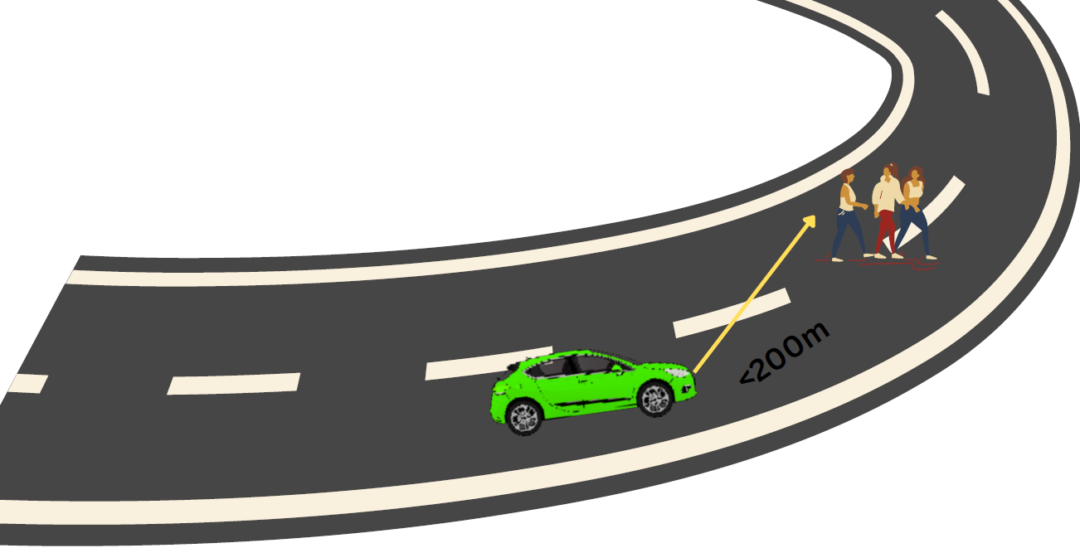
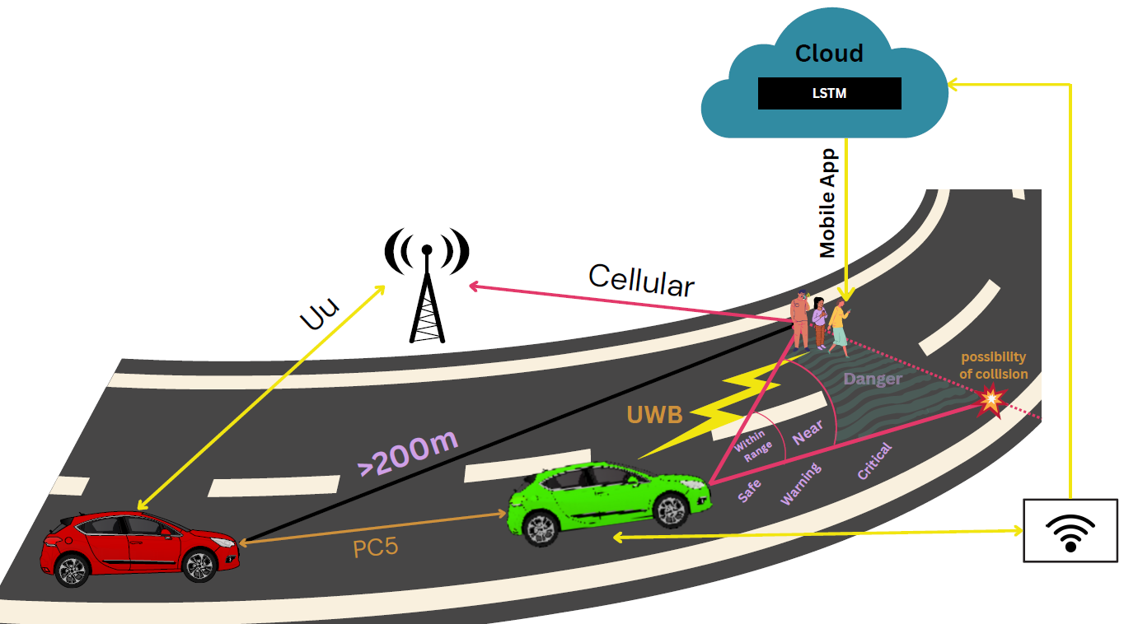
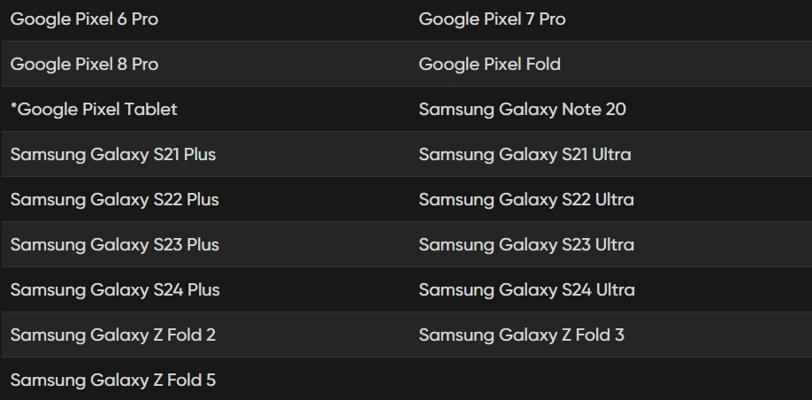
Real time Scenario
Detecting
Locating
Tracking and Predicting
UWB Supporting Models

Slide 27
Conclusions
UWB localization was virtually executed. Simulations for different scenarios were performed
Developed an LSTM model to predict the path trajectory of the tag.
Environments like LOS and NLOS were evaluated.
Importance of the number of anchors was discussed .
Optimal anchor recommendation system was proposed.

Slide 28
References
[1] Al-Ammar MA, Alhadhrami S, Al-Salman A, Alarifi A, Al-Khalifa HS, Alnafessah A, Alsaleh M. Comparative survey of indoor positioning technologies, techniques, and algorithms. In2014 International Conference on Cyberworlds 2014 Oct 6 (pp. 245-252). IEEE.
[2] Djaja-Josko V, Kolakowski J. A new method for wireless synchronization and TDOA error reduction in UWB positioning system. In2016 21st International Conference on Microwave, Radar and Wireless Communications (MIKON) 2016 May 9 (pp. 1-4). IEEE.
[3] Zandian R, Witkowski U. Implementation challenges of synchronisation of UWB nodes in TDoA structures. In2018 International Conference on Indoor Positioning and Indoor Navigation (IPIN) 2018 Sep 24 (pp. 1-8). IEEE. 4] Tiemann J, Eckermann F, Wietfeld C. Atlas-an open-source tdoa-based ultra-wideband localization system. In2016 International Conference on Indoor Positioning and Indoor Navigation (IPIN) 2016 Oct 4 (pp. 1-6). IEEE. 5] Chen J, Shi T, Liu Y, Wu S. A time-compensation TDOA-based wireless positioning method for multi-level IoT positioning. In2019 15th International Wireless Communications & Mobile Computing Conference (IWCMC) 2019 Jun 24 (pp. 1731-1736). IEEE.
[6] Sidorenko J, Schatz V, Scherer-Negenborn N, Arens M, Hugentobler U. Error corrections for ultrawideband ranging. IEEE Transactions on Instrumentation and Measurement. 2020 May 22;69(11):9037-47.
[7] Sathyan T, Sinha A, Kirubarajan T. Passive geolocation and tracking of an unknown number of emitters. IEEE Transactions on Aerospace and Electronic Systems. 2006 Apr;42(2):740-50.

Slide 29
Thank You

