Slide 1
Case Study Presentation
Decoding a Decade of Disruption: Analyzing Startup Funding Trends in India (2015–2025)
SRINITHI K - CB.SC.U4CSE24655
B.Tech Computer Science · Amrita Vishwa Vidyapeetham, Coimbatore
Data Visualization Case Study · October 2026
INDIAN STARTUP FUNDING TRENDS
1

Slide 2
Problem Statement and Objectives
Problem background: India’s startup ecosystem has seen boom and slowdown phases since 2015, but raw deal records do not show how funding, sectors, cities and investors changed.
Problem statement: How have funding amount, deal activity, sector mix, city concentration and investor participation in Indian startups changed from 2015 to 2025?
Analytical objectives: (1) Trend of total funding vs deal count by year; (2) sector share shift, 2015–17 vs 2023–25; (3) top cities’ share of funding; (4) deal size by stage and most active investors.
Why it matters: Shows investors, founders and policymakers where capital flows, and how far the data can be trusted.
SECTION 1 · 5 MARKS
2

Slide 3
Dataset Description
Dataset name and source: Kaggle – “Indian Startup Funding” (Sudalai Rajkumar, 2015–2020) and “Indian Startup Funding Dataset 2020–2025” (Vagdevi Titiksha G).
Domain and coverage: Startup funding deals in India, January 2015 – June 2025.
Dataset size: About 4,144 deals after merging (3,044 + 1,100), with 8 shared columns plus a Data Source flag.
Key attributes and types: Startup, Industry, SubVertical, City, Investors, InvestmentType (text); Amount in USD (numeric); Date (datetime).
Data quality concerns: Malformed dates, about 24% of amounts undisclosed, inconsistent city / industry / stage labels
SECTION 1 · 5 MARKS
3

Slide 4
Data Cleaning and Preprocessing
Missing values: About 24% of deals have no amount. They are kept as missing, not zero, and excluded from funding totals; text fields are labelled “Not specified”.
Inconsistent values: Column names standardised, malformed dates fixed, commas removed from amounts, city variants merged (e.g. Bangalore → Bengaluru, Gurugram / Noida → Delhi NCR).
Transformations: Created Year, Month, Amount_M (USD millions), City_Clean, Industry_Clean, Stage and Data Source.
Before → after: Two files with different schemas became one analysis-ready dataset with datetime dates, numeric amounts and consistent labels.
SECTION 1 · 5 MARKS
4

Slide 5
Tools and Visualization Approach
Tool 1 – Matplotlib and Seaborn: static, precisely styled charts: trend, sector mix, cities, stage box plot, heatmap, investors, misleading and corrected charts.
Tool 2 – Power BI: four-page interactive dashboard with slicers (Year, Industry, City, Stage, Data Source), KPI cards and a decomposition tree.
Tool 3 – Plotly: interactive scatter and treemap, with hover detail to explore 4,000+ deals.
Planned charts (8 + 2): combo trend, stacked sector, city bar, stage box plot, heatmap, scatter, treemap, investor bar, plus the misleading and corrected pair.
Why these tools: Python for control and reproducibility, Plotly for interactivity in the notebook, Power BI for a shareable dashboard.
SECTION 2 · 18 MARKS
5

Slide 6
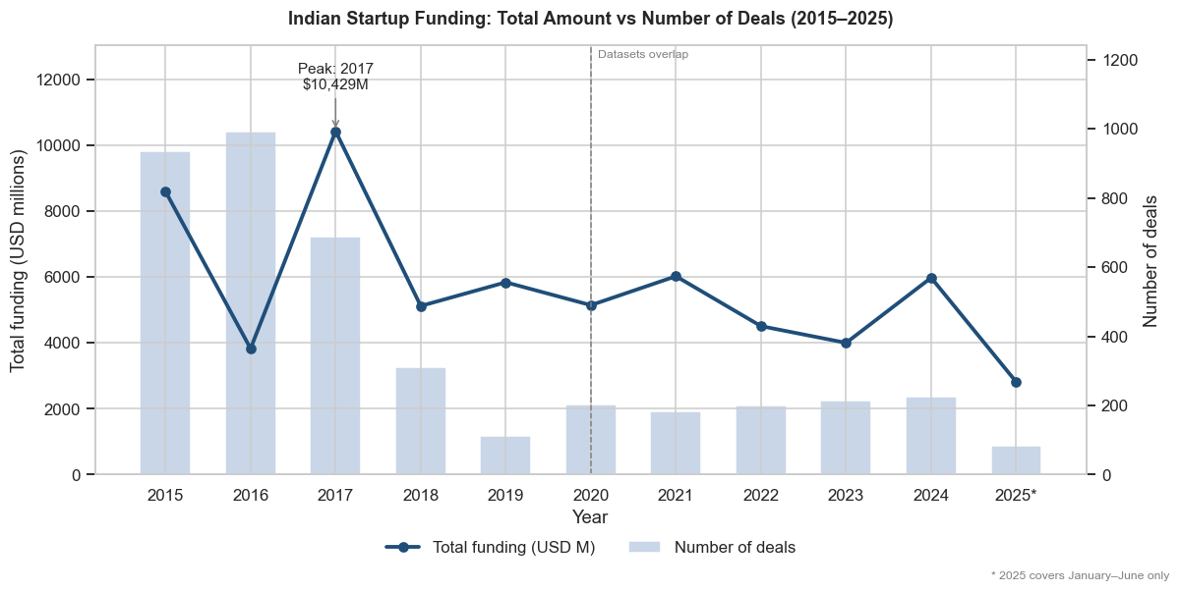
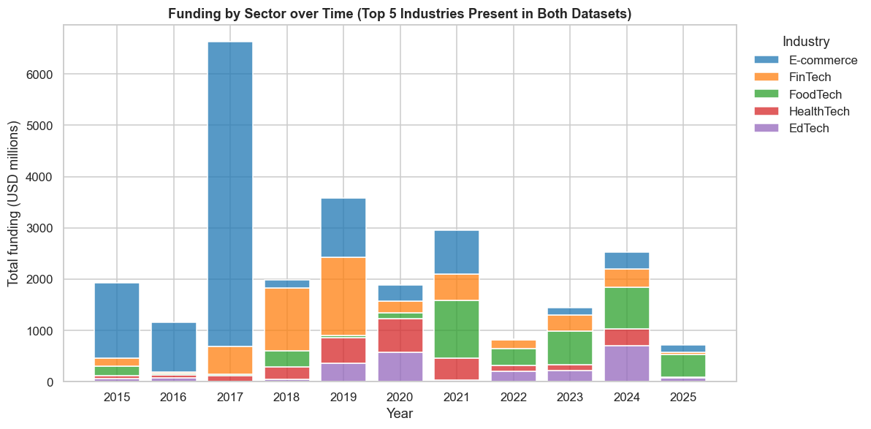
Exploratory Data Analysis – I
Visualization 1: Funding vs deal count by year (Matplotlib)
Visualization 2: Sector mix over time (Seaborn)
Observation: Funding peaked at USD 10,429M in 2017 and fell about 33.6% from 2021 to 2023 before rebounding in 2024. 2025 covers January–June only.
Observation: Between 2015–17 and 2023–25, e-commerce lost the most share (−72.3 pp) while FoodTech gained the most (+25.3 pp).
SECTION 2 · 18 MARKS
6

Slide 7
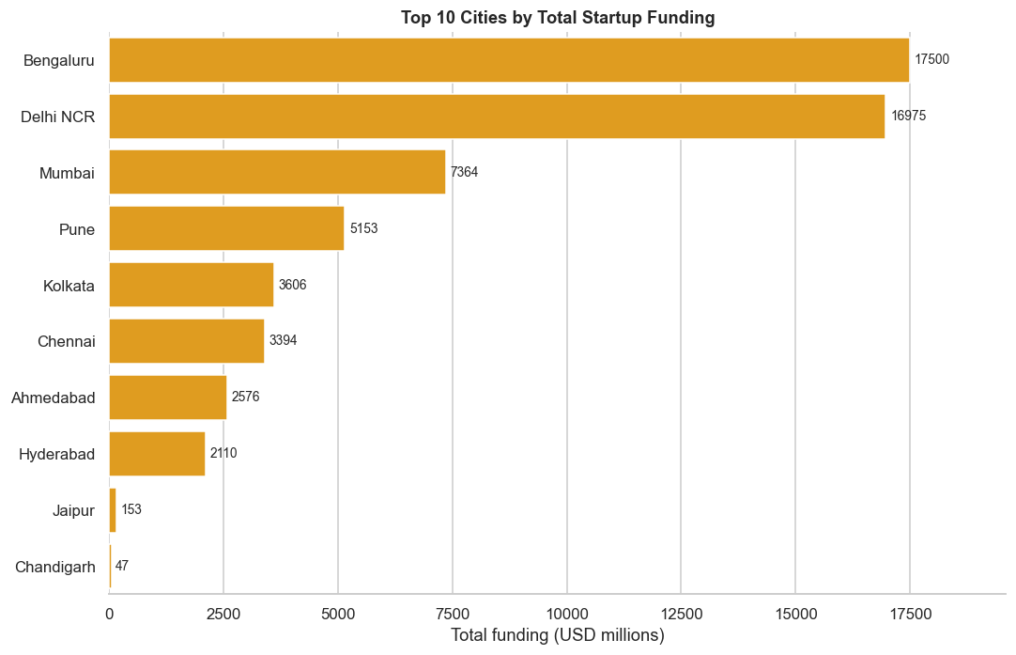
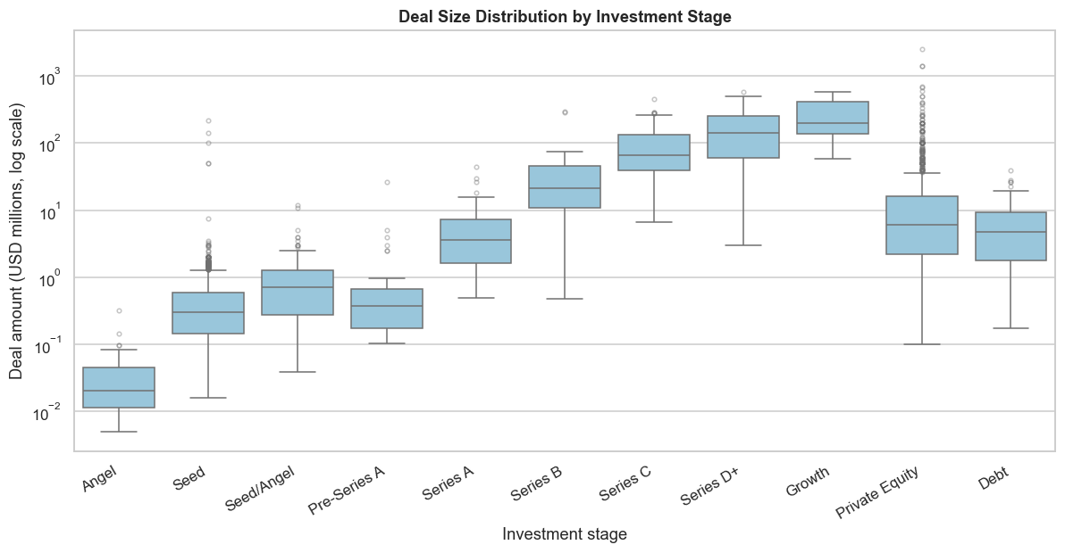
Exploratory Data Analysis – II
Visualization 3: Top funding cities (Seaborn)
Visualization 4: Deal size by stage (Seaborn)
Observation: Bengaluru (29.6%), Delhi NCR (28.7%) and Mumbai (12.5%) hold 70.8% of disclosed funding.
Observation: Median deal size rises from USD 0.30M (Seed) to 3.56M (Series A), 21.3M (Series B) and 65.9M (Series C); log scale.
SECTION 2 · 18 MARKS
7

Slide 8
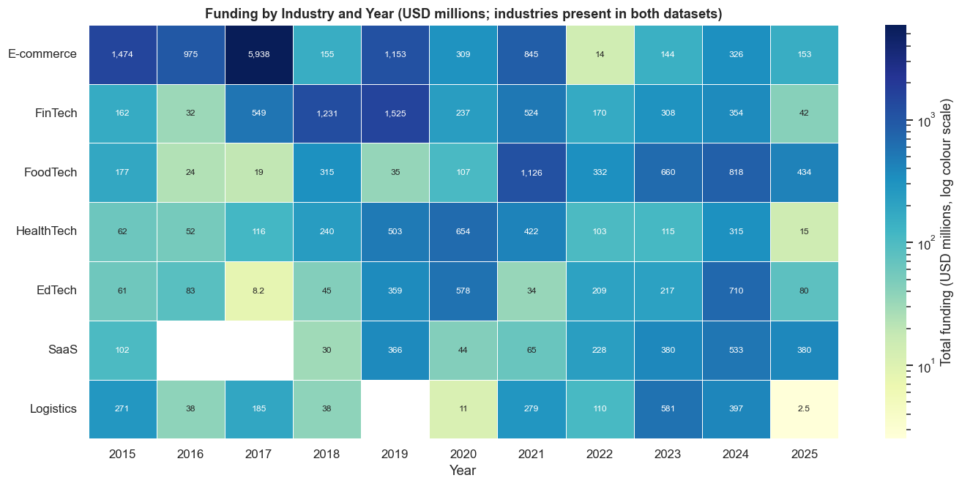
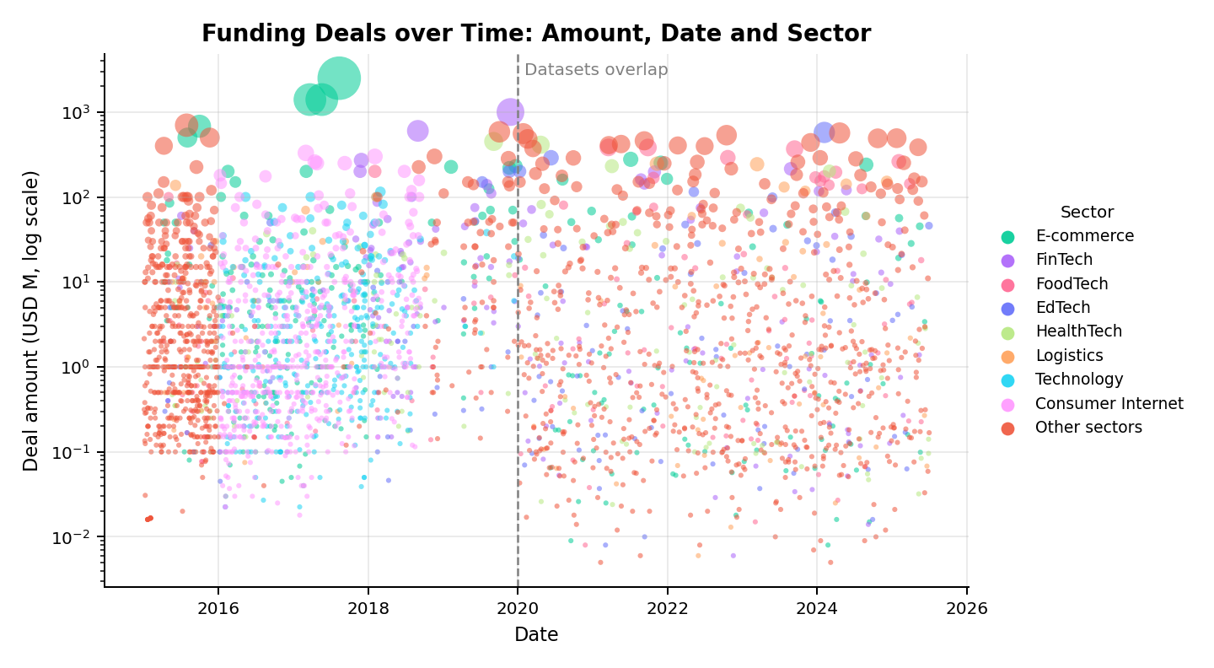
Exploratory Data Analysis – III
Visualization 5: Sector × year heatmap (Seaborn)
Visualization 6: Amount vs date (Plotly)
Observation: E-commerce in 2017 (USD 5,938M) is nearly 4 times the next-largest cell; peak years shift from older to newer sectors.
Observation: The typical deal is small (median about USD 1.0–1.6M in most years). Deals of USD 100M or more are only about 5% of funded deals, but 8 to 21 of them occur every year.
SECTION 2 · 18 MARKS
8

Slide 9
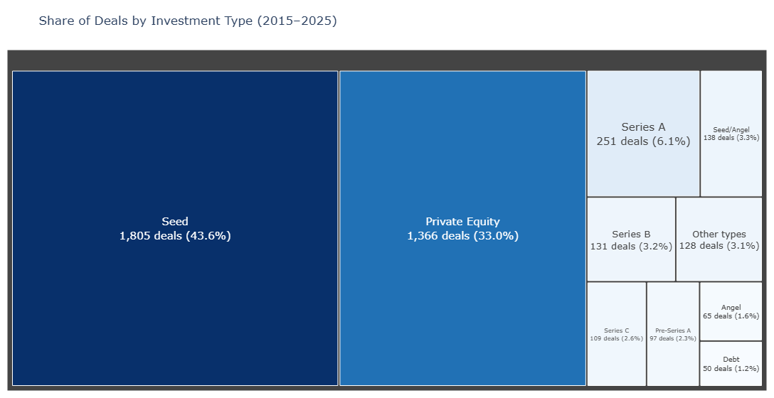
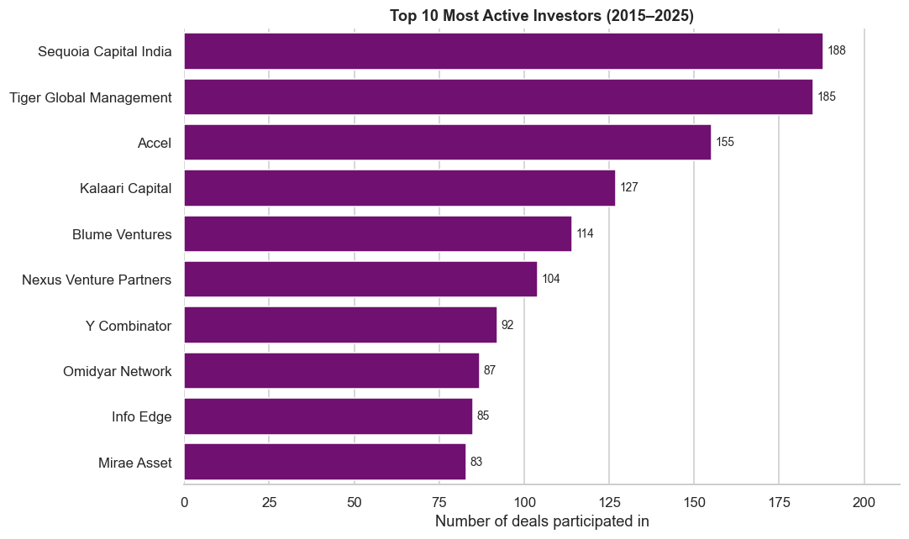
Exploratory Data Analysis – IV
Visualization 7: Investment type treemap (Plotly)
Visualization 8: Top 10 investors (Seaborn)
Observation: Seed is 43.6% of deals with a known type; Seed plus Private Equity make up 76.6%.
Observation: Sequoia Capital India (188 deals) and Tiger Global (185) lead, then Accel (155). About 68% of the top-10 participations come from the 2020–2025 dataset.
SECTION 2 · 18 MARKS
9

Slide 10
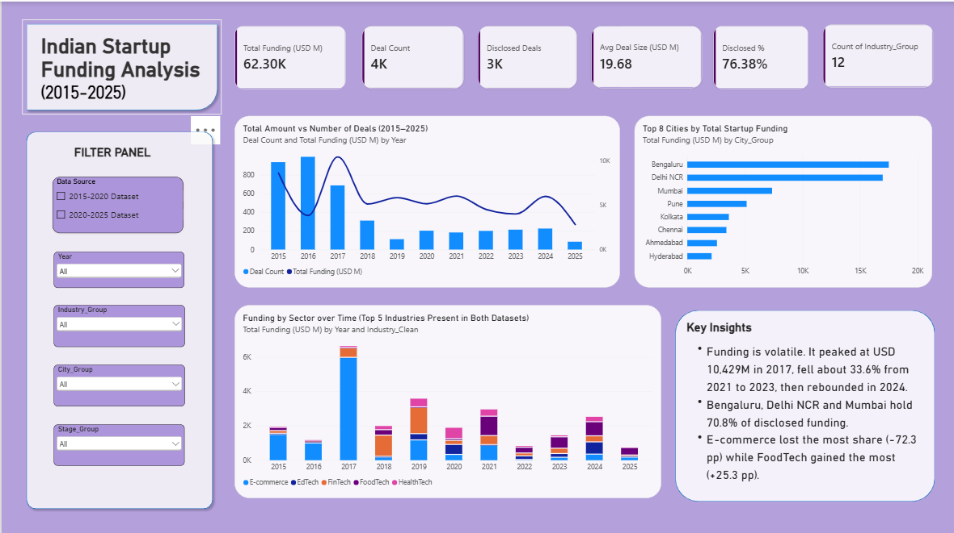
Interactive Dashboard – Tableau / Power BI
Layout: Page 1 – Overview
KPI cards: Total Funding, Deal Count, Disclosed Deals, Disclosed %, Avg Deal Size.
Slicers: Data Source, Year, Industry, City and Stage; they filter every visual.
Visuals: trend combo, top cities, sector columns
Supports objectives: each objective has a visual, and slicers let viewers drill into any year or sector.
SECTION 2 · 18 MARKS
10

Slide 11
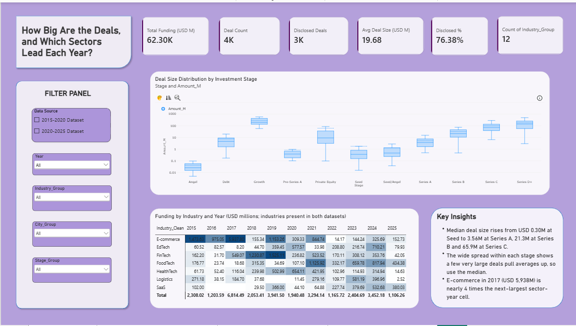
Interactive Dashboard – Tableau / Power BI
Layout: Page 2 - Deal Size and Sectors
KPI cards: Total Funding, Deal Count, Disclosed Deals, Disclosed %, Avg Deal Size.
Slicers: Data Source, Year, Industry, City and Stage; they filter every visual.
Visuals: stage box plot, heatmap
Supports objectives: each objective has a visual, and slicers let viewers drill into any year or sector.
SECTION 2 · 18 MARKS
11

Slide 12
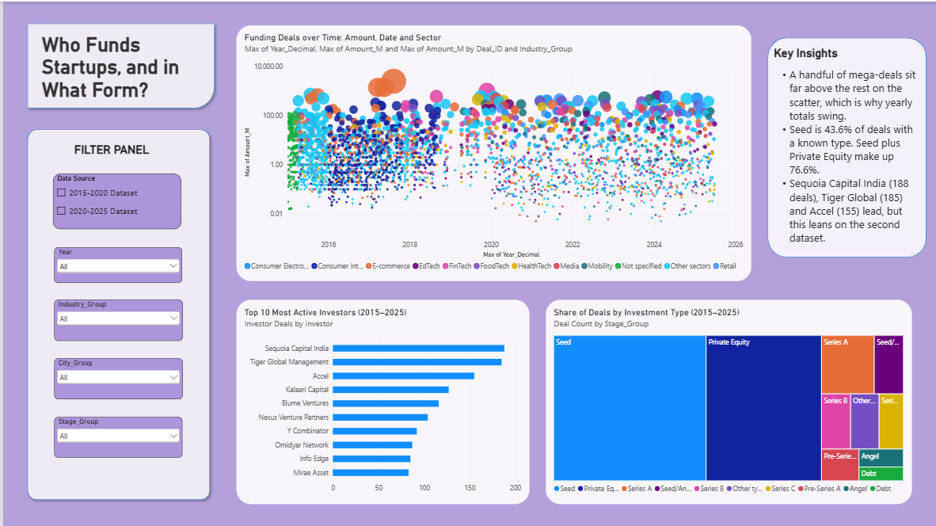
Interactive Dashboard – Tableau / Power BI
Layout: Page 3 - Deals and Investors
Slicers: Data Source, Year, Industry, City and Stage; they filter every visual.
Visuals: scatter, top active investors,treemap
Supports objectives: each objective has a visual, and slicers let viewers drill into any year or sector.
SECTION 2 · 18 MARKS
12

Slide 13
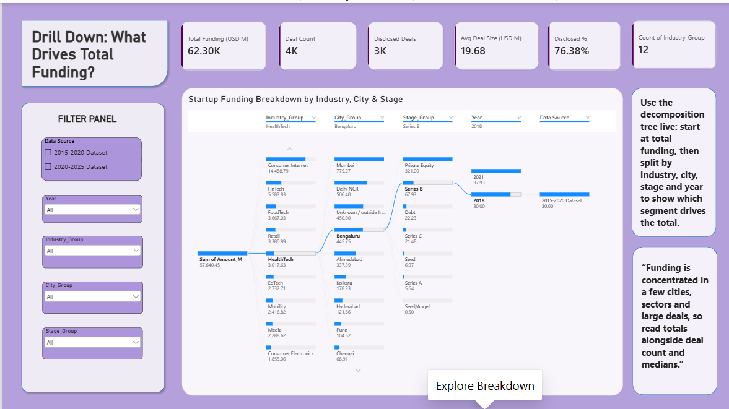
Interactive Dashboard – Tableau / Power BI
Layout: Page 4 - Explore Breakdown
KPI cards: Total Funding, Deal Count, Disclosed Deals, Disclosed %, Avg Deal Size.
Slicers: Data Source, Year, Industry, City and Stage; they filter every visual.
Visuals: decomposition tree (drill down by industry, city, stage and year)
Supports objectives: each objective has a visual, and slicers let viewers drill into any year or sector.
SECTION 2 · 18 MARKS
13

Slide 14
Dashboard Insights and Data Storytelling
What? Funding is volatile, not steadily growing: USD 10.4B peak in 2017, about 33.6% fall from 2021 to 2023, then a rebound in 2024. Leadership moved from e-commerce to FoodTech and other newer sectors.
So what? Yearly totals swing because of a few mega-deals and a change of data source, so trends should be read with deal count and medians.
Now what? Track median deal size and deal count alongside totals, and look beyond the top three cities, which hold 70.8% of funding.
Filter example: Set Year to 2017, then 2023, on the Overview page to see the sector mix change; use the Industry slicer to see one sector’s cities and stages.
SECTION 2 · 18 MARKS
14

Slide 15
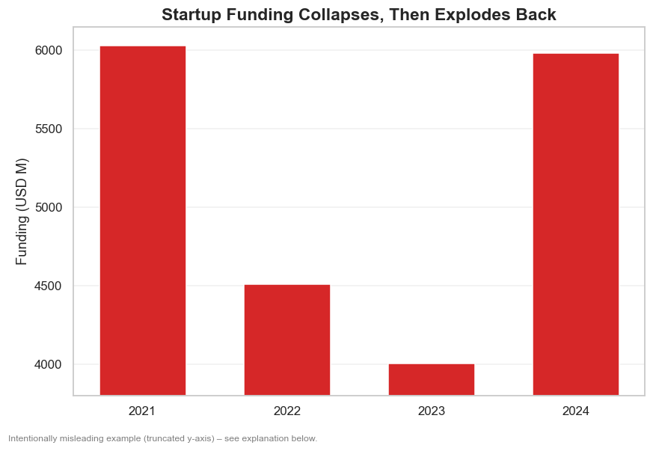
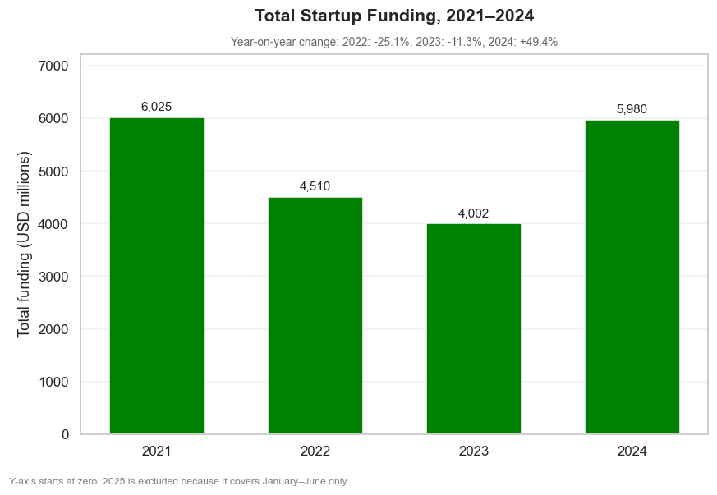
Misleading Visualization and Ethical Redesign
MISLEADING: truncated-axis chart
CORRECTED: zero-baseline chart
Distortion: The y-axis starts near USD 3,800M and the title is sensational, so the 2024 bar looks about 11 times taller than 2023, though the real rise is about 49%.
Correction: Zero baseline, neutral title and value labels: bar heights now match the real change, so viewers see a rebound, not an explosion.
SECTION 2 · 18 MARKS
15

Slide 16
Key Findings and Insights
Finding 1: Funding is volatile. It peaked at USD 10,429M in 2017 and fell about 33.6% from 2021 to 2023 (Objective 1; Visualization 1, dashboard trend).
Finding 2: Sector leadership shifted from e-commerce (−72.3 pp) to FoodTech (+25.3 pp) (Objective 2; Visualizations 2 and 5).
Finding 3: Funding is concentrated: three cities hold 70.8%, and median deal size rises from USD 0.30M at Seed to 65.9M at Series C (Objectives 3 and 4; Visualizations 3 and 4).
Finding 4: Sequoia Capital India (188 deals), Tiger Global (185) and Accel (155) lead investor activity, though this leans on the second dataset (Objective 4; Visualization 8).
SECTION 2 · 18 MARKS
16

Slide 17
Recommendations and Conclusion
Recommendations: (1) Read funding with both amount and deal count, and use medians; (2) look beyond the top three cities; (3) start bar charts at zero and label partial years.
Main conclusion: Indian startup funding is volatile and concentrated in a few cities and large deals; sector leadership moved to newer sectors, and chart design can change the story.
Limitations: About 24% of amounts are undisclosed, and the 2020–2025 file appears to be a sample, so comparisons across 2020 are indicative.
Future improvement: Repeat with a complete, consistently labelled 2020–2025 dataset and add growth rates or a forecast.
SECTION 3 · 7 MARKS
17

Slide 18
Dashboard Demonstration and Viva
Live demonstration checklist:
Open the Power BI file (Overview page first).
Apply the Year / Industry / City slicers and explain what changes.
Explain tool choices: Matplotlib and Seaborn, Plotly, Power BI.
Justify the insights and the truncated-axis redesign.
SECTION 3 · 7 MARKS
18

