Slide 1
Assistive Search on OpenAI Docs

Slide 2


RAG framework – High level view
Retrieval Model
User Query + similar matches
Large Language Model
Answer
User Query
User Query
Similar matches
Knowledge Base

Slide 3
OpenAI documents are scraped as follows:
Initially, I attempted to scrape documents from OpenAI's website using BeautifulSoup, but I encountered challenges when trying to iterate through all the subpages in their extensive documentation.
Next , I have tried “website content crawler” an APIFY actor which can perform a deep crawl of websites and extract text content from the web pages.
From this, I retrieved the results in a CSV format and used it for further implementation

Slide 4
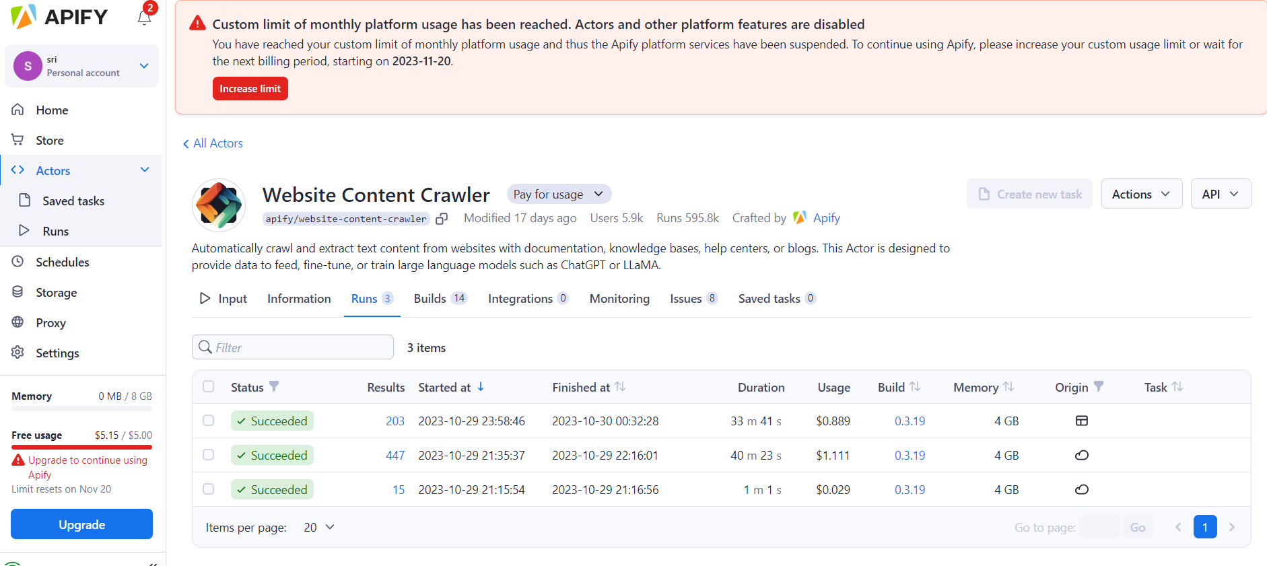
OpenAI documents are scraped using “Website content crawler” actor in APIFY and respective screenshots are given below.

Slide 5
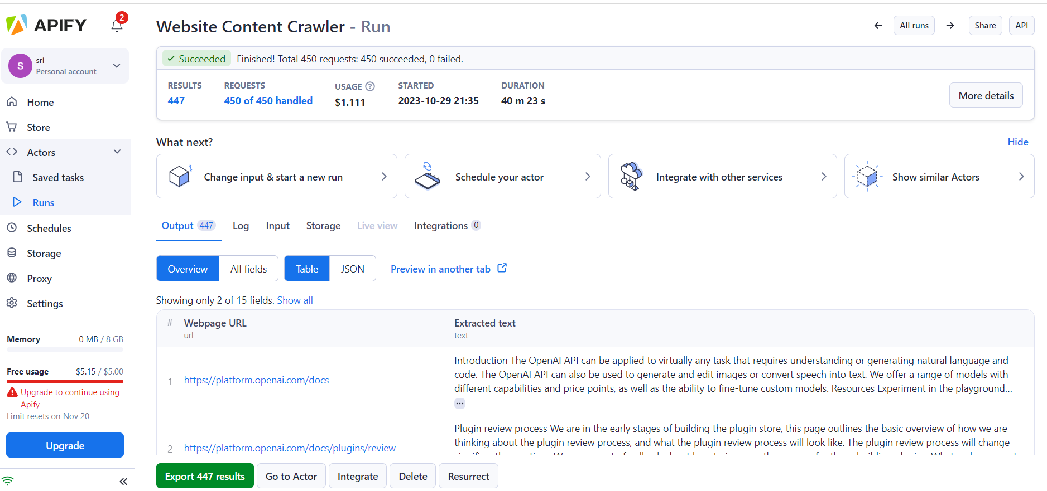

Slide 6
