Slide 1
DIGITAL PORTFOLIO
NAME: NITHIYASRI
REGISTER NO AND NMID: astvu24024024u09009
DEPARTMENT: BACHELOR OF COMPUTER APPLICATION
COLLEGE: WISDOM WOMEN’S COLLEGE OF ARTS AND SCIENCE/
THIRUVALLUR UNIVERSITY

Slide 2
DIGITAL PORTFOLIO
A digital portfolio is a collection of digital artifacts that showcase an individual’s skills, accomplishments, and experiences. It can include various types of content, such as: 1. *Projects*: Examples of work, like writing samples, design projects, or coding projects. 2. *Achievements*: Awards, certifications, or recognition received. 3. *Skills*: Listings of technical skills, software proficiency, or language proficiency. 4. *Experiences*: Descriptions of work experience, internships, or volunteer work. Digital portfolios are often used by: 1. *Professionals*: To showcase their work and skills to potential employers or clients. 2. *Artists and designers*: To display their creative work and style. 3. *Students*: To demonstrate their learning and accomplishments. A digital portfolio can be in the form of a website, blog, or online platform, and it provides a dynamic way to present one’s work and achievements.

Slide 3
AGENDA
Problem Statement
Project overview
End users
Tools and technologies
Portfolio design and layout
Features and functionality
Results and screenshots
Conclusion
GitHub link

Slide 4
PROBLEM STATEMENT
A problem statement is a clear and concise description of a problem or challenge that needs to be addressed. It typically includes: 1. *Problem definition*: A specific description of the issue. 2. *Impact*: The effects or consequences of the problem. 3. *Goals*: What needs to be achieved to resolve the problem. A well-defined problem statement helps to: 1. *Identify the root cause*: Understand the underlying reasons for the problem. 2. *Focus efforts*: Guide the development of solutions. 3. *Measure progress*: Evaluate the effectiveness of solutions.

Slide 5
PROJECT OVERVIEW
A project overview is a brief summary that provides an introduction to a project, including its main objectives, scope, and key elements. It typically covers: 1. *Project purpose*: The reason for undertaking the project. 2. *Objectives*: The specific goals and outcomes the project aims to achieve. 3. *Scope*: The boundaries and limitations of the project. 4. *Key stakeholders*: The individuals or groups involved in or affected by the project. 5. *Timeline*: The expected duration and milestones of the project. A project overview serves as a high-level guide, helping stakeholders understand the project’s context, goals, and expectations. It is often used in project planning, proposals, and reports.

Slide 6
WHO ARE THE END USERS
End users are the individuals or groups who will ultimately use or interact with a product, service, or system. They are the target audience or customers who will benefit from or be impacted by the project or solution. End users can include: 1. *Customers*: People who purchase or use a product or service. 2. *Employees*: Staff members who will use a system or tool as part of their job. 3. *Consumers*: Individuals who will interact with a product or service in their daily lives. Understanding the needs, goals, and behaviors of end users is crucial for designing and developing effective solutions that meet their requirements and provide a positive experience.

Slide 7
TOOLS AND TECHNOLOGIES
Tools and technologies refer to the software, hardware, and platforms used to develop, implement, and maintain a project or solution. This can include: 1. *Software tools*: Programming languages, development frameworks, and applications used to build and test a solution. 2. *Hardware*: Physical devices, infrastructure, and equipment used to support a solution. 3. *Platforms*: Operating systems, cloud services, or other environments that host or support a solution. Tools and technologies can vary widely depending on the project’s requirements, goals, and scope. Examples include: - Programming languages like Java, Python, or JavaScript - Development frameworks like React, Angular, or Vue.js - Databases like MySQL, MongoDB, or PostgreSQL - Cloud platforms like AWS, Azure, or Google Cloud - Design tools like Adobe Creative Cloud or Sketch

Slide 8
PORTFOLIO DESIGN AND LAYOUT
Portfolio design and layout refer to the visual arrangement and organization of content in a portfolio, whether it’s a physical or digital portfolio. A well-designed portfolio layout: 1. *Showcases work effectively*: Highlights the best pieces and demonstrates skills and accomplishments. 2. *Is easy to navigate*: Allows viewers to easily find and view content. 3. *Reflects personal brand*: Conveys the creator’s style, tone, and professionalism. Key elements of portfolio design and layout include: - *Visual hierarchy*: Organizing content to draw attention to key pieces. - *Typography*: Choosing fonts that are readable and consistent with the brand. - *Color scheme*: Selecting colors that complement the work and brand. - *Imagery*: Using high-quality images that showcase work effectively. - *Whitespace*: Balancing content with empty space to create a clean and uncluttered design.

Slide 9
FEATURES AND FUNCTIONALITY
Features and functionality refer to the specific capabilities and characteristics of a product, system, or solution. Features are the individual components or aspects that make up the product, while functionality refers to what those features can do. *Examples of features:* 1. *User interface*: The visual elements and interactions that users engage with. 2. *Search functionality*: The ability to find specific content or data. 3. *Payment gateway*: A feature that enables secure online transactions. *Examples of functionality:* 1. *User authentication*: The ability to verify user identities and control access. 2. *Data analytics*: The ability to collect, analyze, and visualize data. 3. *Real-time updates*: The ability to display live data or updates.

Slide 10
RESULTS AND SCREENSHOTS
Results and screenshots are essential components in various fields, including software testing, quality assurance, and web development. *What are Screenshots?* Screenshots are images captured from a computer or mobile device screen, often used to document test results, visualize bugs, or demonstrate software functionality. They provide visual evidence of application behavior, helping testers identify issues and developers reproduce problems ¹. *What are Results?* In the context of software testing, results refer to the outcome of a test case or scenario. This can include ²: - *Test outcome*: Pass or fail status, indicating whether the test met its expected results - *Screenshots*: Visual documentation of the application’s state during testing - *Error messages*: Details about any errors or exceptions encountered during testing

Slide 11
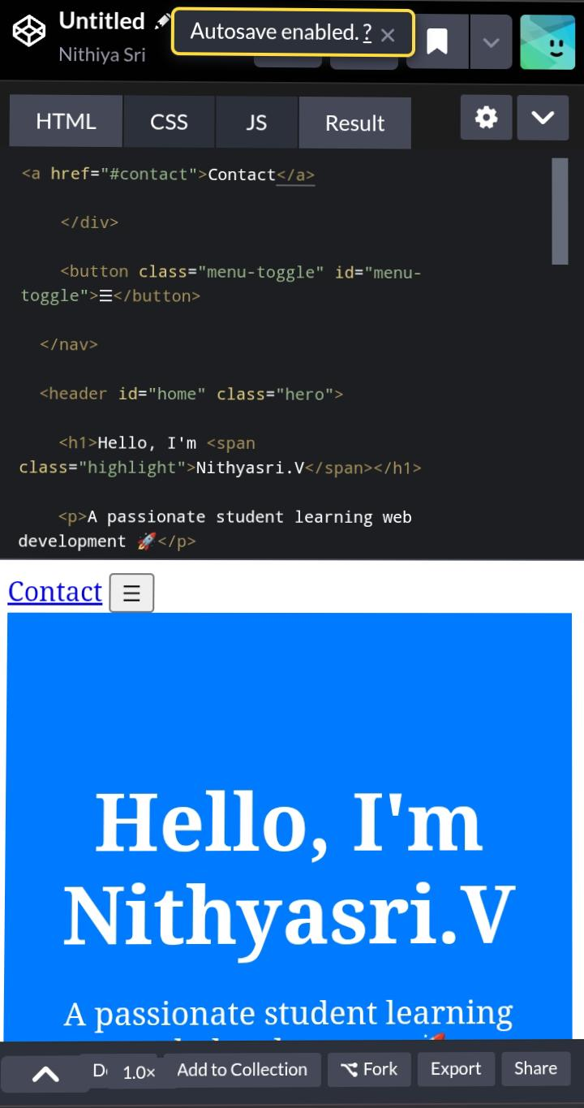
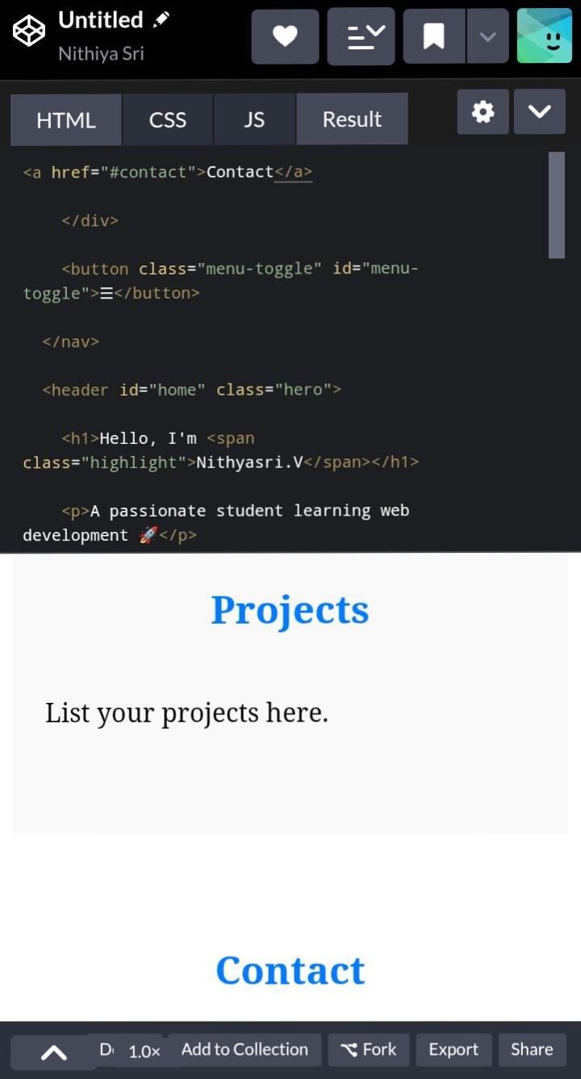
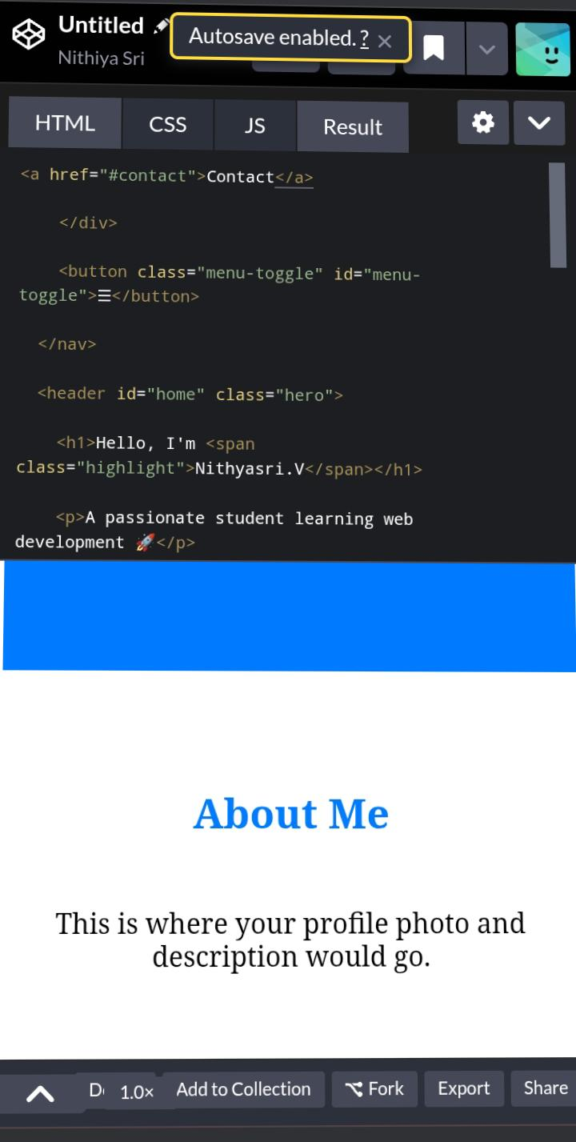
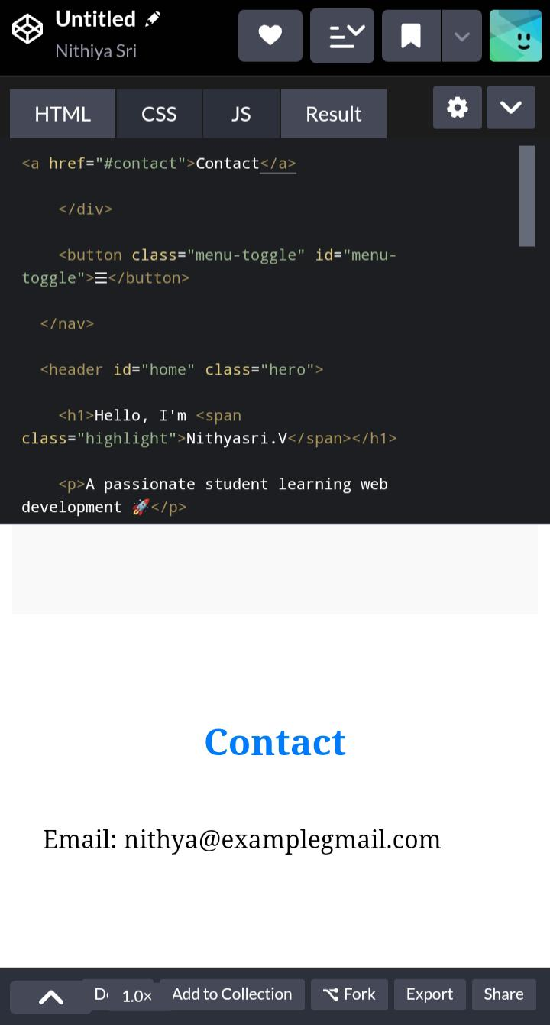

Slide 12
CONCLUSION
A digital portfolio is a powerful tool that enables individuals to showcase their skills, accomplishments, and experiences in a dynamic and interactive way. By creating a curated collection of their work, individuals can demonstrate their capabilities and achievements to potential employers, clients, or collaborators. A well-designed digital portfolio can help individuals stand out in a competitive job market, establish their personal brand, and increase their online visibility. With the ability to include multimedia content, such as images, videos, and links, digital portfolios provide a flexible and engaging way to present one’s work. Whether used for professional development, job searching, or business promotion, a digital portfolio is an essential asset for anyone looking to showcase their talents and achievements in a modern and effective way.

