Slide 1

UNMUTE: A WEEKLY REFLECTION APPLICATION
Student Name: M SRI NITHYA
Student ID: 2320030447)
Cluster:04
Section: 14
Under the Guidance
of
Supervisor Name:NM DEEPIKA
Assistant Professor
Department of CSE

Slide 2
OUTLINE
Abstract
Existing System
Proposed System
System Architecture
Project Modules
Objectives
Co’s Attainments - FWD
Co1
Co2 …….. 5. Co5
Co’s Attainments - DSA
Co1
Co2 …….. 5. Co5
Screen Shots for FWD & DSA
Conclusion
Geo-Tagged Photos

Slide 3
Abstract
UNMUTE is a web-based reflection application designed to help individuals understand their emotions and experiences through structured weekly reflection. The platform provides guided questions that allow users to analyze their week, record meaningful thoughts, and rate their emotional state.
The application includes features such as weekly reflection prompts, mood tracking, and a vault where sealed reflections can be stored and accessed later. By combining structured journaling with interactive web technologies, UNMUTE encourages self-awareness and emotional growth.
The system is implemented using HTML for structure, CSS for design, and JavaScript for interactivity and data management.

Slide 4
Existing System
Most people currently rely on traditional journaling methods or simple note-taking applications to record their thoughts and experiences.
However, these systems have several limitations:
• Lack of guided reflection questions • No structured way to analyze weekly emotions • Difficult to organize past reflections • Limited interactivity and engagement • No mood tracking features
Because of these limitations, users often struggle to maintain a consistent reflection habit.

Slide 5
Proposed System
UNMUTE, provides a structured digital platform for weekly reflection and emotional tracking.
The application allows users to:
• Log in to a private reflection space • Answer guided weekly reflection questions • Rate their emotional state using a mood scale • Write messages to their future selves • Seal reflections in a digital vault • View reflection statistics such as weeks completed and average mood
The system provides a clean, organized interface that encourages users to regularly reflect on their experiences.

Slide 6
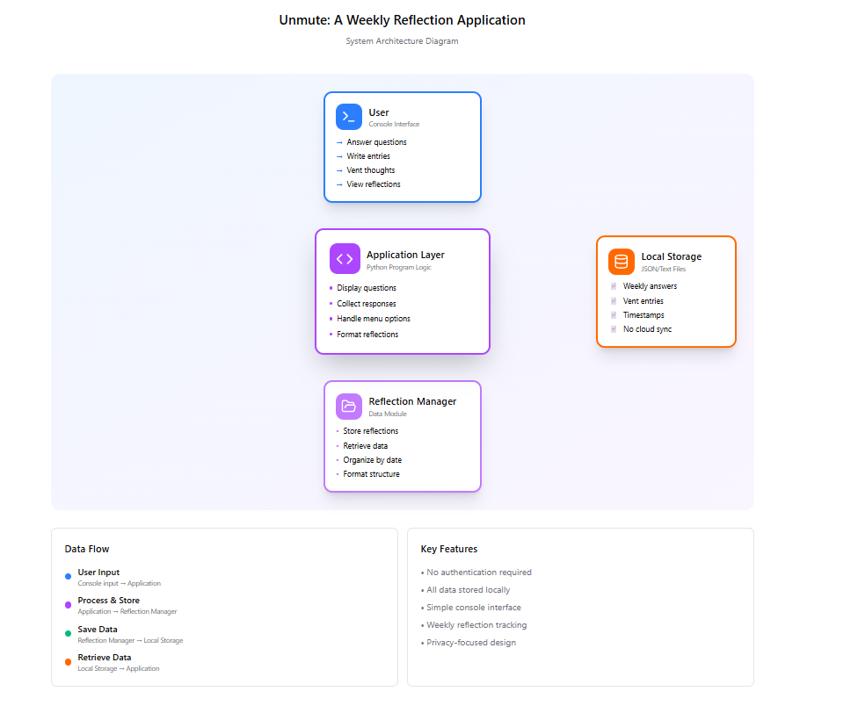
System Architecture

Slide 7
Project Modules
1. Authentication Module
Allows users to enter their reflection space using email credentials. The system verifies the email format and loads the personal journal interface.
2. Weekly Reflection Module (The Ritual)
This module provides structured reflection prompts such as:
• One word to define the week • The heaviest challenge faced • Something the user survived • What made the user feel alive • Who they supported during the week
Users also rate their weekly mood.

Slide 8
3. Emotional Archive Module
Displays reflection statistics such as:
• Total weeks recorded • Reflection streak • Average mood rating
This helps users track emotional progress over time.
4. Vault Module
Stores sealed reflection entries in a digital time capsule. Entries remain locked until the next month and can then be accessed by the user.

Slide 9
Objectives
The main objectives of the UNMUTE application are:
• To provide a structured platform for weekly self-reflection • To encourage emotional awareness and self-analysis • To implement interactive web technologies such as HTML, CSS and JavaScript • To provide a secure digital space for personal thoughts • To track emotional patterns through mood ratings

Slide 10
Co’s Attainments - FWD
CO1 — Internet Fundamentals, HTML & Introductory CSS
The project demonstrates the use of HTML to structure web pages and CSS to style layouts, typography, and color schemes.
CO2 — HTML Forms & CSS Layout
Forms are used to collect reflection responses, while CSS techniques such as Flexbox and responsive layouts are used to structure the interface.
CO3 — JavaScript Programming Essentials
JavaScript is used for conditions, loops, functions, and arrays to process reflection entries and mood data.

Slide 11
CO4 — JavaScript Interactivity & DOM
DOM manipulation and event handling allow the application to dynamically update the interface based on user interactions.
CO5 — Advanced Web Development
The application uses browser storage to store reflection entries and demonstrates dynamic content updates using JavaScript

Slide 12
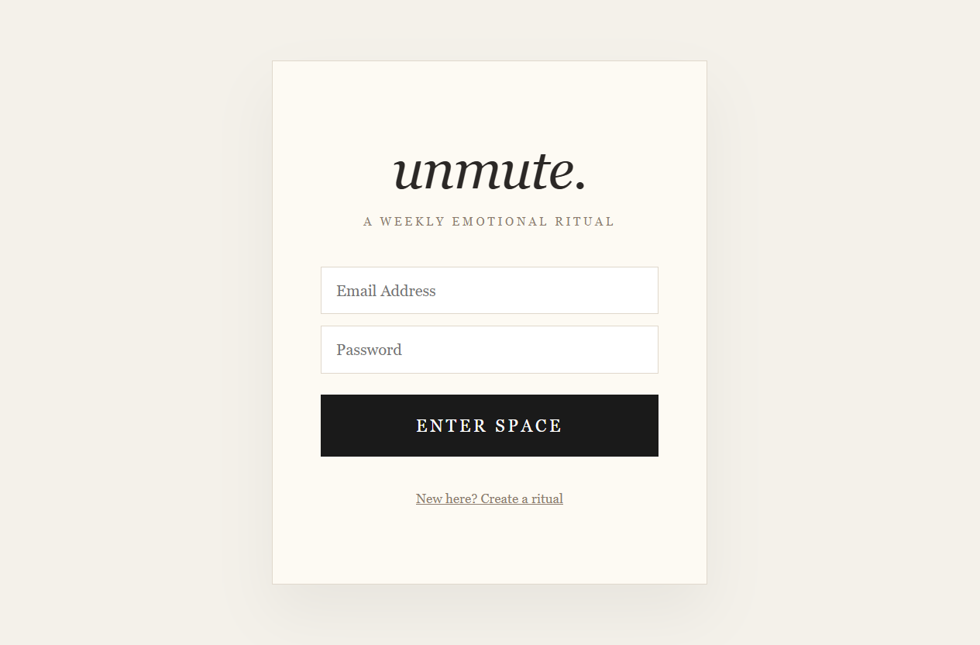
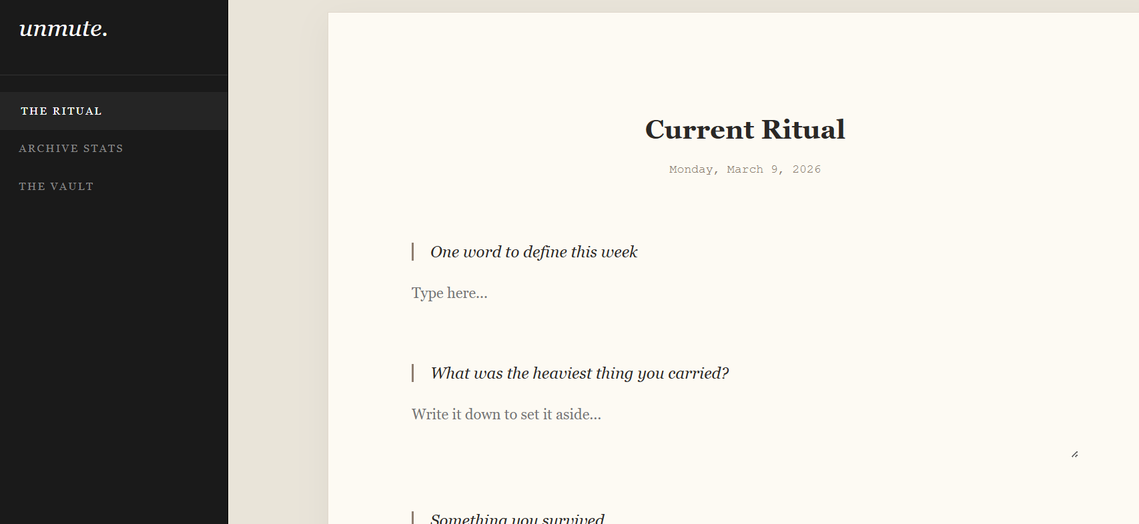
Screenshots for FWD

Slide 13
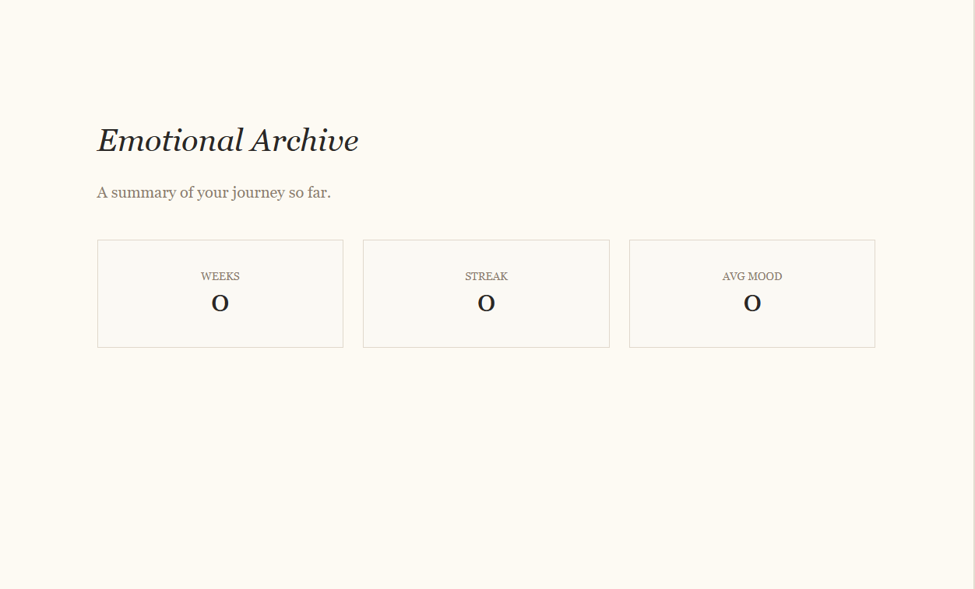
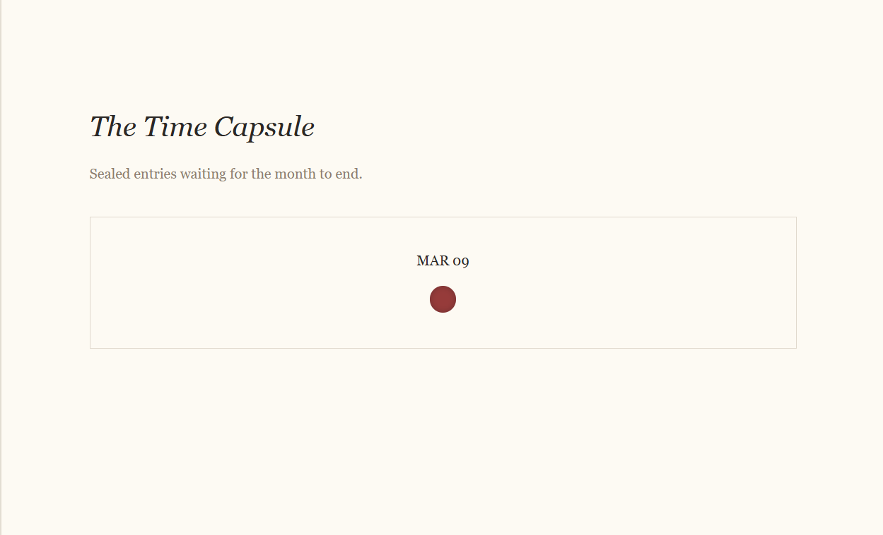

Slide 14
Co’s Attainments - DSA
CO1 – Algorithm Analysis
• Implemented searching (Linear Search) to find ritual entries by mood. • Implemented sorting (Bubble Sort) to arrange ritual entries based on mood.
CO2 – Abstract Data Types (ADTs)
• Created custom classes RitualEntry and VentEntry to store structured data. • Used ArrayList for dynamic data storage and management.
CO3 – Stacks and Queues Applications • The system models a real-world journaling workflow where entries are stored sequentially and retrieved later.

Slide 15
CO4 – Hash-based Data Structures
• Implemented HashMap to store ritual entries using date as the key & enables fast lookup and efficient data management.
CO5 – Application of Linear Data Structures • Built a practical journaling application using ArrayList, searching, and sorting operations.
CO6 – Program Development using Data Structures • Developed a menu-driven Java application demonstrating practical use of data structures and algorithms.

Slide 16
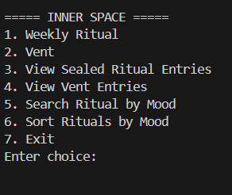
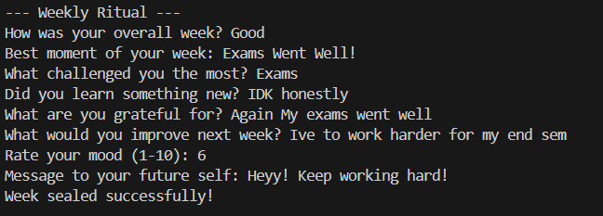
Screenshots for DSA

Slide 17
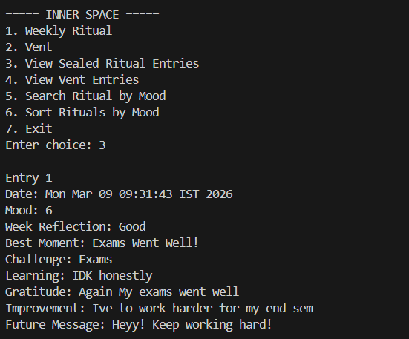


Slide 18
Conclusion
UNMUTE successfully demonstrates how web technologies can be used to create an interactive platform for emotional reflection and self-awareness. By combining structured journaling with dynamic web features, the application encourages users to regularly reflect on their experiences and track their emotional well-being.
The project also showcases practical implementation of HTML, CSS, and JavaScript concepts such as responsive layouts, form handling, DOM manipulation, and browser storage.
Future improvements may include user authentication systems, cloud data storage, and advanced analytics for emotional trends.

Slide 19
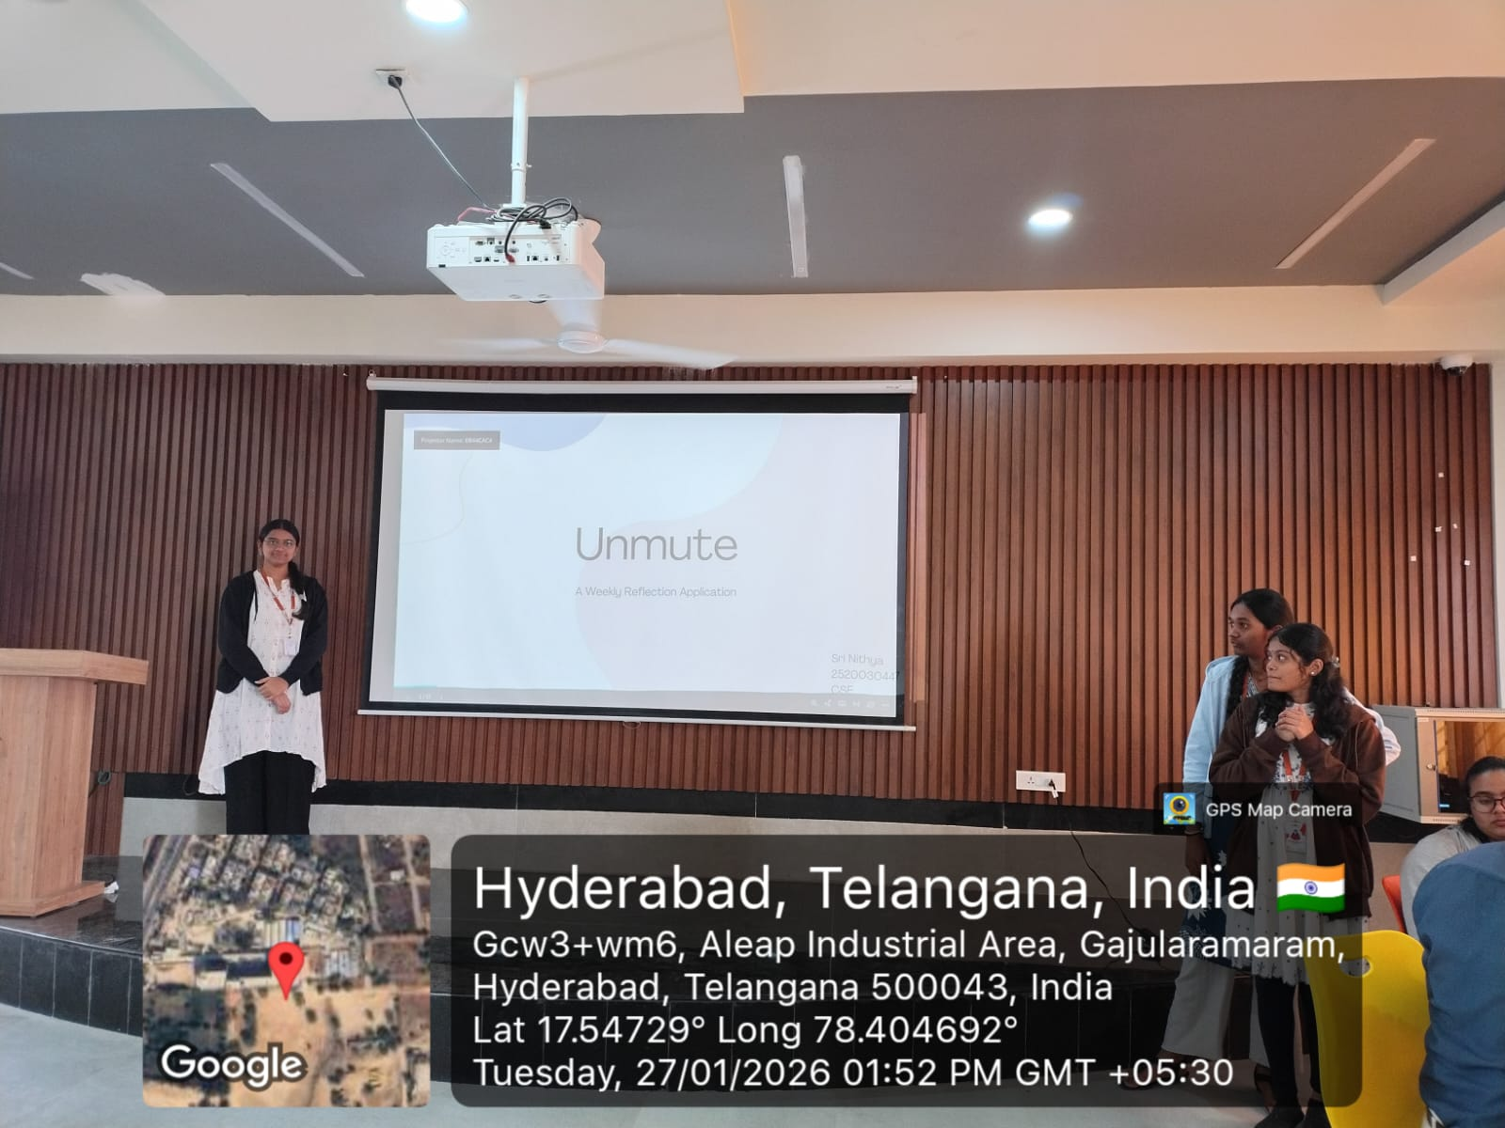
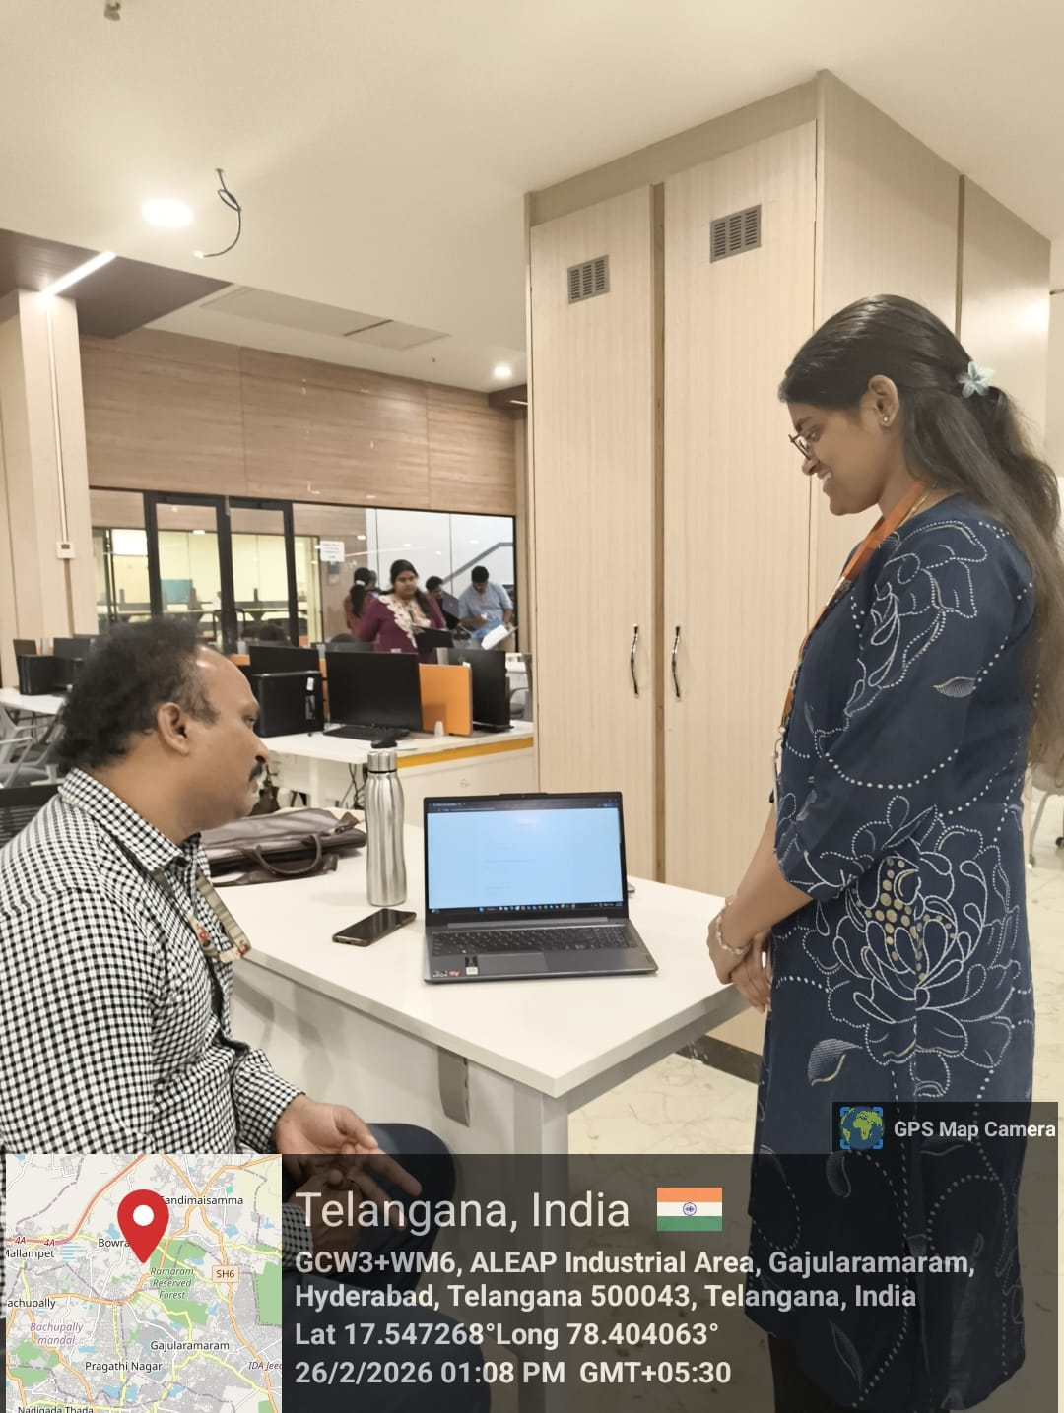
Geo-Tag Photos

Slide 20
THANK YOU

