Slide 1

UNMUTE: A WEEKLY REFLECTION APPLICATION
Student Name: M SRI NITHYA
Student ID: 2320030447)
Cluster:04
Section: 15
Under the Guidance
of
Supervisor Name: Madhavi Ma’am
Assistant Professor
Department of CSE

Slide 2
OUTLINE
Abstract
Existing System
Proposed System
System Architecture
Project Modules
Objectives
Co’s Attainments - FWD
Co1
Co2 …….. 5. Co5
Co’s Attainments - DSA
Co1
Co2 …….. 5. Co5
Screen Shots for FWD & DSA
Conclusion
Geo-Tagged Photos

Slide 3
Abstract
The Unmute is a console-based Java application designed to provide users with a private digital space to express their thoughts and emotions. The system allows users to record weekly reflections (rituals) and vent messages, helping them track their moods and experiences over time.
The application stores entries using ArrayList for dynamic data management and HashMap for faster access to ritual entries. It also includes features such as viewing entries, searching rituals based on mood, and sorting rituals by mood rating. These functionalities help users reflect on their emotional patterns and personal growth.
The project demonstrates the use of Object-Oriented Programming, data structures, searching, and sorting algorithms in Java while creating a simple and meaningful journaling system.

Slide 4
Existing System
Most people currently rely on traditional journaling methods or simple note-taking applications to record their thoughts and experiences.
However, these systems have several limitations:
• Lack of guided reflection questions • No structured way to analyze weekly emotions • Difficult to organize past reflections • Limited interactivity and engagement • No mood tracking features
Because of these limitations, users often struggle to maintain a consistent reflection habit.

Slide 5
Proposed System
UNMUTE, provides a structured digital platform for weekly reflection and emotional tracking.
The application allows users to:
• Log in to a private reflection space • Answer guided weekly reflection questions • Rate their emotional state using a mood scale • Write messages to their future selves • Seal reflections in a digital vault • View reflection statistics such as weeks completed and average mood
The system provides a clean, organized interface that encourages users to regularly reflect on their experiences.

Slide 6
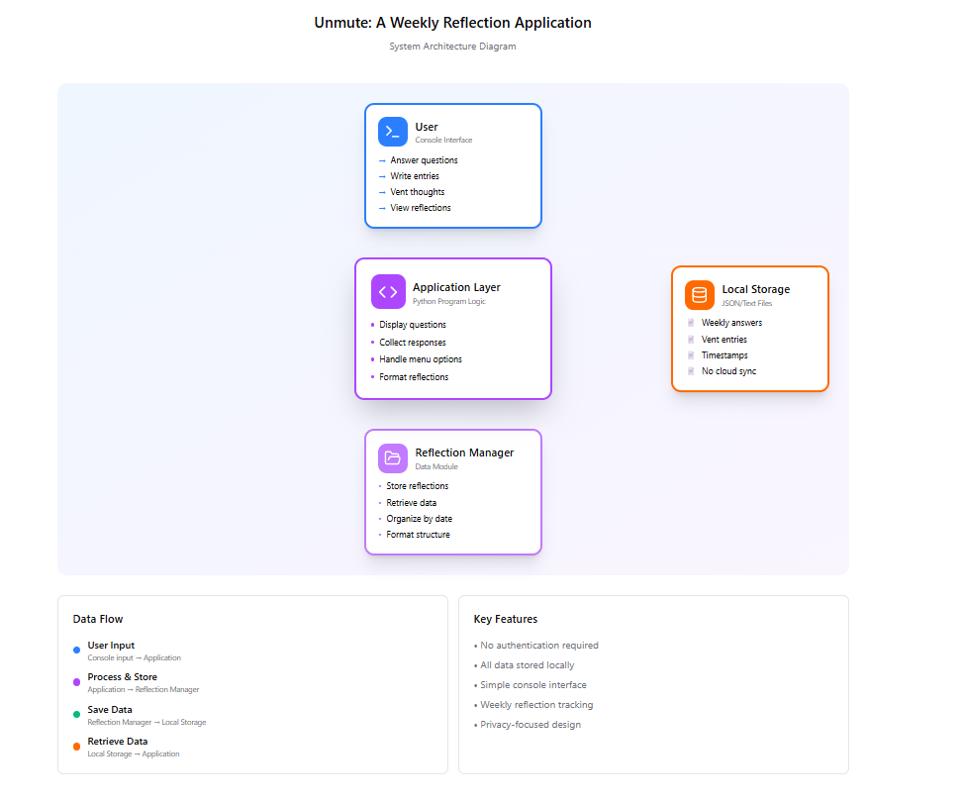
System Architecture

Slide 7
Project Modules
1. Authentication Module
Allows users to enter their reflection space using email credentials. The system verifies the email format and loads the personal journal interface.
2. Weekly Reflection Module (The Ritual)
This module provides structured reflection prompts such as:
• One word to define the week • The heaviest challenge faced • Something the user survived • What made the user feel alive • Who they supported during the week
Users also rate their weekly mood.

Slide 8
3. Emotional Archive Module
Displays reflection statistics such as:
• Total weeks recorded • Reflection streak • Average mood rating
This helps users track emotional progress over time.
4. Vault Module
Stores sealed reflection entries in a digital time capsule. Entries remain locked until the next month and can then be accessed by the user.

Slide 9
Objectives
To develop a console-based journaling application using Java.
To provide users with a private space to express thoughts and emotions through weekly reflections and vent entries.
To implement Object-Oriented Programming concepts such as classes and objects.
To use data structures like ArrayList and HashMap for efficient storage and retrieval of journal entries.
To implement searching and sorting techniques to organize and access ritual entries based on mood.
To create a simple menu-driven system that allows users to easily record, view, search, and sort their journal entries.

Slide 10
Co’s Attainments - FWD
CO1 — Internet Fundamentals, HTML & Introductory CSS
The project demonstrates the use of HTML to structure web pages and CSS to style layouts, typography, and color schemes.
CO2 — HTML Forms & CSS Layout
Forms are used to collect reflection responses, while CSS techniques such as Flexbox and responsive layouts are used to structure the interface.
CO3 — JavaScript Programming Essentials
JavaScript is used for conditions, loops, functions, and arrays to process reflection entries and mood data.

Slide 11
CO4 — JavaScript Interactivity & DOM
DOM manipulation and event handling allow the application to dynamically update the interface based on user interactions.
CO5 — Advanced Web Development
The application uses browser storage to store reflection entries and demonstrates dynamic content updates using JavaScript

Slide 12

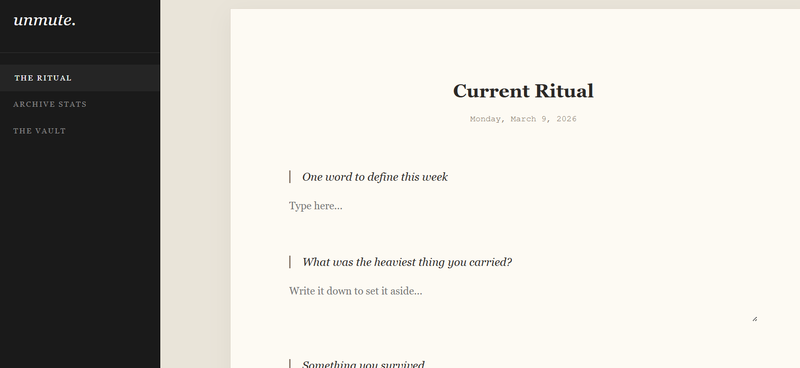
Screenshots for FWD

Slide 13
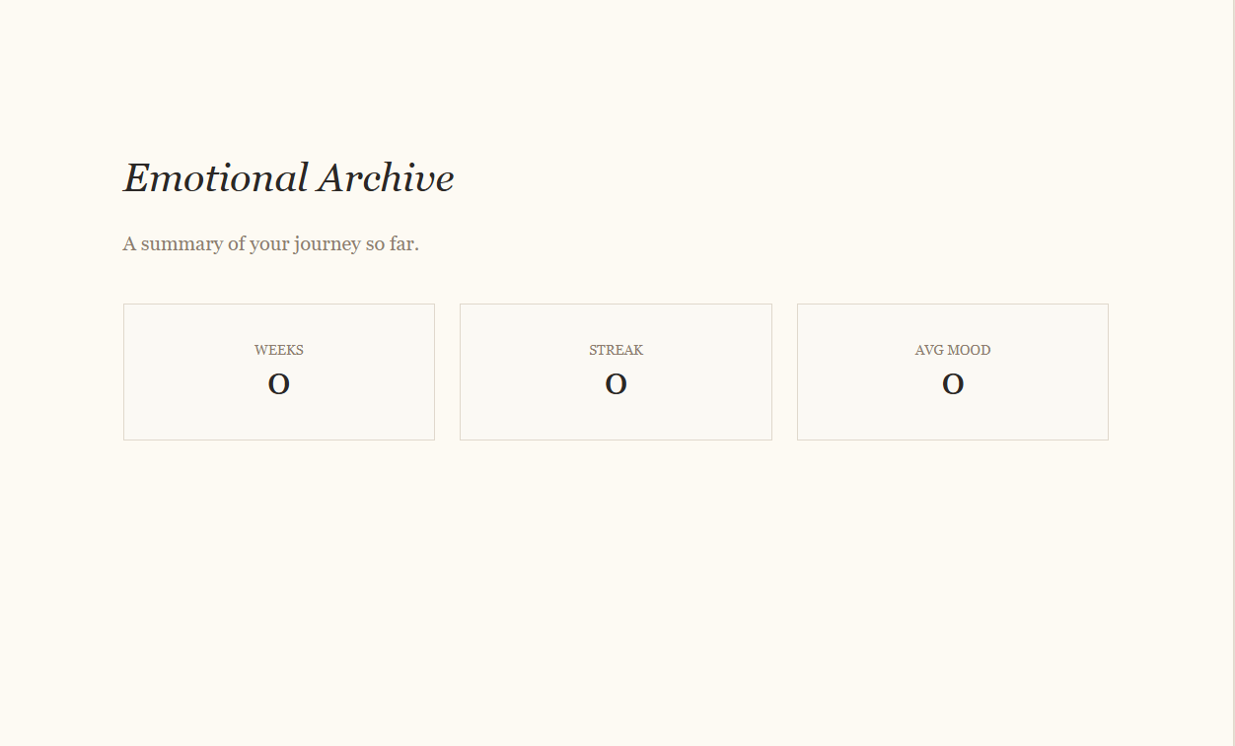
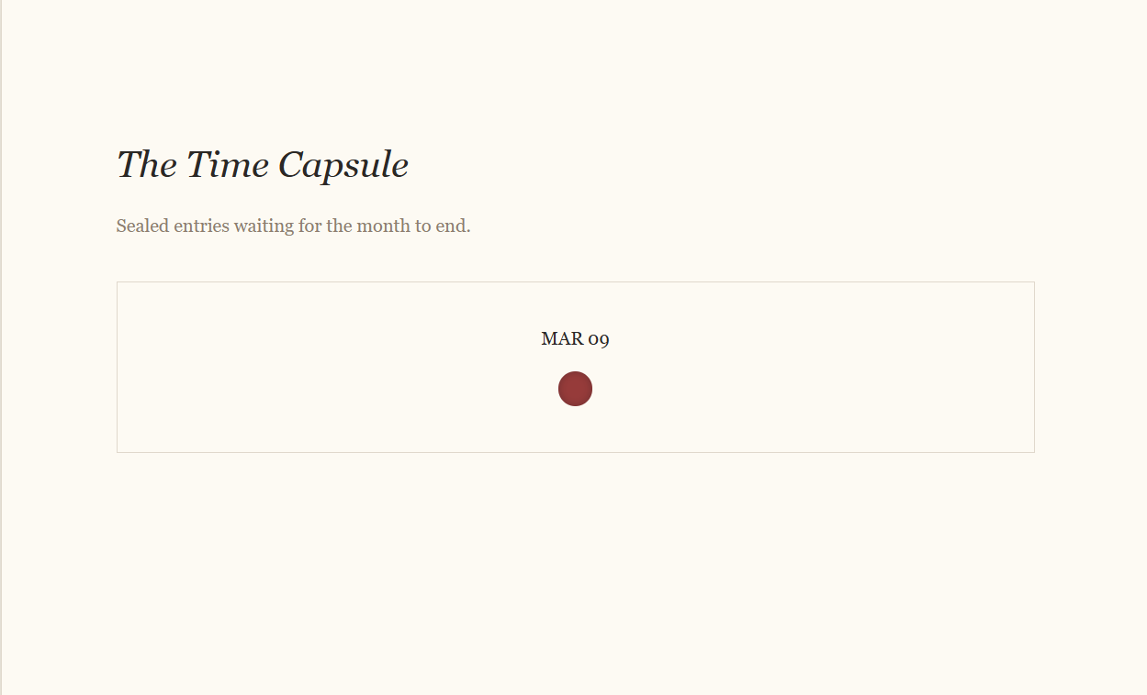

Slide 14
Co’s Attainments - DSA
CO1 – Algorithm Analysis
• Implemented searching (Linear Search) to find ritual entries by mood. • Implemented sorting (Bubble Sort) to arrange ritual entries based on mood.
CO2 – Abstract Data Types (ADTs)
• Created custom classes RitualEntry and VentEntry to store structured data. • Used ArrayList for dynamic data storage and management.
CO3 – Stacks and Queues Applications • The system models a real-world journaling workflow where entries are stored sequentially and retrieved later.

Slide 15
CO4 – Hash-based Data Structures
• Implemented HashMap to store ritual entries using date as the key & enables fast lookup and efficient data management.
CO5 – Application of Linear Data Structures • Built a practical journaling application using ArrayList, searching, and sorting operations.
CO6 – Program Development using Data Structures • Developed a menu-driven Java application demonstrating practical use of data structures and algorithms.

Slide 16
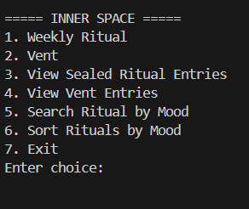
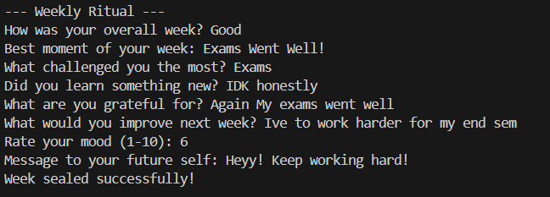
Screenshots for DSA

Slide 17
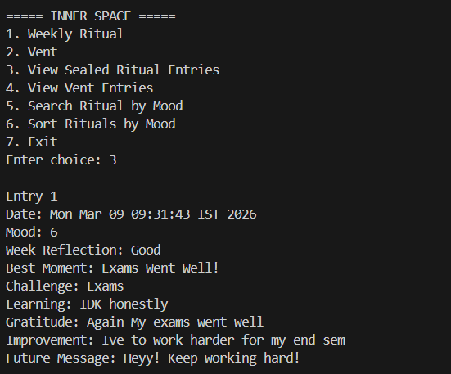


Slide 18
Conclusion
The Unmute provides a simple yet effective platform for users to record their thoughts, emotions, and weekly reflections. By combining structured reflection with free expression, the system encourages users to better understand their emotional patterns and personal experiences.
The project successfully demonstrates the implementation of Java programming concepts such as Object-Oriented Programming, data structures, searching, and sorting algorithms. It also highlights how technology can be used to create meaningful tools that support self-reflection and emotional expression.
With further enhancements such as data storage, graphical interface, and mood analysis, the system could be developed into a more advanced personal journaling application.

Slide 19
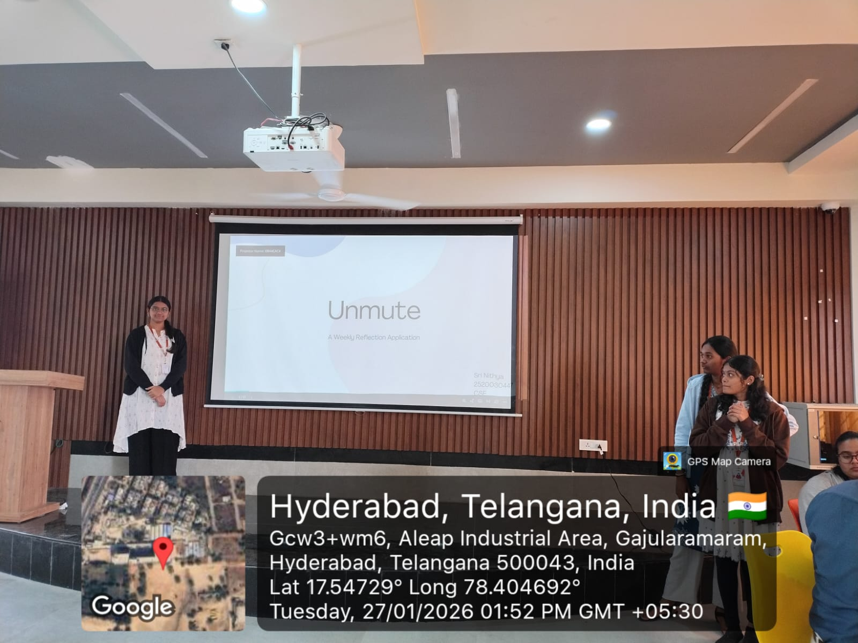
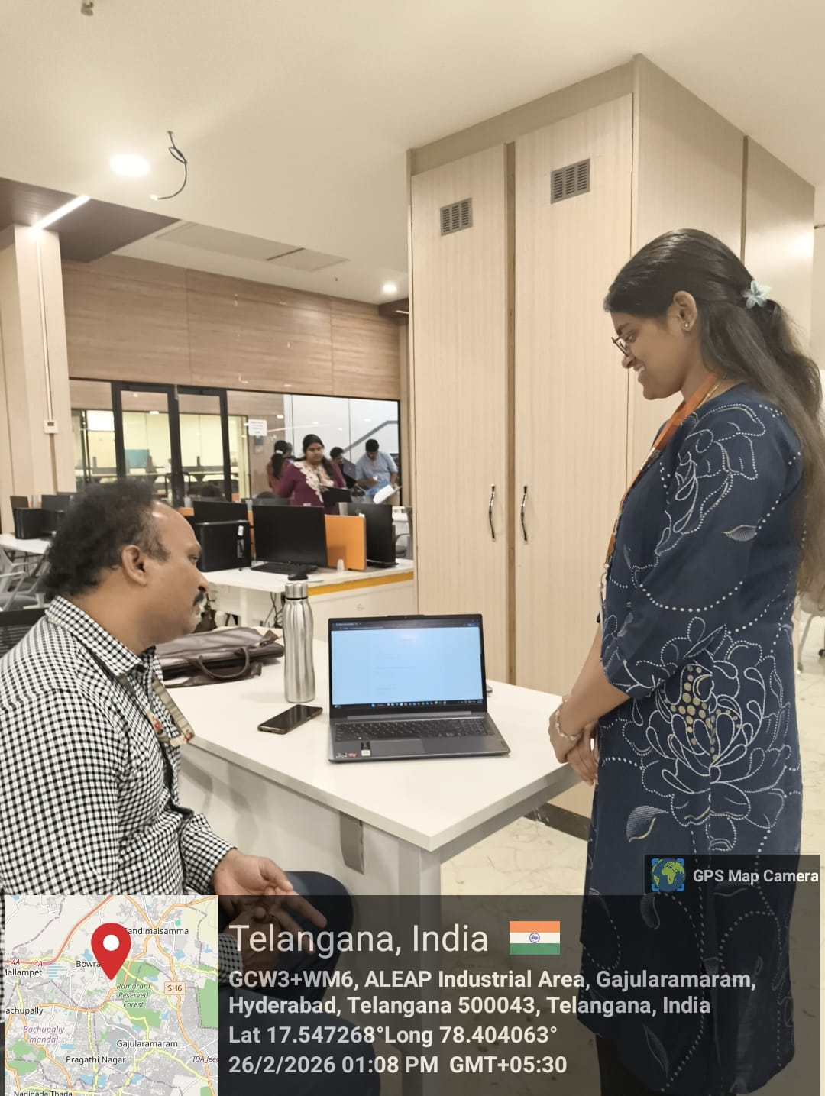
Geo-Tag Photos

Slide 20
THANK YOU

