Slide 1







Alternate Medicine
Recommendation System

Slide 2

















Abstract
The Alternate Medicine Recommendation System is an intelligent tool designed to assist users in finding alternative medications. By inputting the name of a specific medicine, users can receive a list of recommended substitutes along with detailed information about each one. This system leverages data analysis and similarity algorithms to ensure the alternatives are relevant and useful, enhancing the user's ability to access necessary medications efficiently. This tool aims to address issues of medication availability, cost, and awareness, thereby improving healthcare accessibility and convenience for users.

Slide 3





Why do we need this system?
Availability: Medicines can sometimes be out of stock. Providing alternatives ensures continuous access to necessary treatments.
Cost Efficiency: Medications can vary greatly in price. Offering cheaper alternatives helps users manage healthcare costs better.
Awareness: Users may not be aware of all available options. This system increases awareness of different medications with similar effects.
Convenience: Simplifies the process of finding substitutes, saving users time and effort.

Slide 4

Future Scope
Enhanced Algorithms: Improve accuracy and relevance of recommendations with advanced machine learning techniques. Pharmacy Integration: Direct integration with pharmacy databases for real-time availability and pricing.
User Feedback: Implement feedback mechanisms to refine recommendations based on user ratings.
Mobile App: Develop a mobile application for easier access on the go. Expanded Database: Continuously update the database with new medications and alternatives.
Personalization: Tailor recommendations based on user profiles and preferences.

Slide 5
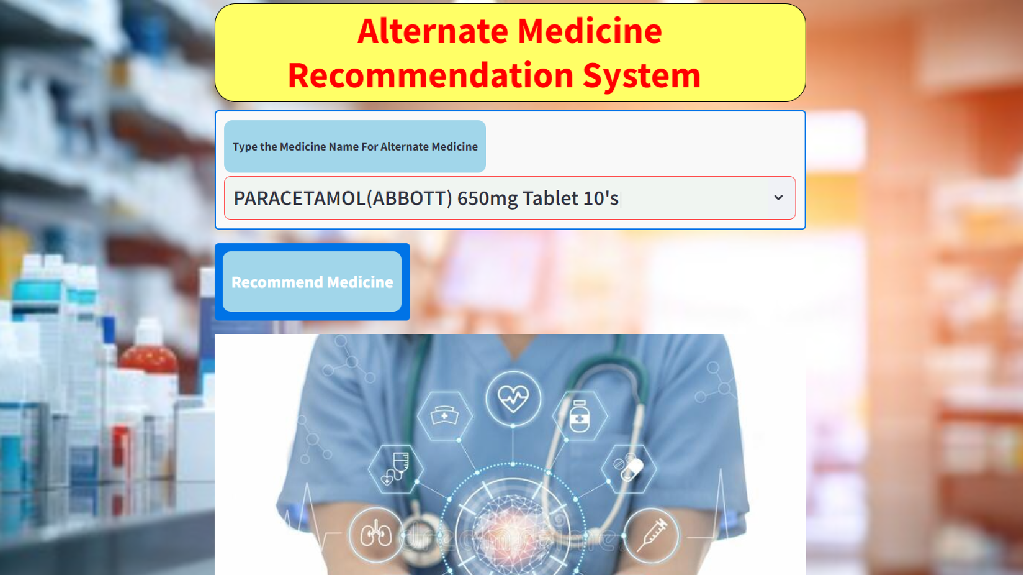

Slide 6
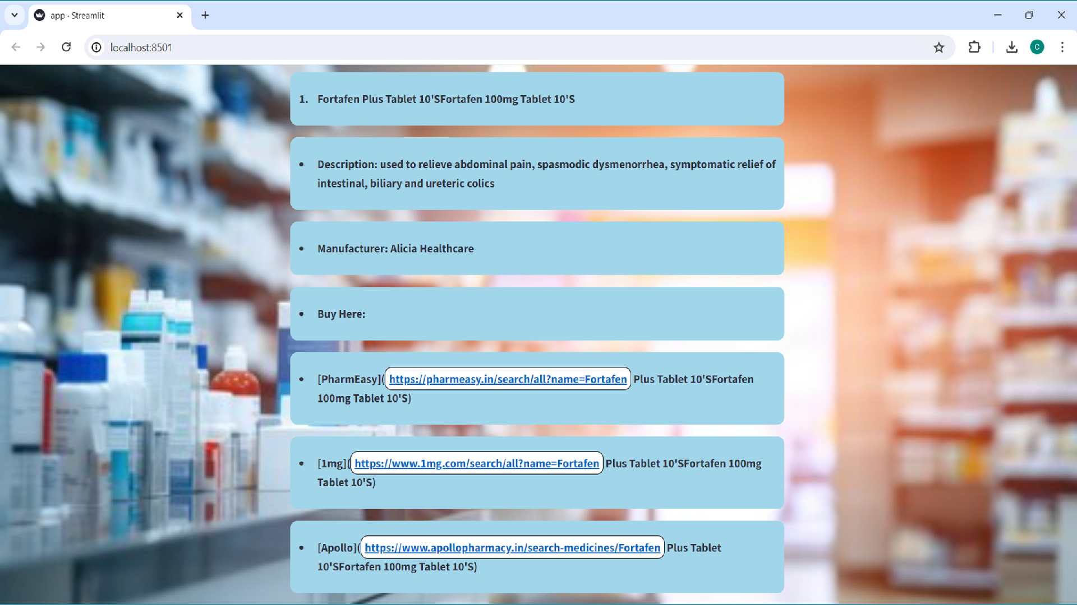

Slide 7






Thank You!

