Slide 1
Inside Out A Hawk Eye’s View of Cricket
Rajesh Bellamkonda – rb3805
Srinivas Bontula – ssb597

Slide 2
Problem Description
Cricket statistics are based around individual measures, from a batsman's average to a bowler's strike rate.
But what matters the most is the runs scored or wickets taken, when placed in a context.
A series played on bowler-friendly pitches might deflate the career averages of the batsmen involved, but that dip fails to account for their performances relative to the conditions.
Batting Averages and Bowling Strike rate, don’t tell the full story.

Slide 3


Scenario
Let us consider two batsmen (A and B) and their performances in a sample set of 3 series.
Series in Australia
Batsman | Innings | Runs | Average
A | 5 | 250 | 50.0
C | 5 | 220 | 44.0
D | 5 | 200 | 40.0
… | … | … | …
… | … | … | …
B | 5 | 140 | 28.0
Batsman | Innings | Runs | Average
A | 5 | 200 | 40.0
C | 5 | 180 | 36.0
D | 5 | 150 | 30.0
…. | …. | …. | ….
B | 5 | 130 | 26.0
…. | …. | …. | ….
Batsman | Innings | Runs | Average
B | 5 | 600 | 120.0
C | 5 | 520 | 104.0
D | 5 | 450 | 90.0
A | 5 | 400 | 80.0
…. | …. | …. | ….
…. | …. | …. | ….

Slide 4
Difference
Batsman sorted by Average
Batsman sorted by Percentile
Batsman | Average | Percentile
C | 61.33 | 83.33
B | 58.0 | 50.0
A | 56.666 | 83.333
D | 53.33 | 66.666
…. | ….. | ……
Batsman | Average | Percentile
A | 56.666 | 83.333
C | 61.33 | 83.33
D | 53.33 | 66.666
B | 58.0 | 50.0
…. | ….. | ……

Slide 5
Our Approach
A series is a fair unit to use to break down careers. The numbers of a bowler or batsman over a series are self-contained indicators of performance that are also somewhat normalized for conditions.
01
Instead of looking at raw runs, wickets and averages over a series, we will try to look at the relative standing of a player in the run charts in a particular series, and average that over his whole career.
02

Slide 6
Our Approach (Continued)
A batsman and a bowler are allotted a percentile value based on his ranking: a top rank gets you 100 points, and the points decrease according to your rank.
We then average this value over all series the batsman has played, weighed by the number of matches in each series.
This "Series Percentile Value" sums up his run-scoring relative to all other batsmen who have played with or against him in a series.
SPV (tentative) -> 100 * (1 – (position in series/total no. of players))

Slide 7
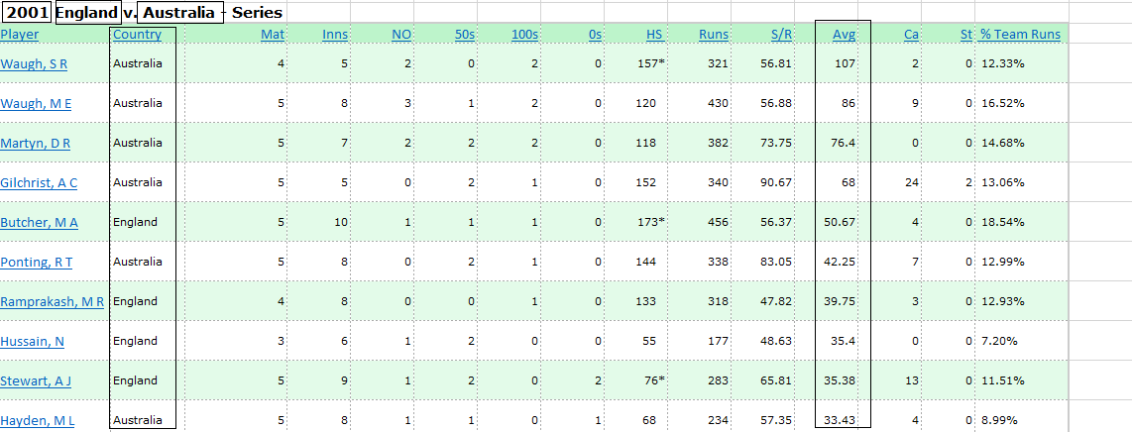
Sample DATA

Slide 8
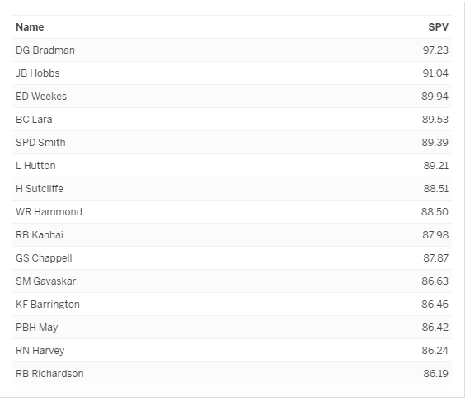
Sample Output

Slide 9
Workflow and Schedule
Step1
Scraping the web for the data of the series. [03/12/2018 – 04/01/2018]
Obtain SPVs for the players. [04/02/2018 – 04/06/2018]
Step2
Add weights to the SPVs based on playing conditions. [04/07/2018 – 04/15/2018]
Step3
Computing the weighted averages for the above. [04/16/2018 – 04/22/2018]
Conditions -> Nature of the pitch, Home or Away, Year etc.
Generating the outputs based on different metrics. [04/23/2018 – 04/29/2018]
Final Project Presentation and Report. [04/30/2018 – 05/02/2018]

Slide 10
Expected Applications
Ranking batsman and bowlers by our formula (Average SPV (using multiple metrics)).
Predicting a team for a series from a rooster (based on the conditions and previous performances).
All time X1s for each team.
The batsmen who have never been in the lower half of the run-scoring table of a series.
and more……………………..

Slide 11
Course Scope

