Slide 1
Inside Out A Hawk Eye’s View of Cricket
Rajesh Bellamkonda rb3805
Srinivas Bontula ssb597

Slide 2
Problem Description
Cricket statistics are based around individual measures, from a batsman's average to a bowler's strike rate.
But what matters the most is the runs scored or wickets taken, when placed in a context.
A series played on bowler-friendly pitches might deflate the career averages of the batsmen involved, but that dip fails to account for their performances relative to the conditions.
Batting Averages and Bowling Strike rate, don’t tell the full story.

Slide 3
Course Scope
The concepts learnt in the course such as function decorators, function call overheads, itertools, multiprocessing, other python inbuilt functions and packages were applied for the following steps –
Web Scraping – [BeatifulSoup, itertools, functools, geocoder, multiprocessing]
Modifying the datasets – [pandas, itertools]
Designing the algorithm – [numpy, itertools, math, pandas]
Predicting the teams – [threading, numpy, itertools]

Slide 4
Data Collection
Web Scraping of the cricket websites -> Cricinfo and Howstat
Requests -> For asynchronous calls to the website.
Beautiful Soup -> For parsing the HTML webpage. (navigating, searching, and modifying)
Multiprocessing -> Extracting the data series wise.
Partial -> To solve the global variable issue.

Slide 5
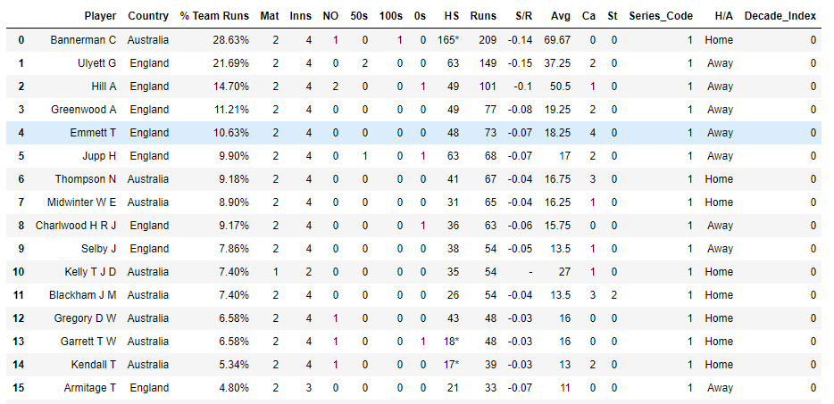
Datasets - Batsman

Slide 6
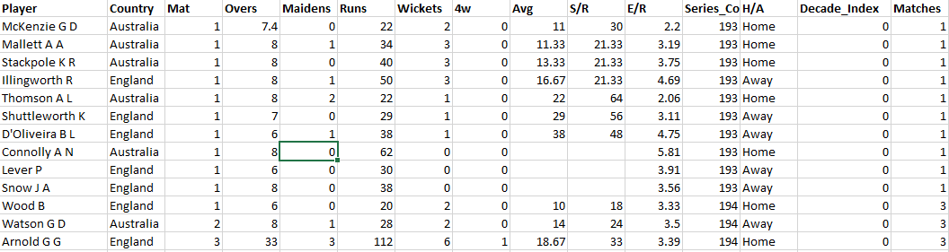
Datasets - Bowlers

Slide 7
Our Approach
A series is a fair unit to use to break down careers. The numbers of a bowler or batsman over a series are self-contained indicators of performance that are also somewhat normalized for conditions.
Instead of looking at raw runs, wickets and averages over a series, we will try to look at the relative standing of a player in the run charts in a particular series, and average that over his whole career.
Adding weights to the runs based on the time period of the series to curb the scoring trends, along with the host nation of the series.

Slide 8
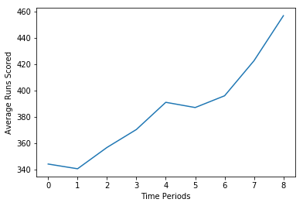
Why different Time Periods?
0 - 1971-1980
1 - 1981-1985
2 - 1986-1990
3 - 1991-1995
4 - 1995-1999
5 - 2001-2005
6 - 2006-2010
7 - 2011-2015
8 - 2016-2020

Slide 9
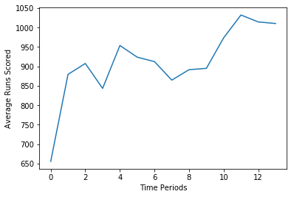
Test Matches
1877-1900
1901-1920
1921-1940
1941-1960
1961-1970
1971-1980
1981-1985
1986-1990
1991-1995
1995-1999
2001-2005
2006-2010
2011-2015
2016-2020

Slide 10
Algorithm for Batsman
Time Period Index
Assigned period wise weights to the runs of each player in a series.
Opposition Index
Calculated the weights based on the different conditions (Home/Away), (Strength of the opposition)
Series Percentile Value
100 * (1 – (position in series/total no. of players))
Result
The aggregate final set of the players

Slide 11
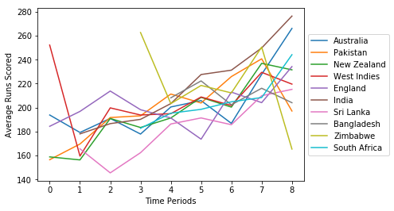
Run scoring trends in a venue – Host nation (ODIS)
0 - 1971-1980
1 - 1981-1985
2 - 1986-1990
3 - 1991-1995
4 - 1995-1999
5 - 2001-2005
6 - 2006-2010
7 - 2011-2015
8 - 2016-2020

Slide 12
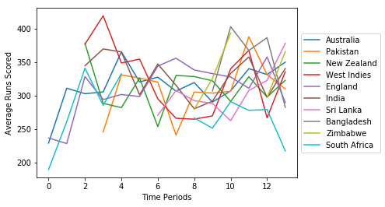
Run scoring trends in a venue – Host nation (Tests)
1877-1900
1901-1920
1921-1940
1941-1960
1961-1970
1971-1980
1981-1985
1986-1990
1991-1995
1995-1999
2001-2005
2006-2010
2011-2015
2016-2020

Slide 13
Algorithm for Bowlers
Bowling Average Index
Peer analysis of the average of the bowlers in a series
Strike Rate Index
Peer analysis of the strike rate of the bowlers in a series
Economy Rate Index
Peer analysis of the economy rate of the bowlers in a series
Result
The aggregate final set of the players

Slide 14
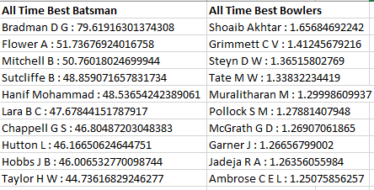
Results

Slide 15
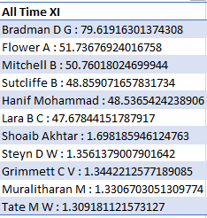
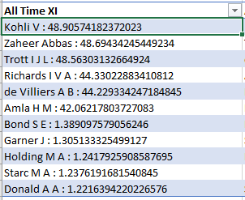
Results
All time X1s (Test and One day Internationals)
TESTS
ODIS

Slide 16
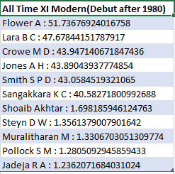
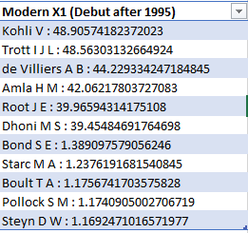
Results
Modern X1s (Test and One day Internationals)

Slide 17
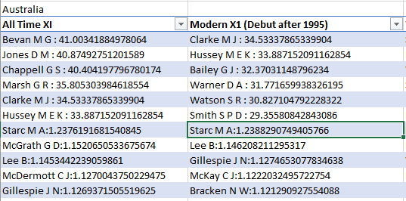
Results
All time X1 and Modern X1 for each country.
E.g ->

Slide 18
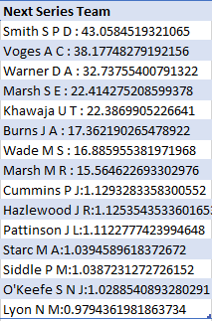
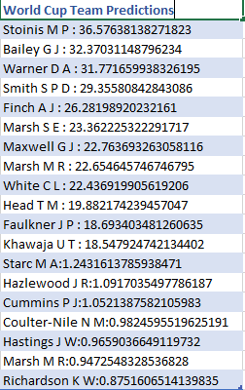
Squad Prediction

Slide 19
References
http://www.espncricinfo.com/magazine/content/story/461783.html
http://www.cricbuzz.com/cricket-news/99969/wanderers-pitch-india-vs-south-africa-the-rules-for-rating-a-pitch-dangerous-or-unfit
http://www.espncricinfo.com/magazine/content/story/487445.html
http://www.espncricinfo.com/story/_/id/22414318/batsmen-analysed-series-dominance
http://www.espncricinfo.com/magazine/content/story/626913.html
http://www.espncricinfo.com/magazine/content/story/626913.html
http://www.howstat.com/cricket/home.asp

Slide 20
Q & A
Thank You

