Slide 1




Slide 2

LOGARITHMS

Slide 3

TEST TIME ON PERMUTATION AND COMBINATIONS-2
QR CODE:

Slide 4
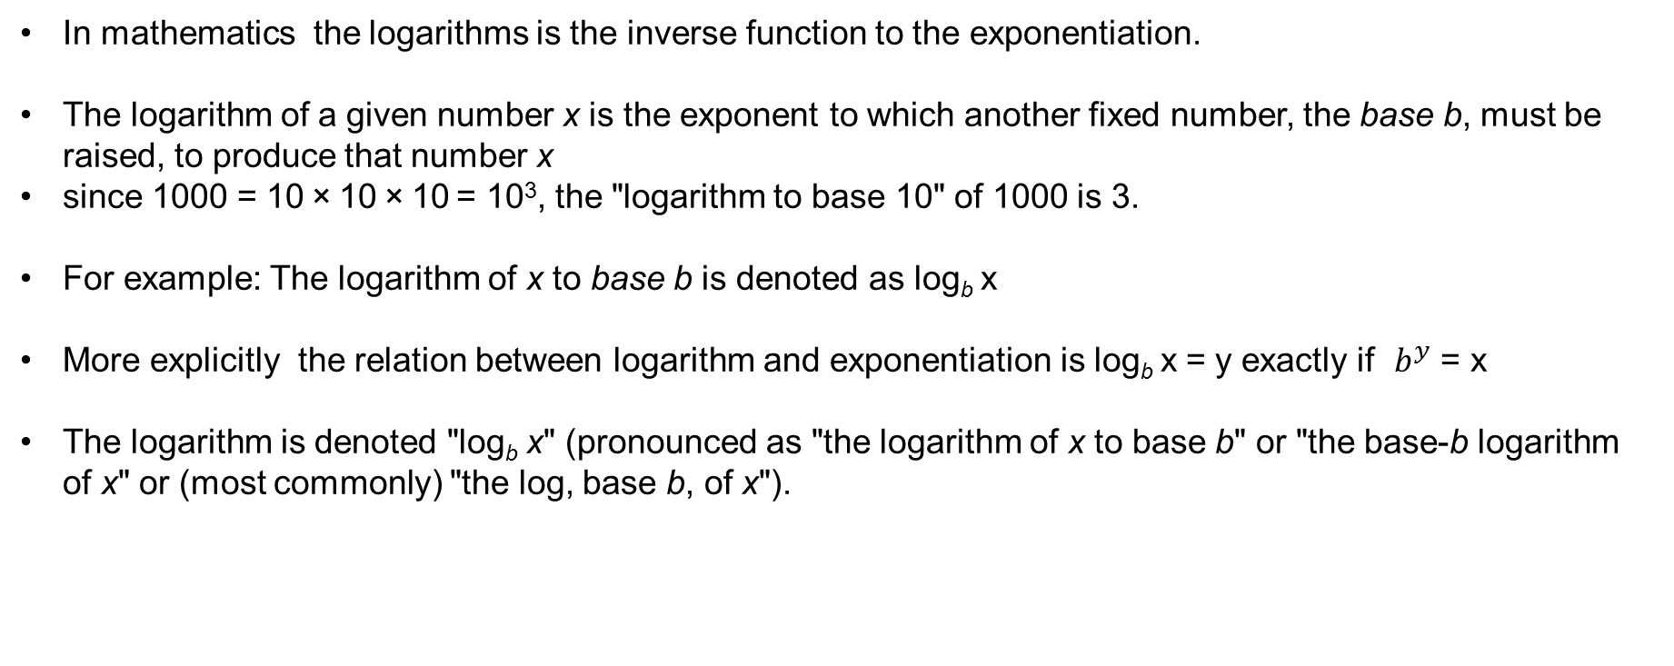
LOGARITHMS

Slide 5
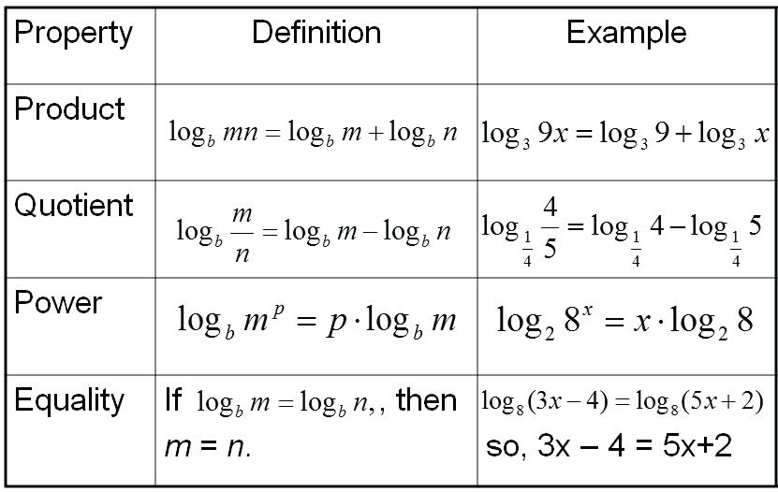
LOGARITHMS

Slide 6
Question: 01
If log 27 = 1.431, then the value of log 9 is ___________.
A. 0.934
B. 0.945
C. 0.954
D. 0.958
Answer: C

Slide 7
CLOCKS
Explanation: 01
Log 27=1.431
log (3³ ) = 1.431
3 log 3 = 1.431
log 3 = 0.477
log 9 = log(3² ) = 2 log 3 = (2 x 0.477) = 0.954.

Slide 8
Question: 02
log₆(216) + [ log(42) - log(6) ] / log(49)
A. 7/2
B. 1/2
C. 4/3
D. 2/3
Answer: A

Slide 9
Explanation: 02
log₆(216) + [ log(42) - log(6) ] / log(49)
= log₆(6³) + log(42/6) / log(7²)
= 3 + log(7) /2 log(7) = 3 + ½
= 7/2

Slide 10
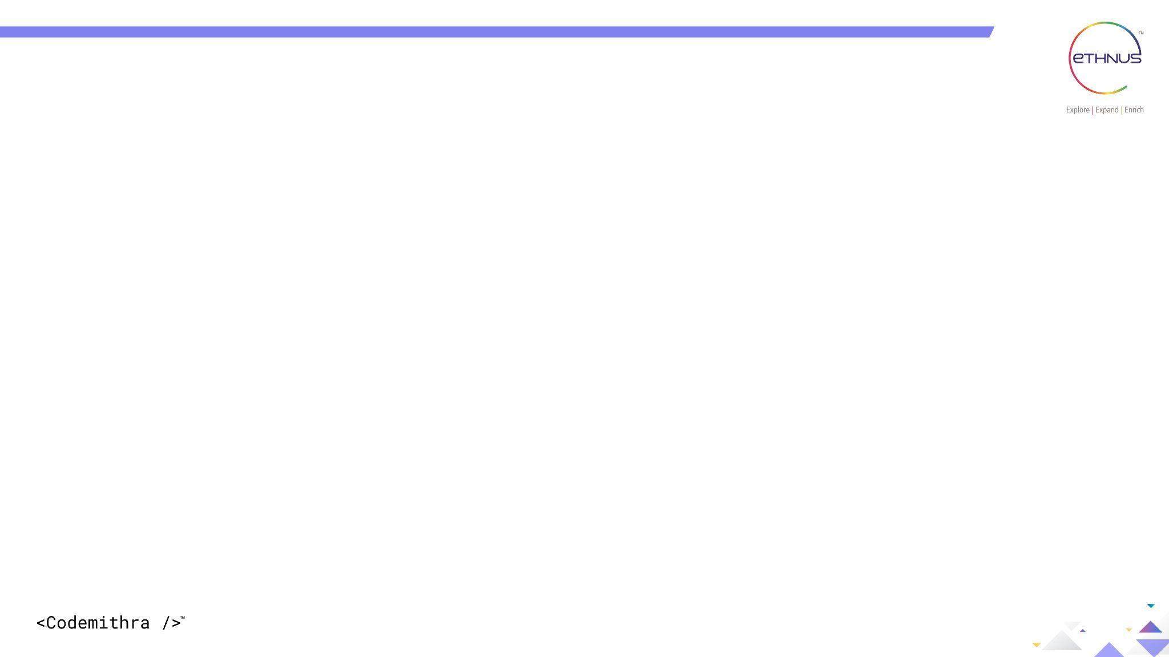
Question: 03
Find the value of log₂ 2 + log₂ 2² + log₂ 2³ + ........ + log₂ 2^{n}.
A. n(n+1)/2
B. n+1
C. n
D. 2n
Answer: A

Slide 11
Question: 01
Explanation: 03
log₂ 2 + log₂ 2² + log₂ 2³ + ........ + log₂ 2^{n} = log₂ 2 + 2log₂ 2 + 3log₂ 2 + ........ + nlog₂ 2 = 1+2+3+........+n = n(n+1)/2

Slide 12
Question: 04
If log 2 = 0.301 and log 3 = 0.4771, find the number of digits in 48¹²?
A. 19
B. 20
C. 21
D. 24
Answer: C

Slide 13
Explanation: 04
We have log 48¹² = 12 × log 48 = 12 × log (2⁴ × 3) = 12 × (4 log 2 + log 3) = 12 × (4 × 0.301 + 0.4771) = 12 × (1.204 + 0.4771) = 12 × 1.6811 = 20.1732 Now the characteristic is 20, so the number of digits = 20 + 1 = 21.

Slide 14
Question: 16
Question: 05
Solve for ‘x:’ the equation is 2log₂x – log₂ (x – 2) = 3
A. 6
B. 4
C. 1
D. 2
Answer: B

Slide 15
Question: 09
Explanation: 05
We have 2log₂x – log₂ (x – 2) = 3 ⇒ log₂x² – log₂ (x – 2) = 3 ⇒ log₂(x²/x-2) = 3 ⇒ log₂(x²/x-2) = 2³ = 8 ⇒ x² = 8(x-2) ⇒ x² - 8x + 16 = 0 ⇒ (x-4)² = 0 ⇒ x=4 Hence answer is option B

Slide 16
Question: 02
Question: 06
Log₁₀ 3+log₁₀ (4x+1)=log₁₀ (x+1)+1
A. 2/7
B. 7/2
C. 3/7
D. 7/3
Answer: B

Slide 17
Explanation: 06
log₁₀ 3+log₁₀ (4x+1)=log₁₀ (x+1)+1
Log₁₀ 3+log₁₀ (4x+1)=log₁₀ (x+1)+log₁₀ (x+1)+log₁₀ 10
Log₁₀ (3(4x+1))=log₁₀ (10(x+1))
=3(4x+1)=10(x+1)=12x+3
=10x+10
=2x=7=x=7/2

Slide 18
Question: 07
If log₁₀ 2 = 0.3010, the value of log₁₀ 80 is _________.
A. 1.6020
B. 1.9030
C. 9030
D. None of these
Answer: B

Slide 19
Question: 04
Question: 08
If log₁₀ 5 + log₁₀ (5x + 1) = log₁₀ (x + 5) + 1, then x is equal to:
A. 1
B. 3
C. 5
D. 10
Answer: B

Slide 20
Explanation: 07
log₁₀ 80 = log₁₀ (8 *10)
= log₁₀ 8 + log₁₀ 10
= log₁₀ (2³ ) + 1
= 3 log₁₀ 2 + 1
= (3 x 0.3010) + 1
= 1.9030.

Slide 21
Explanation: 08
log₁₀ 5 + log₁₀ (5x + 1) = log₁₀ (x + 5) + 1
log₁₀ 5 + log₁₀ (5x + 1) = log₁₀ (x + 5) + log₁₀ 10
log₁₀ [5 (5x + 1)] = log₁₀ [10(x + 5)]
5(5x + 1) = 10(x + 5)
5x + 1 = 2x + 10
3x = 9
x = 3.

Slide 22
Question: 05
Question: 09
log3x + logx3 =17/4. Find X?
A. 3^4
B. 3^(⅛)
C. 3^4 or 3^(¼)
D. 3^(⅓)
Answer: C

Slide 23
Explanation: 09
log₃x + log_{x}3 =17/4
Let y = log₃x
We know that log_{x}3 =1/log 3(x)
Thus the equation can be written as y + 1/y = 174
4y² + 4 = 17y 4y² + 4 - 17y = 0
y = 4 or ¼
log₃x = 4
Then x = 3⁴
If y = 1/4
log₃x = 1/4
x = 3^{1/4}

Slide 24
Question: 10
If log x + log (x + 3) = 1 then the value(s) of x will be, the solution of the equation
x + x + 3 = 1
x + x + 3 = 10
x (x + 3) = 10
x (x + 3) = 1
Answer: C

Slide 25

Explanation:
Explanation: 10
taking log x= log10x
using the law of logs
Log A+log B=log AB
we have
Log x+log (x+3)=1
Log x(x+3)=1−−(1)
definition of logs
Log ab=c⇒ac=b
(1)→101=x(x+3)
∴x2+3x=10
x2+3x−10=0
factorising and solving
(x+5)(x−2)=0
⇒x=−5, or x=2
When solving with x=2 the equation becomes as option c

Slide 26
Question: 11
Find x if log x = log 1.5 + log 12
A. 18
B. 8
C. 15
D. 12
Answer: A

Slide 27
Explanation:
Explanation: 11
log x = log 1.5 + log 12
X= 1.5*12
X=18

Slide 28
Question: 08
Question: 12
log_{a}4 + log_{a}16 + log_{a}64 + log_{a}256 = 10. Then a = __________.
2
4
8
5
Answer: B

Slide 29
Explanation:
Explanation: 12
log a ^{(4*16*64*256)} =log a 4¹⁰ =10 then a=4

Slide 30
Question: 09
Question: 13
Find the value of log 59049(base 9)
9
8
6
5
Answer: D

Slide 31
Question: 09
Explanation: 13
We have log9 59049 = log9 95 = 5 × log9 9 = 5 × 1 = 5.

Slide 32
Question: 10
Question: 14
If ‘x’ is an integer then solve (log2 x) ^2 – log2 x^4 - 32 = 0.
256
125
128
375
Answer: A

Slide 33
Explanation:
Explanation: 14
Sol : Option B
We have (log2 x) 2 – log2 x4 - 32 = 0.
⇒ (log2 x) 2 – 4log2 x - 32 = 0......(1)
Let log2 x = y
(i) ⇒ y2 – 4y – 32 = 0
⇒ y2 – 8y + 4y – 32 = 0
⇒ y (y – 8) + 4 (y – 8) = 0
⇒ (y – 8) (y + 4) = 0
⇒ y = 8, -4
⇒ log2 x = 8 or log2 x = - 4
⇒ x = 28 = 256 or x = 2-4 = 1/16
Since ‘x’ is an integer so x = 256.

Slide 34
Question: 11
Question: 15
If log5y – logsub>5√y = 2 logy 5, then find the value of y.
25
15
35
10
Answer: A

Slide 35
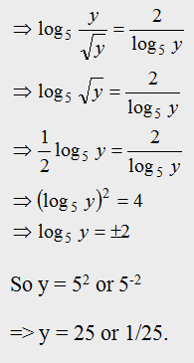
Question: 09
Explanation: 15

Slide 36




THANK YOU
+91 78150 95095
codemithra@ethnus.com
www.codemithra.com

