Slide 1

ECE-2002 Computer Organization and Architecture
Dr. Kritika Bansal
School of Electronics Engineering, VIT-AP

Slide 2
Non-Restoring Division Algorithm for
Unsigned Integer

Slide 3
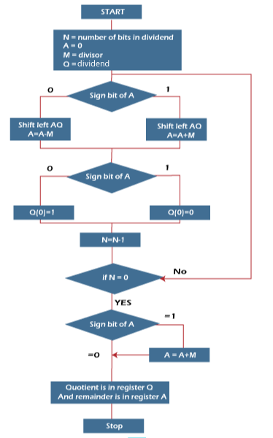
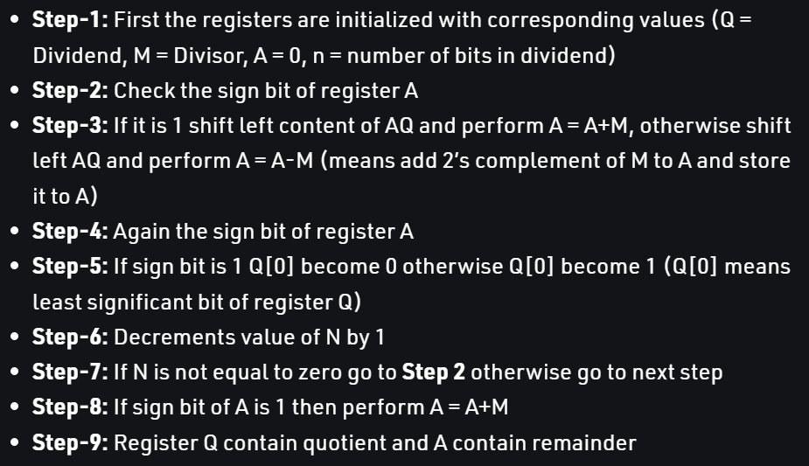

Slide 4
Example: 7/3
N | M | A | Q | Operations
4 | 0011 | 0000 | 0111 | Initial
3 | 0011 | 0000 1101 1101 | 111_ 111_ 1110 | Shift A-M Q(0)=0
2 | 0011 | 1011 1110 1110 | 110_ 110_ 1100 | Shift A+M Q(0)=0
1 | 0011 | 1101 0000 0000 | 100_ 100_ 1001 | Shift A+M Q(0)=1
0 | 0011 | 0001 1110 1110 | 001_ 001_ 0010 | Shift A-M Q(0)=0
 | 0011 | 0001 | 0010 | A+M

Slide 6
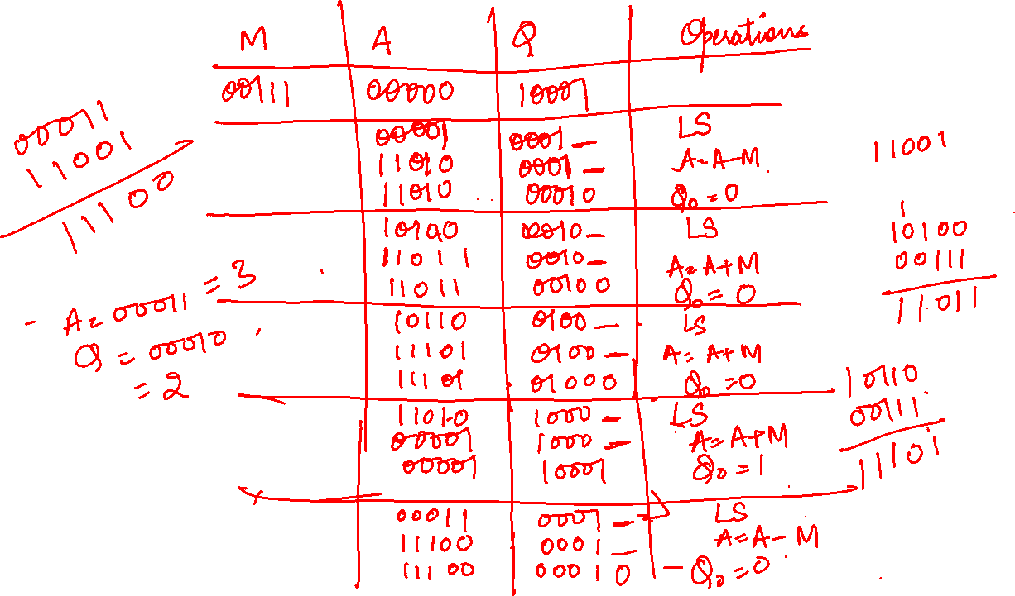
Solve: 17/7

Slide 7
N | M | A | Q | Operations
5 | 00111 | 00000 | 10001 | Initial
4 | 00111 | 00001 11010 11010 | 0001_ 0001_ 00010 | Shift A-M Q(0)=0
3 | 00111 | 10100 11011 11011 | 0010_ 0010_ 00100 | Shift A+M Q(0)=0
2 | 00111 | 10110 11101 11101 | 0100_ 0100_ 01000 | Shift A+M Q(0)=0
1 | 00111 | 11010 00001 00001 | 1000_ 1000_ 10001 | Shift A+M Q(0)=1
0 | 00111 | 00011 11100 11100 | 0001_ 00010 00010 | Shift A-M Q(0)=0
 |  | 00011 | 00010 | A+M
Solve: 17/7

Slide 8
Non Restoring Division Algorithm for Signed Integer

Slide 9
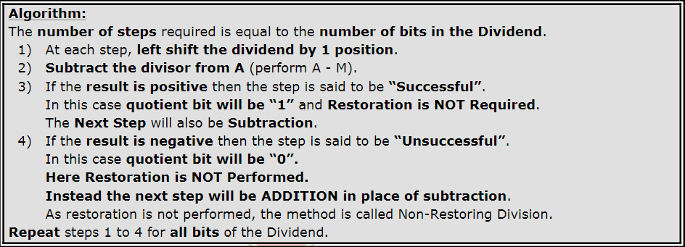
Algorithm
Note: In the last step if the A value is negative after the operation then add ‘M’ to it (A=A+M) to get the true remainder

Slide 10
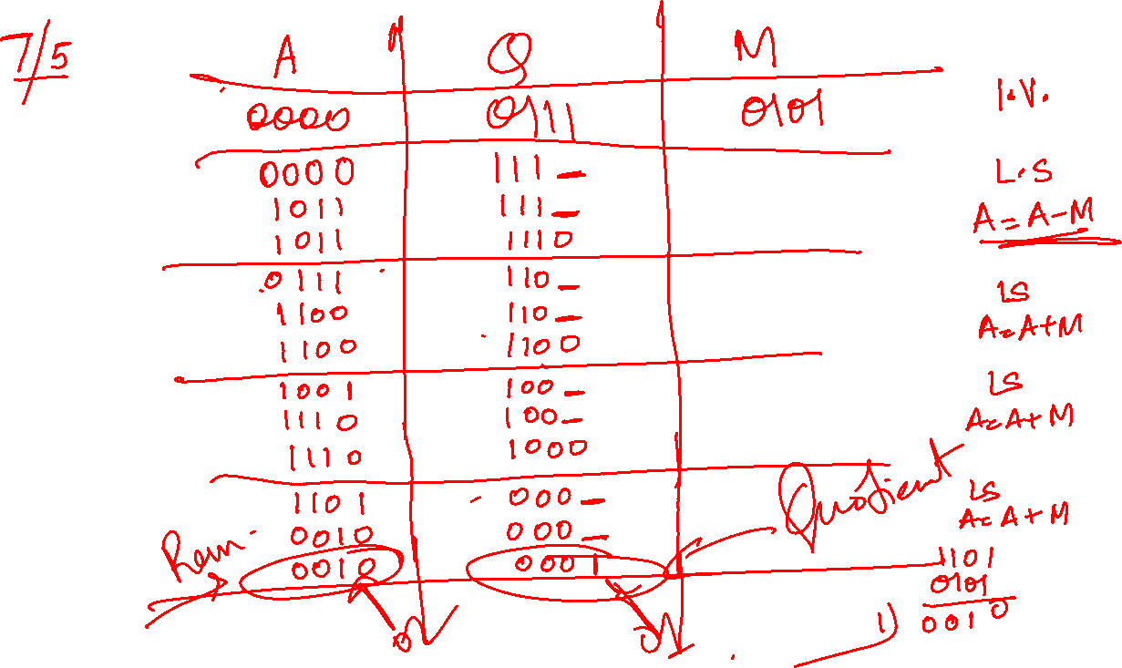

Slide 11
