Slide 1

ECE-2002 Computer Organization and Architecture
Dr. Kritika Bansal
School of Electronics Engineering, VIT-AP

Slide 2
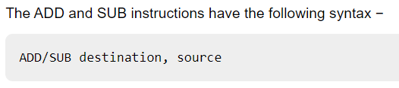
ADD and SUB Instructions
The ADD/SUB instruction can take place between −
Register to register
Memory to register
Register to memory
Register to constant data
Memory to constant data
Memory-to-memory operations are not possible using ADD/SUB instructions.

Slide 3
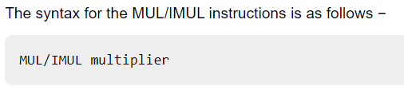
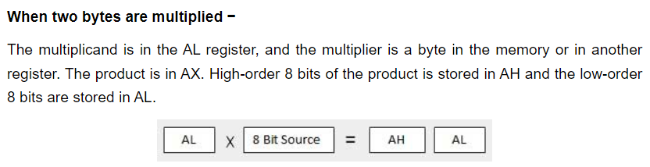
MUL/IMUL Instructions
Multiplicand in both cases will be in an accumulator.

Slide 4
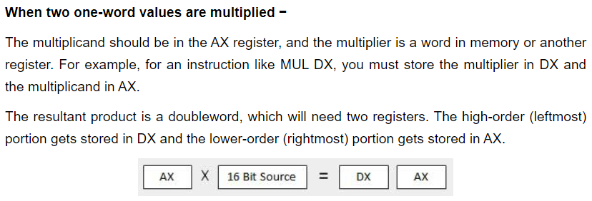
MUL/IMUL Instructions

Slide 5
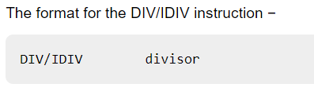
DIV/IDIV Instructions
The dividend is in an accumulator.

Slide 6
Write an assembly language program to compute Y=(A+B)*C+(A-B)*D
A is stored in 2000
B is stored in 2002
C is stored in 2004
D is stored in 2006
Store Y in 3000

Slide 7
Write an assembly language program to compute Y=(A+B)*C+(A-B)*D
MOV AX, [2000]
MOV BX, [2002]
ADD AX, BX
MOV [5000], AX
MOV AX, [2000]
SUB AX, BX
MOV [5002], AX
MOV AX, [2004]
MUL [5000]
MOV [6000], AX
MOV AX, [2006]
MUL [5002]
MOV [6002], AX
MOV AX, [6000]
ADD AX, [6002]
MOV [3000], AX
HLT
A is stored in 2000
B is stored in 2002
C is stored in 2004
D is stored in 2006
Store Y in 3000

Slide 8
Write an assembly language program to compute Y=(A-B)/(C+(D*E))
A is stored in 2000
B is stored in 2002
C is stored in 2004
D is stored in 2006
E is stored in 2008
Store Y in 3000

Slide 9
Write an assembly language program to
Add two 8-bit numbers
Add two 16-bit numbers

Slide 10
Write an assembly language program to
Add two 8-bit numbers with or without carry
Add two 16-bit numbers with or without carry

Slide 11
Write an assembly language program to add two 8-bit numbers with or without carry
MOV CL, 00
MOV AL, [2000]
MOV BL, [2001]
ADD AL, BL
JNC LOOP
INC CL
LOOP MOV [2002], AL
MOV [2003], CL
HLT
1st number in 2000
2nd number in 2001
Store result in 2002
Store carry in 2003

Slide 12
Write an assembly language program to add two 16-bit numbers with or without carry
MOV CX, 0000
MOV AX, [2000]
MOV BX, [2002]
ADD AX, BX
JNC LOOP
INC CX
LOOP MOV [2004], AX
MOV [2006], CX
HLT

Slide 13
Write an assembly language program to
Subtract two 8-bit numbers with or without borrow
Subtract two 16-bit numbers with or without borrow

Slide 14
Write an assembly language program to multiply two 16-bit numbers where starting address is 1000 and the numbers are at 2000 and 2002 memory address and store result into 2004 and 2006 memory address.

Slide 15
Write an assembly language program to multiply two 16-bit numbers
MOV AX, [2000]
MOV BX, [2002]
MUL BX
MOV [2004], AX
MOV AX, DX
MOV [2006], AX
HLT

