Slide 1

ECE-2002 Computer Organization and Architecture
Dr. Kritika Bansal
School of Electronics Engineering, VIT-AP

Slide 2
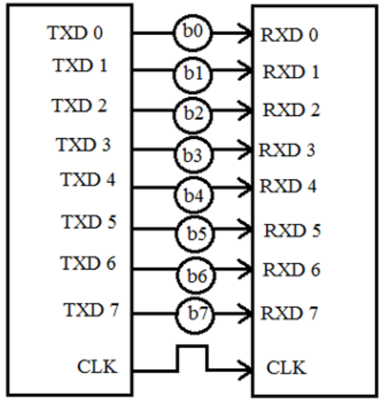
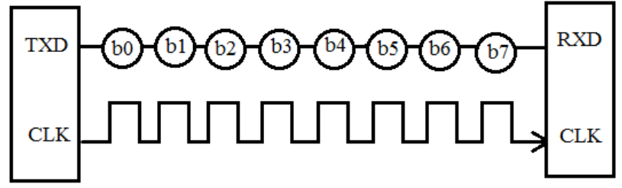
Interfacing
Interface is the path for communication between two components.
The process of sending data sequentially over a computer bus is called as serial communication, which means the data will be transmitted bit by bit.
While in parallel communication the data is transmitted on several data lines or buses at a time.

Slide 3
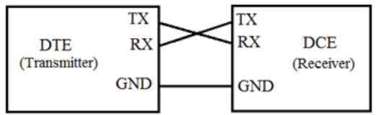
RS232
RS232 is a standard protocol used for serial communication, used for connecting computer and its peripheral devices to allow serial data exchange between them.
It is used in serial communication up to 50 feet with the rate of 1.492kbps.
RS232 is used for connecting Data Terminal Equipment (DTE) and Data Communication Equipment (DCE).
Notes:
https://www.geeksforgeeks.org/difference-between-dte-and-dce/

Slide 4
Handshaking
Handshaking is an automated process of negotiation between two participants through the exchange of information that establishes the protocols of a communication link at the start of the communication, before full communication begins.
Handshaking is a process of communication between a computer system and an external device, by which each tells the other that data is ready to be transferred, and that the receiver is ready to accept it.

Slide 5
Hardware Handshaking
The receiver uses a special memory location called Receiver Buffer.
The received data is stored in the buffer before it is read by the receiver.
The Receiver Buffer can typically store a single bit of data and this data must be read before the next data arrives
In Hardware Handshaking, the transmitter first asks the receiver whether it is ready to receive the data.
The receiver then checks its buffer and if the buffer is empty, it will then tell the transmitter that it is ready to receive.
The transmitter will transmit the data and it is loaded into the receiver buffer.
During this time, the receiver tells the transmitter not to send any further data until the data in the buffer has been read by the receiver.

Slide 6
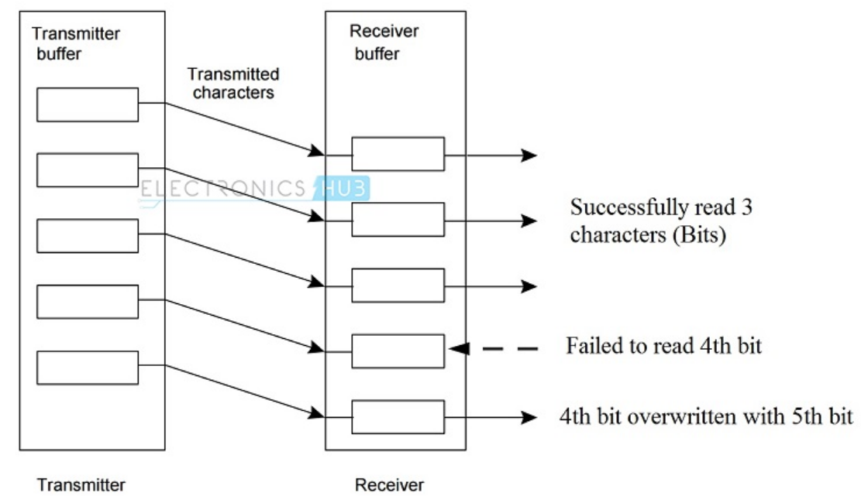
NO Handshaking
If handshaking is not used, then the receiver (DCE) must read the data that is already received by it before the transmitter (DTE) sends the next data.
If it is not cleared, the existing data will be overwritten with the new data.

Slide 7
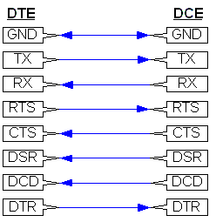
Hardware Handshaking
The RS232 Protocol defines five signals for the purpose of Handshaking:
Ready to Send (RTS)
Clear to Send (CTS)
Data Set Ready (DSR)
Data Carrier Detect (DCD)
Data Terminal Ready (DTR)

Slide 8
Hardware Handshaking
When the transmitter (DTE) wants to send data, it pulls the RTS line to high.
Then the transmitter waits for CTS to go high and hence it keeps on monitoring it.
If the CTS line is low, it means that the receiver (DCE) is busy and not yet ready to receive data.
When the receiver is ready, it pulls the CTS line to high.
The transmitter then transmits the data. This method is also called as RTS/CTS Handshaking.
Ready to Send (RTS)
Clear to Send (CTS)
Data Set Ready (DSR)
Data Carrier Detect (DCD)
Data Terminal Ready (DTR)

Slide 9
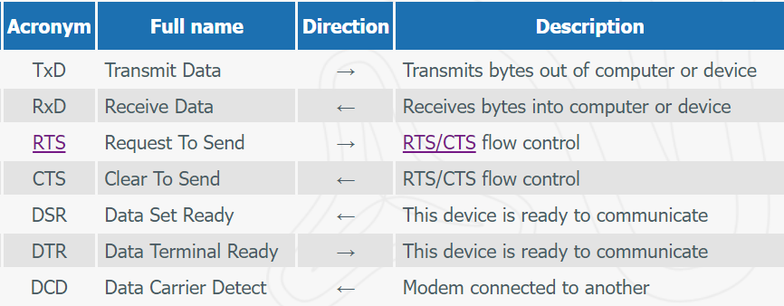
Hardware Handshaking

Slide 10
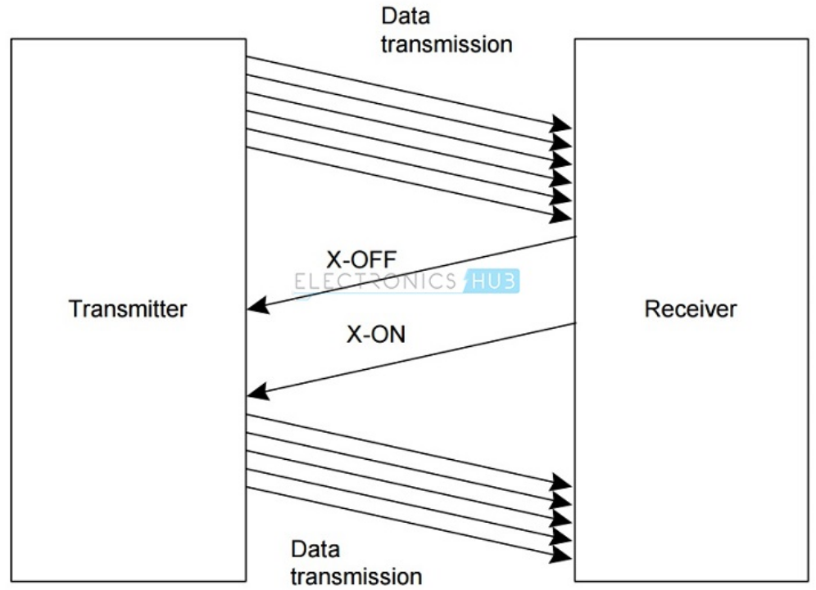
Software Handshaking
Software Handshaking in RS232 involves two special characters for starting and stopping the communication.
These characters are X-ON and X-OFF (Transmitter On and Transmitter OFF).
The transmitter starts sending data only after it receives the X-ON signal.
When the receiver sends an X-OFF signal, the transmitter stops sending the data.

Slide 11
IEEE-488
The IEEE 488 or General Purpose Interface Bus (GPIB) bus is an 8-bit parallel interface bus that is used for short-distance communications.
Within IEEE 488, the equipment on the bus falls into three categories:
Talker: Talker is an entity on the bus that issues instructions onto the bus.
Listener: A listener is an entity connected to the bus that accepts instructions from the bus.
Example: Printer that only accepts data from the bus.
Controller:
The controller is the entity that controls the operation of the bus.
It is usually a computer that ensures no conflicts occur on the bus.
Notes:
If two talkers tried to talk at the same time then data would become corrupted and the operation of the whole system would be seriously impaired. It is possible for multiple controllers to share the same bus; but only one can act as a controller at any particular time.

Slide 12
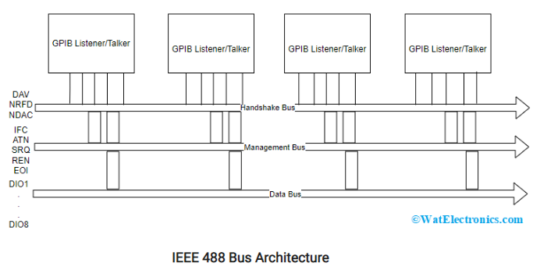
IEEE-488
The IEEE 488 bus architecture, consists of 16 signaling lines that are used to carry information between various devices that have connections with the bus.
These 16 signals are classified into three groups which are:
Data lines: 8 lines used to transfer information between devices on the bus. DIO 1 is the LSB bit and DIO 8 is the MSB bit.

Slide 13
IEEE-488
Handshake lines: 3 lines used to handshake the transfer of information across data lines
DAV: Data valid
Active talker has placed data on data lines
NRFD: Not ready for data
Active listener is not ready for more data
NDAC: Not data accepted
Active listener has not accepted the current data

Slide 14
IEEE-488
Bus management lines: 5 lines for control of bus activities
IFC: Interface clear
IFC high makes the devices on bus to be in an idle state
ATN: Attention
When ATN is high, the bus signifies command mode and when ATN is low, the bus signifies data byte mode
SRQ: Service request
The device which has a connection with the bus is requesting a service

Slide 15
IEEE-488
Bus management lines: 5 lines for control of bus activities
REN: Remote enable
When the REN pin high, then the bus moves to a remote state, and the devices will be addressed either to talk or listen
EOI: End or identity
EOI pin high signifies the last byte

