Slide 1

ECE-2002 Computer Organization and Architecture
Dr. Kritika Bansal
School of Electronics Engineering, VIT-AP

Slide 2
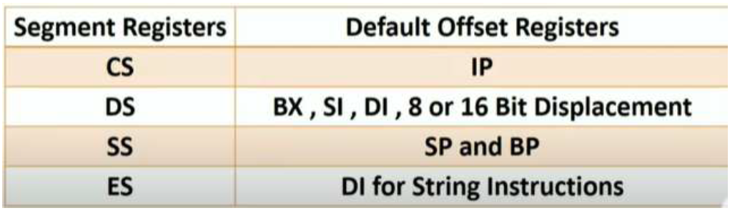
1. Calculate the effective address for the following register:
CS=1111H, BX=2025H, IP=1234H, SP=1010H,
DS=3333H, SS=2525H, BP=4500H, DI= 0021H
Physical Address = Segment address X 10 + offset address
Notes:
CS= 12342
DS= 33350
SS= 26360

Slide 3
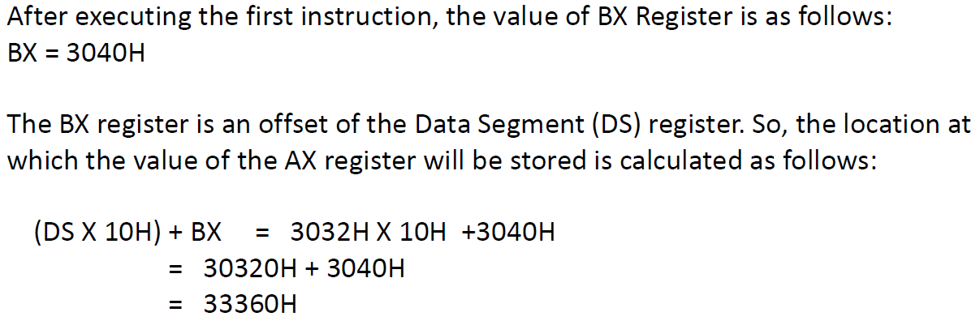
2. The value of DS register is 3032H. BX register contains 3032H. After the following operations calculate the address at which AX will be stored.
ADD BX, 0008H
MOV [BX], AX
Notes:
CS= 12342
DS= 33350
SS= 26360

Slide 4
3. Write a program to add two 8-bit numbers and two 16-bit numbers with and without carry. Use subsequent memory locations.
MOV CL, 00
MOV AL, [2000]
MOV BL, [2001]
ADD AL, BL
JNC LOOP
INC CL
LOOP MOV [2002], AL
MOV [2003], CL
HLT
MOV CX, 0000
MOV AX, [2000]
MOV BX, [2002]
ADD AX, BX
JNC LOOP
INC CX
LOOP MOV [2004], AX
MOV [2006], CX
HLT
Notes:
CS= 12342
DS= 33350
SS= 26360

Slide 5
4. Write a program to subtract two 8-bit numbers and two 16-bit numbers with and without carry. Use subsequent memory locations.
MOV CL, 00
MOV AL, [2000]
MOV BL, [2001]
SUB AL, BL
JNC LOOP
INC CL
LOOP MOV [2002], AL
MOV [2003], CL
HLT
MOV CX, 0000
MOV AX, [2000]
MOV BX, [2002]
SUB AX, BX
JNC LOOP
INC CX
LOOP MOV [2004], AX
MOV [2006], CX
HLT
Notes:
CS= 12342
DS= 33350
SS= 26360

Slide 6
5. Write a program to add a data byte located at offset 0500H in 2000H segment to another data byte available at 0600H in the same segment and store the result at 0700H in the same segment.
MOV AX, 2OOOH ; Initialising DS with value
MOV DS, AX ; 2OOOH
MOV AX, [05OOH] ; Get first data byte from O5OOH offset
ADD AX, [06OOH] ; Add this to the second byte from O6OOH
MOV [07OOH], AX ; Store AX in O7OOH (result).
HLT ; Stop
Notes:
CS= 12342
DS= 33350
SS= 26360

Slide 7
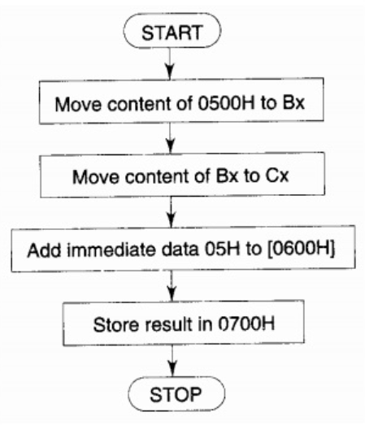
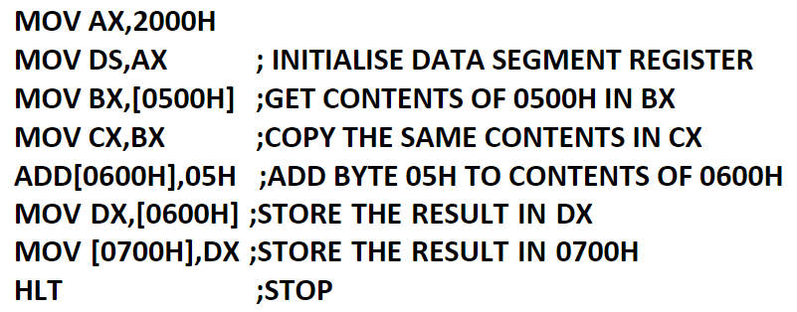
6. Write a program to move the contents of the memory location 0500H to register BX and to CX. Add immediate byte 05H to the data residing in memory location, whose address is computed using DS = 2000H and offset= 0600H. Store the result of the addition in 0700H. Assume that the data is located in the segment specified by the data segment register DS which contain 2000H.
Notes:
CS= 12342
DS= 33350
SS= 26360

Slide 8
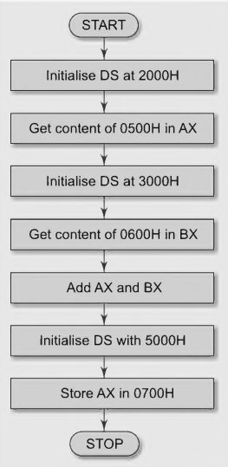
7. Write a program to add the contents of the memory location 2000H:0500H to contents of 3000H:0600H and store the result in 5000H:0700H.
MOV DX, 2000H ; Initialize DS at 2000H
MOV DS, DX
MOV AX, [500H] ;Get first operand in AX
MOV DX, 3000H ;Initialize DS at 3000H
MOV DS, DX
MOV BX, [0600H] ;Get second operand in BX.
ADD AX, BX ;Perform addition
MOV DX, 5000H ;Initialize DS at 5000H
MOV DS, DX
MOV [0700H],AX ; Store the result
HLT ; Stop
Notes:
CS= 12342
DS= 33350
SS= 26360

Slide 9
8. Write a program to move 10 bytes of data from the offset 0300H to 0400H in the segment 5000H.
MOV DS, 5000H Set DS to segment 5000H
MOV SI, 0300H Source offset
MOV DI, 0400H Destination offset
MOV CX, 000AH Number of bytes to move (10)
CLD Clear direction flag (forward movement)
REP MOVSB Move CX bytes from DS:SI to ES:DI
HLT Halt execution
Notes:
CS= 12342
DS= 33350
SS= 26360

Slide 10
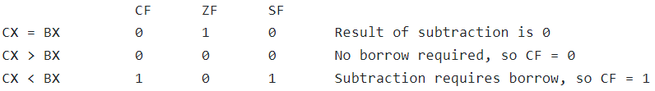
CMP (Compare)
CMP REG, memory
memory, REG
REG, REG
memory, immediate
REG, immediate
Result is not stored anywhere, flags are set (OF, SF, ZF, AF, PF, CF) according to the result.
CMP CX,BX
Compare CX with BX. Depending on the value of CX and BX the below flags will be set
Notes:
CS= 12342
DS= 33350
SS= 26360

Slide 11
9. Write a program to find out the largest number from an unordered array of sixteen 8-bit numbers stored sequentially in the memory locations starting at offset 0500H in the segment 2000H.
MOV AX, 2000H Load segment address
MOV DS, AX Set DS to 2000H
MOV SI, 0500H Load offset address of the array
MOV CX, 0FH Loop counter (16 numbers, but 15 comparisons)
MOV AL, [SI] Load the first number as the initial maximum
INC SI Move to the next element
NEXT_NUM:
CMP AL, [SI] Compare AL with the current number
JAE SKIP If AL >= [SI], skip update
MOV AL, [SI] Update AL with the new maximum
SKIP:
INC SI Move to the next element
LOOP NEXT_NUM Repeat for the remaining elements
MOV [0600H], AL Store the largest number at offset 0600H
HLT Halt execution
Notes:
CS= 12342
DS= 33350
SS= 26360

Slide 12
10. Write a program to sort a 8 bit data array in ascending order. The array consists of 5 numbers starting from location 3000H:4000H
MOV AX, 3000H Load segment address
MOV DS, AX Set DS to 3000H
MOV SI, 4000H Load offset address of the array
MOV CX, 5 Outer loop counter (Number of elements)
OUTER_LOOP:
MOV DI, SI Start comparing from the first element
MOV BX, CX Copy CX to BX
DEC BX Inner loop runs (N-1) times
INNER_LOOP:
MOV AL, [DI] Load first number
MOV DL, [DI+1] Load next number
CMP AL, DL Compare AL and DL
JBE SKIP_SWAP If AL <= DL, no swap needed ;
//Swap AL and DL
MOV [DI], DL Store DL in [DI]
MOV [DI+1], AL Store AL in [DI+1]
SKIP_SWAP:
INC DI Move to the next element
DEC BX Decrease inner loop counter
JNZ INNER_LOOP Repeat inner loop until BX = 0
DEC CX Decrease outer loop counter
JNZ OUTER_LOOP Repeat outer loop until sorted
HLT Halt execution
Notes:
CS= 12342
DS= 33350
SS= 26360

Slide 13
11. Write a program to find the factorial of a number stored in memory offset 500. Store the result at 600 and 601 memory offset.
MOV CX, [0500]
MOV AX, 0001
MOV DX, 0000
L1: MUL CX
LOOP L1
MOV [0600], AX
MOV [0601], DX
HLT
Notes:
CS= 12342
DS= 33350
SS= 26360

