Slide 1

SCHOOL OF COMPUTER SCIENCE AND ENGINEERING
SOFTWARE ENGINEERING (SE)
(CSE1005)
Module No-1 : Software Process Models
jainabbi banda
Assistant Professor @ SCOPE
s

Slide 2
Software Process Models:
Linear
RAD
Incremental
Spiral
Component – based development
Fourth Gen Techniques.

Slide 3
Software Process Models
Software processes are the activities for designing, implementing, and testing a software system.
The software development process is complicated and involves a lot more than technical knowledge.
A software process model is an abstract representation of the software development process.
The models specify the stages and order of a process.
So, think of this as a representation of the order of activities of the process and the sequence in which they are performed.
A model will define the following:
The tasks to be performed
The input and output of each task
The pre and post-conditions for each task
The flow and sequence of each task
The goal of a software process model is to provide guidance for controlling and coordinating the tasks to achieve the end product and objectives as effectively as possible.

Slide 4
There are many kinds of process models for meeting different requirements. The most popular and important SDLC models are as follows:
Waterfall model
V model
Incremental model
RAD model
Agile model
Iterative model
Prototype model
Spiral model

Slide 5
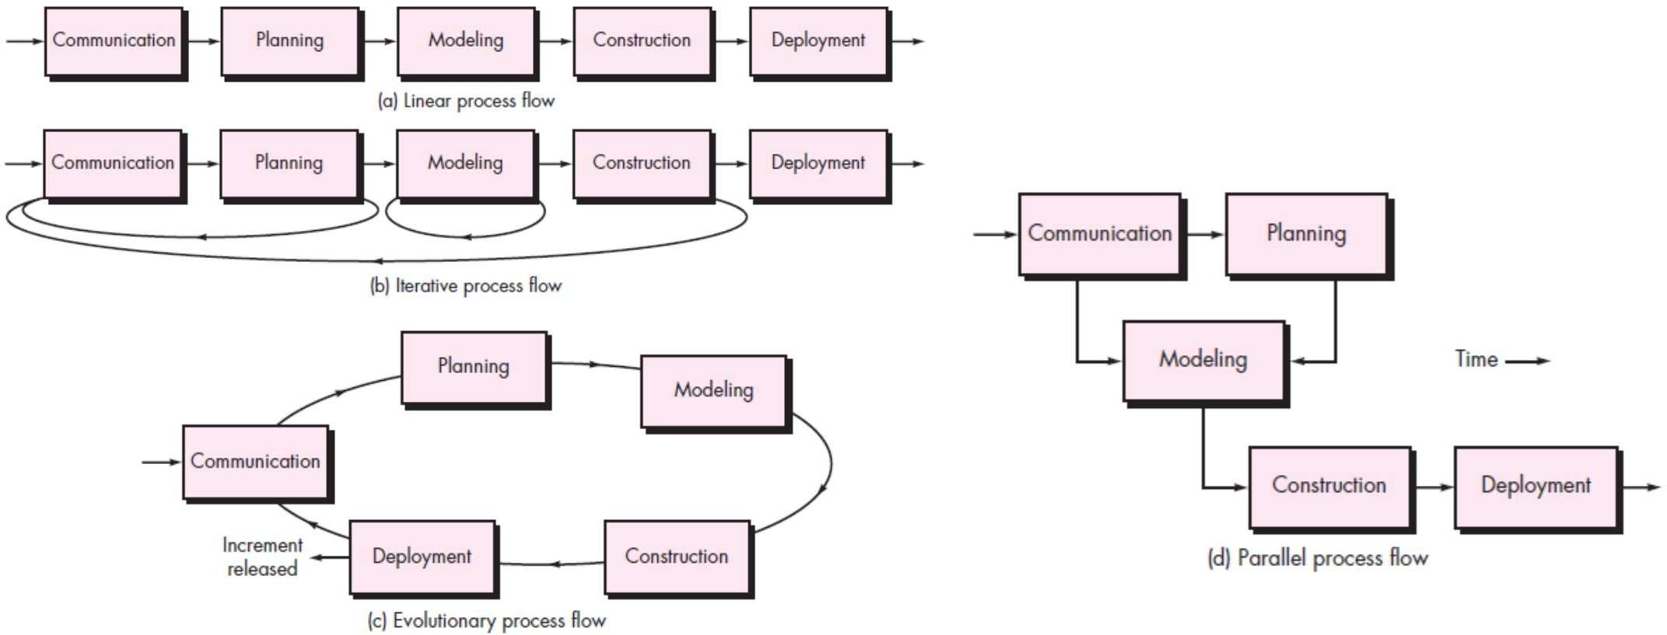
A Generic Process Model
Process Flow
5

Slide 6
Linear Process Models
Linear process model follow a pattern which is completing phases one by one.
In this case after completing a phase it will move to next phase and as soon as moves to next phase there is no way to back to previous phase.
Linear process model is suitable for those projects, who has little or no feedback or refinement.
To make a project successful by using linear process model then understand what client want and all requirements at the very beginning of the project because there is no option for revisit any stage.
Some well-known linear process models are - Waterfall Model & V-Model.

Slide 7

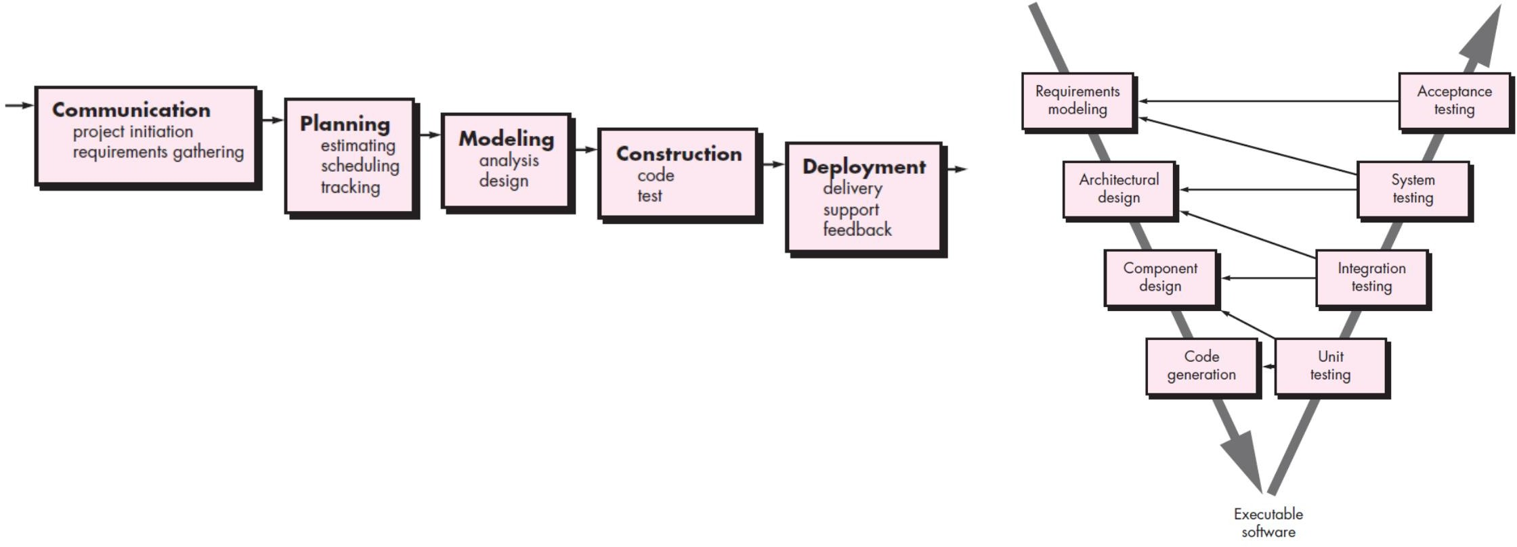
Linear Process Models
Waterfall Model & V-Model
7

Slide 8
Benefits and Drawbacks of Waterfall model
Benefits
Process is easy to understand
Clearly define deliverable and milestones
Emphasizes to analysis the system and requirement before design and implementation
It can be suitable for those product whose are well specified and no need to change after development
Drawbacks
Not very adaptable to changes
Need to know all requirement before start the process and there is no option to change
in middle of the process
Testing occurs at the very end of the project so if there any bug found during testing
it become costly to fix those bug

Slide 9
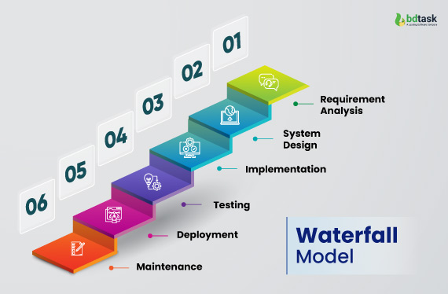
In waterfall model client can’t see the product until close to the end of development. The developed product may not match with what customer wants. In that case the product may become useless

Slide 10
V-Model
Like waterfall model V-model is also a linear process model. It focuses more on testing the system. V model has two branches looks like V.
Like linear model V model also starts with analysis and identification of requirements then move to design and implementation phases.
The left branch forms analysis and design related activities on the other hand the right branch forms different types of testing like Unit Testing, Integration Testing, System Testing, Acceptance Testing etc. Each testing activity right branch verifies corresponding analysis and design related activities of left branch.

Slide 11
Benefits and Drawbacks Benefits are- 1. Straightforward so easy to understand 2. Allow to verify product at multiple level by executing different types of testing Drawbacks are- 1. Doesn’t accommodate any changes

Slide 12

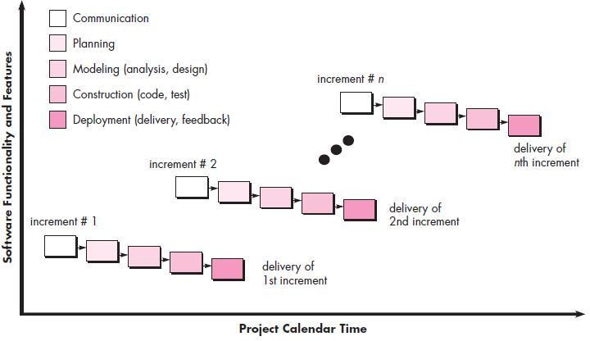
Incremental Process Model
12

Slide 13
Incremental Model
Incremental Model is a process of software development where requirements divided into multiple standalone modules of the software development cycle.
In this model, each module goes through the requirements, design, implementation and testing phases.
Every subsequent release of the module adds function to the previous release. The process continues until the complete system achieved.
When we use the Incremental Model?
When the requirements are superior.
A project has a lengthy development schedule.
When Software team are not very well skilled or trained.
When the customer demands a quick release of the product.
You can develop prioritized requirements first.

Slide 14
Advantage of Incremental Model 1. Errors are easy to be recognized. 2. Easier to test and debug 3. More flexible. 4. Simple to manage risk because it handled during its iteration. 5. The Client gets important functionality early. Disadvantage of Incremental Model 1. Need for good planning 2. Total Cost is high. 3. Well defined module interfaces are needed.

Slide 15
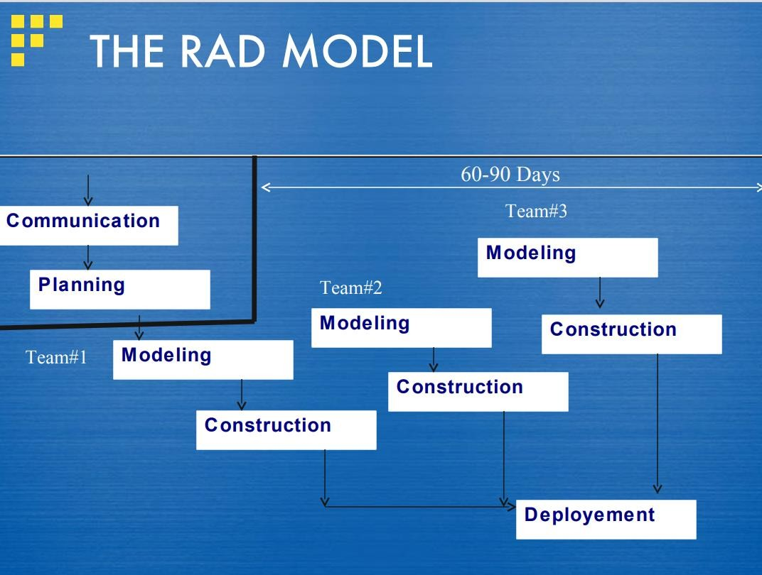
RAD Process Model
15

Slide 16
RAD (Rapid Application Development) Model
RAD is a linear sequential software development process model that emphasizes a concise development cycle using an element based construction approach.
If the requirements are well understood and described, and the project scope is a constraint, the RAD process enables a development team to create a fully functional system within a concise time period.
RAD (Rapid Application Development) is a concept that products can be developed faster and of higher quality through:
1. Gathering requirements using workshops or focus groups
2. Prototyping and early, reiterative user testing of designs
3. The re-use of software components
4. A rigidly paced schedule that refers design improvements to the next product version
5. Less formality in reviews and other team communication

Slide 17
When to use RAD Model?
When the system should need to create the project that modularizes in a short span time (2-3 months).
When the requirements are well-known.
When the technical risk is limited.
When there's a necessity to make a system, which modularized in 2-3 months of period.
It should be used only if the budget allows the use of automatic code generating tools.
Advantage of RAD Model
This model is flexible for change.
In this model, changes are adoptable.
Each phase in RAD brings highest priority functionality to the customer.
It reduced development time.
It increases the reusability of features.
Disadvantage of RAD Model
It required highly skilled designers.
All application is not compatible with RAD.
For smaller projects, we cannot use the RAD model.
On the high technical risk, it's not suitable.
Required user involvement.

Slide 18
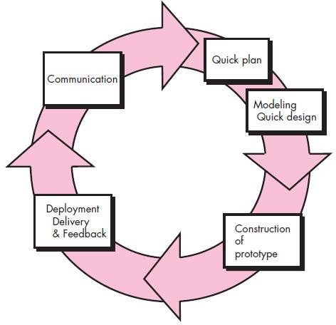
Evolutionary Process Models
The prototyping paradigm
The prototyping model is a systems development method in which a prototype is built, tested and then reworked as necessary until an acceptable outcome is achieved from which the complete system or product can be developed.
18

Slide 19
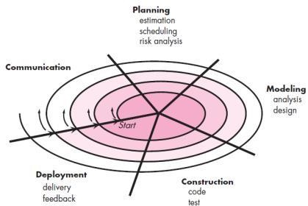
Evolutionary Process Models
The Spiral Model
19

Slide 20
Spiral Model The spiral model is an evolutionary software process model that couples the iterative feature of prototyping with the controlled and systematic aspects of the linear sequential model. 1. The spiral model is a systems development lifecycle (SDLC) method used for risk management that combines the iterative development process model with elements of the Waterfall model. 2. The spiral model is used by software engineers and is favored for large, expensive and complicated projects. Advantages High amount of risk analysis Useful for large and mission-critical projects. Disadvantages Can be a costly model to use. Risk analysis needed highly particular expertise Doesn't work well for smaller projects.

Slide 21
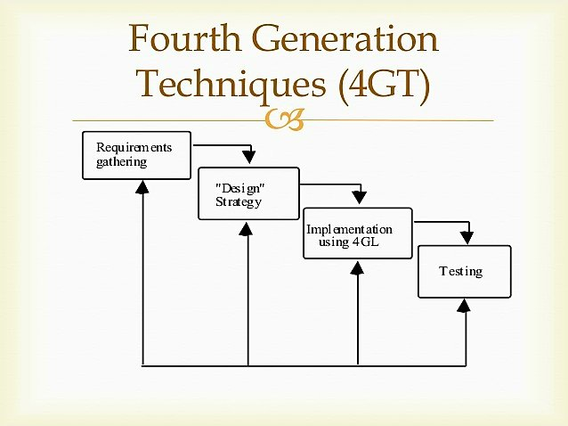
Fourth Gen Techniques Fourth Generation Technique (4GT) is a software development methodology that emphasizes using high-level programming languages and automated tools to expedite the software development process. 4GT techniques are designed to improve the productivity of developers and reduce the time and cost of software development.

Slide 22
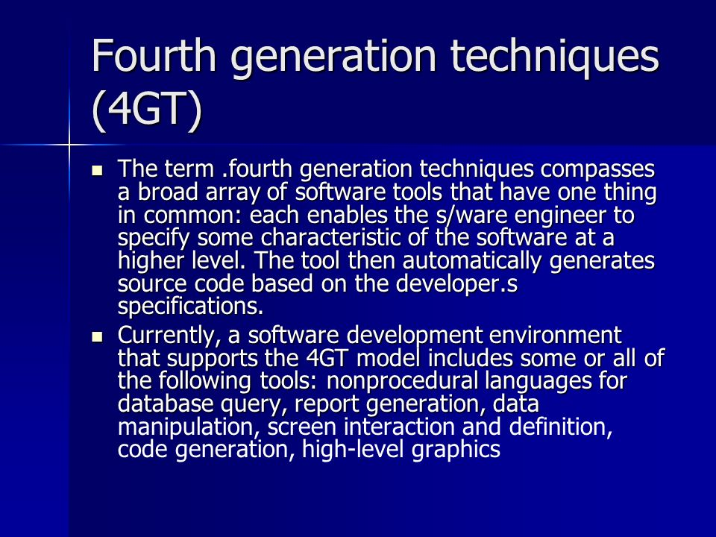

Slide 23
Advantages of Fourth Generation Techniques Rapid Development User-Friendly Interfaces Productivity Improvement Reduced Coding Errors Automatic Code Generation Less Dependency on Highly Skilled Programmers

Slide 24
Disadvantages of Fourth Generation Techniques Limited Control Over Code Portability Issues Performance Concerns Tool Dependency Incompatibility with Complex Systems Resistance to Change

Slide 25
Specialized Process Models
Component-Based Development
The Formal Methods Model
Aspect-Oriented Software Development

Slide 26
Component-Based Development
Incorporates the following steps
(implemented using an evolutionary approach):
Available component-based products are researched and evaluated for the application domain in question.
Component integration issues are considered.
A software architecture is designed to accommodate the components.
Components are integrated into the architecture.
Comprehensive testing is conducted to ensure proper functionality.

Slide 27
The Formal Methods Model
The development of formal models is currently quite time consuming and expensive.
Because few software developers have the necessary background to apply formal methods, extensive training is required.
It is difficult to use the models as a communication mechanism for technically unsophisticated customers.

Slide 28
Aspect-Oriented Software Development
Localized software characteristics are modelled as components (e.g., object-oriented classes) and then constructed within the context of a system architecture.
When concerns cut across multiple system functions, features, and information, they are often referred to as crosscutting concerns.
Aspectual requirements define those crosscutting concerns that have an impact across the software architecture.
28

Slide 29
Component–based development 1. Component-based development (CBD) is a procedure that accentuates the design and development of computer-based systems with the help of reusable software components. 2. With CBD, the focus shifts from software programming to software system composing. 3. Component-based development techniques involve procedures for developing software systems by choosing ideal off-the-shelf components and then assembling them using a well-defined software architecture 4. With the systematic reuse of coarse-grained components, CBD intends to deliver better quality and output. 5. Component-based development is also known as component-based software engineering (CBSE).

Slide 30
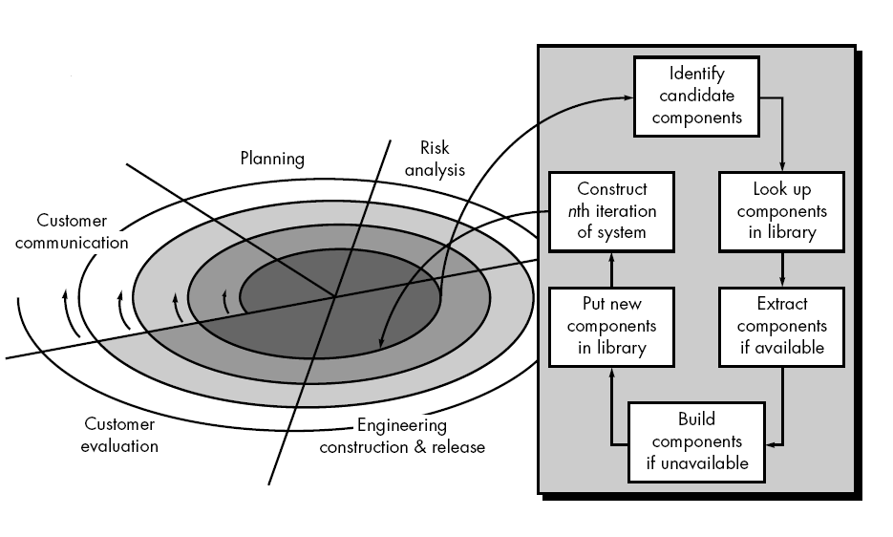
Component –based development

Slide 31
key goals of CBD Save time and money when building large and complex systems Enhance the software quality Detect defects within the systems Some advantages of CBD include: Minimized delivery: Search in component catalogs Recycling of pre-fabricated components Improved efficiency: Developers concentrate on application development Improved quality: Component developers can permit additional time to ensure quality Minimized expenditures The specific routines of CBD are: Component development Component publishing Component lookup as well as retrieval Component analysis Component assembly

Slide 32
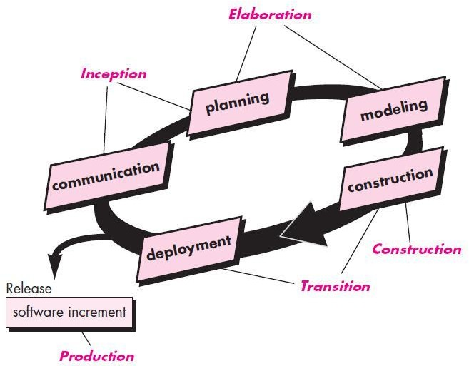
The Unified Process Model
32

Slide 33
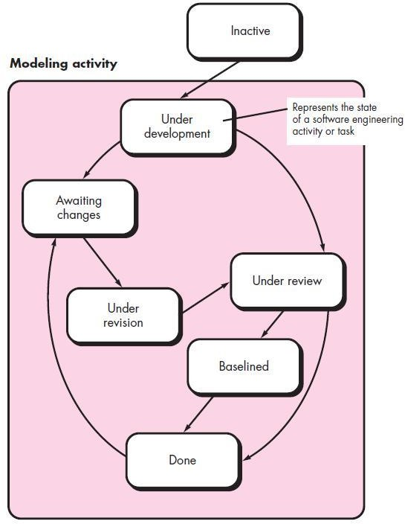
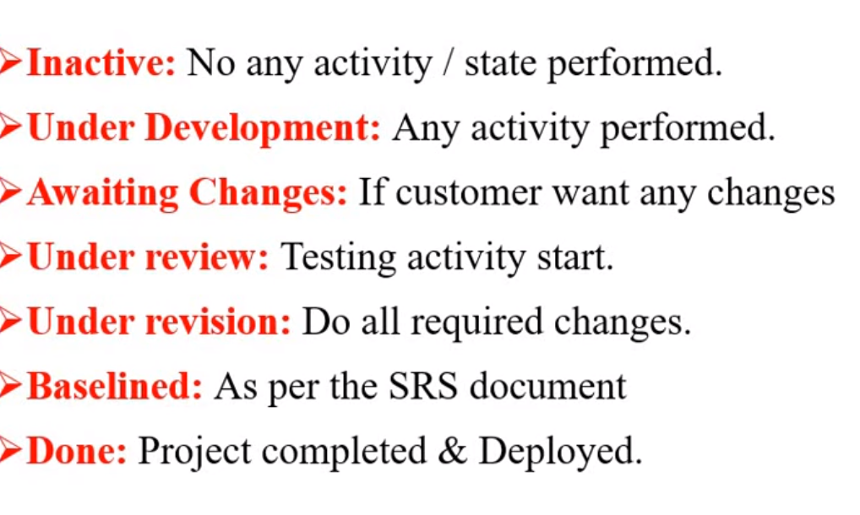
Concurrent Models
33

Slide 34
Thank You

