Slide 1




Slide 2

SYLLOGISM

Slide 3
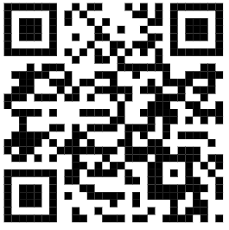
TEST TIME ON SPEAKING SKILLS
QR CODE:

Slide 4
Introduction
Bi
Syllogisms are the logical arguments.
Each of the questions are given two or more statements followed by conclusions.
You have to take the given statements to be true even if they seem to be at variance from commonly known facts.
Read all the conclusions and then decide which of the given conclusions logically follows from the given statements disregarding commonly known facts.

Slide 5
Basic Component
Statement: A fact that must be accepted as true even though it may be an unsound statement logically.
Conclusion: A fact that you must test for validity after assuming the statement to be true.
Example:
Statement: All machines are bad. Some bad are globe. All globe are round.
Conclusions: Some machines are round. No machine is round
Notes:
This is the template for slides with an image and a bullet list

Slide 6
Basic Component
Three Basic Relationships:
No
Some
All
Notes:
This is the template for slides with an image and a bullet list

Slide 7


Basic Component
No
No sheep is in the farm.
Notes:
This is the template for slides with an image and a bullet list

Slide 8
Basic Component
Some
Some sheep are in the farm.
Notes:
This is the template for slides with an image and a bullet list

Slide 9
Basic Component
All
All sheep are in the farm.
Notes:
This is the template for slides with an image and a bullet list

Slide 10
Basic Component
No A is B
Sure Conclusion: No B is A
A
B
Notes:
This is the template for slides with an image and a bullet list

Slide 11
Basic Component
Some A are B
Sure Conclusion: Some B are A
A
B
A & B
Notes:
This is the template for slides with an image and a bullet list

Slide 12
Basic Component
All A are B
Sure Conclusion: Some B are A
B
A
Notes:
This is the template for slides with an image and a bullet list

Slide 13
Basic Component
Step 1:
Represent the statement in Venn Diagram format.
Step 2:
Check whether first conclusion is true for all cases
Example:
Statement:
Some machines are bad
Some bad are globe
All globe are round
Conclusion:
Some machines are round
No machine is round
Notes:
This is the template for slides with an image and a bullet list

Slide 14
Basic Component
Some machines are bad
M
B
M & B
Notes:
This is the template for slides with an image and a bullet list

Slide 15
Basic Component
Some bad are globe
M
M, B
B
M
M & B
B
G
B & G
B, G, M
M, G
B, G
G
Case 1
Case 2
Notes:
This is the template for slides with an image and a bullet list

Slide 16
Basic Component
Some machines are bad | Some bad are globe |
All Globe are round
R
M
B
G
M & B
B & G
Case 1.1
M
B
G
M & B
B & G
R
M
B
G
M & B
B & G
Case 1.2
Case 1
Notes:
This is the template for slides with an image and a bullet list

Slide 17
Basic Component
Some machines are bad | Some bad are globe | All Globe are Round
M
M, B
B
M
M, B
B
R
B, G, M
B, G, M
M, G
B, G
M, G
B, G
G
G
Case 2
Case 2.1
Notes:
This is the template for slides with an image and a bullet list

Slide 18
Basic Component
Some machines are bad | Some bad are globe | All Globe are Round
M
B
G
M & B
B & G
M
M, B
B
Case 1.1
B, G, M
M, G
B, G
G
M
B
G
M & B
B & G
Case 1.2
Case 2.1
Notes:
This is the template for slides with an image and a bullet list

Slide 19
Case 1.1
Case 1.2
Case 2.1
Some machines are round
✗
✓
✓
M
B
G
M & B
B & G
Case 1.1
M
B
M, B
B, G, M
M, G
B, G
G
M
B
G
M & B
B & G
Case 1.2
Case 2.1
Notes:
This is the template for slides with an image and a bullet list

Slide 20
Case 1.1
Case 1.2
Case 2.1
✓
✗
✗
No machine is round
M
B
G
M & B
B & G
Case 1.1
M
M, B
B
B, G, M
M, G
B, G
G
M
B
G
M & B
B & G
Case 1.2
Case 2.1

Slide 21
Steps for solving:
Conclusion 1 is Invalid
If the conclusion is proved false for even one case, the conclusion is invalid
In this case, case 1.1 is false
If the conclusion is proved false for even one case, the conclusion is invalid
Conclusion 2 is false for case 1.2 and 2.1
Notes:
Explanation:
The given statements are in positive considerations So conclusion also must be positive

Slide 22
Steps for solving:
Check the answer options
(1) if only conclusion I is true.
(2) if only conclusion II is true.
(3) if either conclusion I or conclusion II is true.
(4) if neither conclusion I nor conclusion II is true.
(5) if both conclusions I and II are true.
So, what is the answer?
Notes:
Explanation:
The given statements are in positive considerations So conclusion also must be positive

Slide 23
Steps for solving
Case 1.1
Case 1.2
Case 2.1
The Answer is (3)
Some machines are round
No machine is round
For each case, when one conclusion is true, the other is false.
In such a situation, the answer is either conclusion 1 or
conclusion 2 is valid.
✗
✓
✓
Case 1.1
Case 1.2
Case 2.1
✓
✗
✗

Slide 24
Directions for 01 and 10:
(A) if only conclusion I is true.
(B) if only conclusion II is true.
(C) if either conclusion I or conclusion II is true.
(D) if neither conclusion I nor conclusion II is true.
(E) if both conclusions I and II are true.
Notes:
Explanation:
The given statements are in positive considerations So conclusion also must be positive

Slide 25
Question: 01
Statements: All cotton are jute.
All jute are brown.
No brown is red.
Conclusion:
All brown are cotton.
Some jute are cotton.
Answer: B

Slide 26
Explanation: 01
All brown are cotton.
Some jute are cotton.
conclusion II is true.
B
J
R
C

Slide 27
Question: 02
Statements: Some cute are tall.
Some tall are rubbish.
All rubbish are man.
Conclusion:
Some man are tall.
Some cute are man.
Answer: A

Slide 28
Explanation: 02
Some man are tall.
Some cute are man.
conclusion I is true.
M2
M1
C
T
R
C
T
R
C
T
C
T
C
T
M1
R
R

Slide 29
Question: 03
Statements: Some mangoes are yellow.
Some tixo are mangoes.
Conclusion:
Some mangoes are green.
Tixo is a yellow.
Answer: D

Slide 30
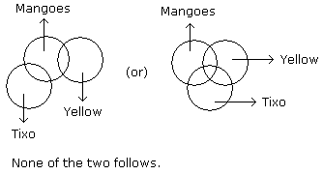
Explanation: 03

Slide 31
Question: 04
Statements:
Some actors are singers.
All the singers are dancers.
Conclusion:
Some actors are dancers.
No singer is actor.
Answer: A

Slide 32
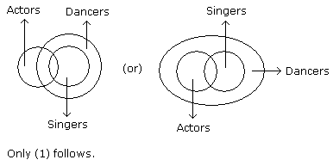
Explanation: 04

Slide 33
Question: 05
Statements:
All cups are books.
All books are shirts.
Conclusion:
Some cups are not shirts.
Some shirts are cups.
Answer: B

Slide 34
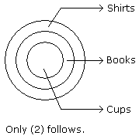
Explanation: 05

Slide 35
Question: 06
Statements:
All the windows are doors.
No door is a wall.
Conclusion:
Some windows are walls.
No wall is a door.
Answer: B

Slide 36
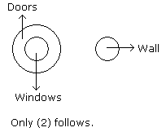
Explanation: 06

Slide 37
Question: 07
Statements:
Some cows are crows.
Some crows are elephants.
Conclusion:
Some cows are elephants.
All crows are elephants.
Answer: D

Slide 38
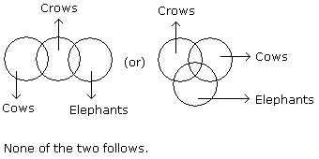
Explanation: 07

Slide 39
Question: 08
Statements:
All harmoniums are instruments.
All instruments are flutes.
Conclusion:
All the flutes are instruments.
All the harmoniums are flutes.
Answer: B

Slide 40
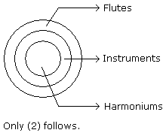
Explanation: 08

Slide 41
Question: 09
Statements:
Some ants are parrots.
All the parrots are apples.
Conclusion:
All the apples are parrots.
Some ants are apples.
Answer: B

Slide 42
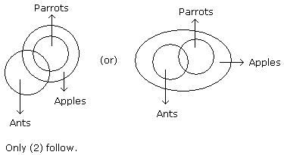
Explanation: 09

Slide 43
Question: 10
Statements:
Some eyes are ears.
Some ears are lungs.
All lungs are hands.
Conclusion:
Some hands are eyes
Some hands are ears
Some lungs are eyes
No hand is eye
Answer: D

Slide 44
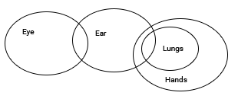
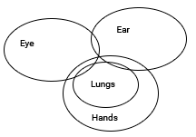
Explanation: 10
From the diagram II definitely follows.

Slide 45
Question: 11
Statements:
All A are B
All B are C
Some D is A
Conclusion:
All A is C
All A are D
Some D is B
A) I, II and III are correct
B) Only I and II are correct
C) Only II and III are correct
D) Only I and III are correct
Answer: D

Slide 46
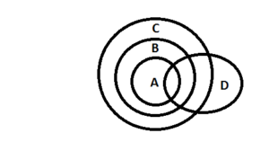
Explanation: 11
From the Venn Diagram, we can see that the conclusions I and III definitely follow. So the correct option is D) Only I and III are correct.

Slide 47
Question: 12
Statements:
All A are B
All B are C
Some D are A
Conclusion:
All D are A is a possibility.
All C are A is a possibility.
A) Both I, II are correct
B) Only I is correct
C) Only II is correct
D) The data is not sufficient
Answer: A

Slide 48
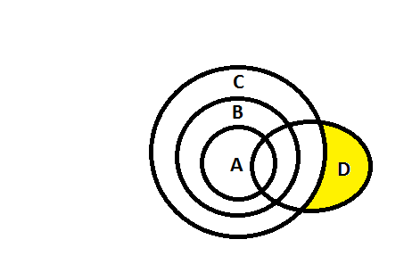
Explanation: 12
Correct option is A) Both I, II are correct.

Slide 49
Question: 13
Statements:
No door is dog.
All the dogs are cats.
Conclusion:
1) No door is cat.
2) No cat is door.
3) Some cats are dogs.
4) All the cats are dogs.
A) Only (2) and (4)
B) Only (1) and (3)
C) Only(3)
D) Only (3) and (4)
E) All the above
Answer: C

Slide 50
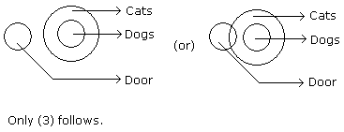
Explanation: 13

Slide 51
Question: 14
Statements:
All green are blue.
All blue are white.
Conclusion:
1) Some blue are green.
2) Some white are green.
3) Some green are not white.
4) All white are blue.
A) Only (1) and (2)
B) Only (1) and (3)
C) Only(3)
D) Only (1) and (4)
E) Only (2) and (4)
Answer: A

Slide 52
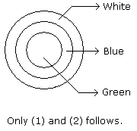
Explanation: 14

Slide 53
Question: 15
Statements:
All the phones are scales.
All the scales are calculators.
Conclusion:
1) All the calculators are scales.
2) All the phones are calculators
3) All the scales are phones.
4) Some calculators are phones.
A) Only (1) and (4)
B) Only (3) and (4)
C) Only (2) and (4)
D) Only (1) and (2)
E) Only (1) and (3)
Answer: C

Slide 54
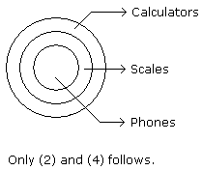
Explanation: 15

Slide 55
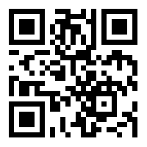
https://learn.codemithra.com

Slide 56




THANK YOU
+91 78150 95095
codemithra@ethnus.com
www.codemithra.com

