Slide 1

ECE-2002 Computer Organization and Architecture
Dr. Kritika Bansal
School of Electronics Engineering, VIT-AP

Slide 2
Multiply 14 times -5 using 5-bit numbers using Booth’s Algorithm.

Slide 3
Multiply 14 times -5 using 5-bit numbers using Booth’s Algorithm.
11101 11010

Slide 4
Restoring Division Algorithm for
Unsigned Integer

Slide 5
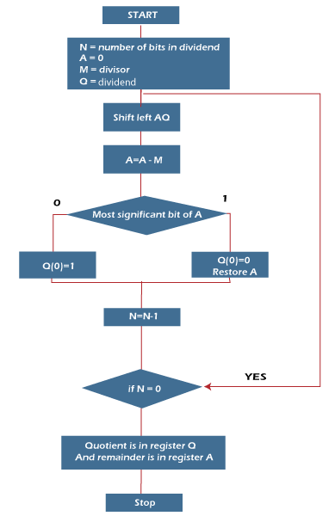
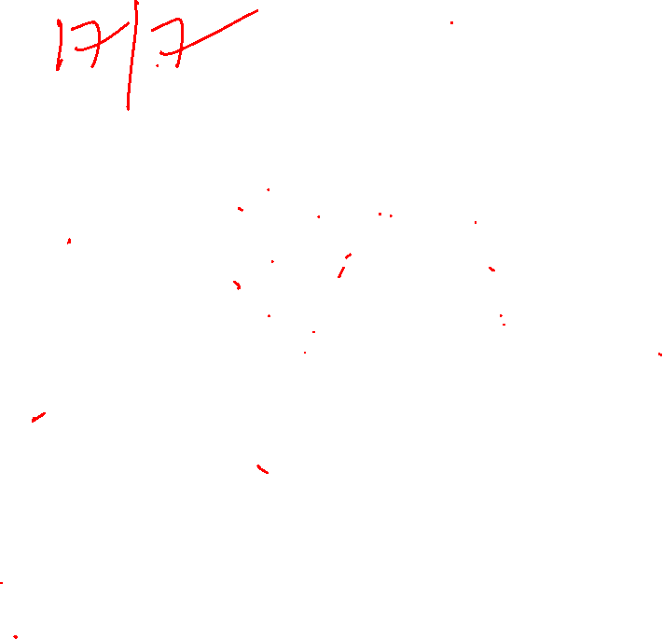
Example: 7/3
N | M | A | Q | Operations
4 | 0011 | 0000 | 0111 | Initial
3 | 0011 | 0000 1101 0000 | 111_ 111_ 1110 | Shift Subtract Q(0)=0, Restore
2 | 0011 | 0001 1110 0001 | 110_ 110_ 1100 | Shift Subtract Q(0)=0, Restore
1 | 0011 | 0011 0000 0000 | 100_ 100_ 1001 | Shift Subtract Q(0)=1
0 | 0011 | 0001 1110 0001 | 001_ 001_ 0010 | Shift Subtract Q(0)=0, Restore

Slide 6
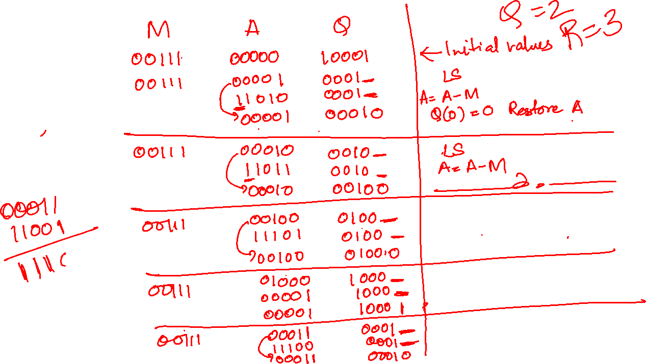
Solve: 17/7

Slide 7
Solve: 17/7
N | M | A | Q | Operations
5 | 00111 | 00000 | 10001 | Initial
4 | 00111 | 00001 11010 00001 | 0001_ 0001_ 00010 | Shift Subtract Q(0)=0, Restore
3 | 00111 | 00010 11011 00010 | 0010_ 0010_ 00100 | Shift Subtract Q(0)=0, Restore
2 | 00111 | 00100 11101 00100 | 0100_ 0100_ 01000 | Shift Subtract Q(0)=0, Restore
1 | 00111 | 01000 00001 00001 | 1000_ 1000_ 10001 | Shift Subtract Q(0)=1
0 | 00111 | 00011 11100 00011 | 0001_ 00010 00010 | Shift Subtract Q(0)=0, Restore

Slide 8
Restoring Division Algorithm for
Signed Integer

Slide 9
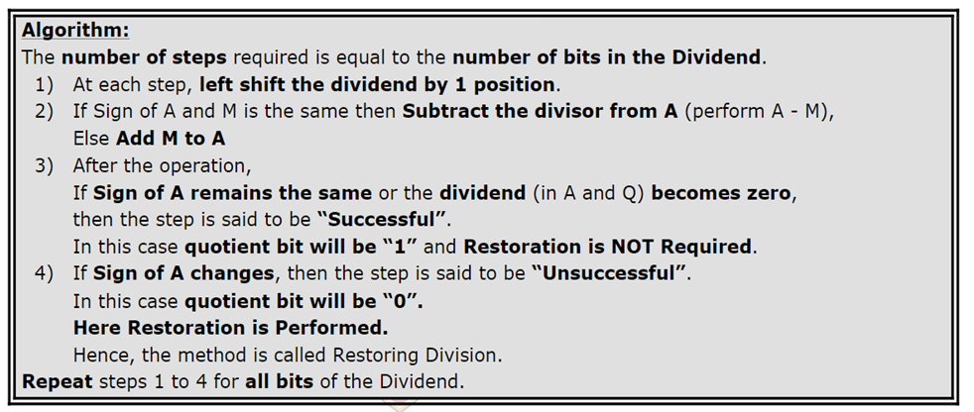
Algorithm
The remainder and the dividend must have the same signs

Slide 10
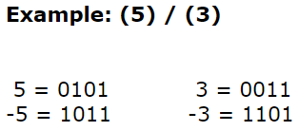
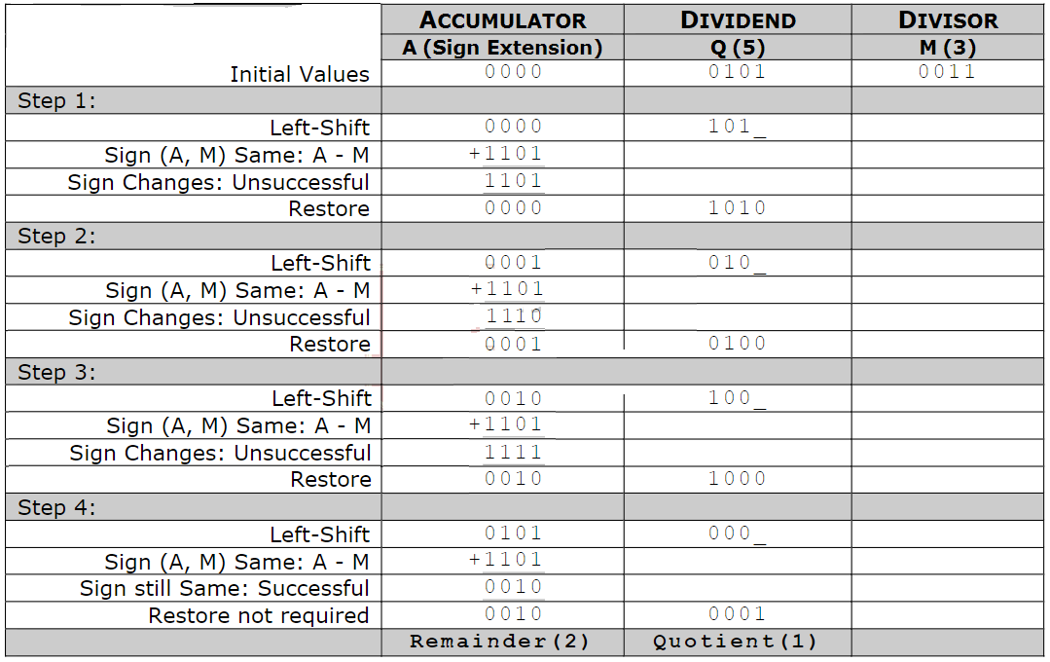

Slide 11
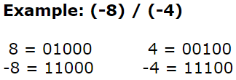

Slide 12
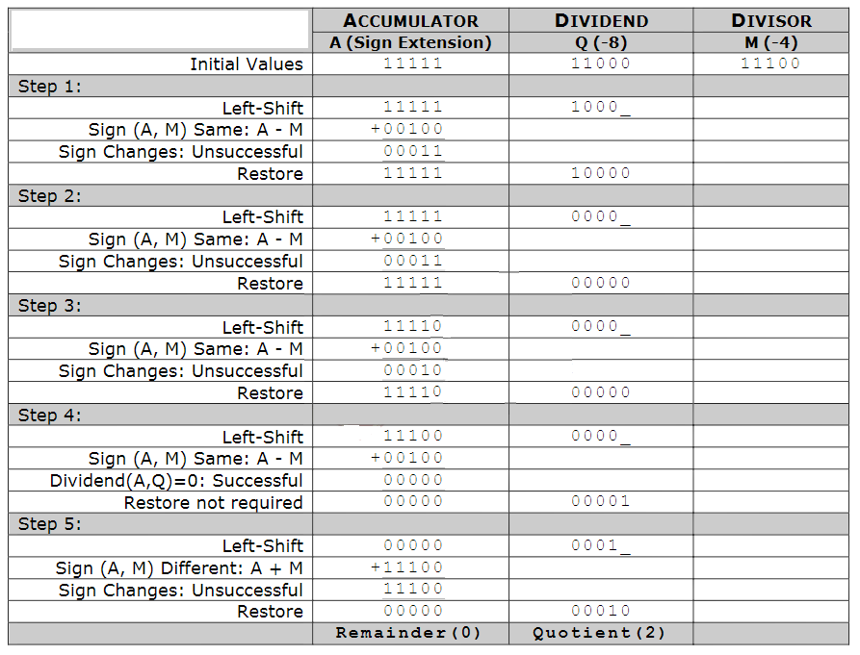

Slide 13
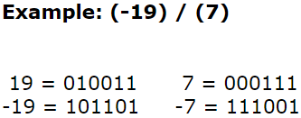

Slide 14
