Slide 1

ECE-2002 Computer Organization and Architecture
Dr. Kritika Bansal
School of Electronics Engineering, VIT-AP

Slide 2
Microprocessors
A microprocessor is the brain of the computer and it performs all the
computational tasks
data processing
The microprocessors can be classified based on the following features:
Instruction Set: It is the set of the instructions that the microprocessor can execute.
Bandwidth: The number of bits processed by the microprocessor in a single instruction, or the number of bits which are transfer via the bus in parallel.
For example, the 8086 microprocessor called 16-bits, i.e. because it can process, send, and evaluate 16 bits in parallel.
Clock Speed: It determines the speed of the instruction processing inside the processor and it is measured in Hz.
Notes:
Intel 4004 to Intel Core i9

Slide 3
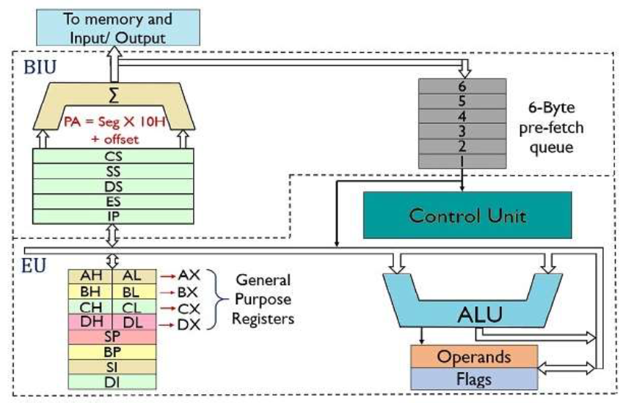
8086 Architecture
The 8086 (16-bit microprocessor) is divided into two independent functional parts to speeds up processing: BIU & EU
Bus Interface unit (BIU)
The BIU handles all transfers of data and addresses on the buses for the execution unit.
The main functions of EU are:
Decoding of Instructions
Execution of instructions
Execution Unit (EU)

Slide 4
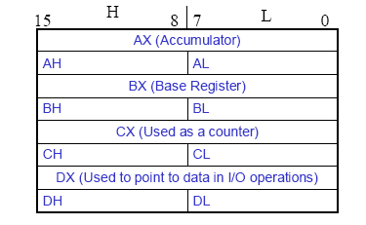
8086 Registers
8086 has a powerful set of 16-bit registers known as: General & Special Purpose registers.
General Data Registers
Segment Registers
Pointers and Index Registers
Flag Register
AX - Accumulator
BX - Base Register
CX - Count Register
DX - Data Register

Slide 5
8086 Registers
General data registers:
The registers AX, BX, CX and DX are the general purpose 16-bit registers.
AX is used as 16-bit accumulator. The lower 8-bit is designated as AL and higher 8-bit is designated as AH.
BX is a 16 bit base register, to hold the starting base location of a memory region. BL indicates the lower 8-bit of BX and BH indicates the higher 8-bit of BX.
The register CX is used as default counter i.e to hold count string, shift and loop instructions.
DX register is a general purpose register to contain I/O port address or I/O instructions.

Slide 6
8086 Registers
Special purpose registers: These registers are used as segment registers, pointers and index registers.
Segment Registers
CS (Code Segment) | Addressing memory location in the code segment of the memory, where the executable program is stored
SS (Stack Segment) | It is used for addressing stack segment of the memory. The stack segment is that segment of memory which is used to store stack data
DS (Data Segment) | Points to the data segment of the memory where the data is stored
ES (Extra Segment) | Points to the additional data segment of the memory where the data is stored

Slide 7
8086 Registers
Pointers and Index Registers
IP (Instruction pointer) | IP contains offset within the code segment
BP (Base Pointer) | Store the base memory address and act as an offset to stack segment
SP (Stack Pointer) | Used to point the current top value of stack and act as an offset to stack segment.
SI (Source Index) | SI is used to store the offset of source data in data segment for string operation
DI (Destination Index) | DI is used to store the offset of destination data in data or extra segment for string operation
*Segment Address - it always points at starting address of segment block.
*Offset Address - use to points random position in segment

Slide 8
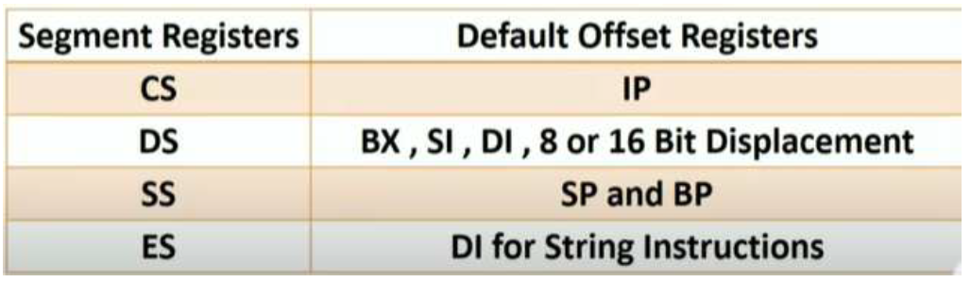
8086 Registers

Slide 9
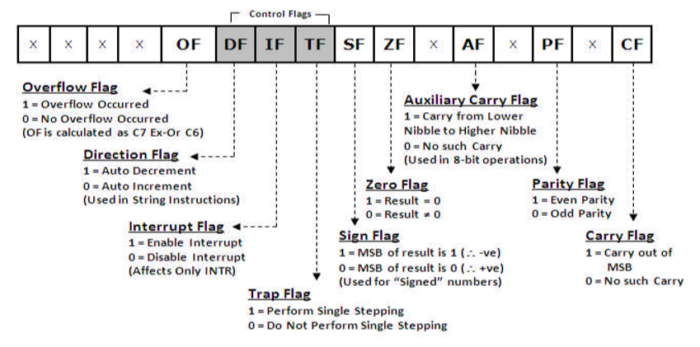
8086 Registers
A 16 bit flag register is used in 8086 divided into two parts .
Status flags (C, P, A, Z, S, & O)
Control flags (T, I, & D)
15
0

Slide 10
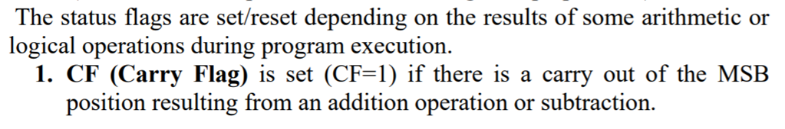
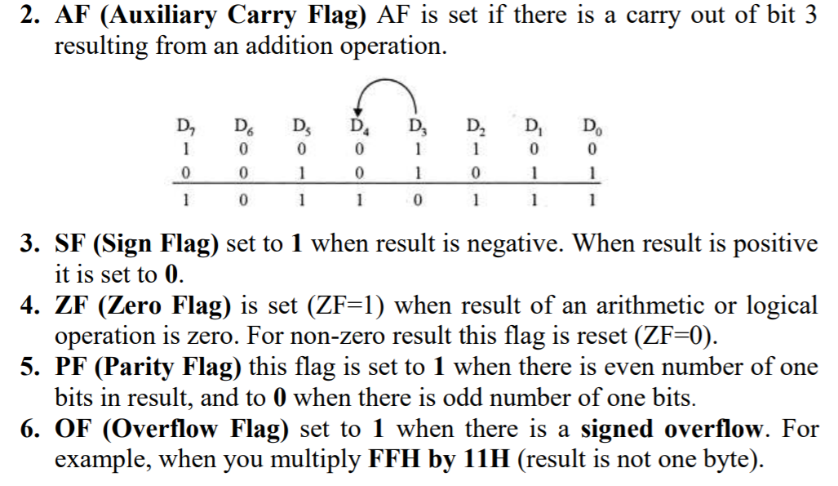
8086 Registers

Slide 11
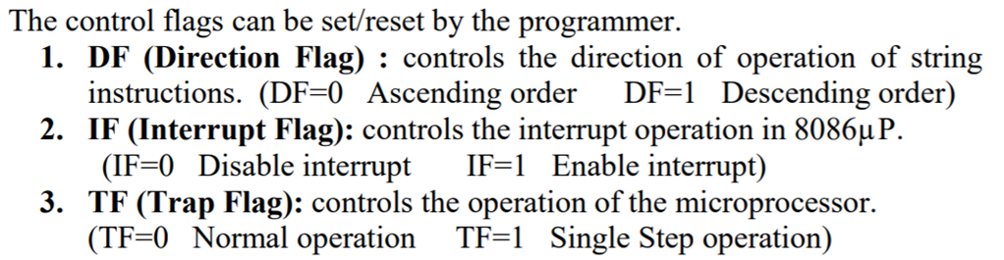
8086 Registers
*An interrupt is a condition that halts the microprocessor temporarily to work on a different task and then returns to its previous task.
*When a system is instructed to single-step, it will execute one instruction and then stop.

Slide 12
ES
Extra Segment
_{BIU registers}
_{(20 bit)}
CS
Code Segment
SS
Stack Segment
DS
Data Segment
IP
Instruction Pointer
AX
AH
AL
Accumulator
BX
BH
BL
Base Register
CX
CH
CL
Count Register
_{EU registers}
DX
DH
DL
Data Register
SP
Stack Pointer
BP
Base Pointer
SI
Source Index Register
DI
Destination Index Register
FLAGS

Slide 13
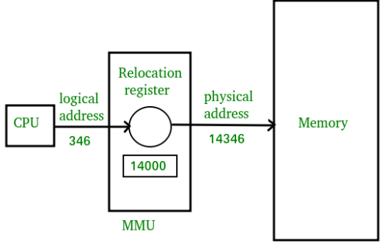

There are two types of addresses that are used for memory in the operating system i.e. the physical address and logical address.
The physical address refers to a location in the memory. It allows access to data in the main memory.
A logical address or virtual address is an address that is generated by the CPU during program execution.
The logical address (generated by CPU) combines with the base address generated by the MMU (Memory Management Unit) to form the physical address .

Slide 14
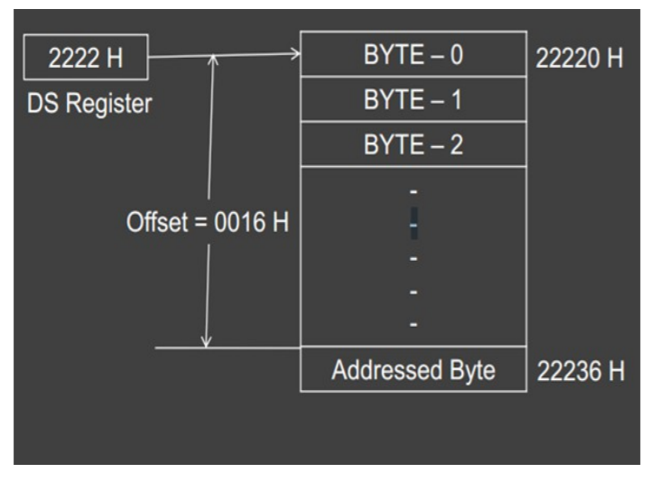
8086 Memory Segmentation
8086 is 16-bit microprocessor
Logical address: 16 bit
Physical address: 20 bits
Example:
If the data at any location has a logical address specified as 2222 H : 0016 H
Then, the number 0016 H is the offset. 2222 H is the value of DS.
PA=2222X10+0016=22236 H
Physical Address = Segment address X 10 + offset address

Slide 15
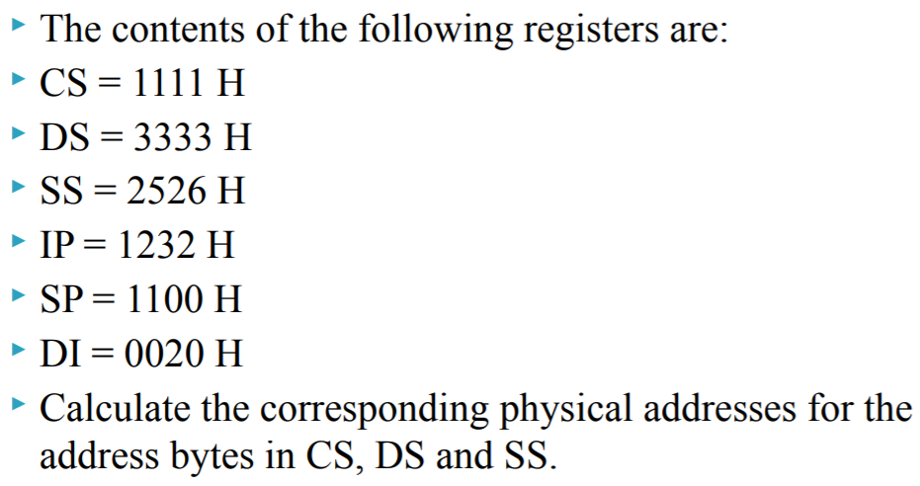
8086 Memory Segmentation
Notes:
CS= 12342
DS= 33350
SS= 26360

Slide 16
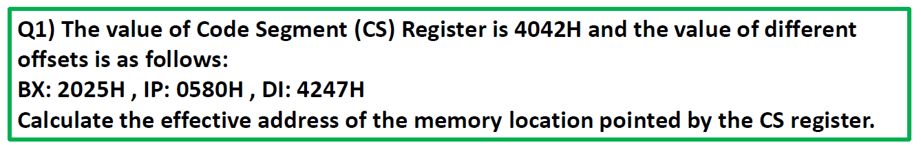
8086 Memory Segmentation
Notes:
CS= 12342
DS= 33350
SS= 26360

Slide 17
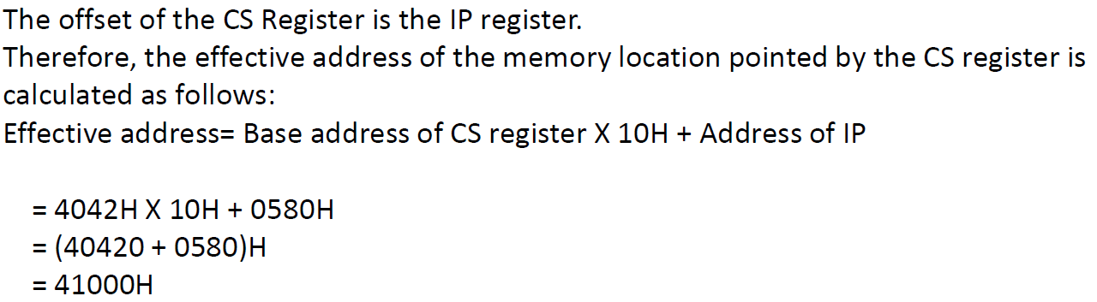
8086 Memory Segmentation
Notes:
CS= 12342
DS= 33350
SS= 26360

Slide 18
8086 Memory Segmentation
Notes:
CS= 12342
DS= 33350
SS= 26360

Slide 19
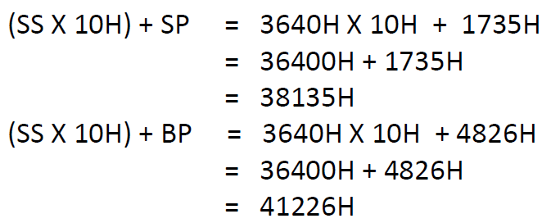
8086 Memory Segmentation
Notes:
CS= 12342
DS= 33350
SS= 26360

