Slide 1

ECE-2002 Computer Organization and Architecture
Dr. Kritika Bansal
School of Electronics Engineering, VIT-AP

Slide 2
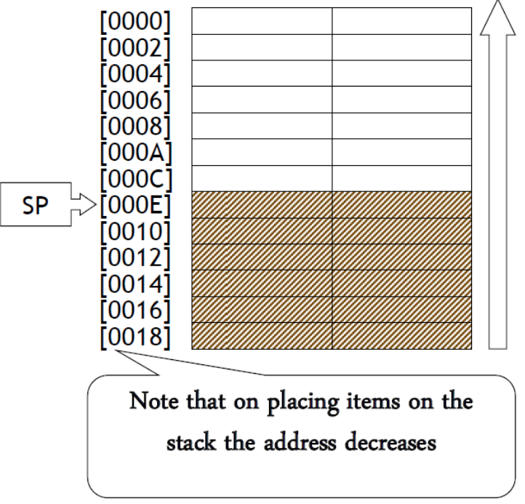
Stack
Block of memory that may be used for temporarily storing the contents of the registers inside the CPU
The stack is essentially Last-In-First-Out (LIFO) data segment (the data which was put last on the stack is the first to be withdrawn)
The Stack is organized in words, (i.e. two bytes at a time). Thus the stack pointer is incremented or decremented by 2.
The Stack pointer keeps track of the position of the last item placed on the stack (i.e. the Top of Stack)

Slide 3
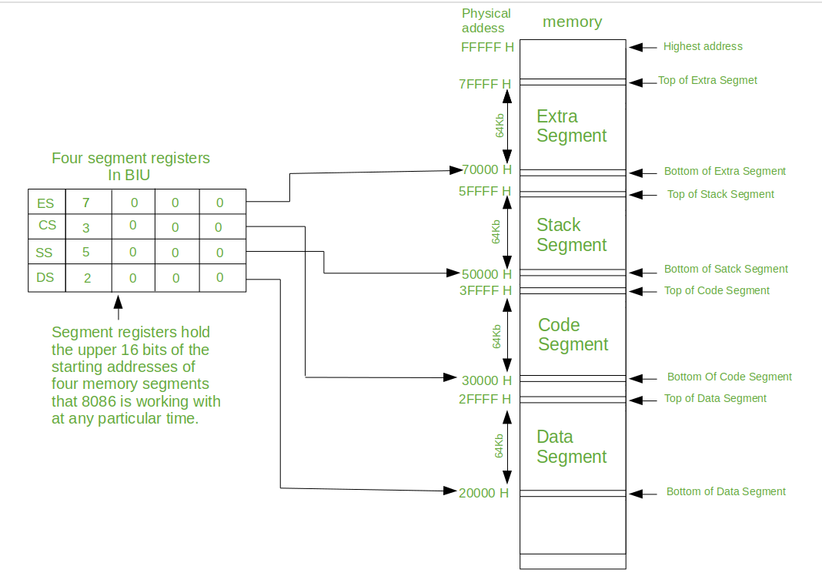
Stack
Storing the data in the stack is called ‘pushing into’ the stack, and transferring the data back from the stack to the CPU register is known as ‘popping off’ the stack.

Slide 4
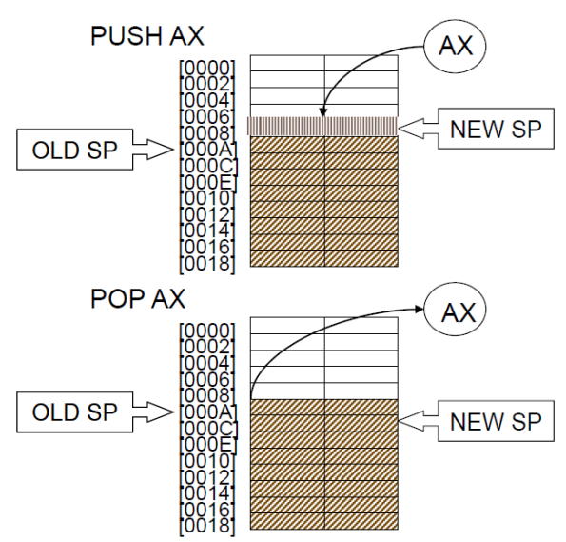
Stack
The two set of instructions which explicitly modify the stack are the PUSH (which places items on the stack) and the POP (which retrieves items from the stack).
In both cases, the stack pointer is adjusted accordingly to point always to the top of stack.
PUSH AX means SP=SP-2 and AX -> [SP]
POP AX means [SP] -> AX and SP=SP+2.

Slide 5
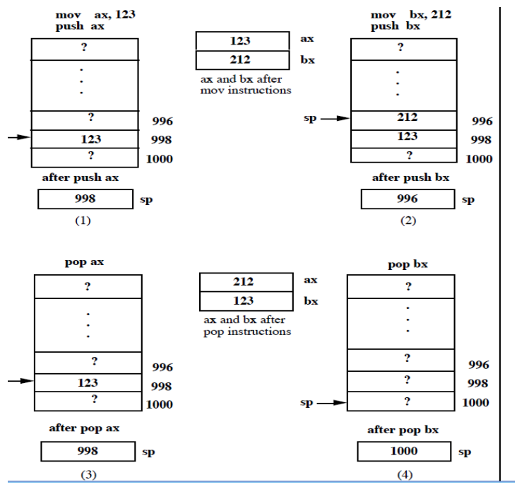
Stack

Slide 6
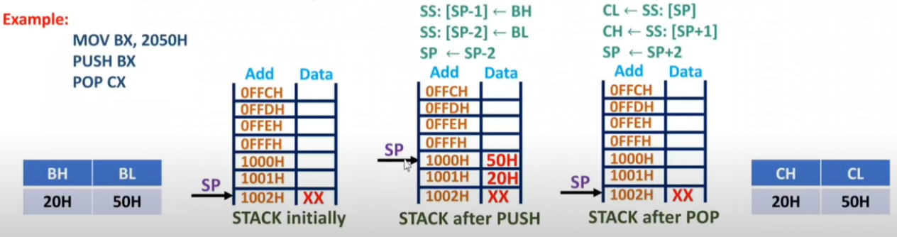
Stack
Notes:
8086 is little endian
In the big-endian assignment, the lower byte addresses are used for the most significant (leftmost) bytes of the word.
In the little-endian assignment, the lower byte addresses are used for the least significant (rightmost) bytes of the word.

Slide 7
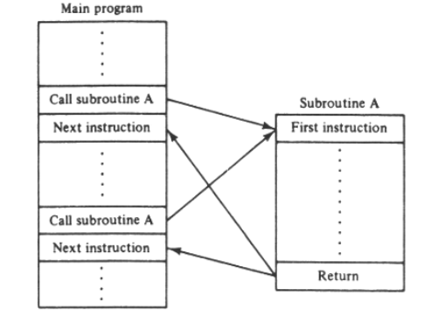
Subroutine
A set of instructions that are used repeatedly in a program can be referred to as Subroutine.
It is a special segment of program that can be called for execution from any point in a program.
Instead of including this piece of code in the main program each time the function is needed, it is put into the program just once as a subroutine.
CALL instruction is used to call the subroutine.
RET instruction must be included at the end of the subroutine to initiate the return sequence to the main program environment

Slide 8
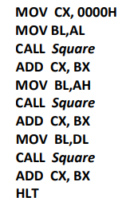
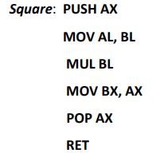
Subroutine
A program that computes y = (AL)² + (AH)² + (DL)² places the result in CX
Square that squares the contents of BL and places the result in BX

Slide 9
Interrupts
An interrupt is a condition that halts the microprocessor temporarily to work on a different task and then returns to its previous task.
Whenever an interrupt occurs, the processor completes the current instruction and starts the implementation of an Interrupt Service Routine (ISR) or Interrupt Handler.
ISR is a program that tells the processor what to do when the interrupt occurs.
After the ISR execution, control returns to the main routine where it was interrupted.
Types of Interrupts:
Hardware: an external signal is applied to the NMI input pin or the INTR input pin
Software: occurs when INT instruction is executed or when some error condition is produced by the execution of an instruction such as divide by zero

Slide 10
Hardware Interrupts – Interrupt pins
INTR: Interrupt Request. Activated by a peripheral device to interrupt the processor.
INTA: Interrupt Acknowledge. Activated by the processor to inform the interrupting device that the interrupt request (INTR) is accepted.
NMI: Non-Maskable Interrupt. Used for major system faults such as power failures.

Slide 11
Interrupt Software Instructions
All x86 processors provide the following instructions related to interrupts:
INT nn: Interrupt. Run the ISR pointed by vector nn.
INT 0 is reserved for the Divide Error
INT 1 is reserved for Single Step operation
INT 2 is reserved for the NMI pin
INT 3 is reserved for setting a Breakpoint
INT 4 is reserved for Overflow (Same as the INTO (Interrupt on overflow) instruction.
CLI: Clear Interrupt Flag. IF is set to 0, thus interrupts are disabled.
STI: Set Interrupt Flag. IF is set to 1, thus interrupts are enabled.
IRET: Return from interrupt. This is the last instruction in the ISR.

Slide 12
Interrupt Software Instructions
Divide-By-Zero Interrupt-Type 0: The 8086 will automatically do a type 0 interrupt if the result of a DIV operation or an IDIV operation is too large to fit in the destination register. Single Step Interrupt-Type 1: In single step mode, system will stop after it executes each instruction and wait for further direction from the user
If TF=1, 8086 will automatically do type 1 interrupt after each instruction executes
Non-maskable Interrupt-Type 2: The 8086 will automatically do a type 2 interrupt response when it receives a low to high transition on its NMI pin.

Slide 13
Interrupt Software Instructions
Breakpoint Interrupt-Type 3: The main use of the type 3 interrupt is to implement a breakpoint function in a system. Whenever we insert a breakpoint, the system executes the instructions up to the breakpoint and then goes to the breakpoint procedure. Overflow Interrupt-Type4: The 8086 overflow flag will be set if the signed result of an arithmetic operation on two signed numbers is too large to be represented in the destination register or memory location. Example: If we add the 8 bit signed number 01101100 and the 8 bit signed number 010111101, the result will be 10111101. This would be the correct result if we were adding unsigned binary numbers, but it is not the correct signed result.

Slide 14
Interrupt Vectors
In 8086, the 1st first 1024 bytes of memory 00000H to 003FFH is set aside as a table for storing the starting addresses of interrupt service procedure.
The starting address of an interrupt service procedure is called interrupt vector or interrupt pointer and the table is referred to as interrupt vector table or the interrupt pointer table
Each entry in the Interrupt Vector Table is 4 bytes long, so the table can hold the starting addresses for 256 interrupt service routines.
The first two represent the offset address and the last two the segment address of the ISR.

Slide 15
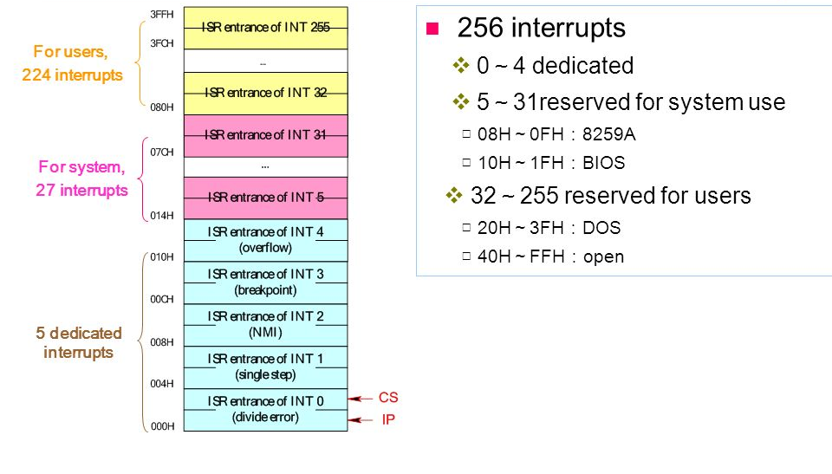
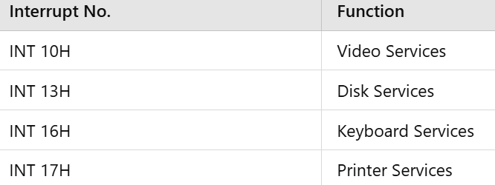
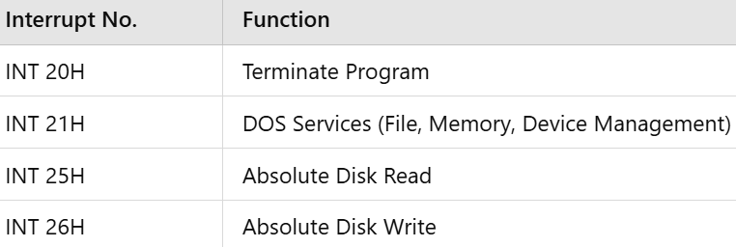
Interrupt Vector Table
BIOS
DOS

Slide 16
Interrupt Vector - Example
• A particular interrupt has a type number n = 41H. If the ISR begins at
address 09E3:0010H, determine the locations in the vector table to
store this address.
• Solution: The vector address is calculated by multiplying 41H by 4 (104H)
IP is stored in the low word location and CS in the high word location.
107H: 09H
106H: E3H
105H: 00H
104H: 10H

Slide 17
Interrupt Vector - Example
Using the Interrupt Vector Table shown below, determine the address of the ISR of a device with interrupt vector 42H.
Answer: Address in table = 4 X 42H = 108H (Multiply by 4 since each entry is 4 bytes)
Offset Low = [108] = 2A, Offset High = [109] = 33
Segment Low = [10A] = 3C, Segment High = [10B] = 4A
Address = 4A3C:332A = 4A3C0 + 332A = 4D6EAH

Slide 18
Intel 82C59A Interrupt Controller
To allow the 8086 to handle a variety of devices and priority structures, it is usually configured with an external interrupt controller, the 82C59A
External devices are connected to the 82C59A, which in turn connects to the 8086
It accepts interrupt requests from attached modules, determines which interrupt has the highest priority, and then signals the processor by raising the INTR line
The processor acknowledges via the INTA line.
The processor can then proceed to process the interrupt and to communicate directly with the I/O module to read or write data

Slide 19
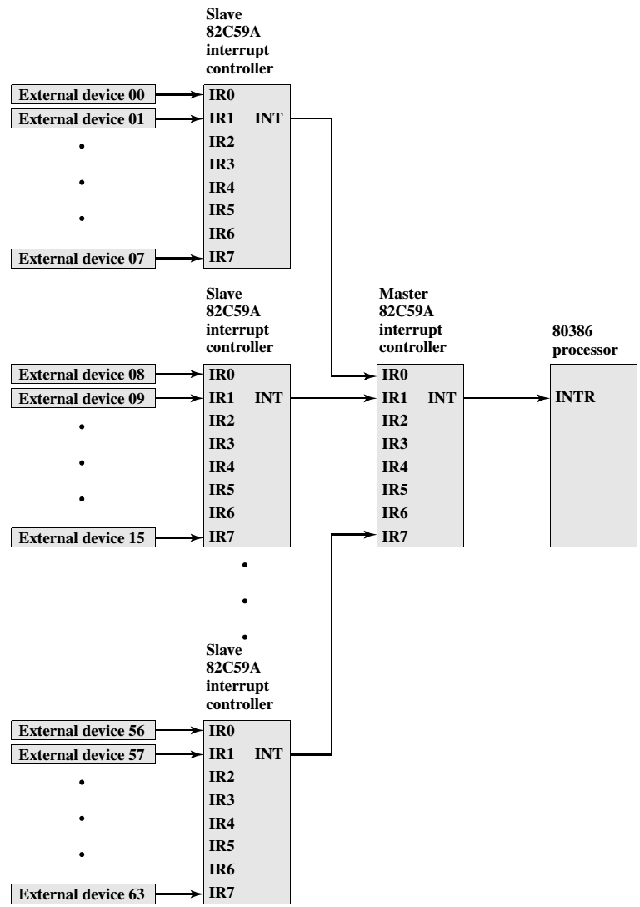
8086

