Slide 1

ECE-2002 Computer Organization and Architecture
Dr. Kritika Bansal
School of Electronics Engineering, VIT-AP

Slide 2
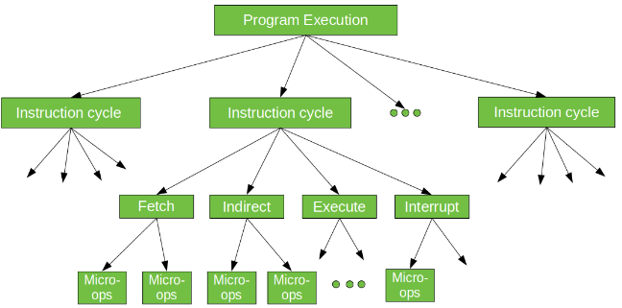
Micro-Operation
Execution of a program consists of a sequence of instruction cycles.
Each instruction executed during an instruction cycle made up of shorter sub-cycles (fetch, indirect, execute, interrupt).
The performance of each sub-cycle involves one or more shorter operations, that is, micro-operations.

Slide 3
Instruction Cycle
Registers involved in each Instruction Cycle:
Memory Address Register (MAR): It holds the address of the location to be accessed from memory.
Memory Buffer Register (MBR): It contains data to be written into or to be read out from the addressed location.
Program Counter (PC): It contains the memory address of the next instruction to be fetched.
Instruction Register (IR): It holds the current instruction fetched.
Notes:
https://www.geeksforgeeks.org/different-instruction-cycles/

Slide 4
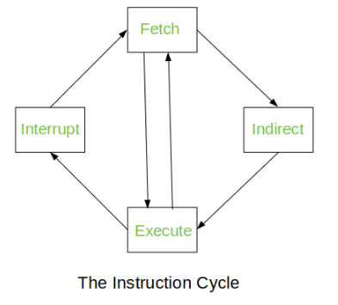
Instruction Cycle

Slide 5
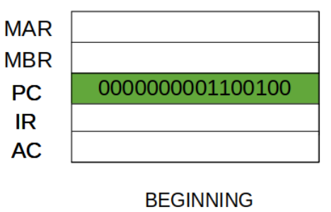
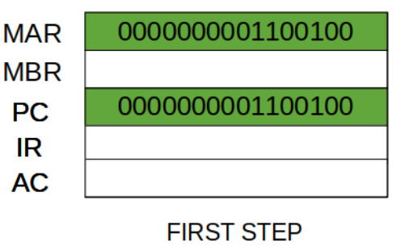
Fetch Cycle
At the beginning of the fetch cycle, the address of the next instruction to be executed is in the Program Counter(PC).
Step 1: The address in the program counter is moved to the MAR

Slide 6
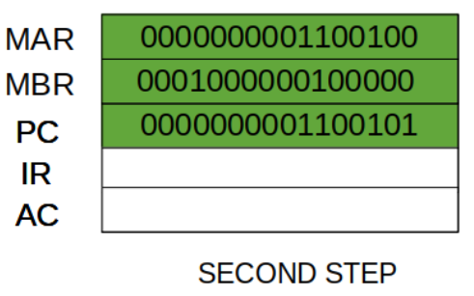
Fetch Cycle
Step 2:
The address in MAR is placed on the address bus, now the control unit issues a READ command on the control bus, and the result appears on the data bus and is then copied into the MBR.
PC is incremented by one, to get ready for the next instruction.
(These two action can be performed simultaneously to save time)

Slide 7
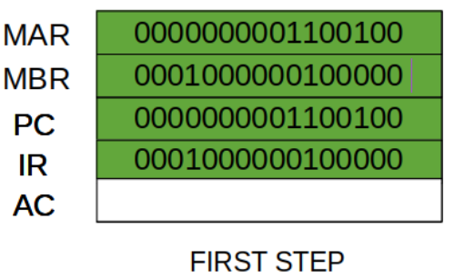
Fetch Cycle
Step 3: The content of the MBR is moved to the IR.

Slide 8
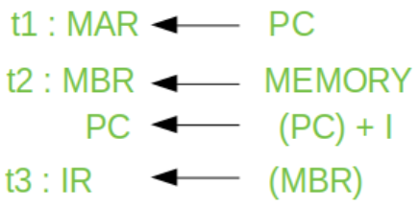
Fetch Cycle
A simple Fetch Cycle consist of four micro-operations. Symbolically, we can write these sequence of events as follows:-
Here ‘I’ is the instruction length. The notations (t1, t2, t3) represents successive time units.
First time unit: Move the contents of the PC to MAR.
Second time unit: Move contents of memory location specified by MAR to MBR. Increment content of PC by I.
Third time unit: Move contents of MBR to IR.

Slide 9
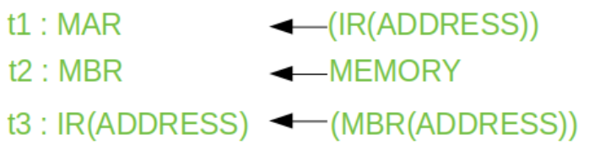
Indirect Cycle
Once an instruction is fetched, the next step is to fetch source operands (for indirect addressing).
Step 1: The address field of the instruction is transferred to the MAR. This is used to fetch the address of the operand.
Step 2: The data is fetched and stored in MBR.
Step 3: The address field of the IR is updated from the MBR.

Slide 10

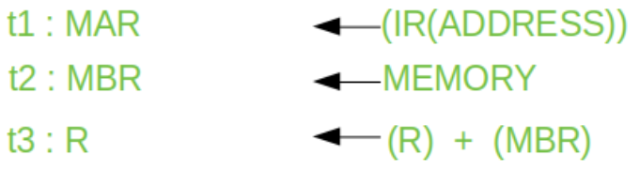
Execute Cycle
Consider an add instruction:
Here, this instruction adds the content of location X to register R. Corresponding micro-operation will be:-
We begin with the IR containing the ADD instruction.
Step 1: The address portion of IR is loaded into the MAR.
Step 2: The data is fetched and stored in MBR.
Step 3: Now, the contents of R and MBR are added by the ALU.

Slide 11
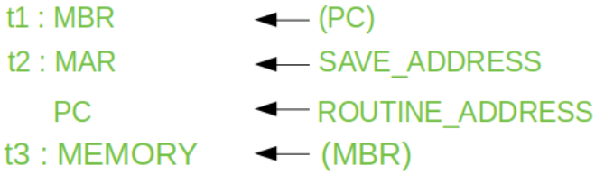
Interrupt Cycle
At the completion of the Execute Cycle, if an enabled interrupt has occurred then Interrupt Cycle occurs.
Step 1: Contents of the PC is transferred to the MBR (so that they can be saved for return).
Step 2: MAR is loaded with the address at which the contents of the PC are to be saved.
PC is loaded with the address of the start of the interrupt-routine.
Step 3: MBR, containing the old value of PC, is stored in memory.

Slide 12
Instruction Cycle
Till now we have seen each phase (fetch, indirect, and interrupt cycles) decomposed into sequence of elementary micro-operations
Complete instruction cycle: Need to tie sequences together
Assume new 2-bit register called Instruction cycle code (ICC) which designates the state of the processor
00: Fetch
01: Indirect
10: Execute
11: Interrupt

Slide 13
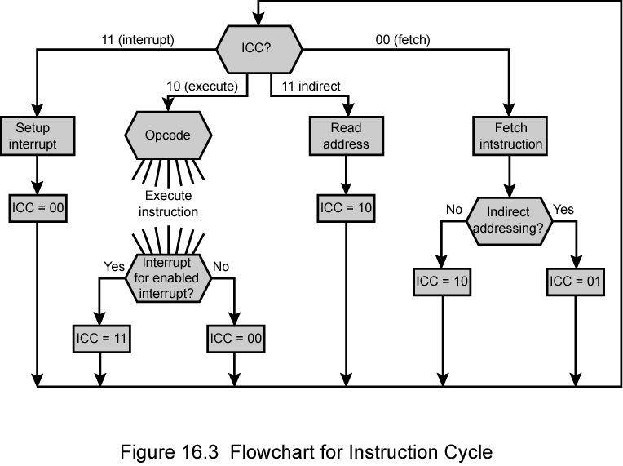
Instruction Cycle
01
00: Fetch
01: Indirect
10: Execute
11: Interrupt

Slide 14
Write the Micro-operations for each instruction
MOV R1, 25H
MOV R1, R2
MOV R1, [2000H]
STC
MOV R1, [R2]
ADD R1, 25H
ADD R1, R2
ADD R1, [2000H]
ADD R1, [R2]

