Slide 1




Slide 2

Geometry

Slide 3

TEST TIME ON SYLLOGISM
QR CODE:

Slide 4
Geomentry
Geometry is a subject in mathematics that focuses on the study of shapes, sizes, relative configurations, and spatial properties.
It is one of the oldest branches of mathematics, having arisen in response to such practical problems as those found in surveying.
Geometry will guide you through points, lines, planes, angles, parallel lines, triangles, similarity, trigonometry, quadrilaterals, transformations, circles and area.

Slide 5
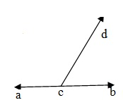
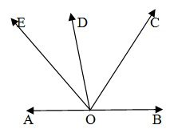
Tips to Solve
1.If a ray stands on a line , than the sum of two adjacent
angle so formed is 180° In the given figure , ray CP
stands on line AB.∠ACD + ∠BCD = 180°.
2. The sum of all angle formed on the same side of a
line at a given point on the line is 180°. In the given figure
four angle are formed on the same side of AOB.
∠AOE + ∠EOD + ∠DOC + ∠COD = 180°.

Slide 6
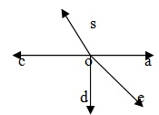

Tips to Solve
3.The sum of all angle around a point is 360° In the given
figure five angle are formed around a point O.
∠AOB + ∠BOC + ∠COD + ∠DOE + ∠EOA=360°.
4. If two lines A Band CD intersect at a point O, then AOC ,
BOD and BOC , AOD are two pair of vertically opposites
angle Vertically opposite angle are always equal.
∠AOC = ∠BOD and ∠AOD = ∠BOC

Slide 7
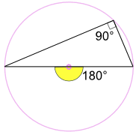
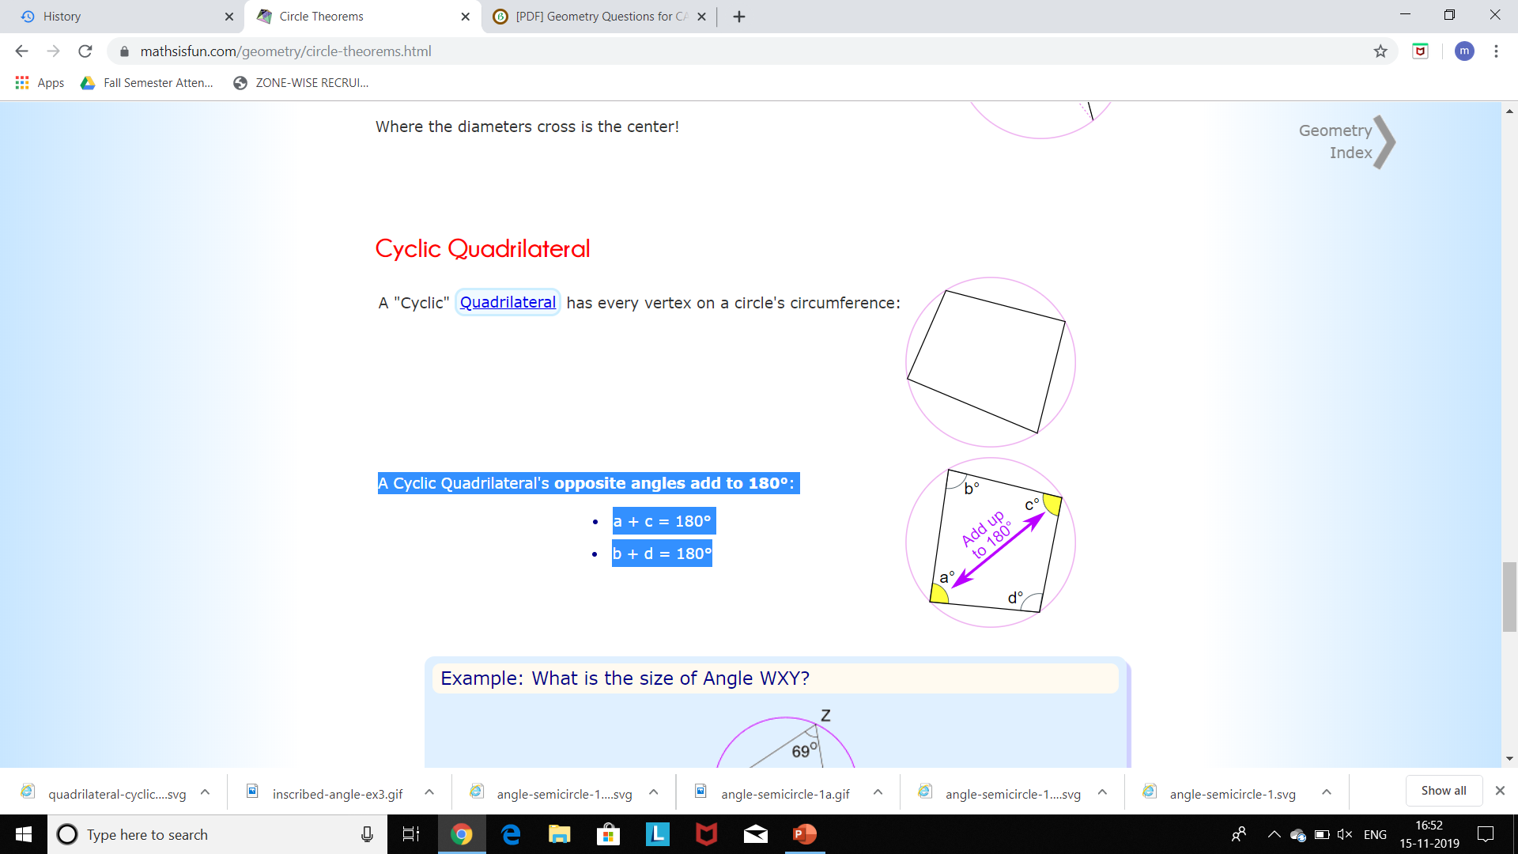
Tips to Solve
Angle at the Center Theorem:
An angle inscribed across a circle's diameter is always
a right angle:
Cyclic Quadrilateral:
A Cyclic Quadrilateral's opposite angles add to 180°:
a + c = 180°
b + d = 180°

Slide 8
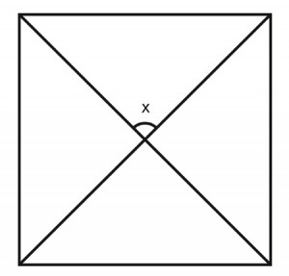
Question: 01
What is measurement of the indicated angle assuming the figure is a square?
A. 45º B. 90º C. 60º D. 30º
Answer: B

Slide 9
Explanation: 01
The diagonals of a square intersect perpendicularly with each other so each angle measures 90º x =90º

Slide 10
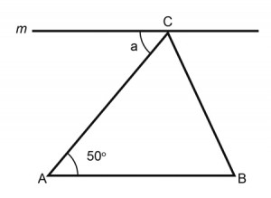
Question: 02
If the line m is parallel to the side AB of ?ABC, what is angle a?
A. 125º B. 25º C. 65º D. 50º
Answer: D

Slide 11
Explanation: 02
Two parallel lines(m & side AB) intersected by side AC a= 50º (interior angles)

Slide 12
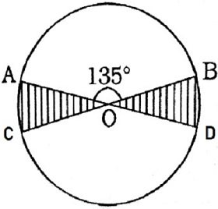
Question: 03
Consider the circle shown below having angle AOB as 135º and the shaded portion is the x part of the circular region. Calculate the value of x.
A. 1/12 B. 1/9 C. 1/6 D. 1/4
Answer: D

Slide 13
Explanation: 03
∠AOC = 180º - 135º = 45 ∠AOC = ∠BOD = 45º Shaded part is xth part of circular region. ∴ x = 90/360 = 1/4 Therefore, value of x is 1/4.

Slide 14
Question: 04
AB and CD are two parallel chords on the opposite sides of the center of the circle. If AB = 10 cm, CD = 24 cm and the radius of the circle is 13 cm, the distance between the chords is
A. 16cm B. 18cm C. 15cm D. 17cm
Answer: D

Slide 15
Explanation: 04
From O, draw OL perpendicular to AB and OM perpendicular to CD. Then, join OA and OC. AL = (1/2)AB = (1/2)10;AL = 5 cm OA = radius of the circle = 13 cm From OAL, (OL)² = (OA)² - (AL)² = (13)² - (5)² = 169 - 25 (OL)² = 144;OL = 12 cm
Then, CM = (1/2)*CD = (1/2)*24 = 12 cm And OC = radius of the circle = 13 cm From âŠ¿OMC, (OM)² = (OC)² - (CM)² = (13)² - (12)² = 169 – 144;(OM)² = 25;OM = 5 cm Therefore, distance between the chords, ML = OM + OL ML = 5+ 12 ML = 17 cm.

Slide 16
Question: 05
Find the center of the circle whose equation is x² + y² -10x + 12y -10 = 0
A. (5,6) B. (-5,6) C. (5,-6) D. (10,-12)
Answer: C

Slide 17
Explanation: 05
Take thex-term coefficient, multiply it by one-half, square it, and then add this to both sides of the equation, as shown. Do the same with they-term coefficient. => (x^2 - 10x + 25) + (y^2 + 12y + 36) = 10 + 25 + 36 => (x – 5)^2 + (y + 6)^2 = 71 => (x – 5)^2 + [y – (-6)]^2 = 71 On comparing it with center-radius form of the circle equation: (x–h)²+ (y–k)²=r² => The center is at (h, k) = (5, -6)
For general format of circle: ax²+by²+cx+dy+e= 0 The center-radius form of the circle equation is in the format(x–h)²+ (y–k)²=r², with the center being at the point(h, k) and the radius being "r". Given eqn is: x^2 + y^2 -10x + 12y -10 = 0 => x^2 + y^2 -10x + 12y = 10 Group thex-stuff together. And theny-stuff together. =>(x^2 - 10x) + (y^2 + 12y) = 10

Slide 18
Question: 06
Find the distance between the points (2,2) and (-1,6)
A. 5 units B. 4 units C. 7 units D. √(26) units
Answer: A

Slide 19
Explanation: 06
Given, two points, (x1,y1) = (2,2) And (x2,y2) = (-1,6) Distance between the points = √{(x2 – x1)^2 + (y2 – y1)^2} = √{(-1 – 2)^2 + (6 – 2)^2} = √{9 + 16} = √(25) = 5 Thus, Distance between the points = 5

Slide 20
Question: 07
Find the area of the triangle formed by the three points whose coordinates are (2, 3), (4, 5) and (6, 3).
A. 2 units B. 4 units C. 3 units D. 6 units
Answer: B

Slide 21
Explanation: 07
Given, three points are (x1,y1) = (2,3) (x2,y2) = (4,5) (x3,y3) = (6,3) Then, Area of triangle = (1/2) * | (x1y2 + x2y3 + x3y1) – (x2y1 + x3y2 + x1y3)| = (1/2) * | (2x5 + 4x3 + 6x3) – (4x3 + 6x5 + 2x3)| = (1/2) * |(10 + 12 + 18) – (12 + 30 + 6)| = (1/2) * |40 – 48| = (1/2) * |(-8)| = (1/2) * 8 = 4

Slide 22
Question: 08
In a triangle ABC, a circle which touches the edges of all three sides is called
A. In circle B. Circumcircle C. Out circle D. Edge circle
Answer: A

Slide 23
Question: 09
In a triangle a circle passes through the vertices of the triangle, then the circle is called as
A. In circle B. Circumcircle C. Out circle D. Edge circle
Answer: B

Slide 24
Question: 10
Which of the following is a Pythagorean triplet ?
A. 11 , 40 , 21 B. 3,4,8 C. 25,24,7 D. 26,25,3
Answer: C

Slide 25
Explanation: 10
24²=576
7²=49
576+49 = 625
Sq.root of 25

Slide 26
Question: 11
A circle of radius 3 cm is drawn inscribed in a right angle triangle ABC, right angled at C. If AC is 10 Find the value of CB.
A. 10.5 cm B. (20/7)√58 cm C. 12 cm D. 15 cm
Answer:A

Slide 27
Explanation: 11
(x + 7)² = 10² + (x + 3)² (Tangents from the external point are equal) ⇒ x = 7.5cm ⇒ OB = x + 3 = 10.5 cm

Slide 28
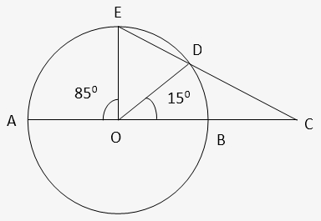
Question: 12
In the given figure, AB is the diameter of the circle with center O. If ∠BOD = 15° & ∠EOA = 85°, then find the value of ∠ECA.
A. 45º B. 25º C. 30º D. 35º
Answer: D

Slide 29
Explanation: 12
∠EOA = 85°, ∠BOD = 15° ∠EOD = 180° - (85° + 15°) = 80° In Δ OED, OE = OD (radii) ∠OED = ∠ODE = 50° In Δ OEC, ∠EOC = 80°+15° = 95°+∠OEC=50° ⇒ ∠ECA = 180°- (95 + 50°) = 35°

Slide 30
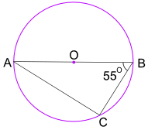
Question: 13
What is the size of Angle BAC?
A. 45º B. 35º C. 60º D. 30º
Answer: B

Slide 31
Explanation: 13
The Angle in the Semicircle Theorem tells us that Angle ACB = 90°
Now use angles of a triangle add to 180° to find Angle BAC:
Angle BAC + 55° + 90° = 180°
Angle BAC = 35°

Slide 32
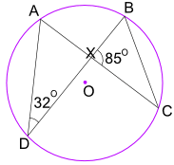
Question: 14
What is the size of Angle CBX?
A. 45º B. 90º C. 60º D. 30º
Answer: C

Slide 33
Explanation: 14
Angle ADB = 32° also equals Angle ACB.
And Angle ACB also equals Angle XCB.
So in triangle BXC we know Angle BXC = 85°, and Angle XCB = 32°
Now use angles of a triangle add to 180° :
Angle CBX + Angle BXC + Angle XCB = 180°
Angle CBX + 85° + 32° = 180°
Angle CBX = 63°

Slide 34
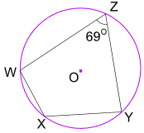
Question: 15
What is the size of Angle WXY?
A. 96º B. 291º C. 21º D. 111º
Answer: B

Slide 35
Explanation: 15
Opposite angles of a cyclic quadrilateral add to 180°
Angle WZY + Angle WXY = 180°
69° + Angle WXY = 180°
Angle WXY = 111°

Slide 36

https://learn.codemithra.com

Slide 37




THANK YOU
+91 78150 95095
codemithra@ethnus.com
www.codemithra.com

